Slide 1
Chapter 1 Vocabulary
Using pages 6-20 define the following terms:
Health
Spiritual Health
Wellness
Chronic Disease
Heredity
Environment
Peers
Culture
Technology
Risk Behaviors
Cumulative Risks
Prevention
Lifestyle Factors

Slide 2
Chapter 1: Health & Wellness

Slide 3
Your Total Health

Slide 4
Being in the best of health throughout your life means making healthy choices and practicing healthful behaviors.

Slide 5
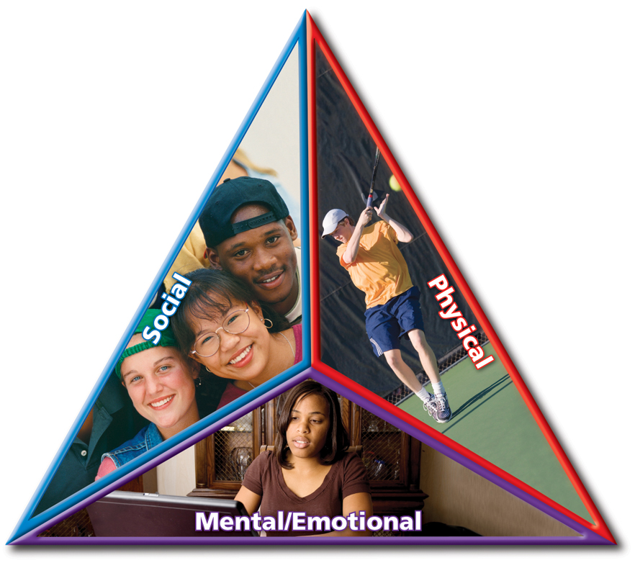
Your Health Triangle
Your health triangle is made up of three equally important areas.

Slide 6
Physical Health
Physical health is all about how well your body functions.
Five Tips for Physical Health
Get eight to ten hours of sleep each night.
Eat nutritious meals and drink eight cups of water each day.
Engage in 30 to 60 minutes of physical activity every day.
Avoid the use of tobacco, alcohol, and other drugs.
Bathe daily, and floss and brush your teeth every day.

Slide 7
Mental/Emotional Health
Mental/emotional health is about your feelings and thoughts. It’s a reflection of:
How you feel about yourself.
How you meet the demands of your daily life.
How you cope with the problems that occur in your life.

Slide 8
Mental/Emotional Health
Characteristics of Mentally and Emotionally Healthy People
Enjoy challenges.
Accept responsibility for their actions.
Have a sense of control over their lives.
Can express their emotions in appropriate ways.
Usually can deal with life’s stresses and frustrations.
Have a positive outlook.
Make thoughtful and responsible decisions.

Slide 9
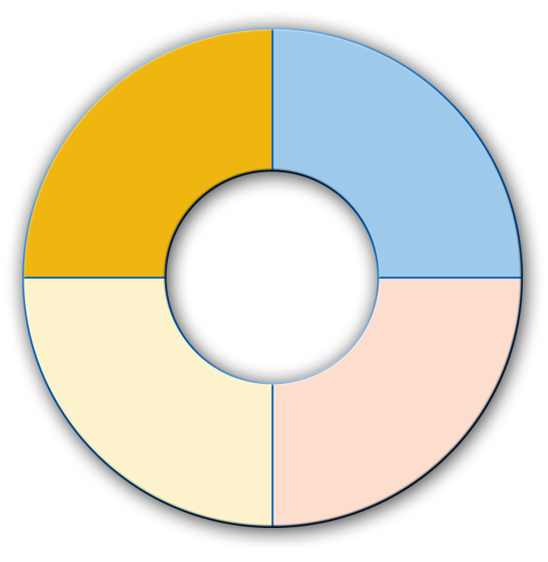
Social Health
Social health is getting along with others.
Maintaining healthy relationships is one way of caring for your social health.
Family
Friends
Your Social Network
Other Community Members
Teachers

Slide 10
BALANCE your triangle!
When your health triangle is balanced, you have a high degree of WELLNESS!
Wellness comes from making responsible decisions and practicing healthful behaviors that are based on sound health knowledge and healthful attitudes.

Slide 11
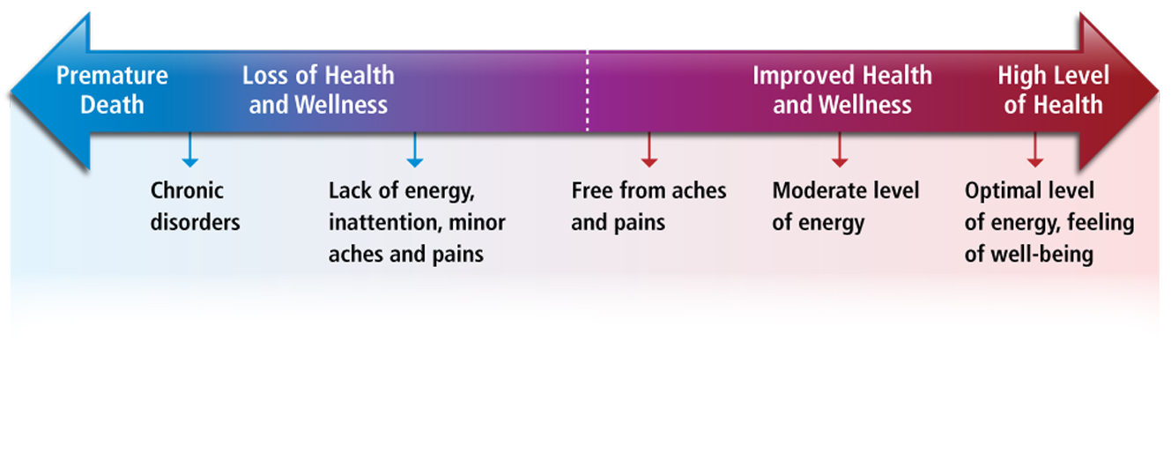
The Health Continuum
Your health can be measured on a sliding scale.

Slide 12
What affects your health?

Slide 13
Influences on Your Health
Heredity
Environment
Physical Environment – neighborhood, access to medical care, etc.
Social Environment – family and peers
Culture
Attitude – how you view situations
Behavior
Media & Technology

Slide 14
Understanding Your Influence
You can take control of your health by understanding the factors that influence it.

Slide 15
Health Risks & Your Behavior

Slide 16
Identifying Health Risks
Engaging in risk behaviors can harm your health.
The following can lead to heart disease, cancer and other serious illnesses:
-tobacco
-alcohol
-inadequate physical activity
-drugs
-behaviors that cause injuries and violence

Slide 17
How to Avoid or Reduce Risks
You can take action to reduce your exposure to health risks.
Use prevention techniques. Ex: Wearing a seatbelt when your are in the car.
Abstain from high-risk behaviors.

Slide 18
Lifestyle Factors
Ways to live a healthy life:
-getting 8 hours of sleep each night
-starting each day with a healthy breakfast
-eating a variety of nutritious foods each day
-being physically active for 30-60 minutes each day
-maintain a healthy weight
-abstaining from smoking, tobacco products, alcohol, and other drugs

