Slide 1
Conditions and Special Tests of the Elbow, Wrist, and Hand

Slide 2
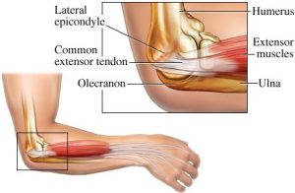
Sprain
Sprain: injuries to any of the ligaments of the elbow.
The elbow joint is a very stable joint, thus sprains are possible but very uncommon.
MOI: usually a hyperextension or valgus force; fall on an outstretched arm
Signs & Symptoms: pain over the area, swelling, bruising
Treatment: PRICES, medical referral based on severity

Slide 3
First degree sprain: one or more of the supporting ligaments are stretched, minor discomfort, point tenderness over the area, little or no swelling
Second degree sprain: a portion of one or more of the ligaments have been torn, there is pain, swelling, point tenderness, and loss of function for several minutes or longer, the is slight abnormal movement, the athlete may not be able to utilize the extremity
Third degree sprain: one of more ligaments have been completely torn resulting in joint instability, there is either extreme pain or little pain (if nerve damage has occurred), loss of function, point tenderness, and rapid swelling.
**A fracture is possible with a third degree sprain**

Slide 4
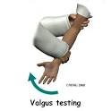
Special Tests:
Valgus Stress Test-tests for MCL/Ulnar Collateral Ligament Sprain
Varus Stress Test-Tests for LCL/Radial Collateral Ligament Sprain

Slide 5
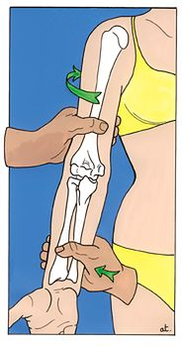
Test for Ligament Stability- Valgus (MCL) and Varus (LCL) Stress TEST
http://www.youtube.com/watch?v=QLjmfLka-gU

Slide 6
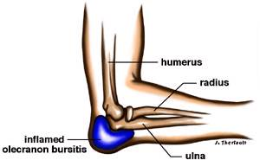
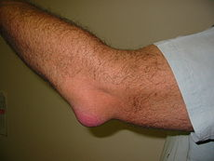
Olecranon Bursitis
Olecranon bursitis: injury to the bursa at the olecranon process (tip of elbow)
MOI: either a direct blow to the area or overuse will cause the inflammation of the olecranon bursa
Signs & Symptoms: swelling, pain, inflammation, warmth (could indicate infection)
Treatment: referral to the physician, ice or heat, compression

Slide 7
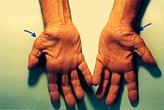
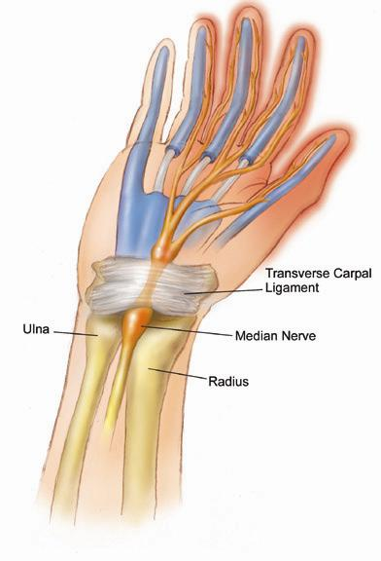
Carpal Tunnel Syndrome
Carpal tunnel syndrome: a medical condition caused by pressure on the median nerve
MOI: overuse injury
Signs & Symptoms: pain, numbness, tingling, difficulty with the activities of daily living (ADL), possible swelling
Treatment: wrist splint, rest, medication, referral to physician

Slide 8
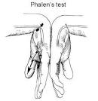
Phalen’s TEST tests for Carpal Tunnel Syndrome (Median Nerve)

Slide 9
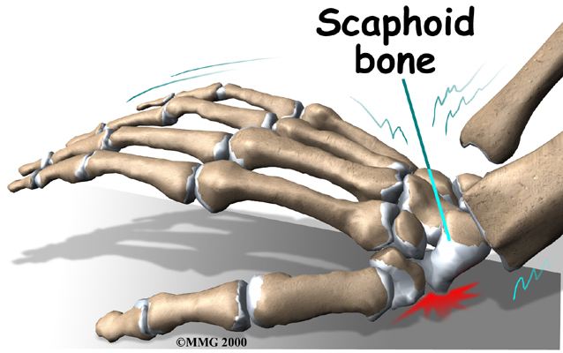
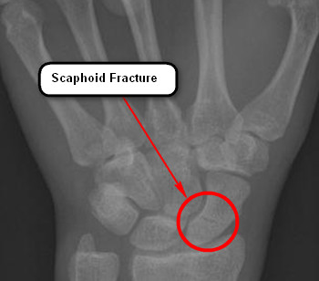
Scaphoid Fracture
Scaphoid fracture: a fracture of the scaphoid bone in the hand
MOI: fall on an outstretched hand with an extended wrist
Signs & Symptoms: usually severe pain is located in the anatomical snuffbox, crepitus, swelling, bruising
Treatment: PRICES, referral to a physician for x-rays, re-evaluation on a weekly basis
**A scaphoid fracture often leads to a non-union of the bone fragments because of its poor blood supply.**

Slide 10
Dislocations and Subluxations
Dislocation: displacement of a bone from its normal position in the joint
**Dislocations and subluxations commonly occur at the head of the radius, lunate, and phalanges.**
Subluxation: temporary displacement of a bone from its normal position in the joint
MOI: fall on an outstretched hand with an extended elbow
Signs & Symptoms: possible deformity, pain, loss of function, swelling, bruising
Treatment: medical referral is necessary

Slide 11
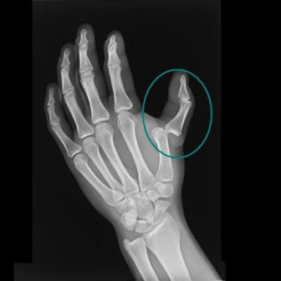
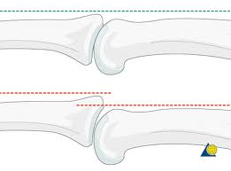
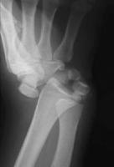
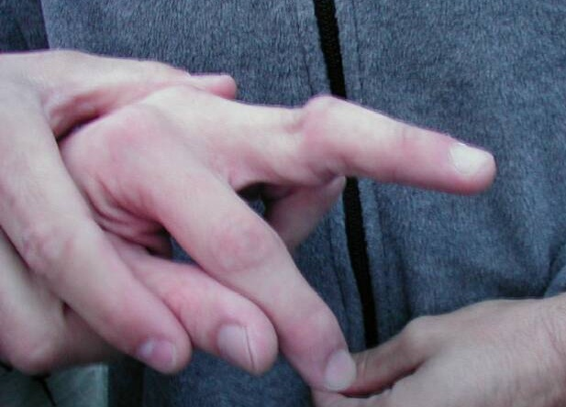
Thumb dislocation
Phalange subluxation
Phalange dislocation
Wrist dislocation

Slide 12
Epicondylitis
Epicondylitis: an inflammation of the epicondyle and the tissues adjoining the humerus
Medial epicondylitis: “Little Leaguers Elbow;” medial epicondyle is the attachment site for the flexors of the elbow, wrist, and hand.
Lateral epicondylitis: “Tennis Elbow;” lateral epicondyle is the attachment site for the extensors of the elbow, wrist, and hand.
MOI: overuse injury
Signs & Symptoms: pain, swelling, bruising, painful overhead motions, muscle weakness
Treatment: ice, heat, strengthening exercises, good biomechanics training, referral based on severity

Slide 13
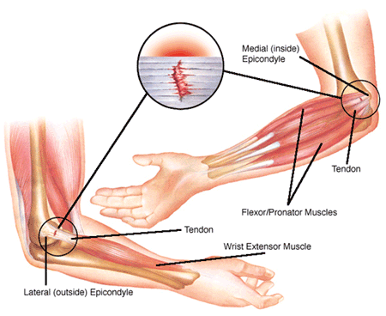
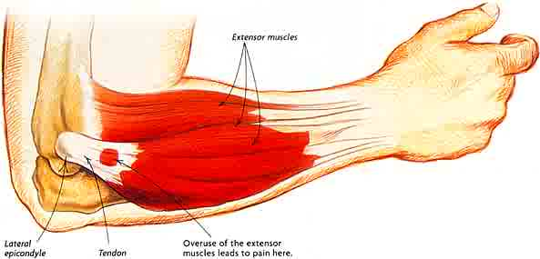
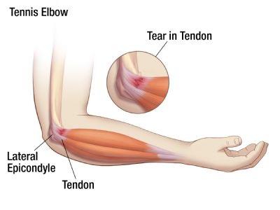
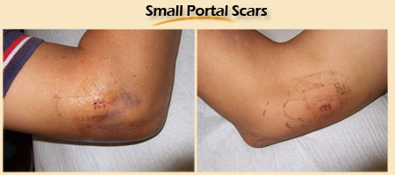

Slide 14
Special Tests for Epicondylitis
Little League Elbow Test-Tests for Medial Epicondylitis
Tennis Elbow Test-tests for Lateral Epicondylitis

Slide 15
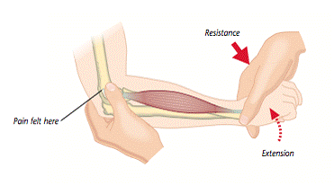
Tennis Elbow Test-tests for Lateral Epicondylitis
Stabilize the forearm and tell patient to make a fist and to extend wrist. Then apply pressure with your other hand to the dorsum of his/her fist in an attempt to force their wrist into flexion. If the patient has tennis elbow, he/she will experience a sudden severe pain at the site of the wrist extensors’ common origin, the lateral epicondyle.
http://www.youtube.com/watch?v=futWq8mXzUo

Slide 16
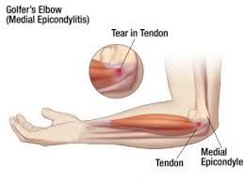
Little Leaguer’s Elbow TEST- Medial Epicondylitis
Stabilize the forearm and tell patient to make a fist and to flex wrist. Then apply pressure with your other hand to the dorsum of his/her fist in an attempt to force their wrist into extension. If the patient has little leaguer’s elbow, he/she will experience a sudden severe pain at the site of the wrist flexors’ common origin, the medial epicondyle.
https://www.youtube.com/watch?v=q3h113jKyKk

Slide 17
Contusion
Contusion: bruise
**Commonly occurs to the hand and the ulnar side of the forearm.**
MOI: direct blow or falling on the extremity
Signs & Symptoms: bruising, pain, swelling, loss of function
Treatment: PRICES, padding for protection

Slide 18
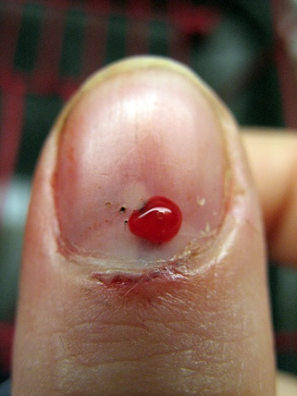
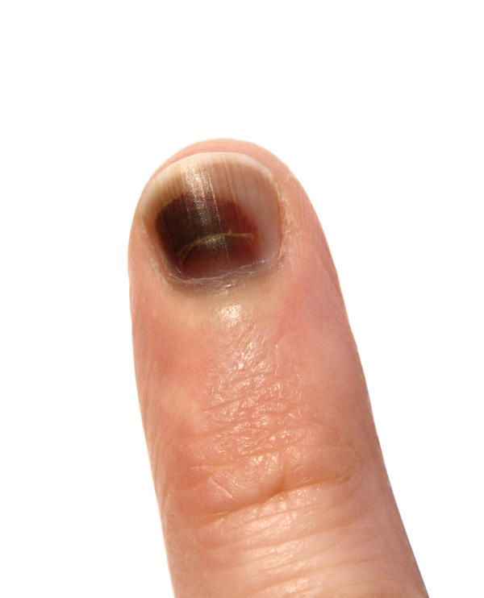
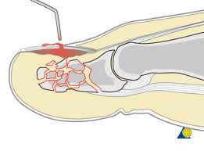
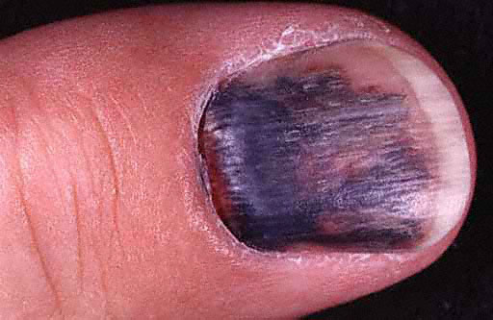
Subungal Hematoma
Subungal Hematoma: a contusion or
bruise underneath the fingernail
MOI: direct trauma
Signs & Symptoms: bruising, pain
Treatment: ice and depending on severity referral to remove the fluid

Slide 19
Boutonneire Deformity
Boutonneire Deformity: a rupture of the extensor tendon from its insertion into the base of the middle phalange
MOI: blow to the tip of the finger forcing the proximal interphalangeal joint into excessive flexion
Signs & Symptoms: proximal interphalangeal joint is in a flexed position and the distal interphalangeal joint is extended; the athlete will be unable to extend their finger completely
Treatment: splint and refer to a physician

Slide 20
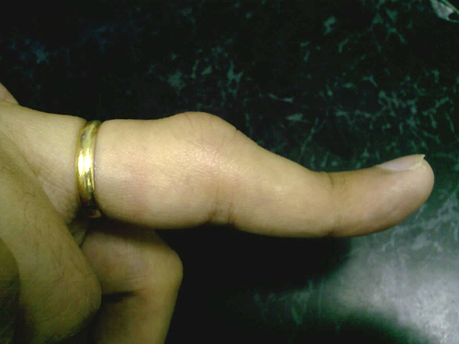
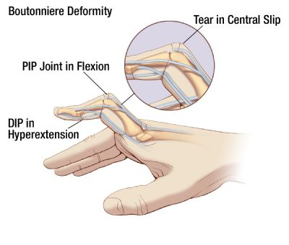
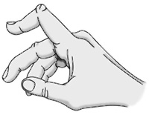

Slide 21
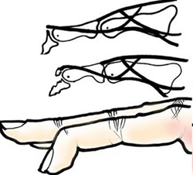
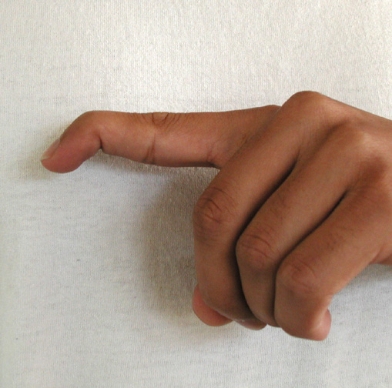
Mallet Finger
Mallet finger: when the extensor digitorum muscle is torn away from its insertion at the distal phalange (usually avulsed)
MOI: blow to the tip of the finger forcing the distal interphalangeal joint into flexion
Signs & Symptoms: palpable bony fragment on top of the finger at the distal phalange; unable to extend distal phalange
Treatment: splint and refer to physician

Slide 22
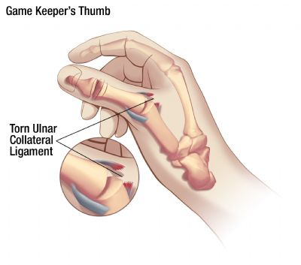
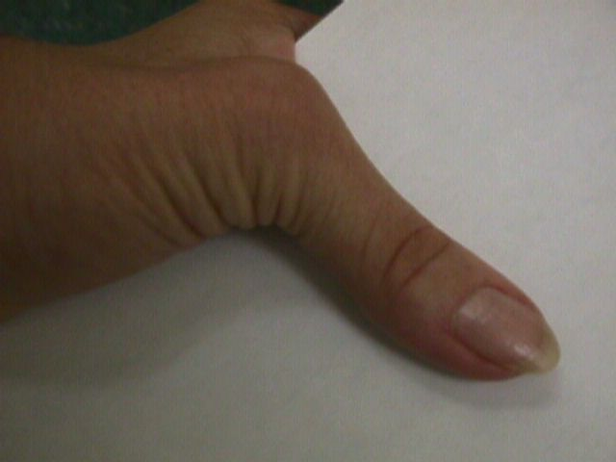
Game Keeper’s Thumb
Game keeper’s thumb: sprained ulnar collateral ligament at the thumb
MOI: forced abduction of the thumb while it is in an extended position
Signs & Symptoms: pain, swelling, bruising, deformity, possible based on severity
**remember classifications of sprains**
Treatment: referral to rule out avulsion fracture

Slide 23
Game Keeper’s Thumb- tests for the UCL of the THUMB

Slide 24
More Special Tests

Slide 25
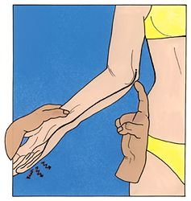
Tinel Sign-tests the Ulnar Nerve
The tinel sign is a test designed to elicit tenderness over a neuroma within a nerve.
If there is a neuroma within the ulnar nerve, tapping the area of the nerve in the groove between the olecranon and the medial epicondyle will send a tingling sensation down the forearm to the ulnar distribution in the hand.
http://www.youtube.com/watch?v=CCO8YHrW5S4

