Slide 1
Elbow, Wrist, and Hand Evaluation
Chapter 19: Pages 432-435; Pages 445-447

Slide 2
History:
Write 10 questions.

Slide 3
H: History
Is this a new injury or is this a chronic problem that has existed for some time?
Is the pain or discomfort caused by direct trauma such as falling on an outstretched arm or landing on the tip of a bent elbow?
Can the problem be attributed to sudden overextension of the elbow or to repeated overuse of a throwing type motion?
Are there movements or positions of the arm that increases or decreases the pain?
Has the elbow been injured before? If so, what was the diagnosis and treatment?
Is there a feeling of locking or grating during movement?
Is there any tingling or numbness radiating down the forearm or in the hand and fingers?

Slide 4
Observation
List 5 signs and symptoms that might be present if someone hurt their EWH.

Slide 5
O: Observation
  Observe carrying angle for abnormalities
  Observe flexion and extension for limitations
  Swelling
  Deformity
  Eccymosis or discoloration
  Heat or warmth
  Crepitus or abnormal sounds at the EWH
  Redness
  Feeling or Sensation
  Range of Motion (ROM)
  Areas of Pain and Point Tenderness
  Muscle Atrophy or Weakness

Slide 6
Palpation:
What can you physically touch at the
  Elbow?
  Wrist?
  Hand?

Slide 7
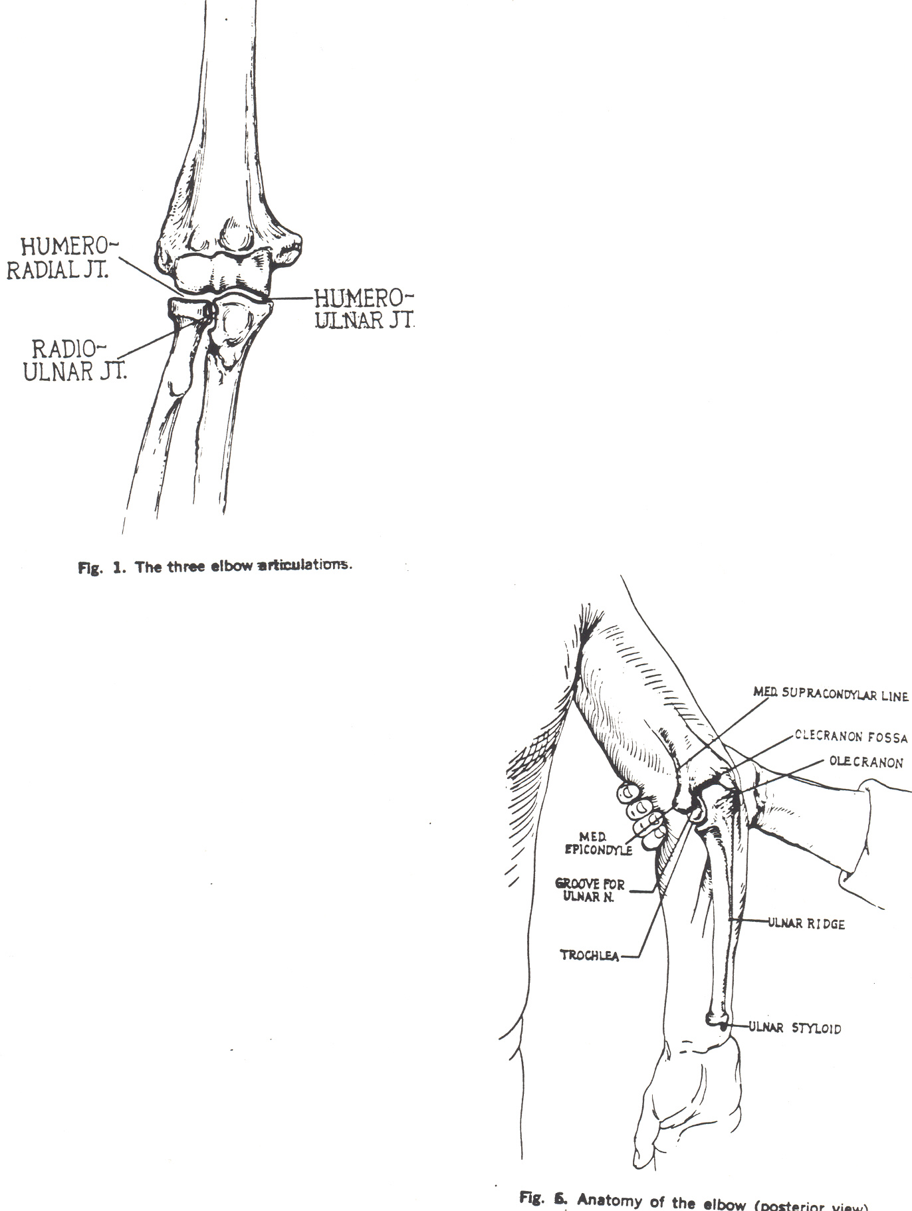
Elbow: What can you palpate?
Bony Landmarks
Olecranon process – sticks out at the tip of the elbow
Medial epicondyle
Lateral epicondyle
Ulnar notch (ulnar nerve)

Slide 8
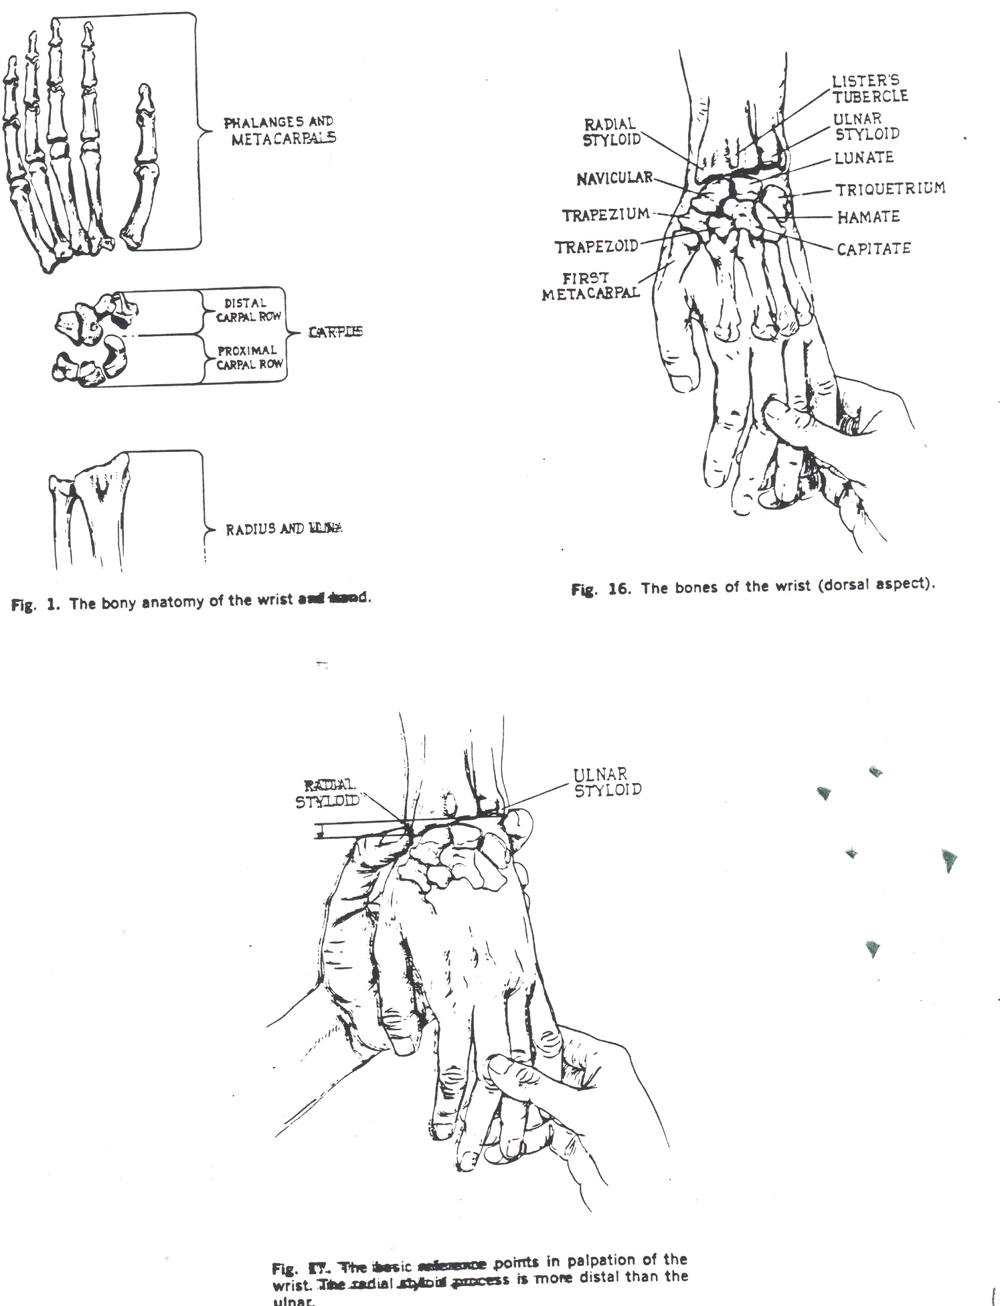
Wrist: What can you palpate?
Bony Landmarks
Styloid process of the radius
Styloid process of the ulna
Scaphoid-at anatomical snuffbox (base of the thumb)
Pisiform

Slide 9
Hand: What can you palpate?
Bony Landmarks
Hook of the hamate
Capitate
Anatomical snuffbox – where scaphoid is located
Knuckles – head of metacarpals
Phalanges

Slide 10
Palpation
What are the ligaments at the EWH?

Slide 11
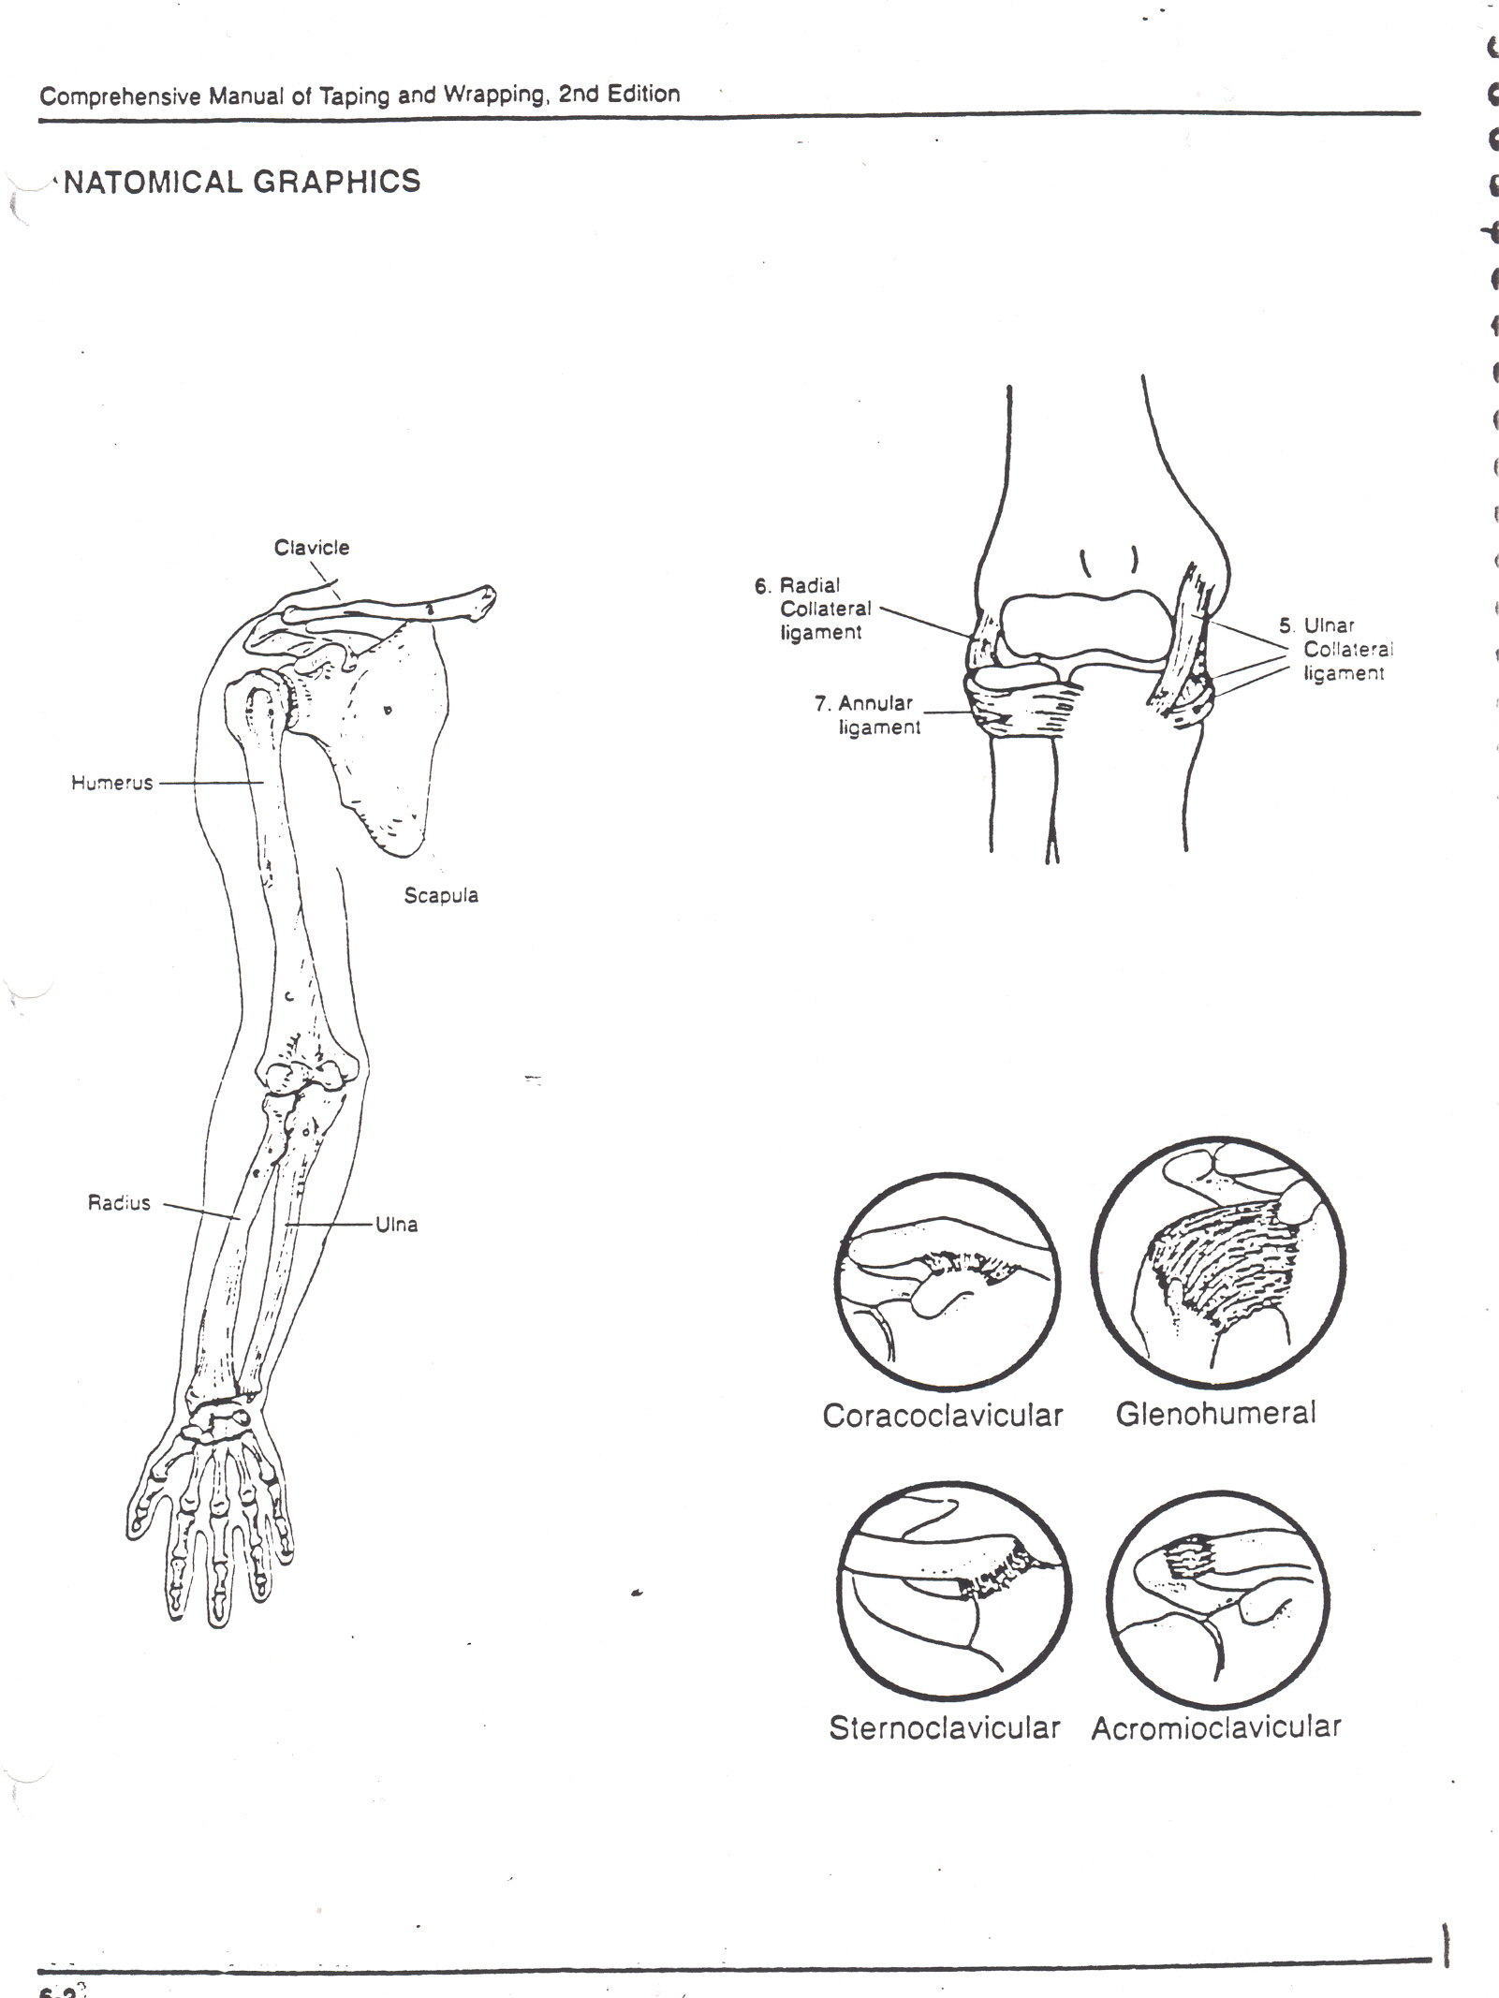
Palpate the Ligaments at the Elbow
Lateral (radial) collateral
Medial (ulnar) collateral
Annular – wraps around the radius

Slide 12
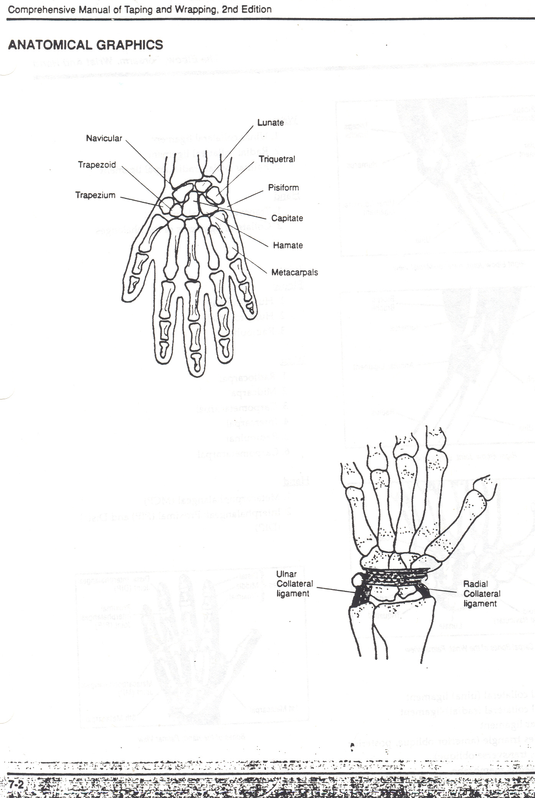
Palpate the Ligaments at the Wrist
Lateral (Radial) collateral
Medial (Ulnar) collateral
Transverse

Slide 13
Palpation:
What muscles can you palpate at the EWH?
  The muscles must be superficial!!!!!

Slide 14
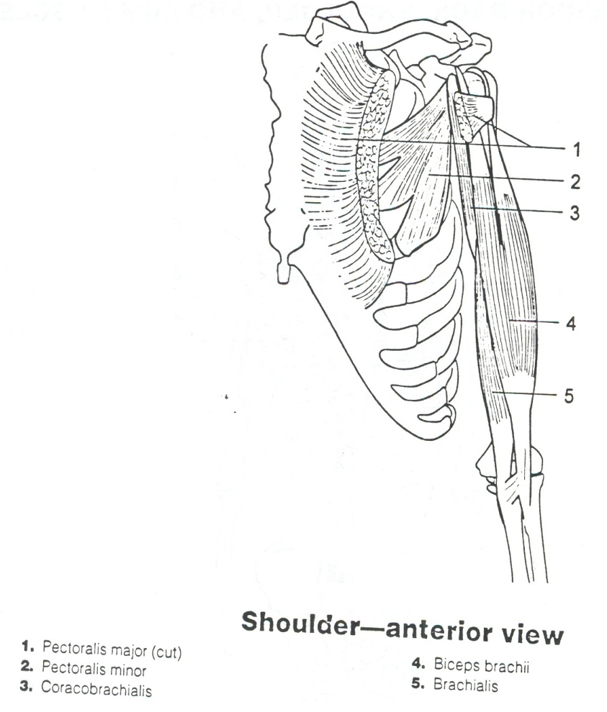
P: Palpation of the EWH Muscles
You can palpate the following Muscles of the Anterior Chest, Arm, and Shoulder.
  Biceps Brachii

Slide 15
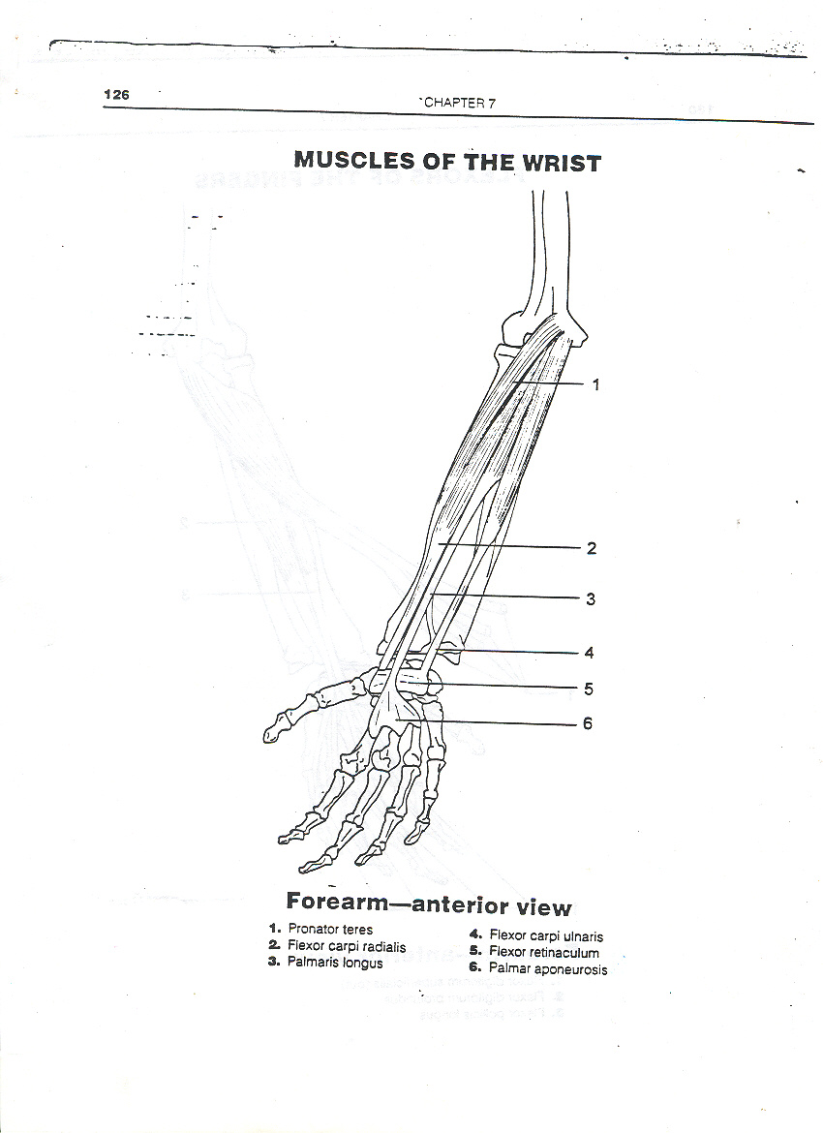
P: Palpation of the EWH Muscles
You can palpate the following EWH Muscles.
  Pronator Teres
  Flexor Carpi Radialis
  Palmaris Longus
  Flexor Carpi Ulnaris
  All of these muscles originate at the Medial Epicondyle.

Slide 16
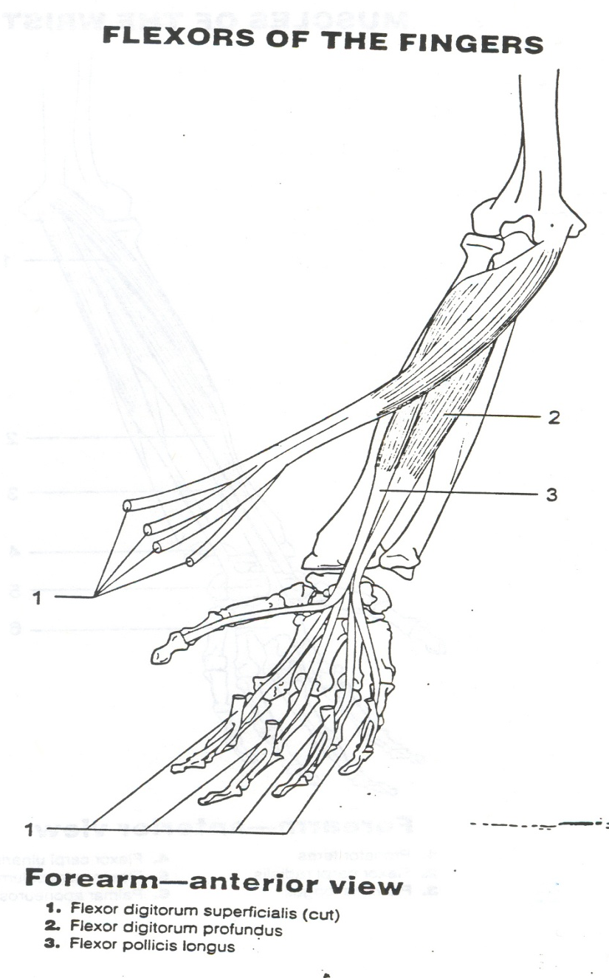
P: Palpation of the EWH Muscles
You can palpate the
  Flexor Digitorum Superficialis
  Flexor Digitorum Profundus
  Flexor Pollicis Longus

Slide 17
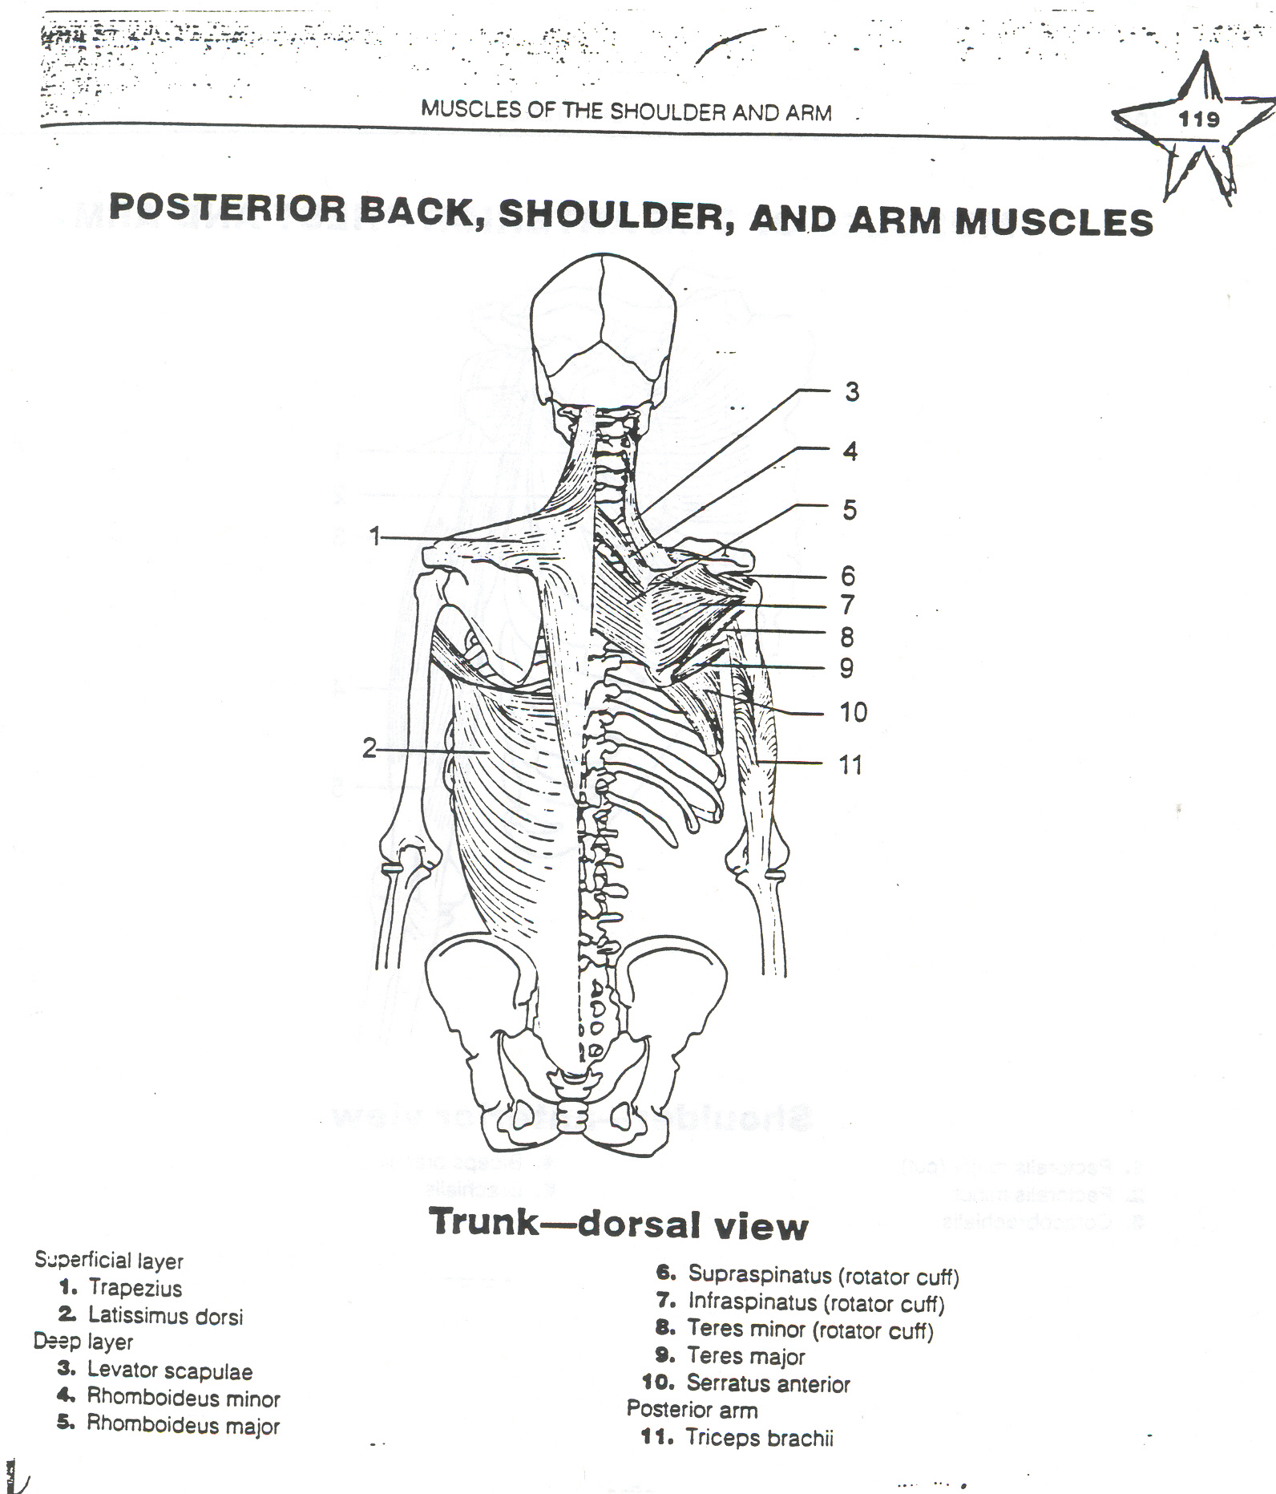
P: Palpation of the EWH Muscles
You can palpate the Triceps Brachii muscle.

Slide 18
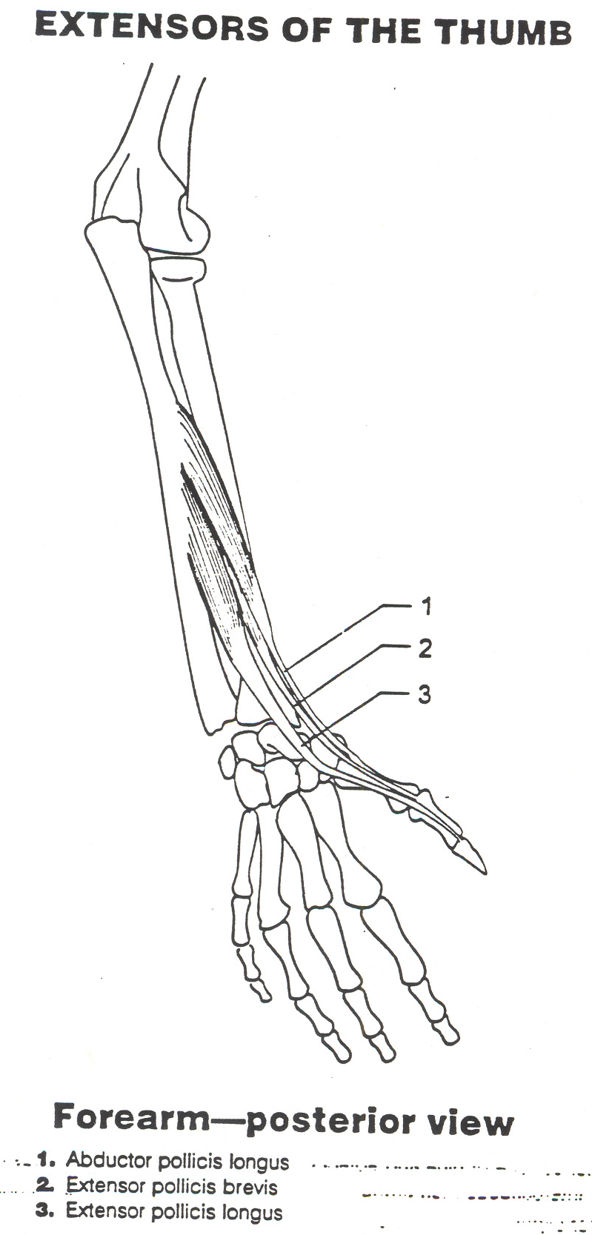
P: Palpation of the EWH
The following muscles of the EWH make up the anatomical snuffbox.
  Abductor Pollicis Longus
  Extensor Pollicis Longus
  Extensor Pollicis Brevis

Slide 19
Special Tests
What muscles do the following movements that occur at the EWH?

Slide 20
Special Tests: EWH-AROM/PROM
Flex Forearm/Elbow-2
Supinate and Flex Elbow/Forearm-1
Pronates -1
Pronate and Flex Elbow/Forearm-1
Flexes Wrist/Hand-3
Flexes Fingers-2
Flexes Thumb-1

Slide 21
Special Tests: EWH-AROM/PROM
Flex Forearm/Elbow
  Brachialis
  Brachioradialis
Supinate and Flex Elbow/Forearm
  Biceps Brachii
Pronates
  Pronator Quadratus
Pronate and Flex Elbow/Forearm
  Pronator Teres
Flexes Wrist/Hand
  Flexor Carpi Radialis
  Palmaris Longus
  Flexor Carpi Ulnaris
Flexes Fingers
  Flexor Digitorum Superficialis
  Flexor Digitorum Profundus
Flexes Thumb
  Flexor Pollicis Longus

Slide 22
Special Tests: EWH-AROM/PROM
Extends Elbow/Forearm-2
Extends Wrist/Hand And Radial Deviation-2
Extends Fingers (or Pinky)-2
Extends Wrist/Hand-1
Supinates-1
Abducts Thumb-1
Extends Thumb-2
Adducts Fingers (PAD)-1
Abducts Fingers (DAB)-1

Slide 23
Special Tests: EWH-AROM/PROM
Extends Elbow/Forearm
  Anconeus
  Triceps Brachii
Extends Wrist/Hand And Radial Deviation
  Extensor Carpi Radialis Longus
  Extensor Carpi Radialis Brevis
Extends Fingers
  Extensor Digitorum Communis
  Extensor Digiti Minimi
Extends Wrist/Hand
  Extensor Carpi Ulnaris
Supinates
  Supinator
Abducts Thumb
  Abductor Pollicis Longus
Extends Thumb
  Extensor Pollicis Brevis
  Extensor Pollicis Longus
Adducts Fingers (PAD)
  Palmar Interossei
Abducts Fingers (DAB)
  Dorsal Interossei

Slide 24
Special Tests:
List the 7 special tests that we discussed in class while going over EWH Conditions.
  Valgus
  Varus
  Tinel
  Phalen’s
  Game Keeper’s Thumb
  Tennis Elbow
  Little Leaguer’s Elbow
Make a note as to what you are testing.

Slide 25
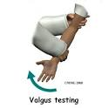

Special Tests:
Valgus Stress Test-tests for MCL SPrain
Varus Stress Test-Tests for LCL Sprain

Slide 26


Tennis Elbow Test-tests for Lateral Epicondylitis
Little LeagueR’s Elbow Test-Tests for Medial epicondylitis

Slide 27
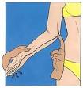

Game Keeper’s Thumb- tests for the UCL of the THUMB
Tinel Sign-tests for an ulnar nerve issue

Slide 28
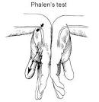
Phalen’s TEST tests for Carpal Tunnel Syndrome
(Median Nerve)

Slide 29
Special Tests: EWH-MMT
MANUAL MUSCLE TESTS
How do you test the strength of each muscle of the EWH?

Slide 30
Special Tests: EWH-MMT
Flex Forearm/Elbow
  Brachialis
  Brachioradialis
Supinate and Flex Elbow/Forearm
  Biceps Brachii
Pronates
  Pronator Quadratus
Pronate and Flex Elbow/Forearm
  Pronator Teres
Flexes Wrist/Hand
  Flexor Carpi Radialis
  Palmaris Longus
  Flexor Carpi Ulnaris
Flexes Fingers
  Flexor Digitorum Superficialis
  Flexor Digitorum Profundus
Flexes Thumb
  Flexor Pollicis Longus

Slide 31
Special Tests: EWH-MMT
Extends Elbow/Forearm
  Anconeus
  Triceps Brachii
Extends Wrist/Hand And Radial Deviation
  Extensor Carpi Radialis Longus
  Extensor Carpi Radialis Brevis
Extends Fingers
  Extensor Digitorum Communis
  Extensor Digiti Minimi
Extends Wrist/Hand
  Extensor Carpi Ulnaris
Supinates
  Supinator
Abducts Thumb
  Abductor Pollicis Longus
Extends Thumb
  Extensor Pollicis Brevis
  Extensor Pollicis Longus
Adducts Fingers (PAD)
  Palmar Interossei
Abducts Fingers (DAB)
  Dorsal Interossei

Slide 32
Special Tests: Functional/Sports Specific
How would you determine if an injured athlete could return to play?
What functional/sports specific activities would they need to be able to do at the EWH?

Slide 33
Special Tests: Functional/Sports Specific Tests
Can the athlete use their EWH when they :
  Walk
  Hop
  Jump
  Run
  Sprint
  Back pedal
  Cut
  Squat
  Lunge
  Change Direction
Depends on the sport:
  Soccer- Throw ins
  Volleyball-Jump Serve/Spike
  Softball/Baseball- Throw/Catch
  Football-Get in Stance/Cut/Change Direction/Start and Stop/Catch/Throw a Ball
  Tennis-Serve, Backhand/Forehand

