Slide 1
The Elbow, Wrist, and Hand

Slide 2
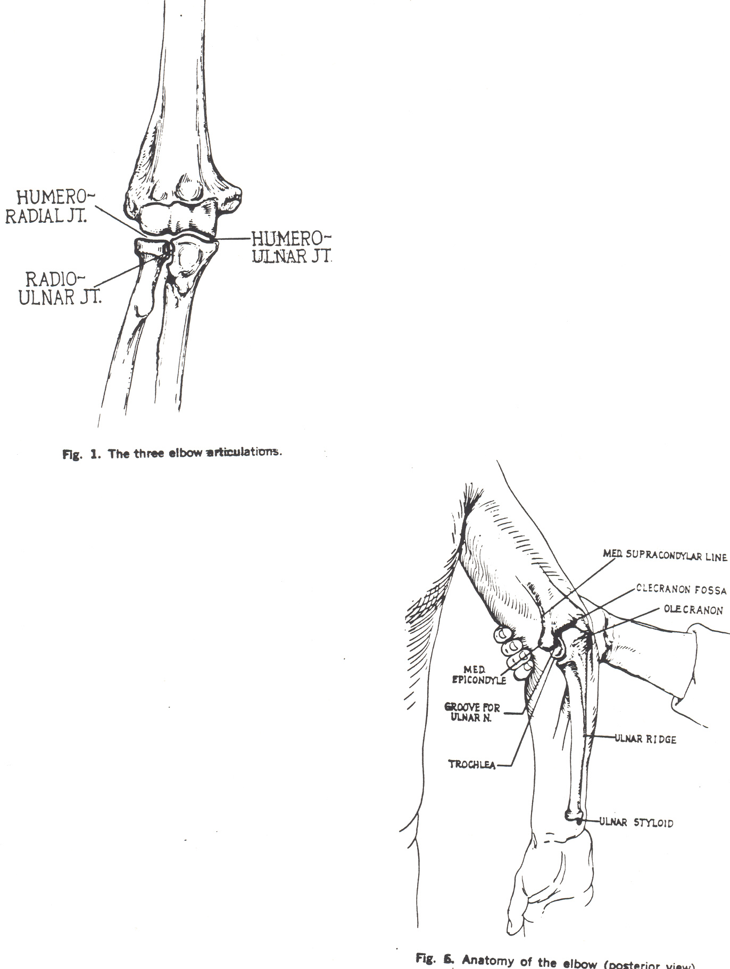
Joints of the Elbow

Slide 3
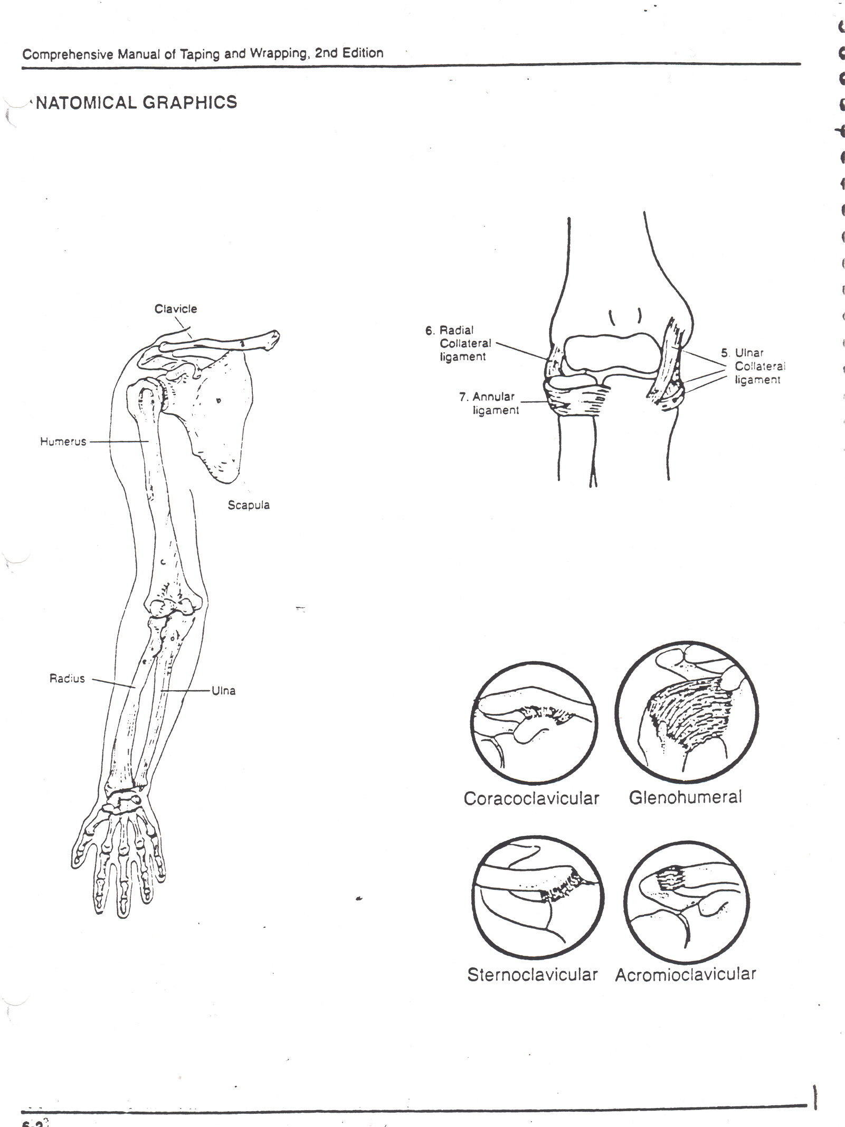
Anatomy of the Elbow
Bones
Humerus – upper arm
Ulna – forearm (medial)
Radius – forearm (lateral)
**Elbow joint is a hinge joint because of the articulation between the ulna and the humerus.
**Radius pivots at the elbow joint.

Slide 4
What can you palpate?
Bony Landmarks
Olecranon process – sticks out at the tip of the elbow
Medial epicondyle
Lateral epicondyle
Ulnar notch (ulnar nerve)

Slide 5
Ligaments at the Elbow
Lateral (radial) collateral
Medial (ulnar) collateral
Annular – wraps around the radius

Slide 6
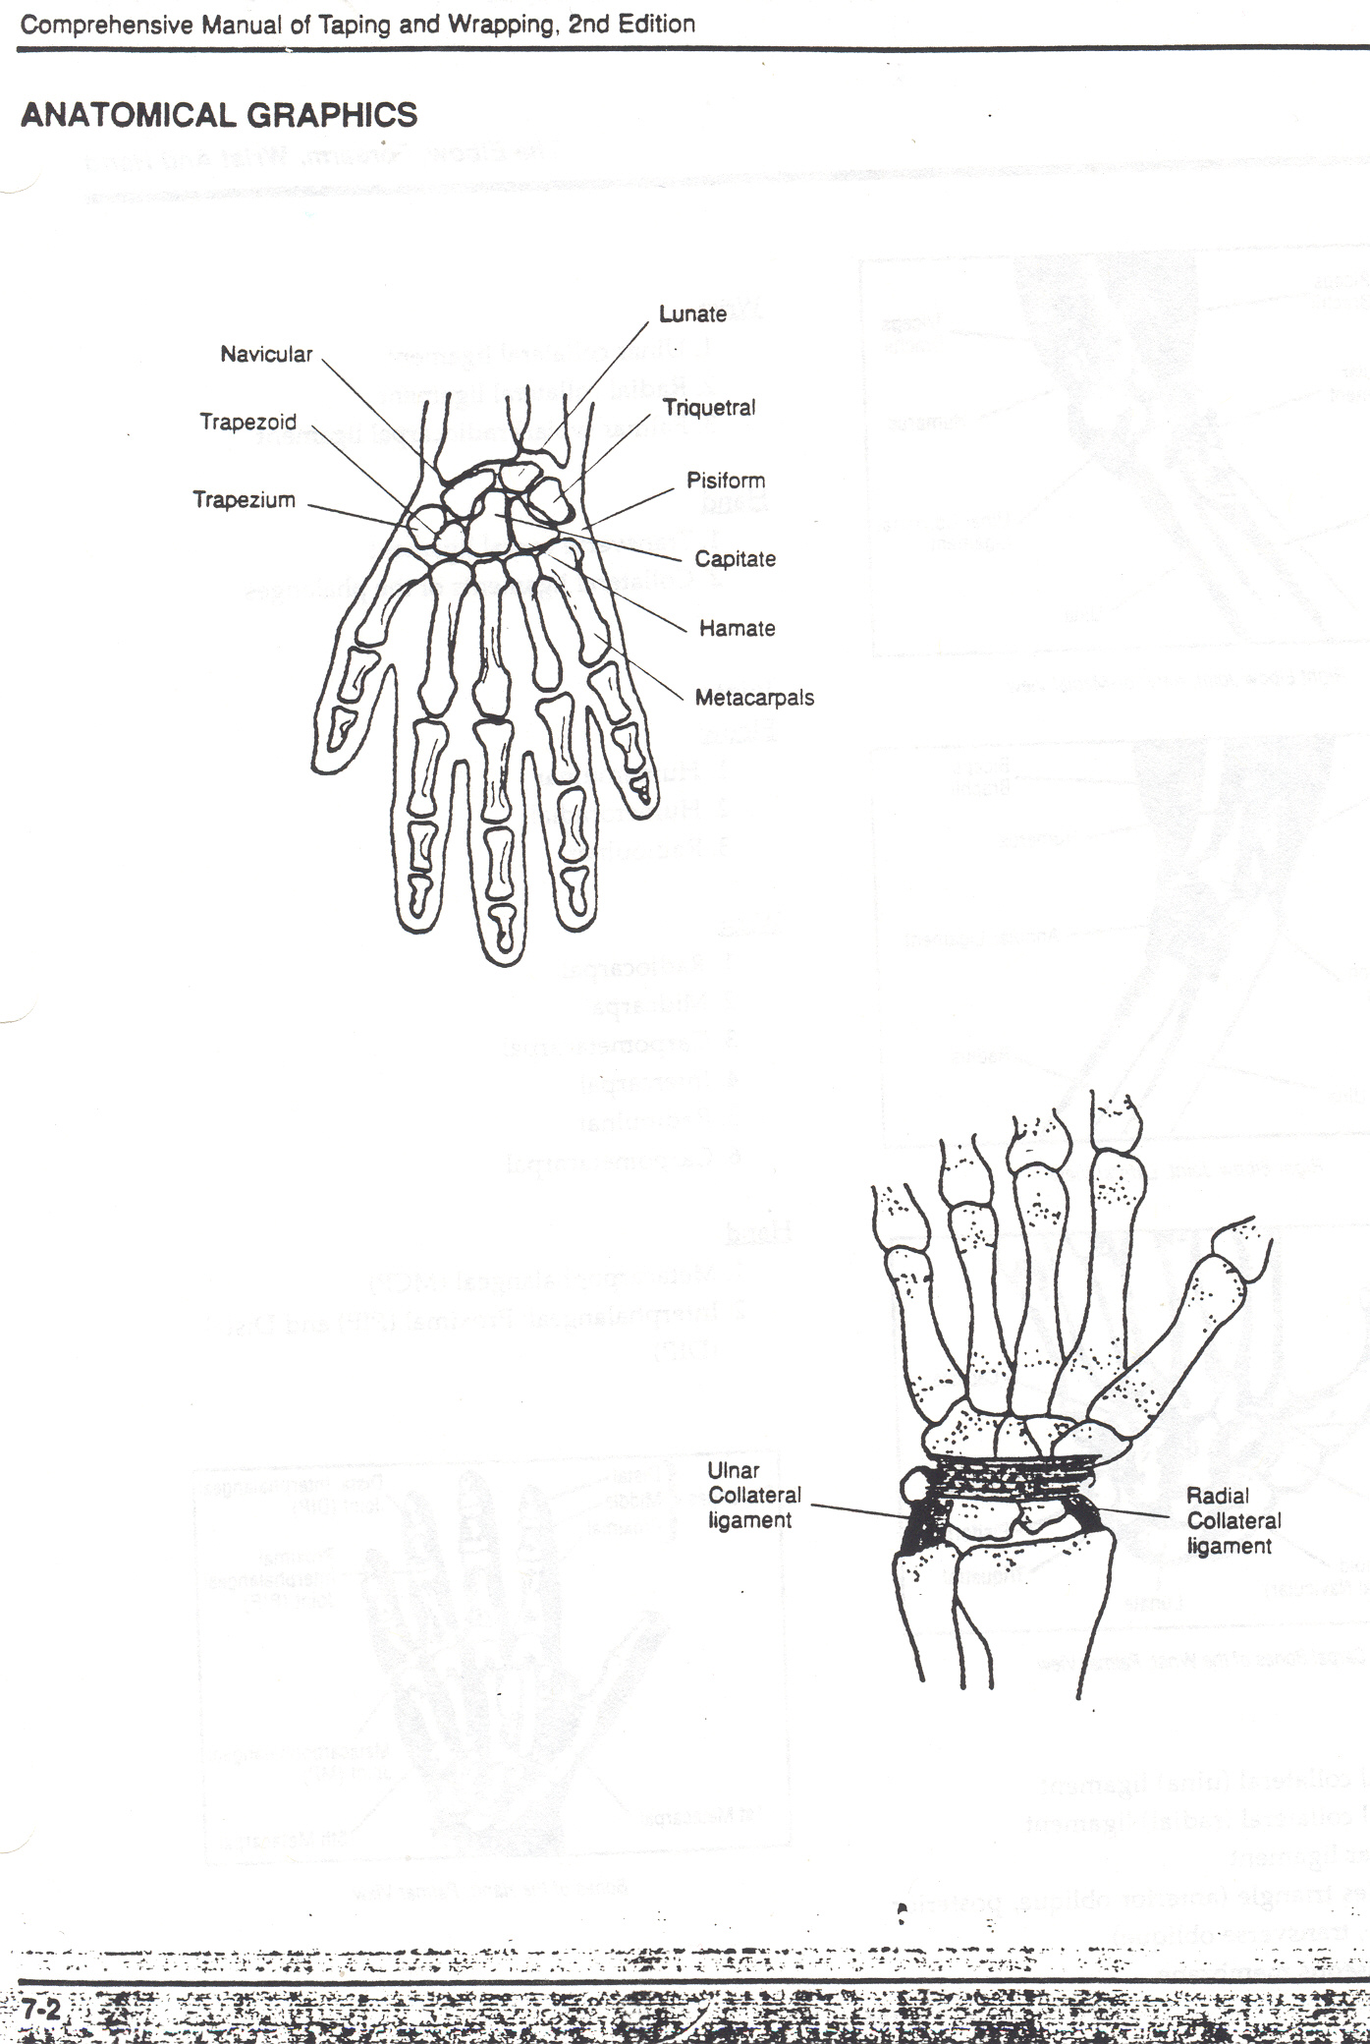
Anatomy of the Wrist
Bones
Radius – forearm (lateral)
Ulna – forearm (medial)
Proximal row of carpal bones (SLTP)- scaphoid, lunate, triquetrum, pisiform

Slide 7
Ligaments at the Wrist
Lateral (Radial) collateral
Medial (Ulnar) collateral
Transverse

Slide 8
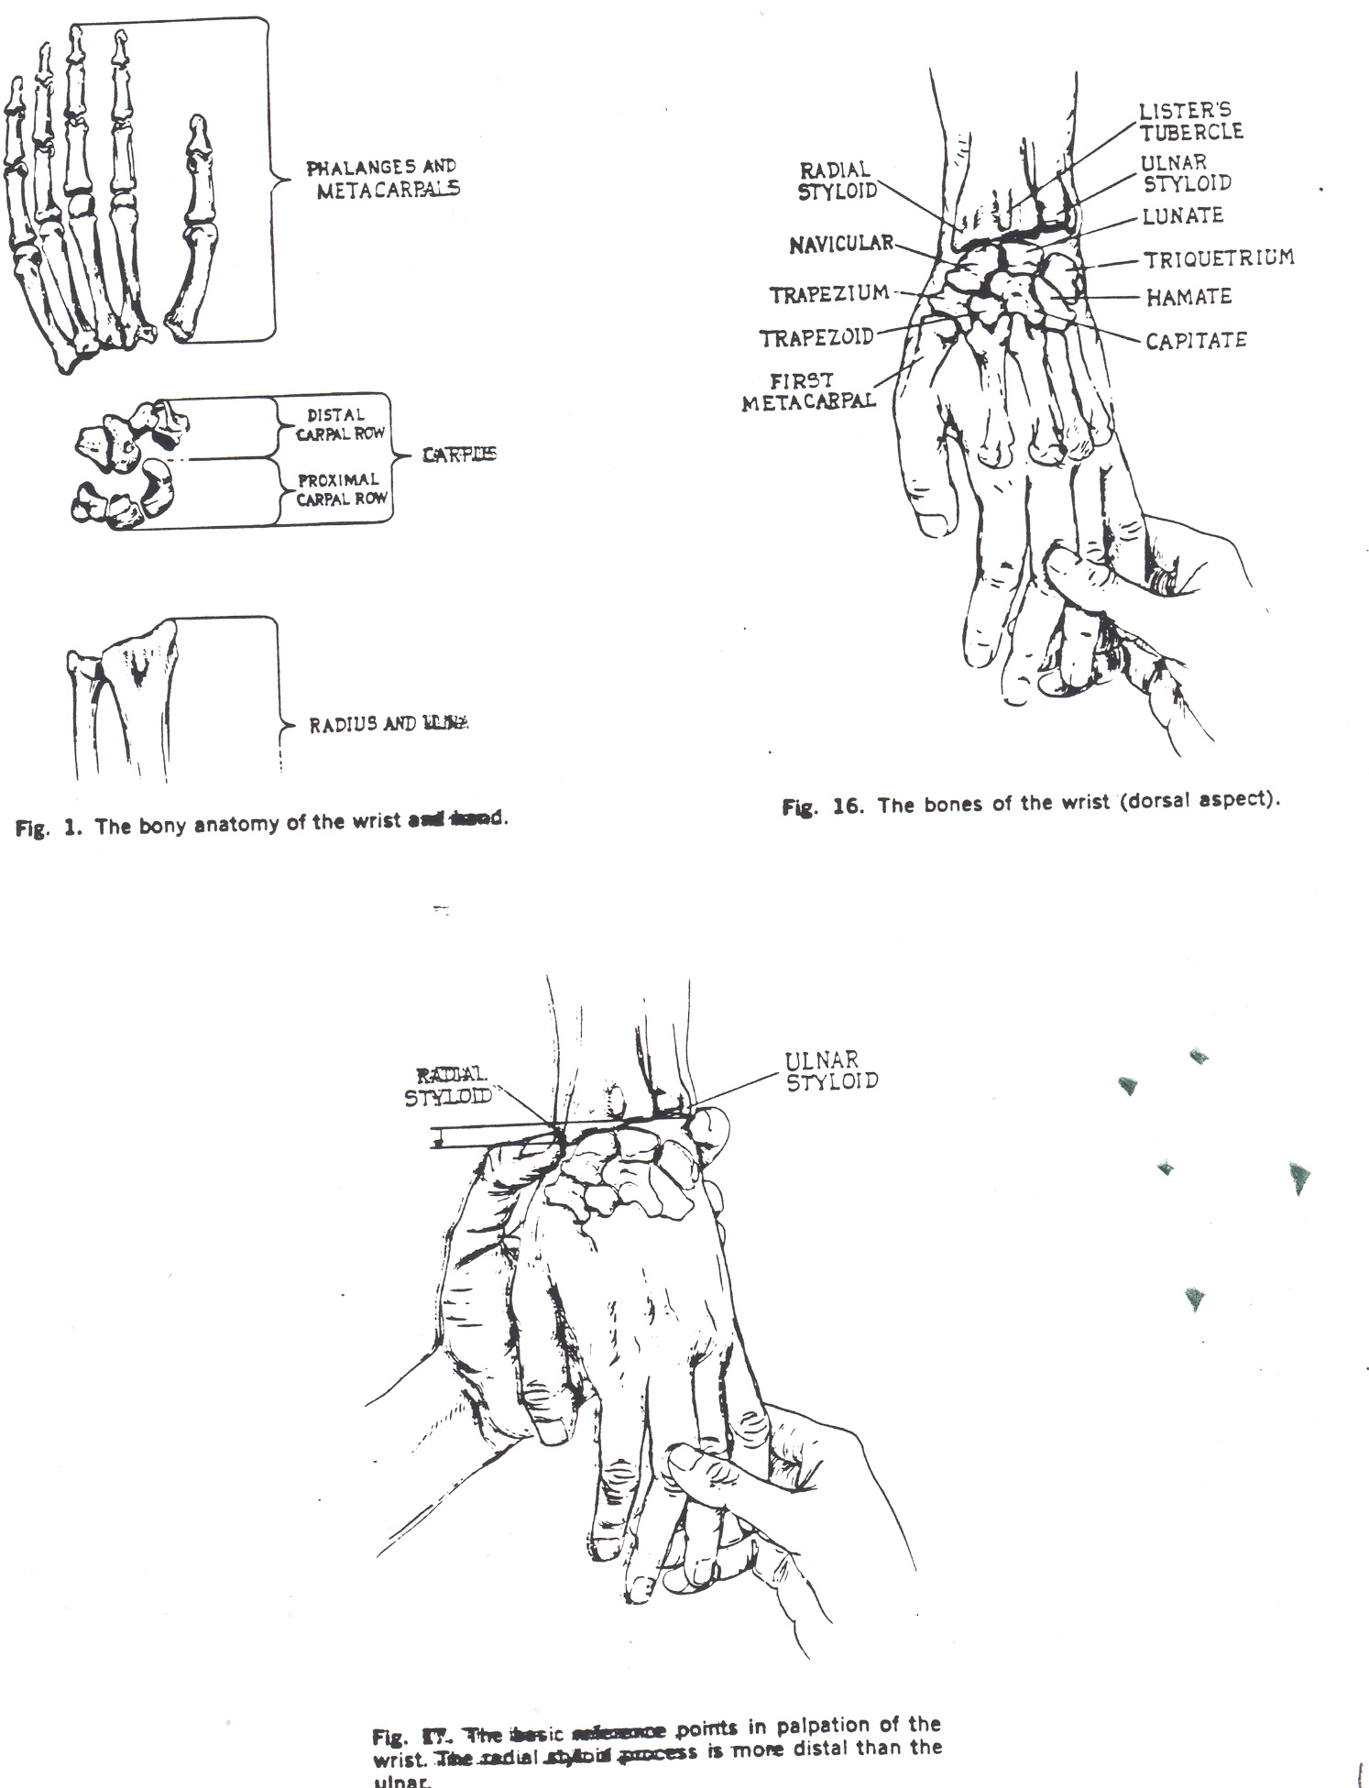
What can you palpate?
Bony Landmarks
Styloid process of the radius
Styloid process of the ulna
Scaphoid-at anatomical snuffbox (base of the thumb)
Pisiform

Slide 9
Anatomy of the Hand
8 carpals (SLTP-proximal row: scaphoid, lunate, triquetrum, pisiform) (TTCH-distal row: trapezium, trapezoid, capitate, hamate)
Acronym for carpal bones **she likes the pasta that they cook here.**
5 metacarpals (1-5; thumb 1, index 2, middle 3, ring 4, pinky 5)
14 phalanges (2 phalanges at the thumb and 3 phalanges at the other 4 fingers)

Slide 10
What can you palpate?
Bony Landmarks
Hook of the hamate
Capitate
Anatomical snuffbox – where scaphoid is located
Pisiform
Knuckles – head of metacarpals
Phalanges

Slide 11
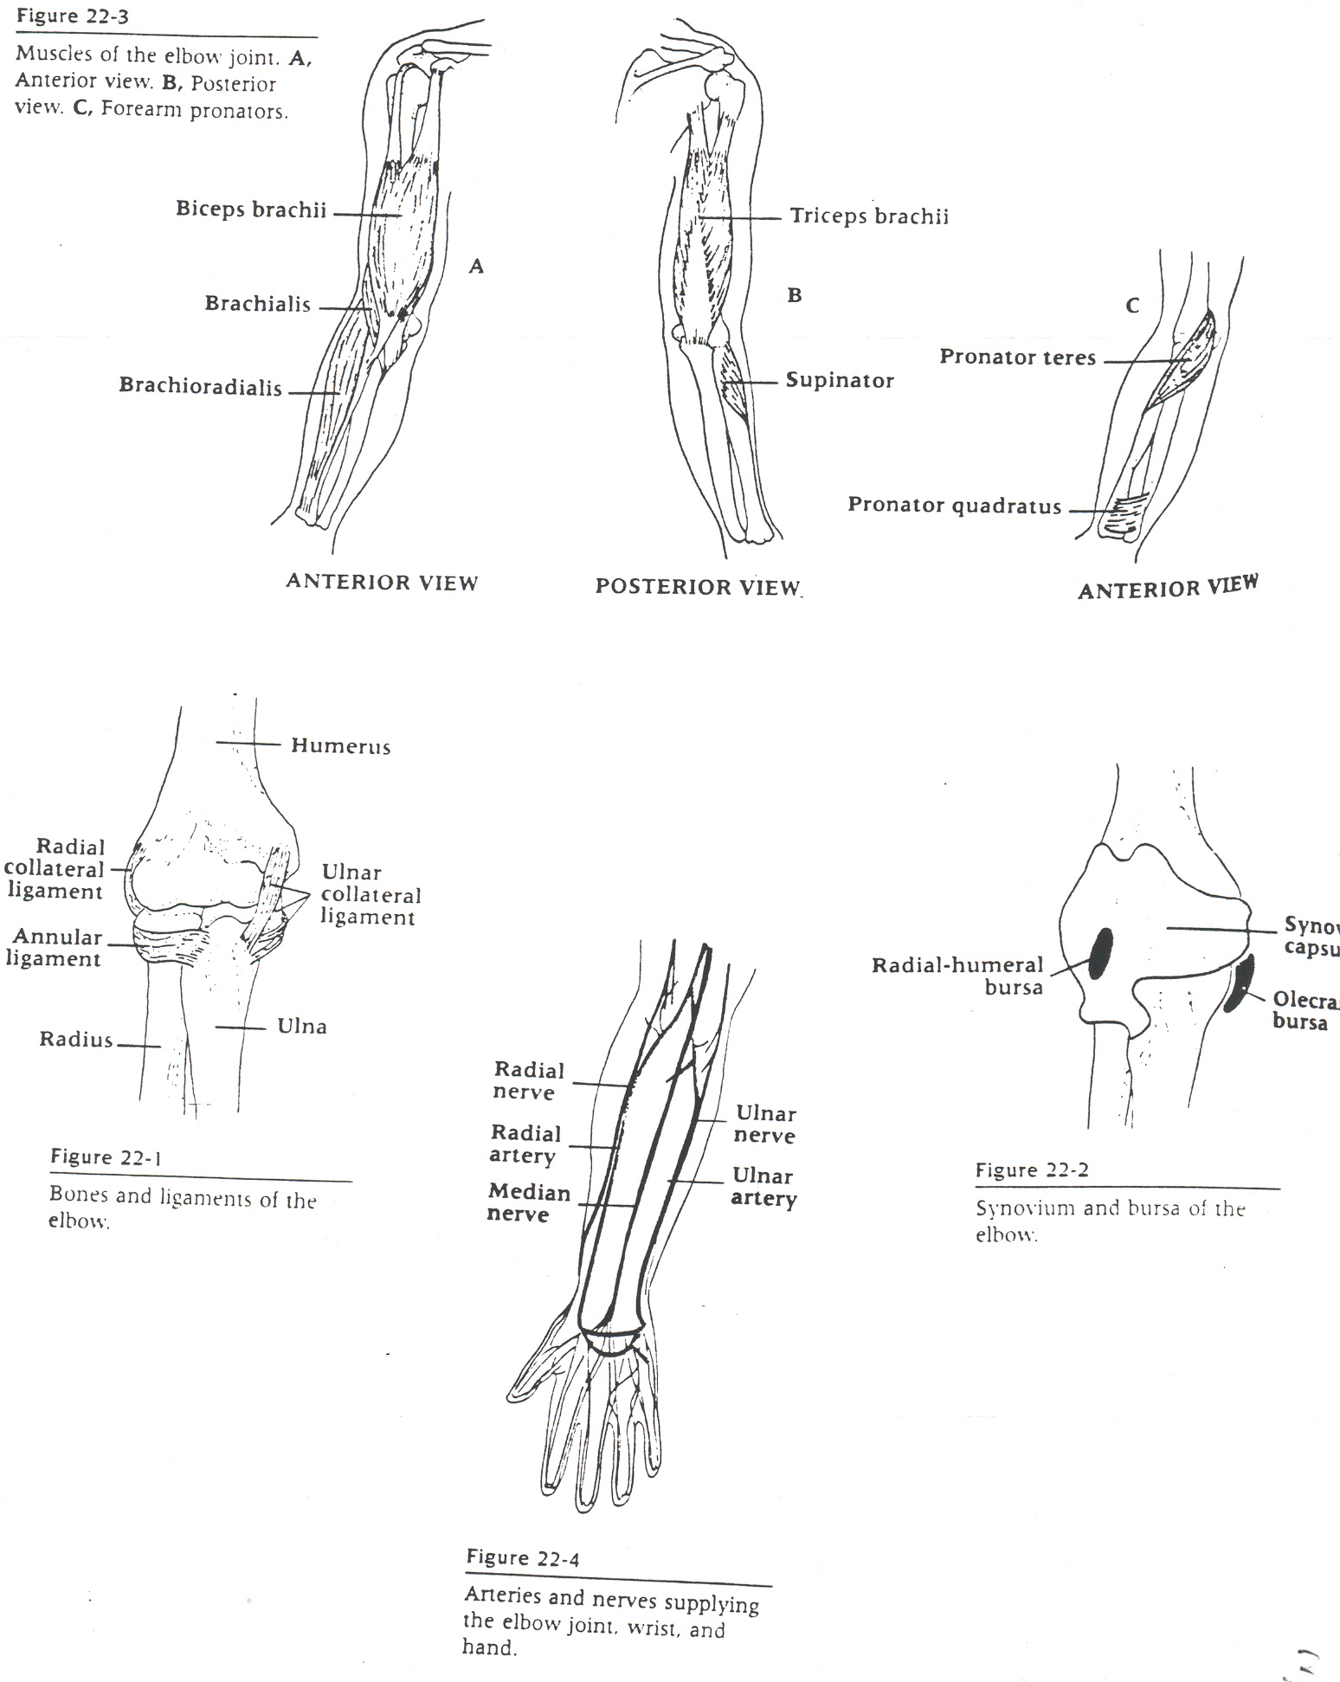
Muscles of the EWH
Wrist Flexors/Pronators at the Medial Epicondyle
Wrist Extensors/Supinators at the Lateral Epicondyle
Supination=Palms Up
Pronation=Palms Down
Finger Adduction=Fingers Together
Finger Abduction= Fingers Apart
Radial/Ulnar Deviation=Waving or Shaking Hands

Slide 12
Any 7 colors of your choice
Flex Forearm/Elbow
  Brachialis
  Brachioradialis
Supinate and Flex Elbow/Forearm
  Biceps Brachii
Pronates
  Pronator Quadratus
Pronate and Flex Elbow/Forearm
  Pronator Teres
Flexes Wrist/Hand
  Flexor Carpi Radialis
  Palmaris Longus
  Flexor Carpi Ulnaris
Flexes Fingers
  Flexor Digitorum Superficialis
  Flexor Digitorum Profundus
Flexes Thumb
  Flexor Pollicis Longus

Slide 13
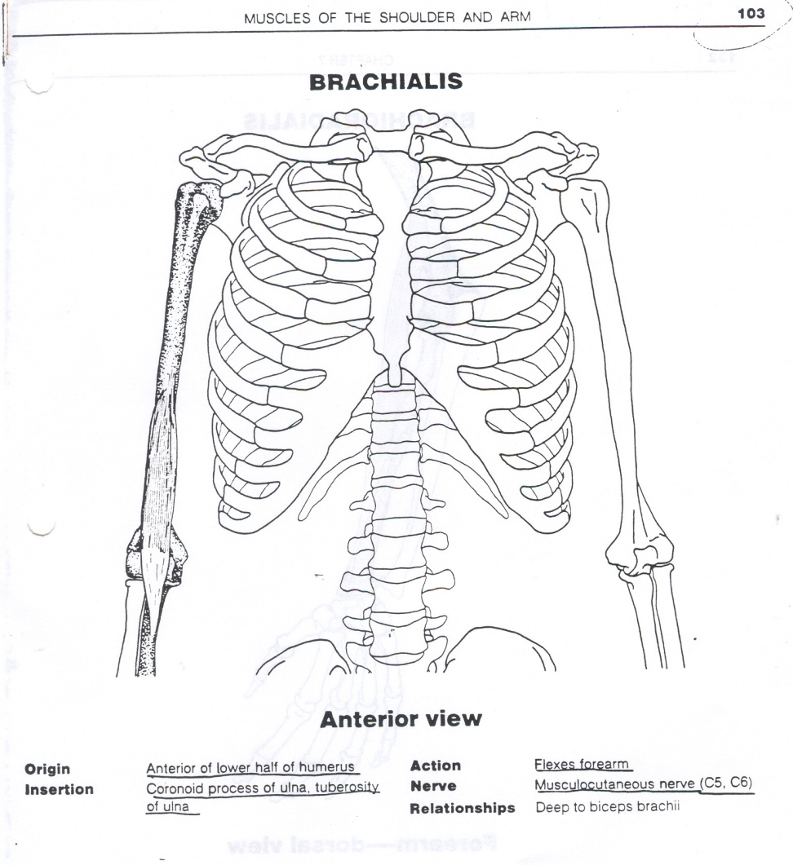
Color One: Brachialis
Action: Flexion of the Elbow/Forearm

Slide 14
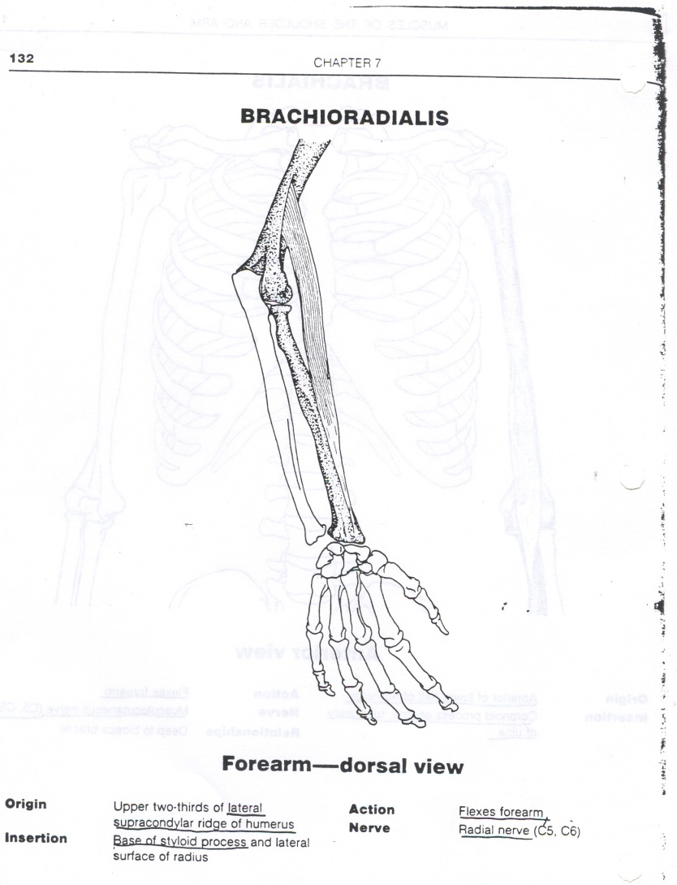
Same Color: Brachioradialis
Flexion of Elbow/Forearm

Slide 15
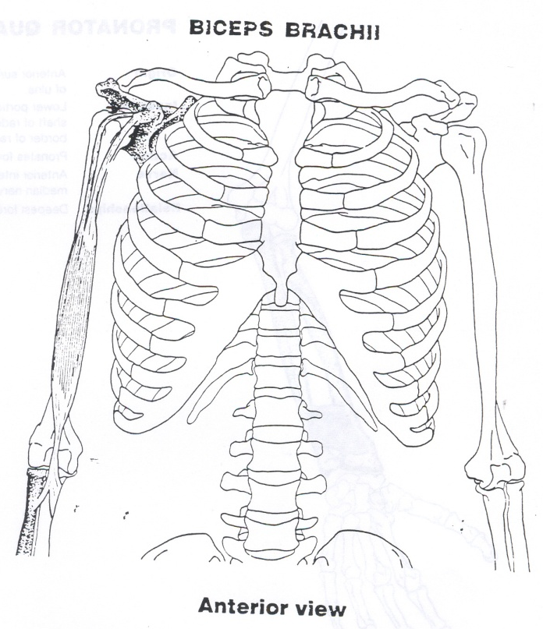
New Color: Biceps Brachii
Action: Supination and Flexion of the Elbow/Forearm
At the Shoulder-Flexion

Slide 16
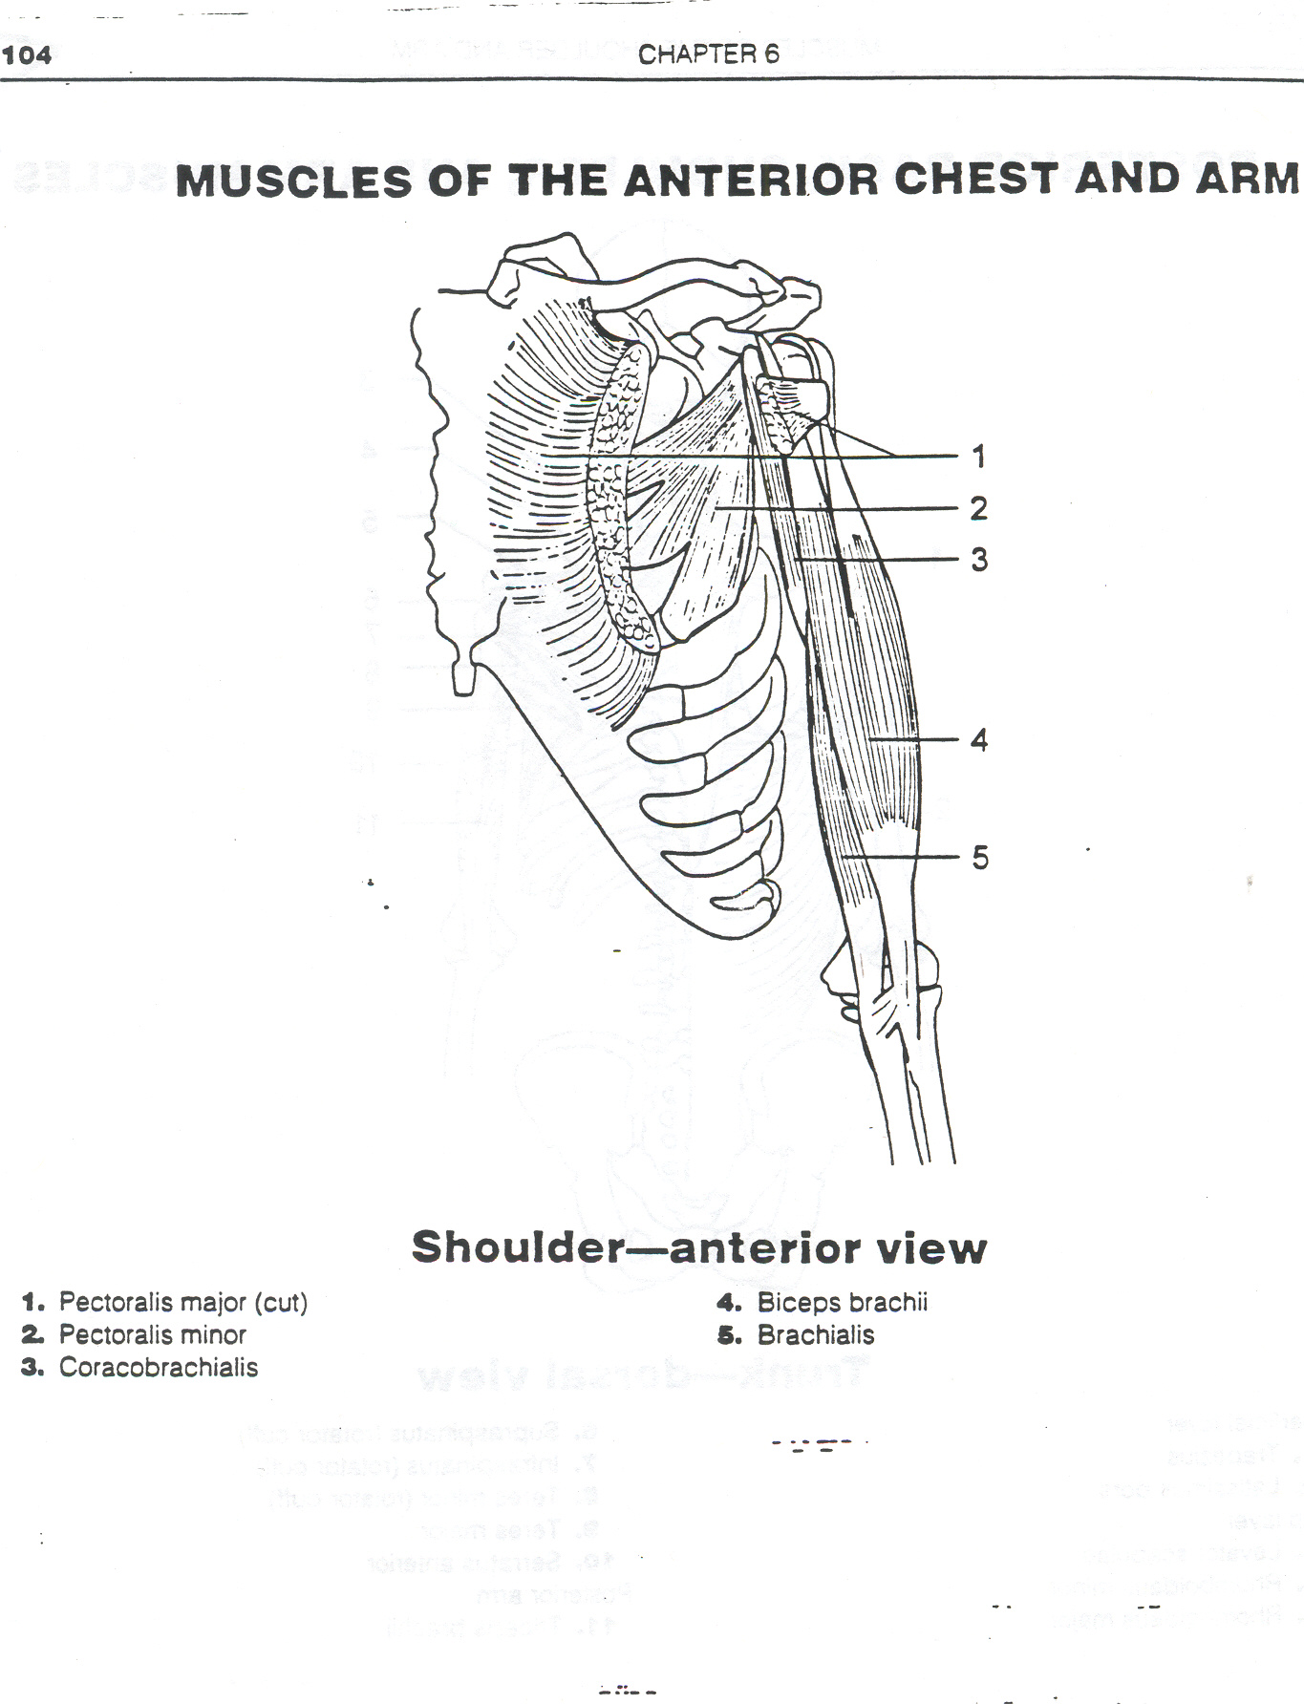

Slide 17
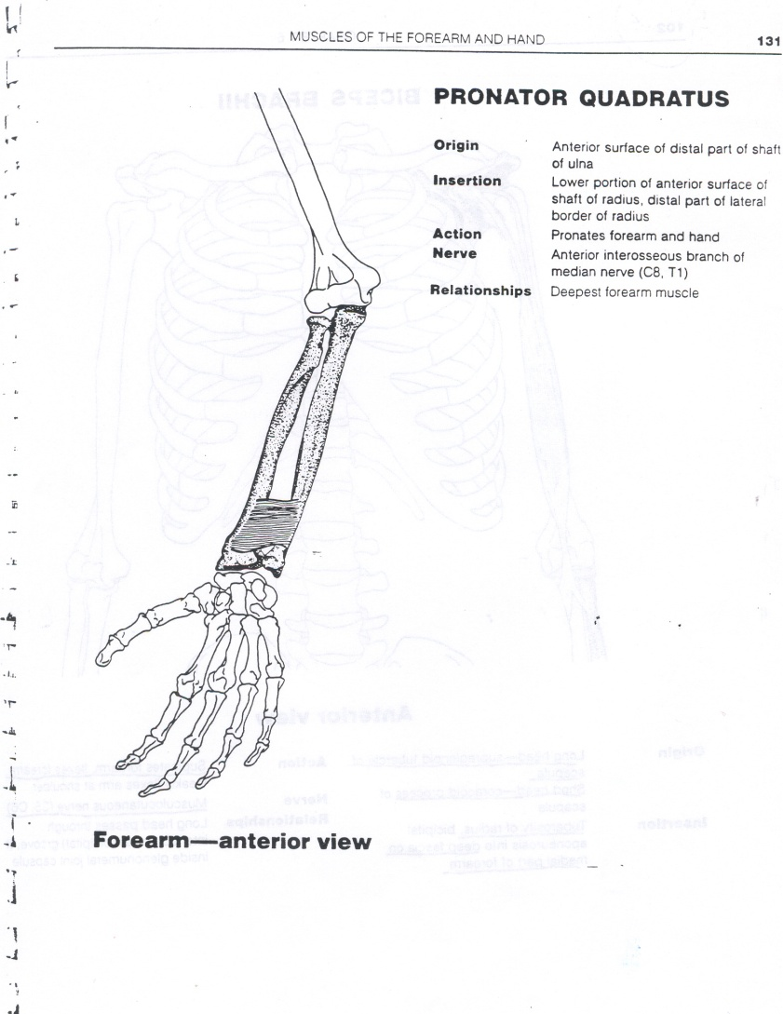
New Color: Pronator Quadratus
Action: Pronates

Slide 18
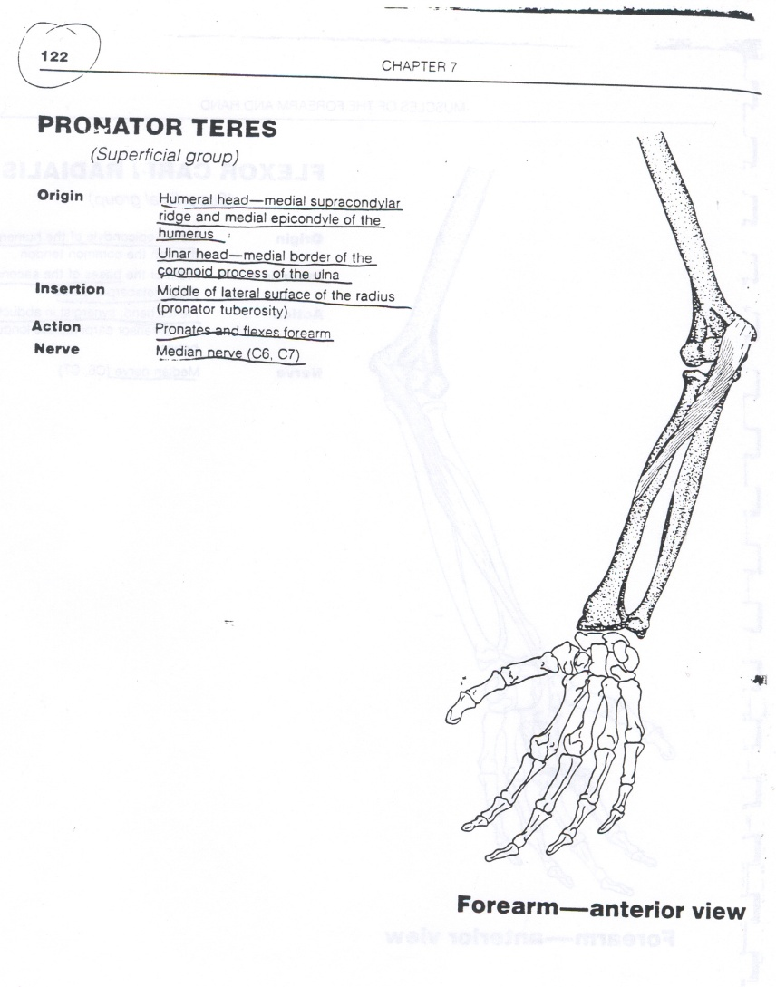
New Color: Pronator Teres
Action: Pronates and Flexes Elbow/Forearm

Slide 19
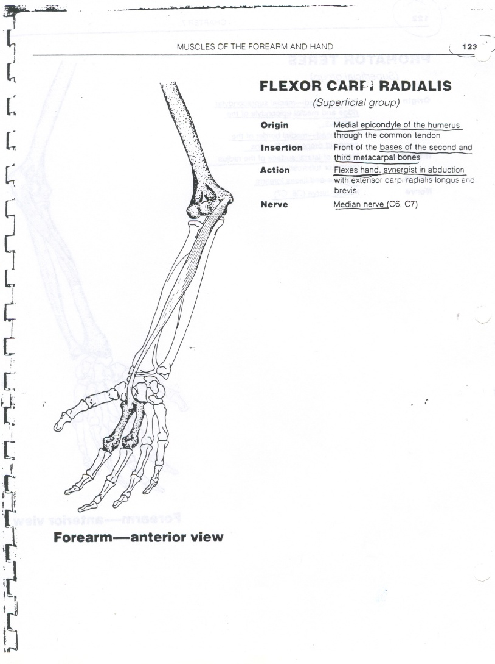
New Color: Flexor Carpi Radialis
Action: Flexes Wrist/Hand

Slide 20
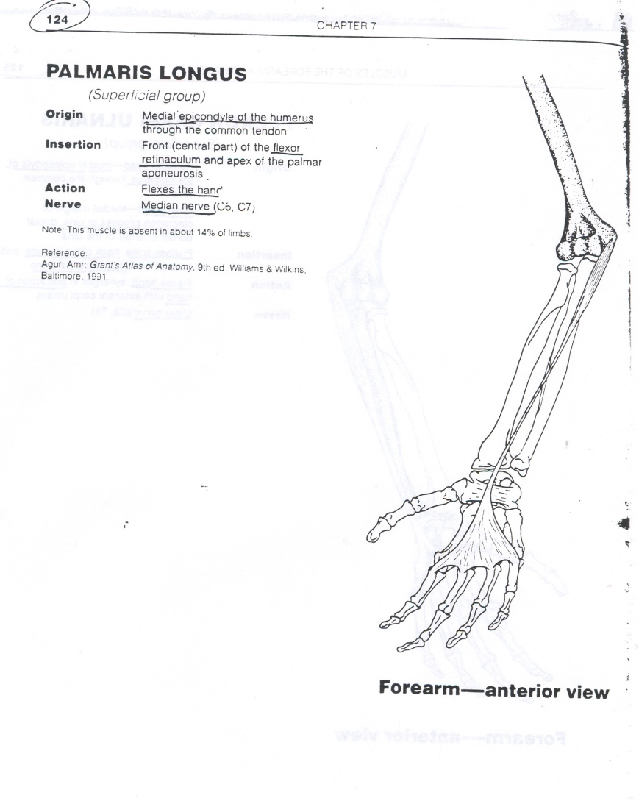
Same Color: Palmaris Longus
Action: Flexes Wrist/Hand

Slide 21
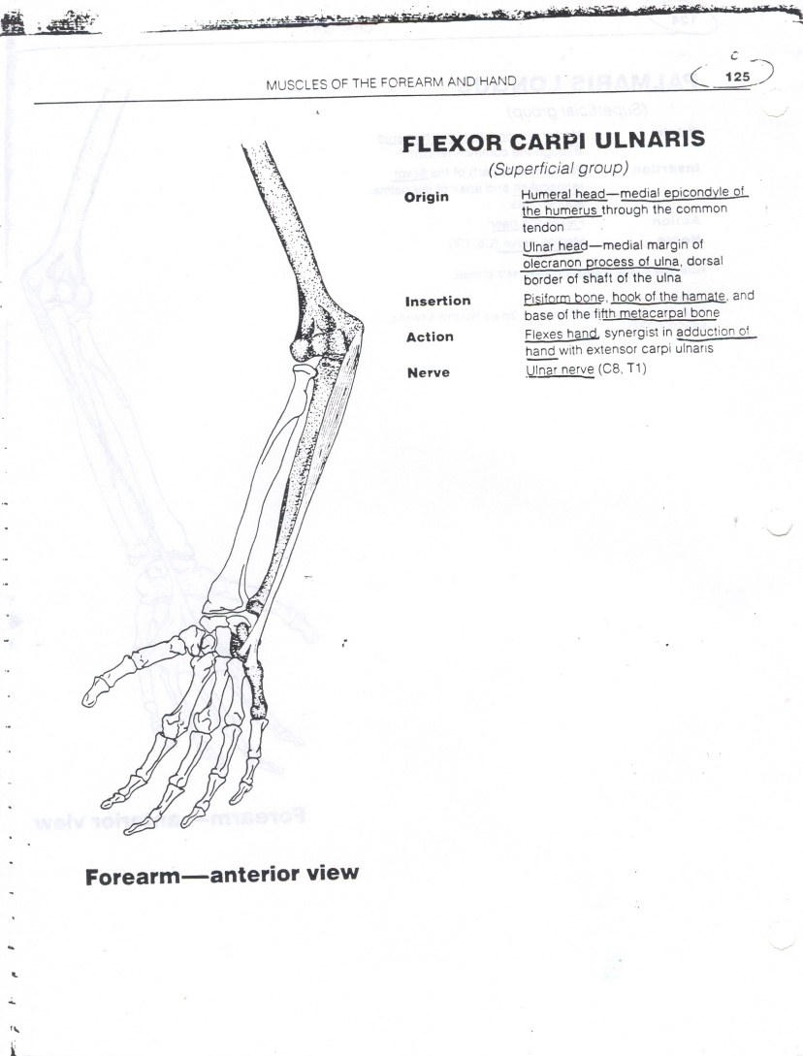
Same Color: Flexor Carpi Ulnaris
Action: Flexes Wrist/Hand

Slide 22
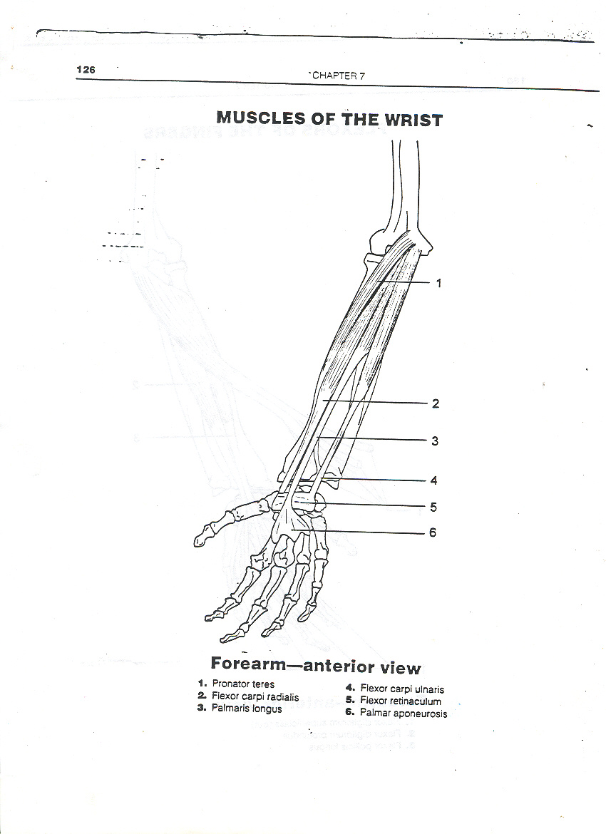

Slide 23
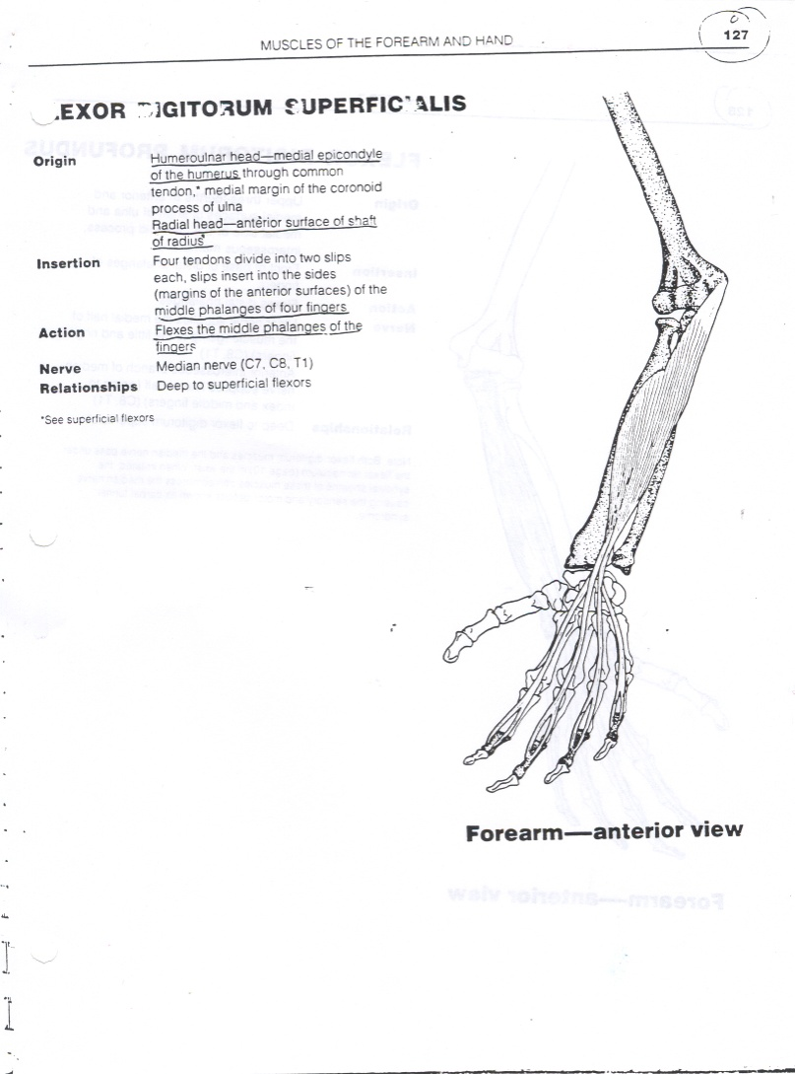
New Color: Flexor Digitorum Superficialis
Action: Flexes 4 fingers
This muscle stops at the middle phalange of each of the four fingers.

Slide 24
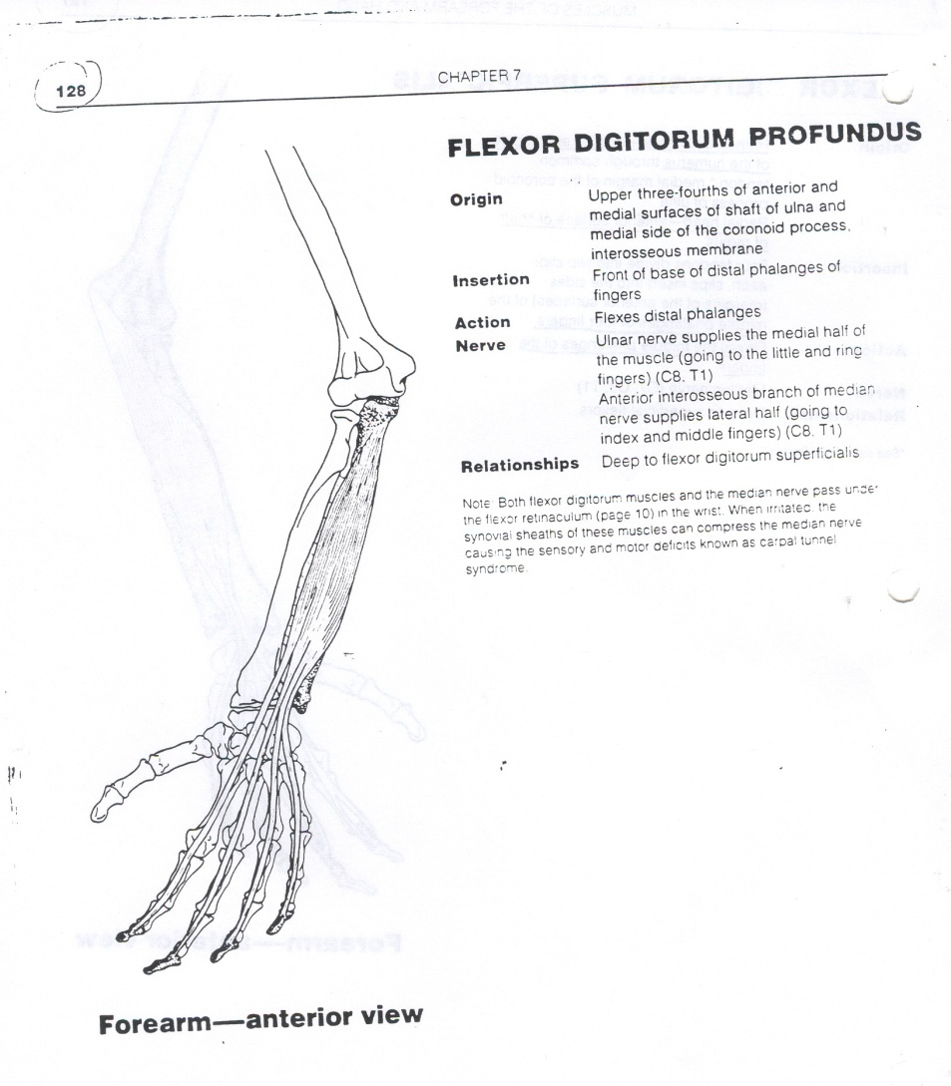
Same Color: Flexor Digitorum Profundus
Action: Flexes 4 fingers
This muscle inserts on the distal phalange of each finger.

Slide 25
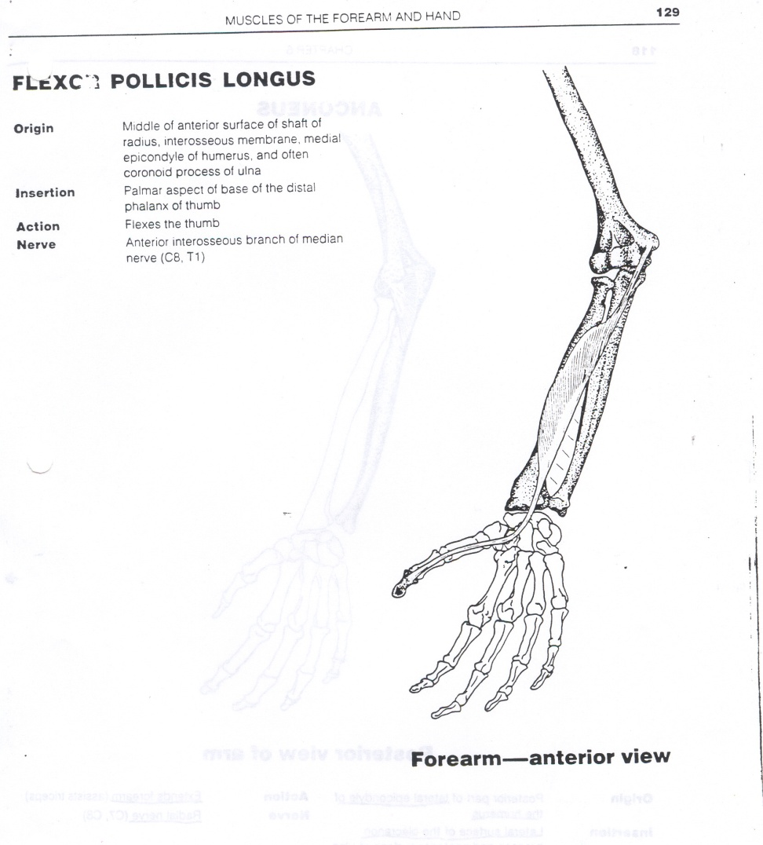
New Color: Flexor Pollicis Longus
Action: Flexes Thumb

Slide 26
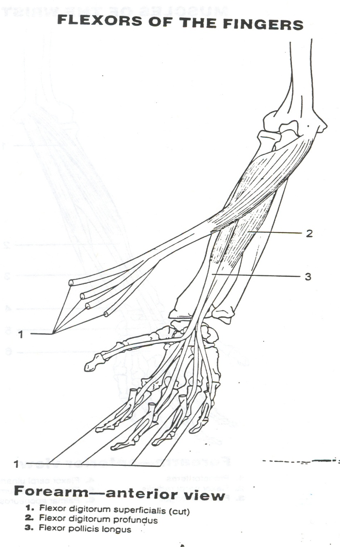

Slide 27
Flash Card TIME!!! (7 Colors)
Flexes Forearm/Elbow
Supinates and Flexes Forearm/Elbow
Pronates
Pronates and Flexes Forearm/Elbow
Flexes Wrist/Hand
Flexes Finger
Flexes Thumb

Slide 28
Flash Card TIME!!! (7 Colors)
Flexes Forearm/Elbow- Brachialis; Brachioradialis
Supinates and Flexes Forearm/Elbow- Biceps Brachii
Pronates- Pronator Quadratus
Pronates and Flexes Forearm/Elbow- Pronator Teres
Flexes Wrist/Hand- Flexor Carpi Radialis; Palmaris Longus: Flexor Carpi Ulnaris
Flexes Fingers- Flexor Digitorum Superficialis; Flexor Digitorum Profundus
Flexes Thumb-Flexor Pollicis Longus

Slide 29
Any 9 Colors of your Choice
Extends Elbow/Forearm
  Anconeus
  Triceps Brachii
Extends Wrist/Hand And Radial Deviation
  Extensor Carpi Radialis Longus
  Extensor Carpi Radialis Brevis
Extends Fingers
  Extensor Digitorum Communis
  Extensor Digiti Minimi
Extends Wrist/Hand
  Extensor Carpi Ulnaris
Supinates
  Supinator
Abducts Thumb
  Abductor Pollicis Longus
Extends Thumb
  Extensor Pollicis Brevis
  Extensor Pollicis Longus
Adducts Fingers (PAD)
  Palmar Interossei
Abducts Fingers (DAB)
  Dorsal Interossei

Slide 30
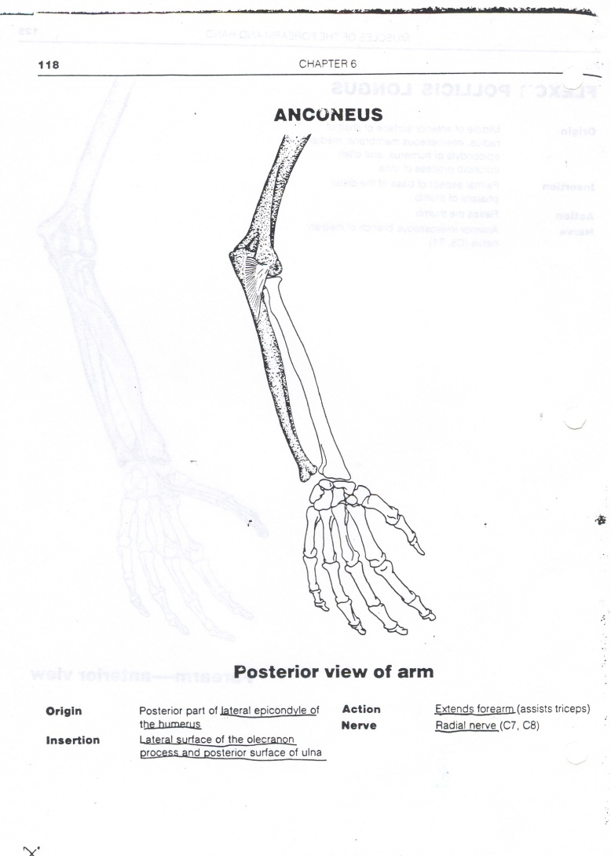
Color one: Anconeus
Action: Extends Elbow/Forearm

Slide 31
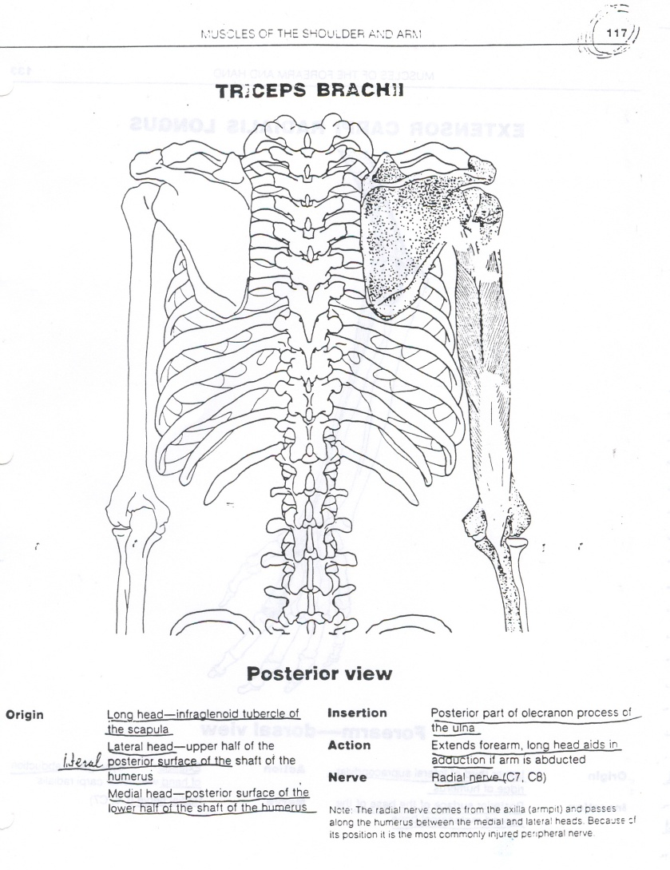
Same Color: Triceps Brachii
Action: Extends Elbow/Forearm
At the Shoulder-Extension

Slide 32
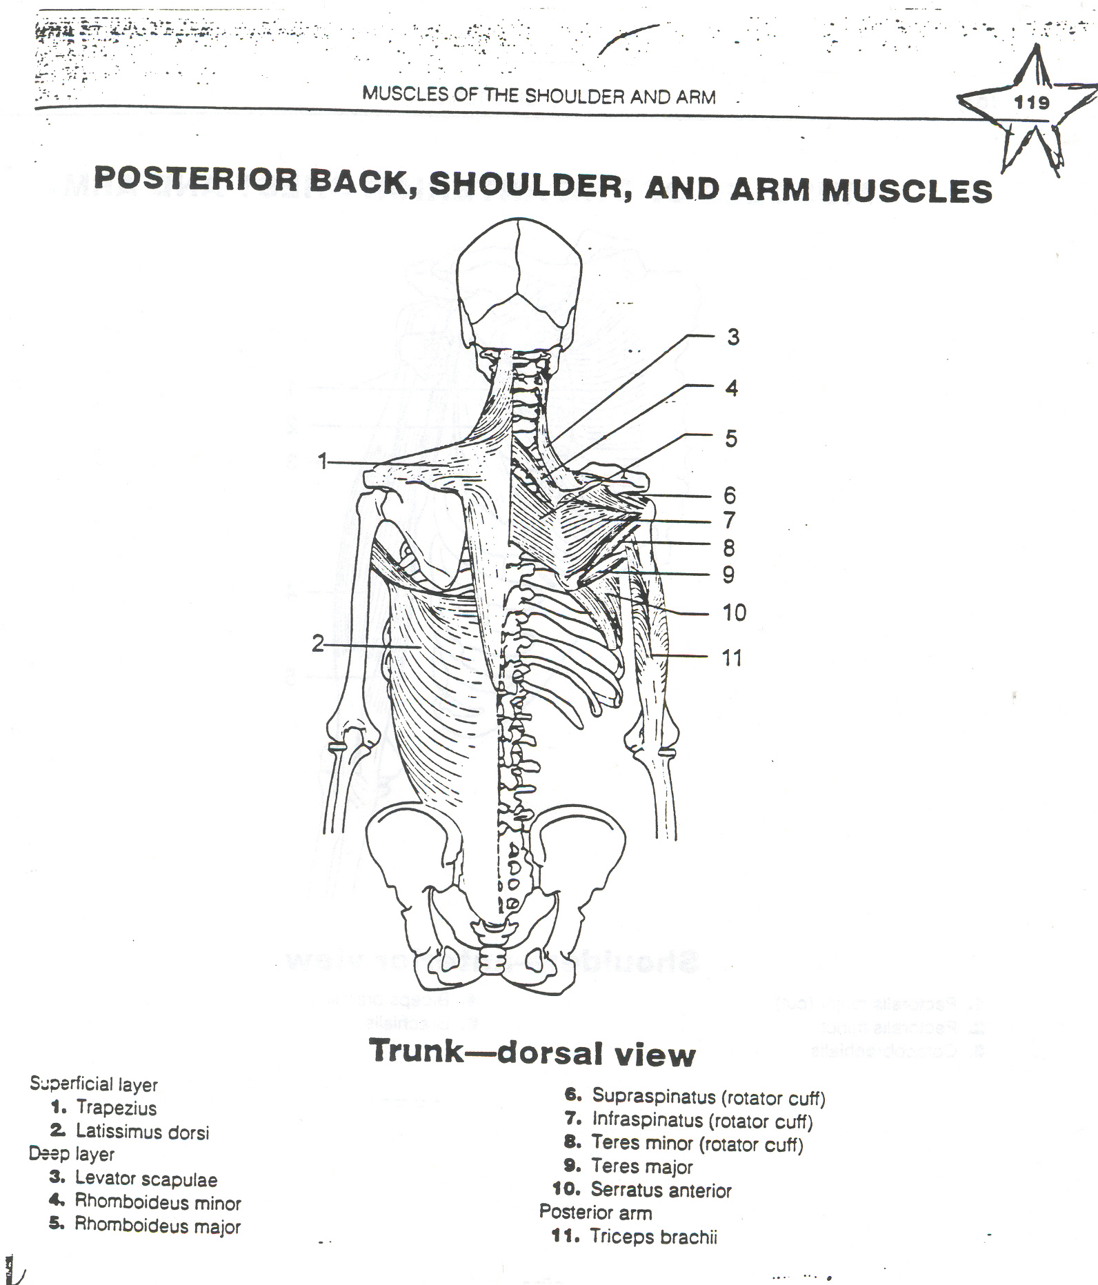

Slide 33
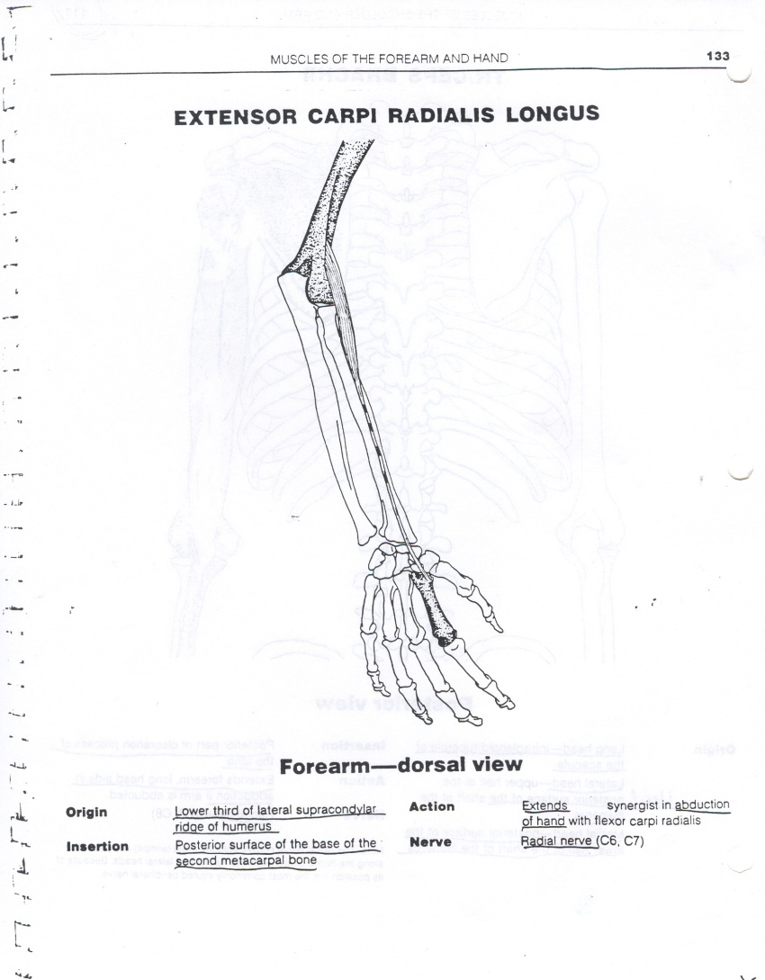
New Color: Extensor Carpi Radialis Longus
Action: Extends Wrist/Hand and Radial Deviation

Slide 34
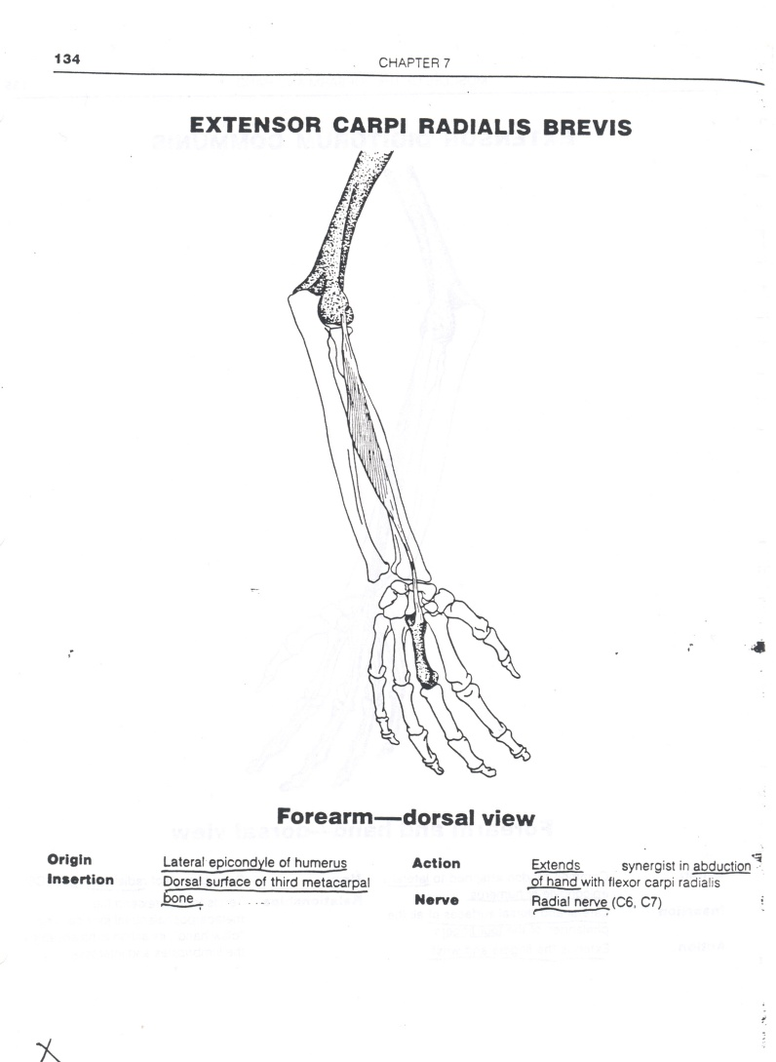
Same Color: Extensor Carpi Radialis Brevis
Action: Extends Wrist/Hand and Radial Deviation

Slide 35
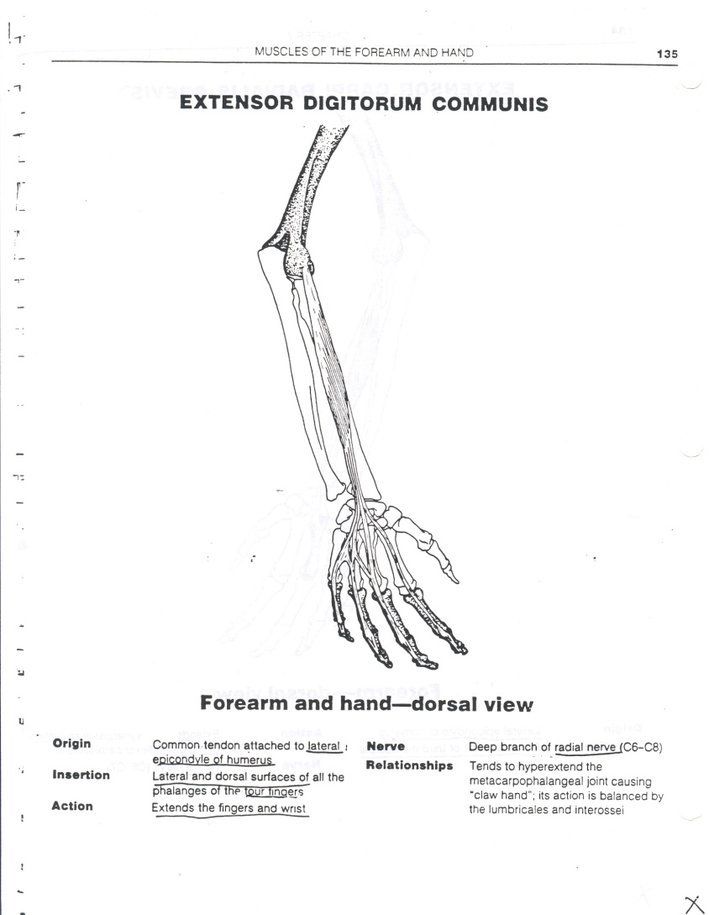
New Color: Extensor Digitorum Communis
Action: Extends 4 fingers

Slide 36
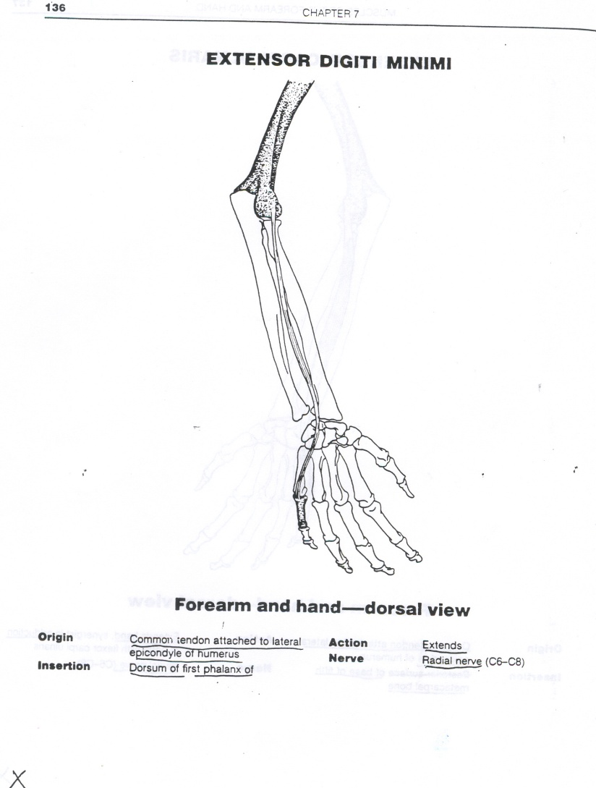
Same Color: Extensor Digiti Minimi
Action: Extends pinky

Slide 37
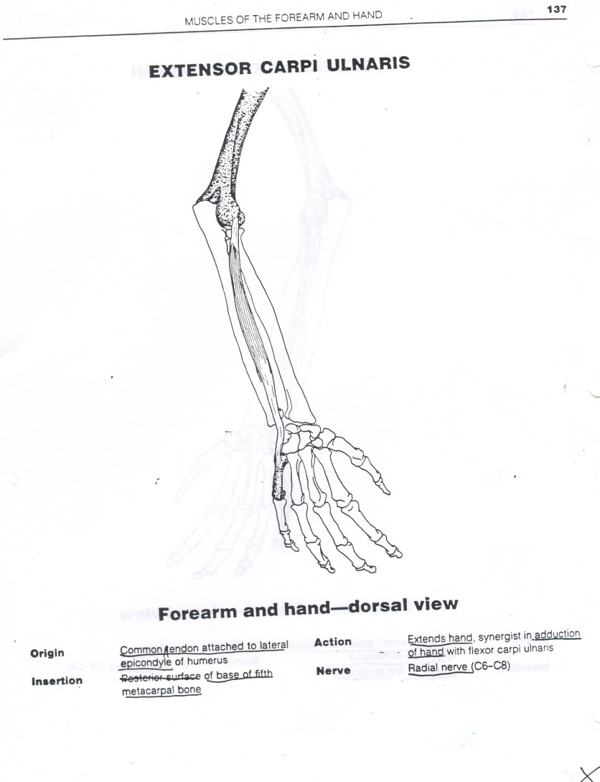
New Color: Extensor Carpi Ulnaris
Action: Extends Wrist/Hand

Slide 38
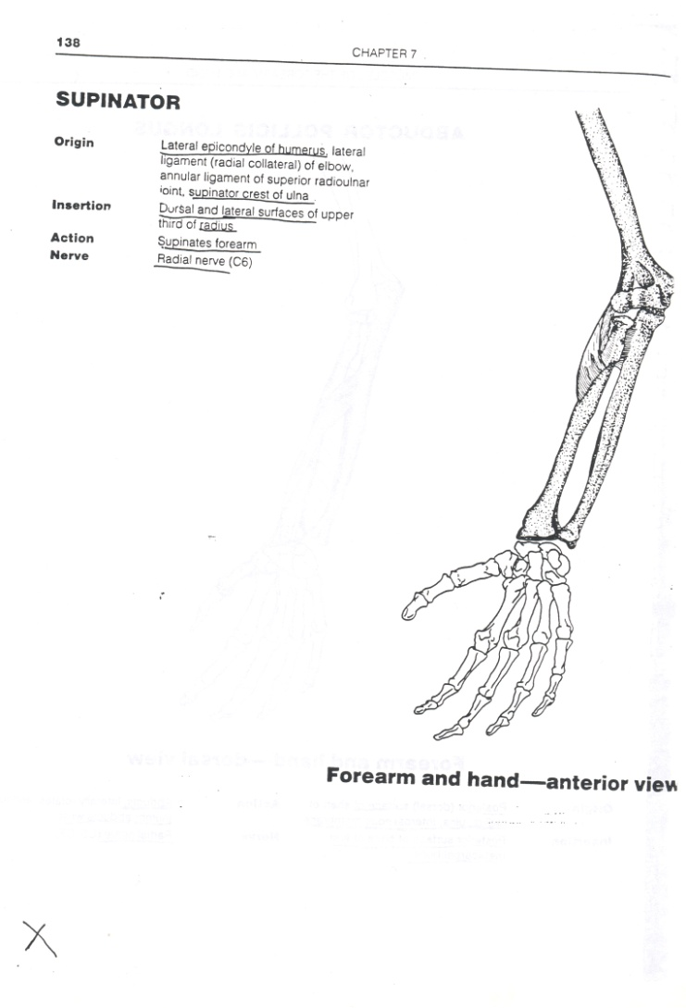
New Color: Supinator
Action: Supinates

Slide 39
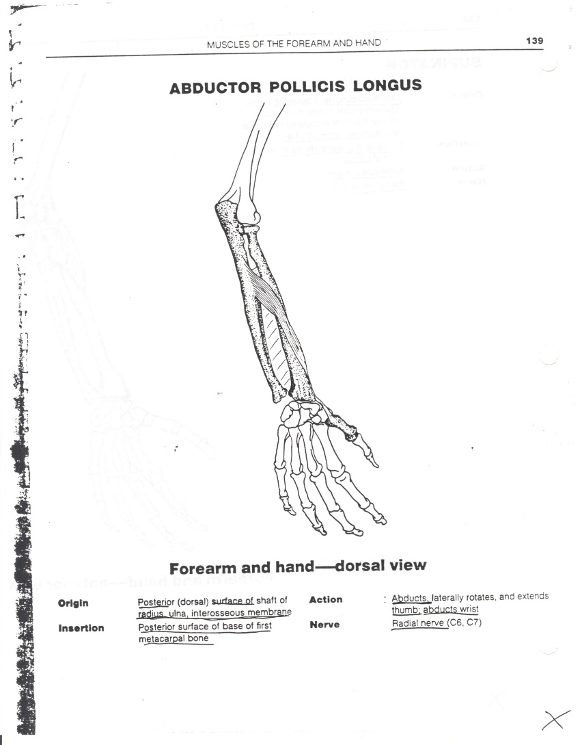
New Color: Abductor Pollicis Longus
Action: Abducts the thumb
This muscle’s tendon helps make the anatomical snuffbox.

Slide 40
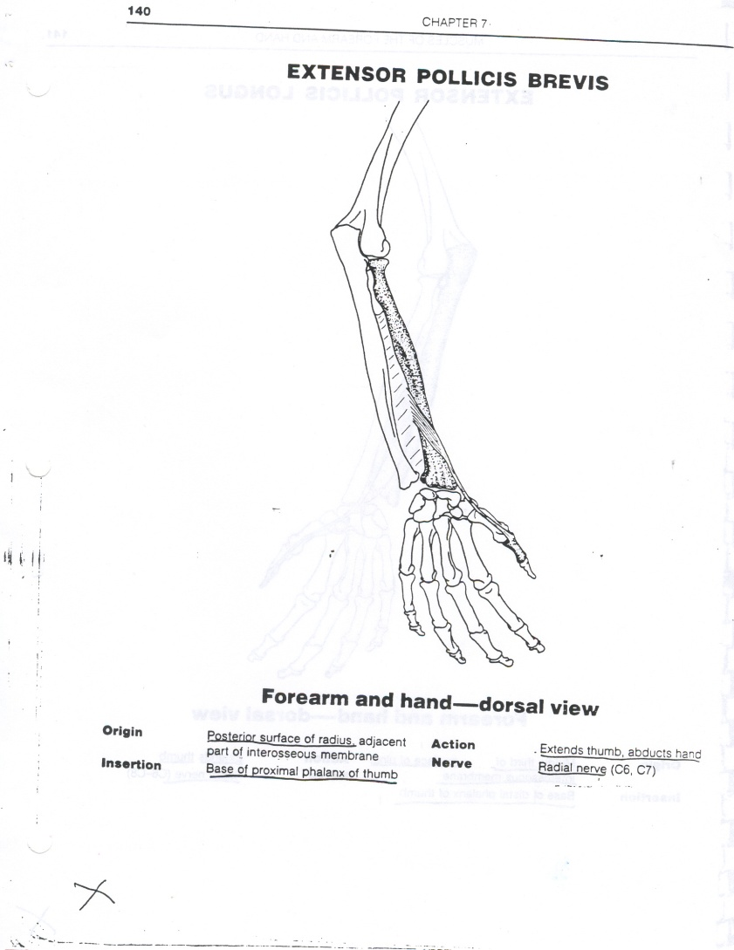
New Color: Extensor Pollicis Brevis
Action: Extends the Thumb
This muscle’s tendon helps create the anatomical snuffbox.

Slide 41
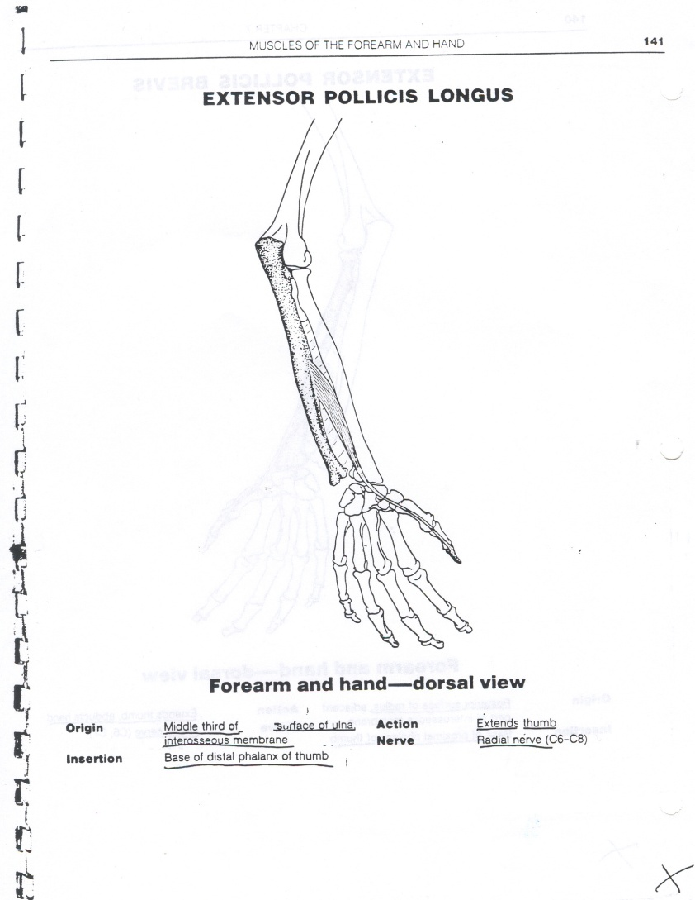
Same Color: Extensor Pollicis Longus
Action: Extends the Thumb
This muscle’s tendons help make up the anatomical snuffbox.

Slide 42
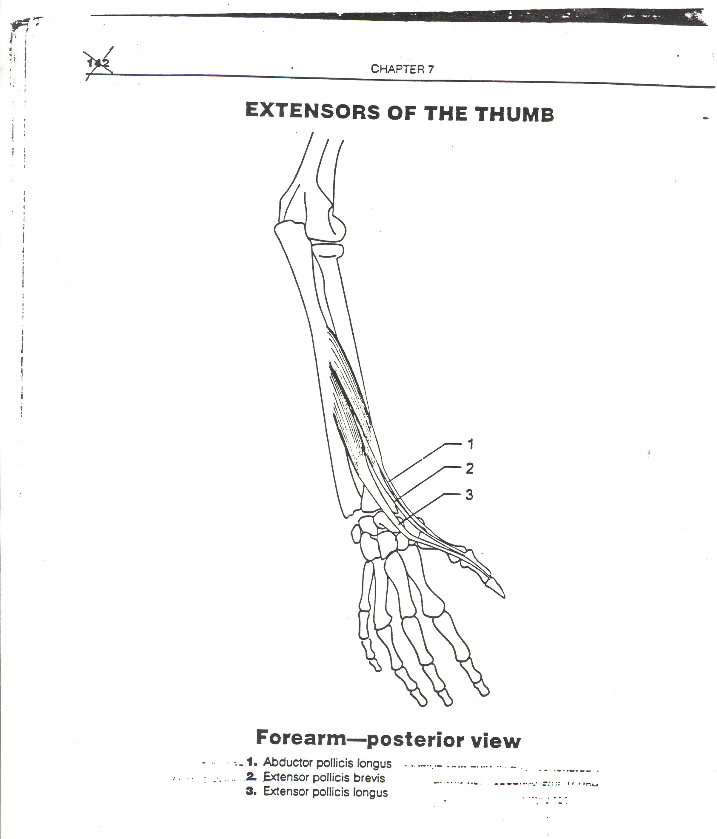

Slide 43
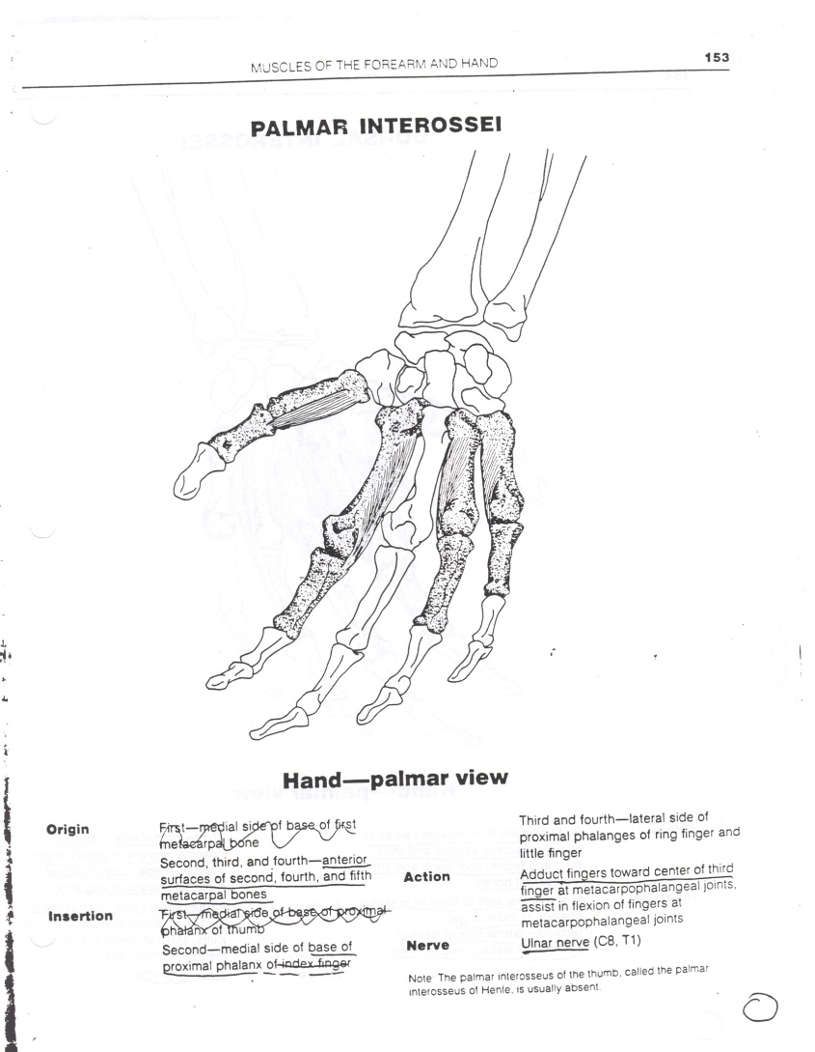
New Color: Palmar Interossei (PAD)
Action: Adducts the Fingers

Slide 44
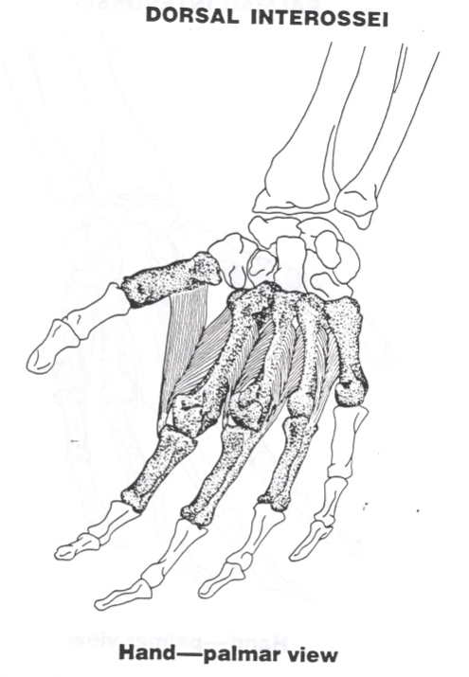
New Color: Dorsal Interossei (DAB)
Action: Abducts the Fingers

Slide 45
Flash Card FUN- 9 Colors
Extends Forearm/Elbow
Extends Wrist/Hand and Radial Deviation
Extends Fingers
Extends Wrist
Supinates
Abducts Thumb
Extends Thumb
Adducts Fingers
Abducts Fingers

Slide 46
Flash Card FUN- 9 Colors
Extends Forearm/Elbow- Anconeus: Triceps Brachii
Extends Wrist/Hand and Radial Deviation- Extensor Carpi Radialis Longus; Extensor Carpi Radialis Brevis
Extends Fingers- Extensor Digitorum Communis; Extensor Digiti Minimi
Extends Wrist- Extensor Carpi Ulnaris
Supinates- Supinator
Abducts Thumb- Abductor Pollicis Longus
Extends Thumb- Extensor Pollicis Brevis: Extensor Pollicis Longus
Adducts Fingers- PAD- Palmar Interossei
Abducts Fingers-DAB- Dorsal Interossei

