Slide 1
Facial Injuries
Sports Med II

Slide 2
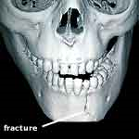
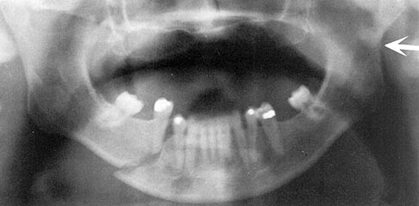
Mandible Fracture
Cause of injury
Direct blow (generally fractures at frontal angle)
Signs of injury
Deformity, loss of occlusion, pain with biting, bleeding around teeth, lower lip anesthesia
Care
Temporary immobilization with elastic wrap followed by reduction and fixation

Slide 3
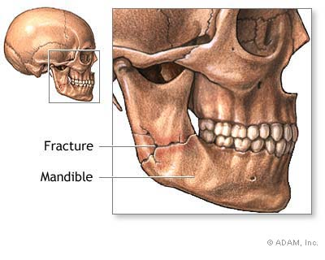
Mandible Fracture

Slide 4
Zygomatic Complex (cheekbone) Fracture
COI – Direct blow
SOI – Deformity, or bony discrepancy, nosebleed, diplopia (double vision), and numbness in cheek
Care – Cold application to control edema and immediate referral to a physician
Healing will take 6-8 weeks and proper gear will be required upon return to play

Slide 5
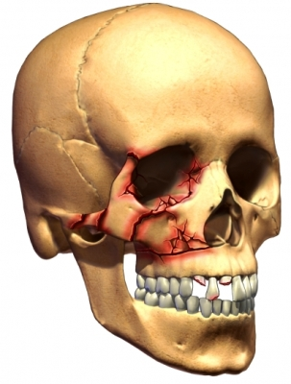

Slide 6
Facial Lacerations
COI – Result of a direct impact, and indirect compressive force or contact w/ a sharp object
SOI – Pain, substantial bleeding, cuts
Care – Apply pressure to control bleeding
Referral to a physician will be necessary for stitches

Slide 7
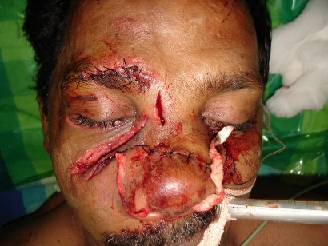
BAD Facial Lacerations!

Slide 8
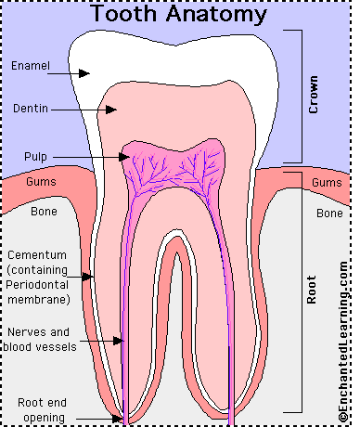
Anatomy of the Tooth
The tooth is a composite of mineral salts
Calcium and phosphorus are most abundant.
Crown – the portion protruding from the gum
Is covered by the hardest substance within the body, the enamel
Root – the portion that extends into the alveolar bone of the mouth
Is called the and is covered by a thin, bony substance known as cementum

Slide 9
Anatomy of the Tooth
Dentin – underneath the enamel and cementum lies the bulk of the tooth, a hard material
Pulp – within the dentin is a central canal and chamber, a substance composed of nerves, lymphatics, and blood vessels

Slide 10
Tooth Fractures-see dentist within 2 hours is BEST!!
COI – Impact to the jaw, direct trauma
SOI – Uncomplicated fractures produce fragments without bleeding
Complicated fractures produce bleeding and a great deal of pain.
Root Fractures are difficult to determine and require an X-ray

Slide 11
Tooth Fractures (cont.)
Care – Uncomplicated crown fractures do not require immediate attention
Fractures pieces can be placed in a bag and if not sensitive to air or cold, follow-up can wait 24-48 hours
Bleeding can be controlled via gauze
Cosmetic reconstruction of tooth
In instances of root fractures, the athlete can continue to play but must follow-up immediately following competition
Tooth repositioning may be required, along with bracing and the use of mouthpieces in the future.

Slide 12
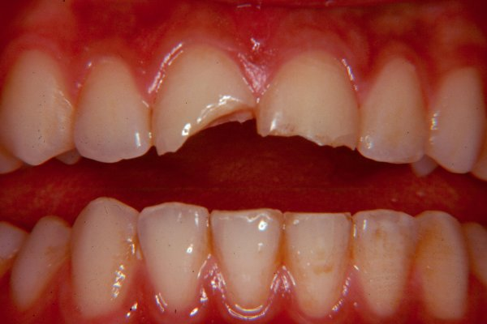

Slide 13
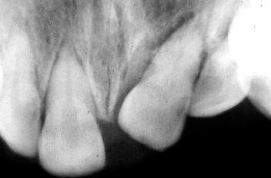
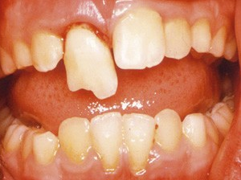
Tooth Subluxation, Luxation and Avulsion
Cause of injury
Direct blow
Signs of injury
Tooth may be slightly loosened, dislodged
When subluxed tooth may be loose within socket with little no pain
With luxations, no fracture has occurred, however, there is displacement
With an avulsion, the tooth is completely knocked from the oral cavity
Care
For a subluxed tooth, referral should occur within the first 48 hours
With a luxated tooth, repositioning should be attempted along with immediate follow up
Avulsed teeth should not be re-implanted except by a dentist (use a Save a Tooth Kit, milk or saline)

Slide 14
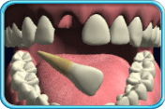
Avulsed Tooth

