Slide 1
Conditions of the Foot, Ankle, and Lower Leg (FALL)

Slide 2
Acute Anterior Compartment Syndrome
MOI: Direct blow to the anterior shin
Etiology: A direct blow causes bleeding into the narrow space housing the nerves and blood vessels. The tight surrounding fascia allows very limited expansion. Pressure increases on the tibial artery and the deep peroneal nerve which cuts off blood flow and feeling.
Medical Emergency: Intramuscular pressure and neurovascular compromise leads to ischemia (lack of oxygen) and necrosis (tissue pain)
Signs and Symptoms: Severe throbbing pain, decreased strength with dorsiflexion and great toe extension, decreased sensation on the dorsum (top) of the foot, decreased circulation at the dorsal pedis pulse, glossy red tight skin
Treatment: Emergency Fasciotomy

Slide 3
Acute Anterior Compartment Syndrome

Slide 4
Chronic Anterior Compartment Syndrome
MOI: Develops gradually with athletic activity
Etiology: Gradual increase in pressure in the anterior compartment due to swelling and muscle hypertrophy
Signs and Symptoms: Weak dorsiflexion and great toe extension, anterior shin pain, decreased sensation on the dorsum of the foot, decreased circulation.
Evaluation: Have athlete exercise to the point when symptoms occur. Once symptoms occur, test strength, sensation, and circulation before symptoms decrease
Treatment: Ice and evaluation, BUT NO COMPRESSION, monitor neurological status and girth measurements of the affected area, crutches for loss of sensation, and referral

Slide 5
Chronic Anterior Compartment Syndrome

Slide 6
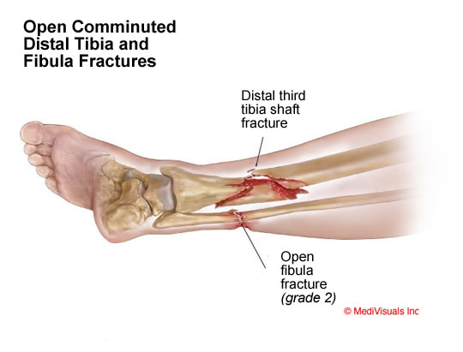
Fracture(s) of the Tibia/Fibula
MOI: Direct blow to the lower leg or a rotational force from planting or turning on a fixed foot
Etiology: Direct blow or rotational force that results in a transverse or spiral oblique fracture of the tibia/fibula
Signs and Symptoms: Obvious deformity, swelling, ecchymosis (discoloration), crepitus(noise), and inability to bear weight especially when the tibia is involved
Treatment: Immobilization, PRICES, refer to physician
Special Test: Percussion /Bump Test
And Compression/Squeeze Test

Slide 7
Fractures to the Tibia/Fibula

Slide 8
Special Tests for Stability of the Tibia and Fibula
Percussion or Bump Test-helps determine a fracture
Compression or Squeeze Test-helps determine a fracture or anterior/posterior tibiofibular sprain

Slide 9
Stress Fracture(s) of the Tibia/Fibula
MOI: Overuse/Repetitive mechanical stress
Etiology: The bone cannot adapt to repetitive loading and attempts to adapt with increasing the breakdown of bone. In return, the laying of new bone follow. Once the breakdown of bone exceeds the laying down of new bone, the bone begins to weaken and a stress fracture forms
Signs and Symptoms: Pain during weight bearing activity and eventually non-weight bearing activity, localized swelling and point tenderness over the affected area
Treatment: Refer for x-rays two weeks after injury; bone scan or MRI may be necessary; treat symptomatically for pain and return to activity when the asymptomatic (normally 4 -6 weeks); REST is the best treatment.

Slide 10
Stress Fractures of Tibia/Fibula

Slide 11
Shin Splints
MOI: Overuse/Repetitive stress
Etiology: Overuse/Repetitive stress forces acting on the proximal insertions of the Flexor Digitorum Longus, Tibialis Posterior, and /or Tibialis Anterior. Inflammation present along muscle attachments to tibia and insertions on the plantar surface
Signs and Symptoms: Aching pain in shin that is aggravated with push-off phase and shock absorption during heel strike; athlete may excessively pronate(have flat feet)
Treatment: Ice cup, taping or orthotics for foot mechanics, stretch routine, and rule out stress fracture. Active Rest!

Slide 12
Shin Splints

Slide 13
Achilles Tendon Rupture
MOI: Strong force during resistive forceful plantarflexion of the ankle with the knee extended or forceful dorsiflexion of the ankle with contraction of the Gastrocnemius/Soleus
Etiology: Partial/complete rupture of the Achilles tendon
Signs and Symptoms: Athlete report a sensation of being kicked or shot in the calf, audible snap, and painful loss of function. Observable gap with a window shade affect, palpable gap, bunching of the tendon proximally, and massive swelling
Special Tests: Thompson Test

Slide 14
Achilles Tendon Rupture

Slide 15
Grades of Achilles Tendon Strain

Slide 16
Thompson Test-for Achilles’ Tendon Ruptures

Slide 17
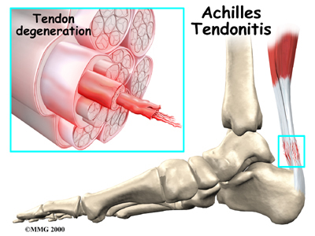
Achilles Tendon Tendonitis
MOI: Overuse injury
Etiology: Microtrauma/Inflammation and possible thickening of the Achilles tendon
Predisposing Factors: Tight achilles Tendon, Extremely High Arches, Excessively Flat Feet
Signs and Symptoms: Pain proximal to calcaneal insertion, morning pain/stiffness, clicking sensation when walking, palpable crepitus, and swelling and thickening of the tendon.
Functional Tests: loss of full dorsiflexion, painful and active and resistive plantarflexion
Treatment: Ice cup and Ultrasound, heel lifts(both shoes), stretching, strengthening, and taping

Slide 18
Achilles Tendon Tendonitis

Slide 19
MOI for Ankle Sprains

Slide 20
Lateral Ankle Sprains
MOI: Inversion (inversion/plantarflexion)
Etiology: Partial/complete rupture of the Anterior Talofibular Ligament, Calcaneofibular Ligament, and/or Posterior Talofibular Ligament, avulsion fracture of the malleolus, chip fracture of the medial malleolus
Signs and Symptoms: Pain/Point tenderness over lateral ligamentous structures, as well as, the medial and lateral malleoli. Inability to bear weight without limp, swelling laterally and posteriorly with swelling migrating to the toes and possible crepitus.
Special Tests: +Anterior Drawer, +Talar Tilt
Treatment: PRICES, Crutches, Rehabilitation

Slide 21
Lateral Ankle Sprain

Slide 22
Special Tests for Lateral Ankle Sprains
Talar Tilt Test-tests for the Calcaneofibular ligament
Anterior Drawer (Ankle)-tests for the Anterior Talofibular ligament

Slide 23
Medial Ankle Sprains
MOI: Eversion (Eversion/Dorsiflexion)
Etiology: Partial/Complete rupture of the deltoid ligament, avulsion fracture of the medial malleolus, chip fracture of the lateral malleolus, spiral oblique fracture of the shaft of the tibia/fibula
Signs and Symptoms: Pain/Point tenderness over medial ligamentous structures, as well as, the medial and lateral malleoli. Inability to bear weight without limp, swelling medially and posteriorly with additional swelling migrating to the toes and possibly crepitus.
Special Tests: + Kleiger Test

Slide 24
Medial Ankle Sprains

Slide 25
Kleiger Test-determines a Medial Ankle Sprain and injury to the DELTOID ligament

Slide 26
Classification of Ankle Sprains
1st DEGREE: Mild stretching of the ligament with mild swelling, minor point tenderness, and no instability.
2nd DEGREE: Partial tear of the ligament with moderate swelling, pain, moderate point tenderness, ecchymosis, and instability with firm end field.
3rd DEGREE: Complete rupture of the ligament with severe swelling, ecchymosis, pain, and gross instability with a soft end field.

Slide 27
Heel Contusion (Heel Bruise)
MOI: Direct blow to the heel during extreme weight bearing
Etiology: Contusion to the heel area with irritation of the fat pad, calcaneus, and surrounding nerves
Signs and Symptoms: Pain during weight bearing especially on the lateral side during heel strike, swelling in the heel area, ecchymosis, and palpable mass of blood.
Treatment: Ice, padding, taping, crutches

Slide 28
Heel Bruise (Heel Contusion)

Slide 29
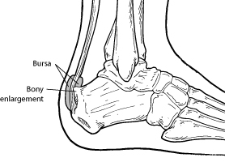
Retro-calcaneal bursitis (Pump Bump)
MOI: Overuse injury, caused by friction and pressure
Signs and Symptoms: Redness, swelling, warmth, callus formation, and point tenderness at the inserting of the Achilles Tendon
Treatment: Padding

Slide 30
Plantar Fasciaitis
MOI: Overuse
Etiology: The plantar fascia becomes inflames due to repetitive forces. Tightness of the plantar fascia is a common cause. Having a tight gastrocnemius/soleus complex as well as hamstrings may contribute.
Signs and Symptoms: Pain and point tenderness at mid plantar surface and migrating to the calcaneus. Pain in the morning and during the push off phase of gait. Athlete may walk on the lateral side of foot to decrease their pain.
Treatment: Ice cup and Ultrasound, Anti-inflammatory drugs, orthotics tape, stretching.

Slide 31
Plantar Fasciaitis

Slide 32
Sprain of the Metatarsalphalangeal Joint of the Great Toe – “Turf-Toe”
MOI: Forces hyperextension or hyperflexion of the Metatarsalphalangeal Joint of the Great Toe. It is often seen when athletes wear flexible shoes on a hard surface.
Etiology: Sprain of the plantar or dorsal ligaments of the MP joint of the great toe.
Signs and Symptoms: Pain during push-off phase of gait, pain and swelling at the MP Joint, pain with passive extension or flexion and side to side motions.
Treatment: Ice, tape, rigid shoes

Slide 33
Metatarsophalangeal Joint Sprain “Turf Toe”

Slide 34
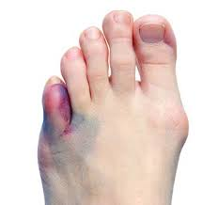
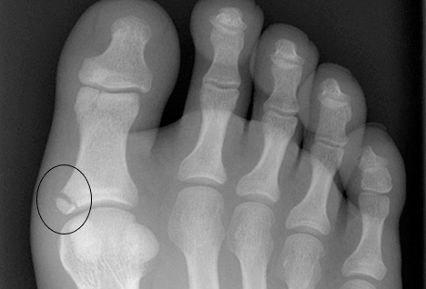
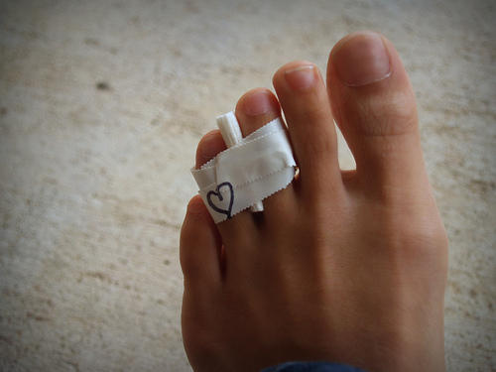
Toe Fractures
MOI: Direct blow
Signs and Symptoms: Pain with gait, swelling,
ecchymosis
Treatment: Refer to physician for x-rays

Slide 35
Base of the 5th Metatarsal Fractures
Sometimes called a Jones Fracture
MOI: Forced inversion
Etiology: Fracture occurs between the peroneus brevis and peroneus tertius. May disrupt blood supply-risk of non-union. It is very hard to heal!
Signs and Symptoms: Swelling, ecchymosis,
point tenderness at the base of the 5th
metatarsal
Treatment: Refer for x-rays

Slide 36
5th Metatarsal Fractures

Slide 37
Avulsion Fractures
MOI: Inversion
Etiology: The inversion mechanism causes the muscles (peroneus brevis and peroneus tertius) to pull off a piece of the bone at the base of the 5th metatarsal bone
Signs and Symptoms: Swelling, ecchymosis, point tenderness at the base of the 5th.
Treatment: Refer for x-rays.

Slide 38
Avulsion Fractures

Slide 39
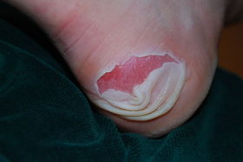
Blisters
MOI: Friction
Etiology: As the layers of skin rub together, friction causes a seperation. The body responds with fluid formation in this seperation.
Signs and Symptoms: Pain, fluid formation, open wound is possible
Treatment: Padding, Lubrication, Prevent infection at all times

