Slide 1
FALL Evaluation
The Foot Chapter 14 Pages 321-322
The Ankle and Lower Leg Chaper 15 Pages342-344

Slide 2
Learning About EVALUATIONS
SPORTS MEDICINE STUDENTS SHOULD NEVER PERFORM AN ACTUAL EVALUATION ON AN INJURED ATHLETE.
EVALUATIONS ARE FOR THE PROFESSIONAL MEDICAL PROVIDER (ATC, MD) TO PERFORM.
HOWEVER, IT IS IMPORTANT TO LEARN THE PROCESS.

Slide 3
History:
The History section involves asking questions.
In asking questions, you are trying to determine the Mechanism of Injury (MOI) as well as the type of injury that happened.
List 10 questions you would ask someone if they had a FALL (foot, ankle, lower leg )injury!
You may use the Essentials of Athletic Injury Management Textbook to Help! Pages 321-322, 342-343, and 350-351

Slide 4
H: History
Questions may include:
  How did the injury happen?
  What happened?
  What type of pain is there? Sharp or dull.
  Did you hear a snap or a pop?
  Can you point to the exact site of pain?
  Is this a new injury? Or has it happened before?
  What makes it feel better or what makes it feel worse?

Slide 5
More on History
  What type of shoes were you wearing when it happened?
  What type of surface were you on when you got hurt?
  Do you have any weakness? Numbness?
  How disabling is this injury? On a scale of 1 to 10, 10 means call 911, what would this injury be?
  Can you bear weight on your FALL and walk normally or do you walk with a limp?
  Was there immediate swelling, or did the swelling occur later (or at all)? Where did the swelling occur?
  What past FALL injuries have you had?

Slide 6
Observation:
In the observation section, you are looking for signs and symptoms of an injury.
Remember, signs are what you would see on the injured athlete’s FALL. Symptoms are feelings that the injured athlete would described to you or tell you about their injured FALL.
List 5 signs or symptoms that could be present if someone injured their FALL.
Use the textbook if you need to Pages 321-322; 342-343, 350-351.

Slide 7
O: Observation
Look for signs and symptoms of injury at the FALL. Try to determine the severity based on them.
Some signs and symptoms may include:
  Walking with a limp or unable to bear weight
  Swelling
  Deformity
  Eccymosis or discoloration
  Is the Arch- neutral, supinated, or pronated
  Heat or warmth
  Crepitus or abnormal sounds in the FALL
  Redness

Slide 8
More Observation
  Feeling or Sensation
  Range of Motion (ROM)
  Areas of Pain and Point Tenderness

Slide 9
P:Palpation-
In the palpation section, you are trying to determine what anatomy is involved in the injury.
Sports Medicine Students do not actually PALPATE the injured FALL.
However, the ATC/MD may palpate bony structures first, then ligaments and muscles/tendons.
In the evaluation we are making a note of any swelling, deformities, lumps, muscle spasms, or muscle guarding.
We also check for feeling and circulation.

Slide 10
Palpation
The palpation section involves touching the athlete.
Remember, Sports Medicine Students SHOULD NOT touch the injured FALL of the athlete.
For the palpation section, try to list BONES, LIGAMENTS, MUSCLES/TENDONS that you KNOW you can touch or FIND...
Use your ANATOMY handouts from class to help figure it out or simply palpate and analyze yourself.

Slide 11
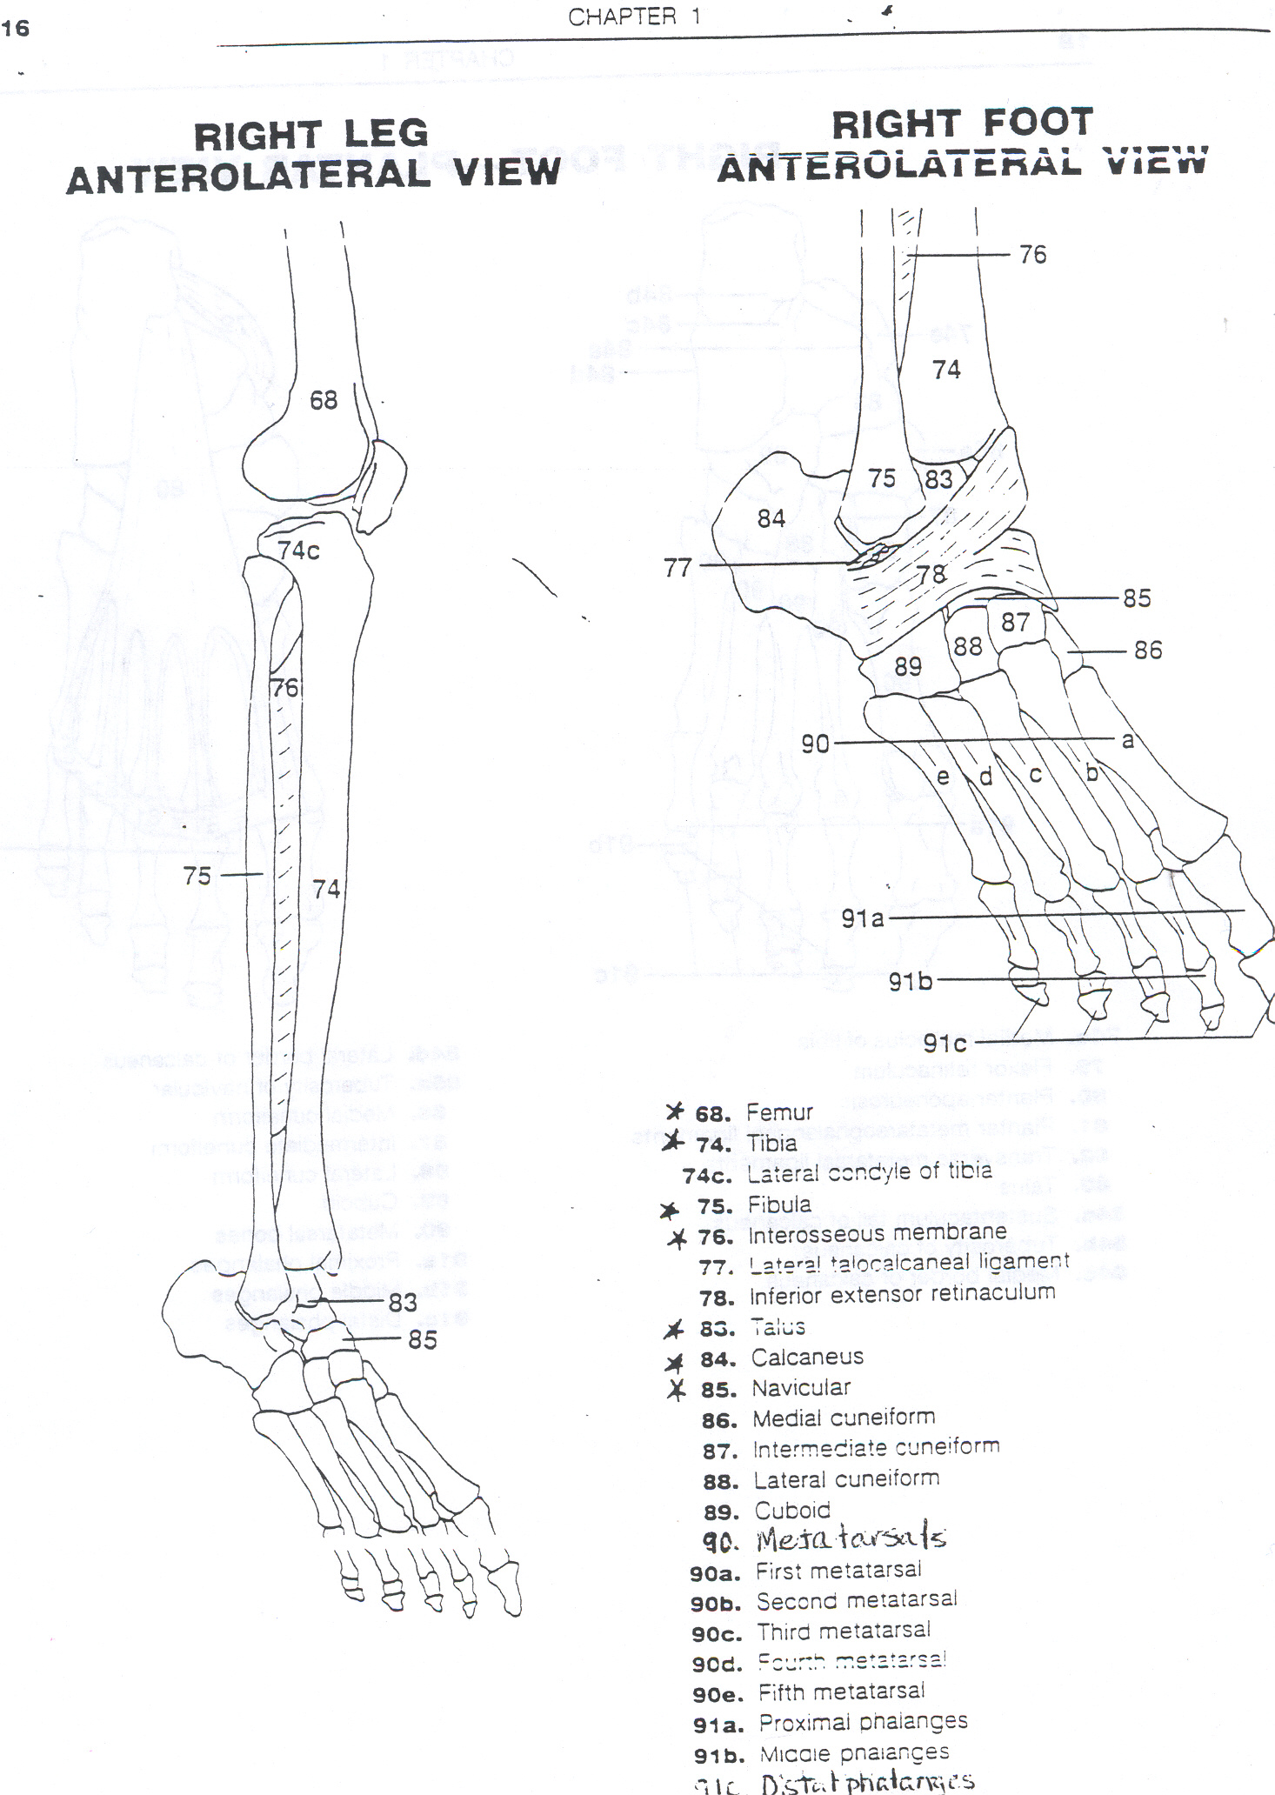
Bony Palpation
At the foot, palpate
  Phalanges
  5th metatarsal and metatarsal heads
  Calcaneus
  Navicular
  Sesamoid bones
At the ankle, palpate
  Medial malleoli (Tibia)
  Lateral Malleoli (Fibula)
At the lower leg, Palpate
  The Entire Length of the Fibula and Tibia

Slide 12
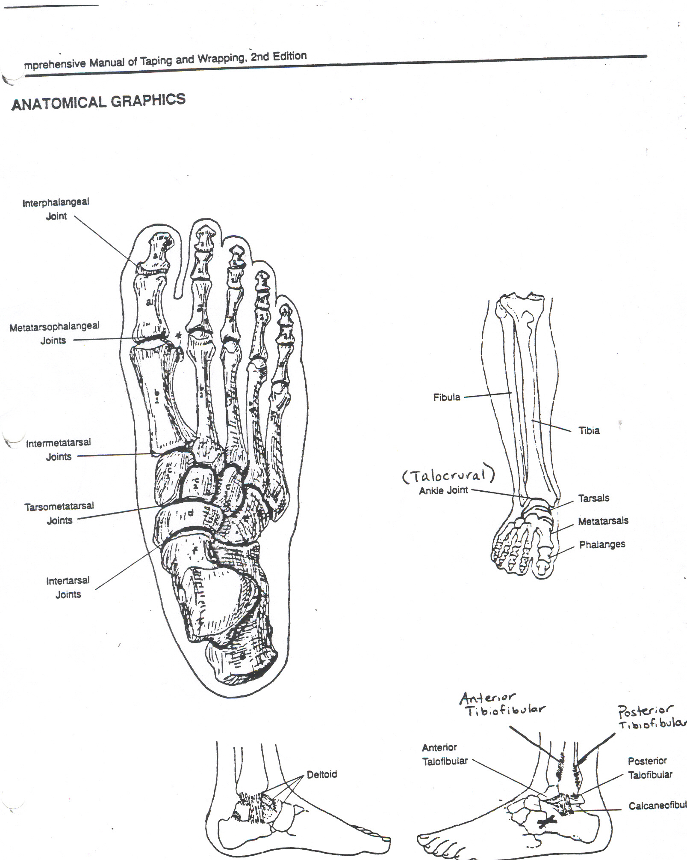
Palpate the Ligaments
Medial Ligaments
  Deltoid Ligament at the base of the Medial Malleoli
Lateral Ligaments
  Anterior Talofibular Ligament at the Sinus Tarsi
  Calcaneofibular Ligament at the base of the Lateral Malleoli
  Anterior Tibiofibular Ligament between the Lower Leg near the Talus

Slide 13
Palpate the Muscles/Tendons
Anterior and Lateral Compartment
  Anterior Tibialis-front of the shin
  Extensor Hallucis Longus-big toe
  Extensor Digitorum Longus-top of the foot
  Peroneal Muscles-insert at the 5th metatarsal and behind the lateral malleoli

Slide 14
Palpate the Muscles/Tendons
Posterior Compartment
Superficial/Middle Layer
  Gastrocnemius- back of the lower leg
  Soleus- underneath Gastrocnemius
  Achilles Tendon- at the calcaneus

Slide 15
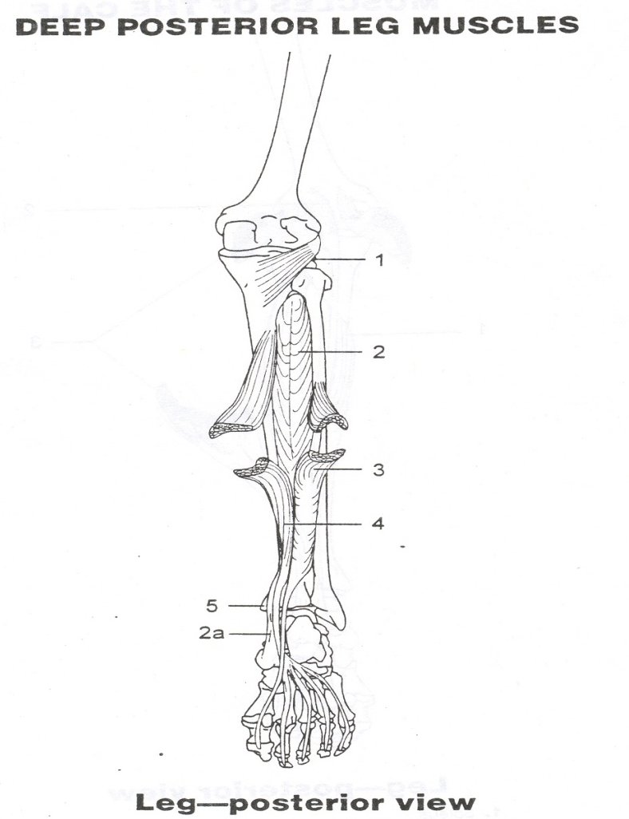
Palpate the Muscles/Tendons
Posterior Compartment
Deep Layer
  Posterior Tibialis Tendon-diagonal from the medial malleoli at the calcaneus
  Flexor Hallucis Longus-big toe
  Flexor Digitorum Longus- bottom of foot at the 4 toes only

Slide 16
S:Special Tests
The special test section involves evaluating a variety of structures in the following areas:
ROM: Active (AROM) and Passive (PROM)
STRENGTH: Manual Muscle Tests (MMT)
SPECIAL TESTS: Stability
FUNCTIONAL: Sport Specific Tests
Sports Medicine Students SHOULD NOT perform Special Tests!!!!

Slide 17
ROM: Range of Motion
List the movements that occur at the FALL.
In testing ROM, the evaluator is trying to determine if the athlete can perform the movements in Active Range of Motion (AROM).
In testing ROM, the evaluator is also trying to determine if the athlete has pain with Passive Range of Motion (PROM). PROM involves stretching.

Slide 18
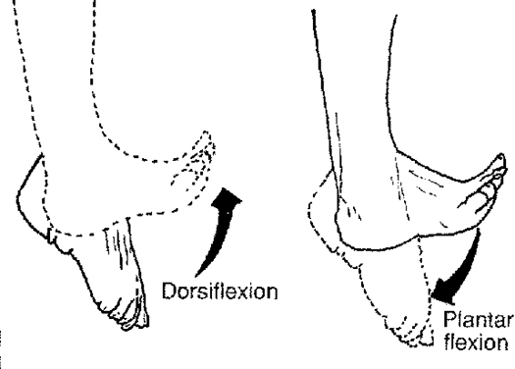
Movements of the Ankle
Plantarflexion
Dorsiflexion

Slide 19
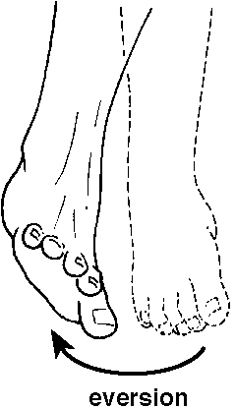
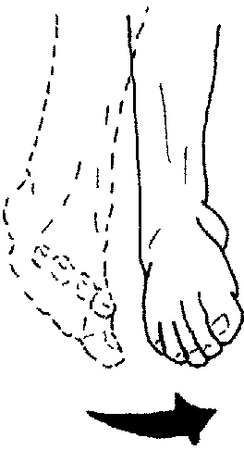
Movements at the Ankle
Eversion
Inversion

Slide 20
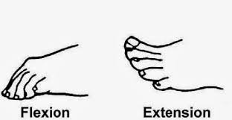
Movements of the Toes
Toe Flexion
Toe Extension

Slide 21
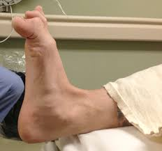
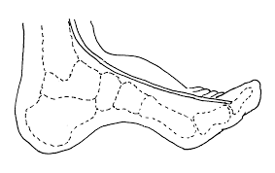
Movements of the Hallux
Flexion of the Big Toe
Extension of the Big Toe

Slide 22
ROM: Active and Passive
Can the athlete perform movements at the FALL without pain or problems?
Perform movements bilaterally (with each FALL)?
Passive ROM: the evaluator moves the FALL of the injured athlete; generally, problems with PROM = ligament is injured
Active ROM: the evaluator asks the athlete to perform each movement at the FALL; generally, problems with AROM = muscle/tendon is injured

Slide 23
Strength: MMT
What muscles perform the movements you just listed?
In Strength or Manual Muscle Testing (MMT), the evaluator is trying to determine if a muscle or tendon are injured and if it is weak or not.

Slide 24
Strength: MMT
Perform all movements of the FALL with resistance.
Determine if there is a weakness.
Check each compartment.
  Anterior
  Posterior
  Lateral

Slide 25

More Strength: MMT

Slide 26
Special Tests: Stability
In the Stability section of Special Tests, specific tests can be performed by the evaluator that can help pinpoint a specific injury.
From class, try to recall the structures and injures for the following SPECIAL TESTS.
  Percussion/Bump
  Squeeze/Compression
  Talar Tilt
  Anterior Drawer
  Kleiger
  Thompson

Slide 27

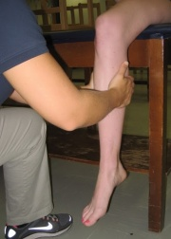
Special Tests: Stability
Percussion or Bump Test-helps determine a fracture
Compression or Squeeze Test-helps determine a fracture or anterior/posterior tibiofibular sprain

Slide 28
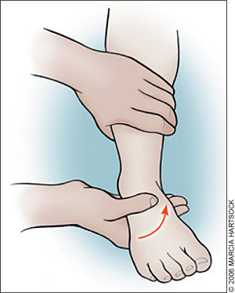
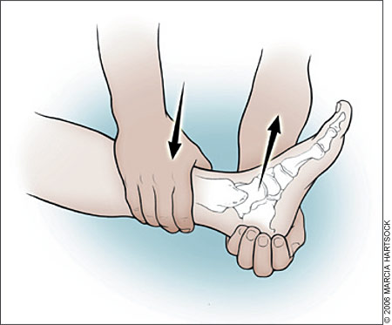
Special Tests: Stability
Talar Tilt Test-tests for the Calcaneofibular ligament
Anterior Drawer (Ankle)-tests for the Anterior Talofibular ligament

Slide 29
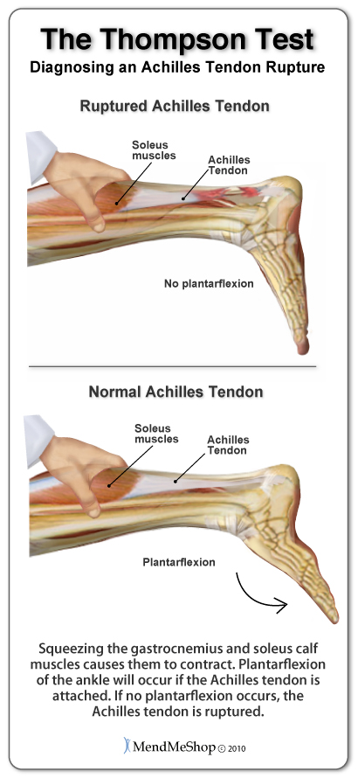
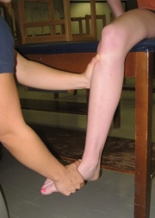
Special Tests: Stability
Kleiger Test-tests for the Deltoid ligament
Thompson Test-tests for a ruptured Achilles’ tendon

Slide 30
Functional: Sports Specific Tests
The last section of Special Tests involves performing Functional or Sports Specific activities.
Whenever an athlete gets injured, their FIRST question is: “Can I play?”
This portion of the evaluation will answer that question!
List activities that the FALL will have to be able to do in order to play a SPORT….

Slide 31
Functional: Sports Specific Tests
Can the athlete:
  Walk
  Hop
  Jump
  Run
  Sprint
  Back pedal
  Cut
  Squat
  Lunge
  Change Direction
Depends on the sport:
  Soccer-Kick/Throw the Ball
  Volleyball-Serve/Spike
  Basketball-Shoot/Pivot
  Softball/Baseball-Swing a Bat/Field the Ball/Throw the Ball
  Swim/Dive-Push off the Block/Side of the Pool

