Slide 1
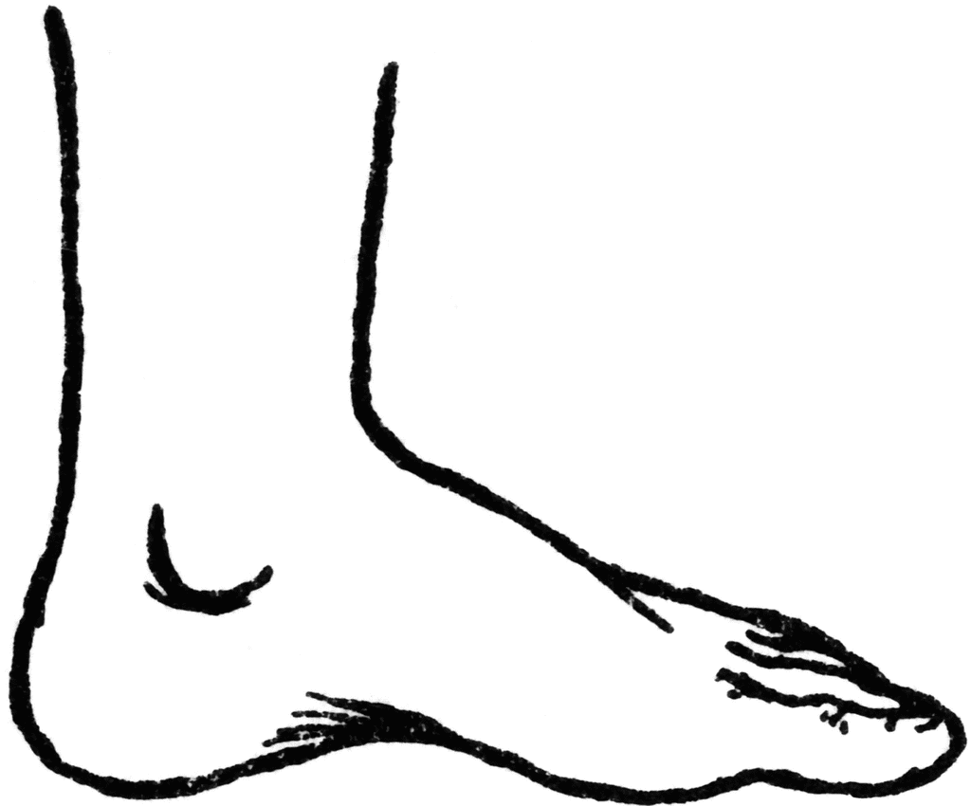
The Foot, Ankle, and Lower Leg
Chapter 14-15

Slide 2
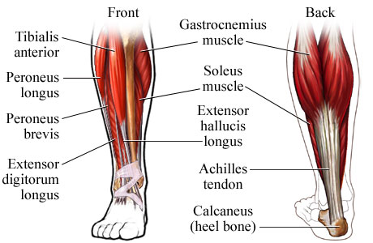
MUSCLES OF THE ANKLE
Movements of the ankle joint:
Dorsiflexion
Plantarflexion
Inversion
eversion

Slide 3
THE ANTERIOR COMPARTMENT
Anterior Muscles-
Extensor Hallucis Longus (extends big toe)
Extensor Digitorum Longus (extends toes)
Peroneus Tertius-(dorsiflexion/eversion)
Tibialis Anterior-(inversion/dorsiflexion)

Slide 4
THE POSTERIOR COMPARTMENT
Posterior Muscles (three layers)-
Superficial Layer : Gastrocnemius (plantarflexion)
Middle Layer:
Soleus (plantarflexion)

Slide 5
More on THE POSTERIOR COMPARTMENT
Deep Layer:
Tibialis Posterior (plantarflex/inverts)
Flexor Digitorum Longus (flexes toes)
Flexor Hallucis Longus
(flexes big toe)

Slide 6
THE LATERAL COMPARTMENT
Lateral Muscles-
Peroneus Longus
Peroneus Brevis
Action: Eversion

