Slide 1
Head and Nasal Injuries

Slide 2
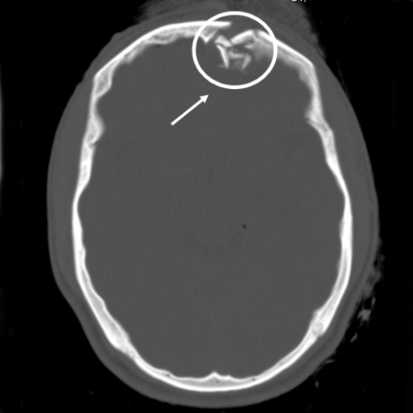
Skull fracture
Cause of injury
Most common cause is blunt trauma
Signs of injury
Severe headache and nausea
Palpation may reveal defect in skull
May be blood in the middle ear, ear canal, nose and ecchymosis (discoloration) around the eyes (raccoon eyes) or behind the ear (Battle’s sign)
Cerebrospinal fluid may also appear in ear and nose
Care
Immediate hospitalization and referral to neurosurgeon

Slide 3
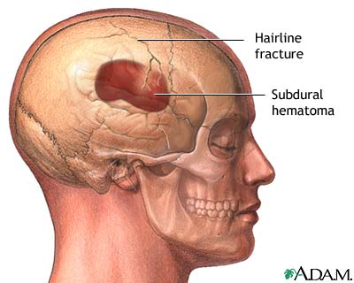
Skull Fracture Continued…

Slide 4
Concussions (Mild Head Injuries)
Cause of Injury
Result of direct blow, acceleration/deceleration forces results in the shaking of the brain
Signs of Injury
Brief periods of diminished consciousness or unconsciousness that lasts seconds or minutes
Headache, tinnitus (ringing in the ears), nausea, irritability, confusion, disorientation, dizziness, amnesia (loss of memory), concentration difficulty, blurred vision, photophobia (light sensitivity), sleep disturbances, phonophobia (sound sensitivity).

Slide 5
Concussions Continued…
Care
Any sign and symptom of a head injury/concussive symptoms= STOP all participation in practice/play, refer to a physician for an evaluation, complete Gfellar-Waller Concussion Act Paperwork (and send it with athlete to the physician)
Objective measures (Symptom Checklist, Cranial Nerve Assessmnet, BESS and SAC) should be used to determine readiness to play as well as Baseline IMPACT cognitive computer test scores
All post-concussive symptoms should be resolved prior to returning to play
After asymptomatic, return to play should be gradual (5-7 day process)
Athlete must be cleared by the team physician before FULL return to play
Recurrent concussions can produce cumulative traumatic injury to the brain
Following an initial concussion the chances of a second episode are 3-6 times greater

Slide 6
Concussions Continued…

Slide 7
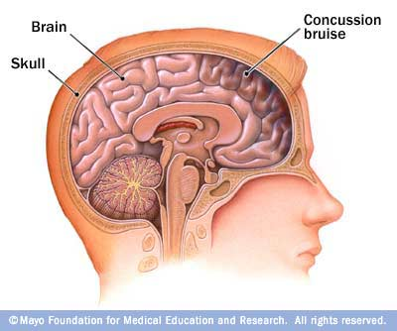
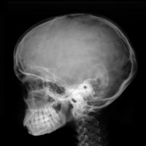
Concussion

Slide 8
Post concussion Syndrome-lingering symptoms that will not go away!
Cause of Injury
Condition which occurs following a concussion
May be associated with those Mild Heat Injuries that don’t involve LOC or in cases of severe concussions
Signs of Injury
Athlete complains of a range of post concussion problems
Persistent headaches, impaired memory, lack of concentration, anxiety and irritability, giddiness, fatigue, depression, visual disturbances
May begin immediately following injury and symptoms have fully resolved
Care
ATC should treat symptoms to greatest extent possible
Return athlete to play when all signs and symptoms have fully resolved

Slide 9
Second Impact Syndrome
Cause of Injury
Result of rapid swelling and herniation of brain after a second head injury before symptoms of the initial injury have resolved
Second impact may be relatively minimal and not involve contact with the cranium
Impact disrupts the brain’s blood autoregulatory system leading to swelling, increasing intracranial pressure
Signs of Injury
Often athlete does not LOC and may looked stunned
Within 15 seconds to several minutes of injury; the athlete’s condition degrades rapidly
Dilated pupils, loss of eye movement, LOC leading to coma, and respiratory failure
Care
Life-threatening injury that must be addressed within 5 minutes with life saving measures performed at an emergency facility
Best management is prevention from the ATC’s perspective-don’t let athletes return to play or participation with any sign or symptom of a head injury!!!!!

Slide 10
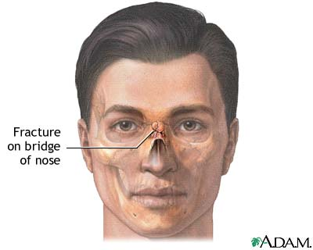
Nasal Fractures and Chondral Separation
Cause of injury
Direct blow
Signs of injury
Separation of frontal processes of maxilla, separation of lateral cartilage or combination
Profuse bleeding and hemorrhaging, immediate swelling and deformity
Care
Control bleeding and refer to a physician for X-ray, examination and reduction
Uncomplicated and simple fractures will pose little problem for the athlete’s quick return
Splinting may be necessary

Slide 11
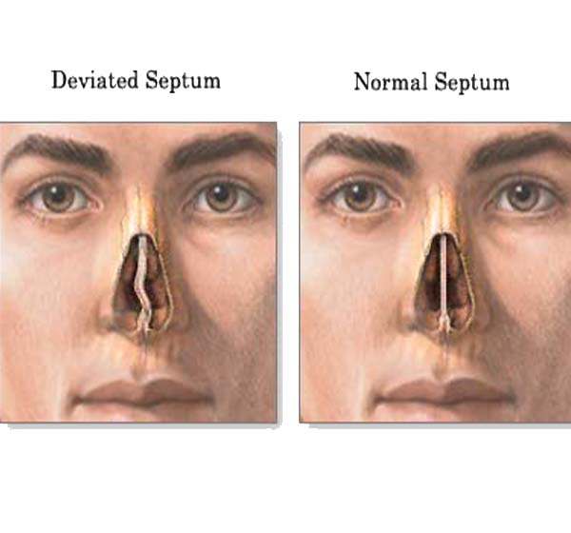
Deviated Septum
Cause of injury
Compression or lateral trauma
Signs of injury
Bleeding and in some instances a
septal hematoma
Athlete will complain of nasal pain
Care
At the site of the hematoma,
compression will be required (and if
present, drained immediately)
Following drainage, a wick is inserted
to allow for further drainage
Packing will be necessary to prevent a return of the hematoma
A neglected hematoma will result in formation of an abscess along with bone and cartilage loss and deformity

Slide 12
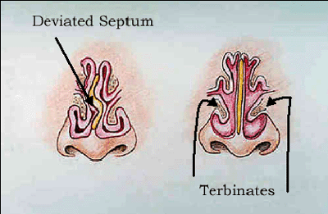
Deviated Septum Continued…

Slide 13
Nosebleed (Epistaxis)
Cause of Injury
Result of a direct blow, a sinus infection, high humidity, allergies, a foreign body or some other serious facial injury
Signs of Injury
Generally bleeding from the anterior aspect of the septum
Generally presents with minimal bleeding and resolves spontaneously
More severe bleeding may require more medical attention
Care
For acute bleeding, sit upright with a cold compress over the nose, pressure on the affected nostril and the ipsilateral (same side) carotid artery
Also place gauze between the upper lip and gum – limits blood supply
Use a nose plug or tampon to stop bleeding
If bleeding does not cease in 5 minutes, an astringent or styptic may need to be applied along with a gauze/cotton nose plug to encourage clotting
After bleeding has ceased, the athlete can return to play but should be reminded not to blow the nose under any circumstances for at least 2 hours

Slide 14
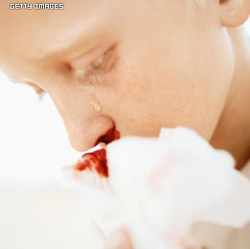
Nosebleed (Epistaxis)

Slide 15
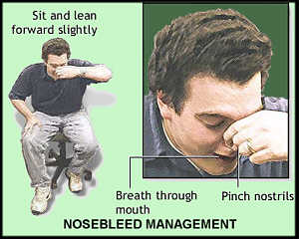
Nosebleed Continued…

