Slide 1
Head, Face, Ear, EYE, Nose, and Throat Evaluation

Slide 2
History: Head Questions
Questions to ask:
Do you know where you are?
Did you get hit in the head?
Can you tell me what happened?
Can you remember if you have ever been knocked out before?
Does your head hurt?
Do you have any pain in your neck?
Can you move your hands and feet?
Do you have numbness or weakness anywhere?

Slide 3
History: More Questions
NOSE
What portion of your nose hurts?
Did you hear a snap or pop upon contact?
Are you have difficulty with breathing?
EYES
Can you see clearly?
Do you wear contacts?
Is your vision blurry or abnormal (seeing double)?
Does the light bother you?

Slide 4
History: More Questions
Throat
Does it bother you to swallow?
Ear
Are you having any ringing in your ears?
Are you having any issues hearing?
Face
Does it bother you to smile? Or stick out your tongue?
Can you close your right eye? Left eye?
Do you smell anything abnormal?

Slide 5
Observation:
Look for the following signs and symptoms:
Is the athlete disoriented and unable to tell where he or she is, what time it is, who the opponent is?
Is there a blank or vacant stare? Does the athlete have difficulty keeping the eyes open?
Is there slurred or incoherent speech?
Are there delayed verbal and motor responses (slow to answer questions or follow instructions)?
Is there gross disturbances to coordination (stumbling, inability to walk in a straight line, can’t touch finger to nose)?

Slide 6
More to Observe:
Look out for the following:
Is there an inability to focus attention and is the athlete easily distracted?
Does there appear to be a memory deficit exhibited by repeated asking of the same questions or not knowing what happened?
Does the athlete have normal cognitive functioning (spell a word backwards, serial 7s, months in reverse, ABCs in reverse)?
Is there a normal emotional response?
Is there clear fluid coming out of the ear canal or nose?

Slide 7
More to Observe
Walking, Standing, Sitting----Watch Facial Expressions
Posture
Swelling
Deformity
Eccymosis or discoloration
Are they Off??
Heat or warmth
Crepitus or abnormal sounds at time of injury
Redness
Feeling or Sensation
Range of Motion (ROM)
Areas of Pain and Point Tenderness
Muscle Atrophy or Weakness
Mental State
Emotional State
Personality

Slide 8
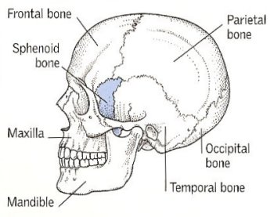
Palpation: Head and Face
Head and Face
Frontal
Parietal
Occipital
Temporal
Maxilla
Mandible
Nasal
Zygoma

Slide 9
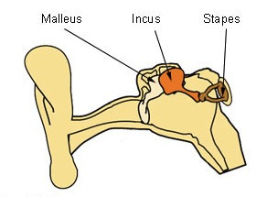
Palpation: Ear
You can palpate the
Auricle and a portion of the External Auditory Canal.
Perform a “snaps” test.

Slide 10
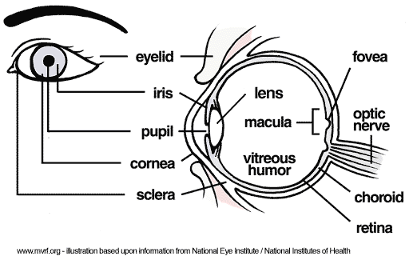
Palpation: Eye
You can palpate the Eye Socket for deformity.
Perform a vision check.
Read something.
Close each eye.
Check pupils. (PEARL)
Eye Movement

Slide 11
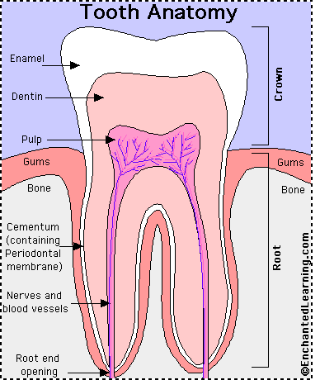
Palpation: Tooth
Palpate the tooth or have the athlete check to make sure the tooth has not shifted out of its socket.
Also check the mouth for any open wounds and bleeding.

Slide 12
Special Tests: Symptom Checklist
http://www.cdc.gov/concussion/pdf/TBI_schools_checklist_508-a.pdf

Slide 13
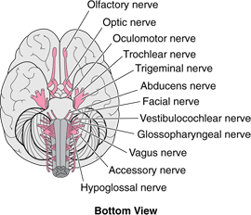
Special Tests: Neurological Testing
Cranial Nerve Assessment
Olfactory (s) – smell
Optic (s) – vision
Occulomotor (s/m) – blink; pupil reaction
Trochlear (s/m) – eyeball movement
Trigeminal (s/m) – chewing
Abducens (s/m) – eyeball movement
Facial (s/m) – smile
Vestibulocochlear (s) – balance/snaps
Glossopharyngeal (s/m) – saliva/BP
Vagus (s/m) – sharp/dull
Accessory (s/m) – yes/no/so-so/swallow
Hypoglossal (s/m) – stick out tongue/swallow

Slide 14
Special Tests: Eye Function
Pupils should be equal, accommodate, round and reactive to light (PEARL).
Check for ability of the eye to track smoothly.
Blurred vision is determined by the inability or difficulty to read something.

Slide 15
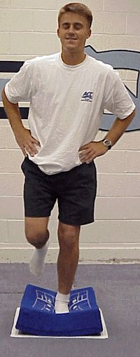
Special Test: Balance Test
Balance Error Scoring System (BESS):
Clinical Test Battery
Six 20 second trials using 3 different stances (double, single, tandem) on 2 different surfaces (firm, foam)
Record Errors
Hands lifted off iliac crests
Opening eyes
Step, stumbles, or falls
Moving into >30 degrees of hip flexion or abduction
Remaining out of testing position for >5 seconds

Slide 16
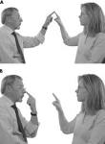
Special Tests: Coordination Tests
Finger to Nose
Heel to Toe Walking

Slide 17
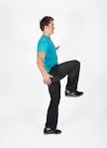
Special Tests: Coordination Tests
Standing Heel to Knee Test

Slide 18
Special Tests: Cognitive Tests
SAC Test
Reverse Thinking Activities
http://www.mc.edu/faculty/files/2113/3364/5950/Concussion_Standardized_SAC_Concussion_form_b.pdf
Serial 7s
Count backwards from 100 by 7
Months in Reverse Order
ABCs in Reverse Order

Slide 19
Sports Specific/Functional Testing
Generally when someone suffers a Head, Face, Ear, Eye, Nose, and/or Throat injury a doctor’s referral is necessary.
Caution should be taken to return athlete’s back to competition. Generally a doctor’s clearance is REQUIRED!
It is also imperative that proper documentation is kept about this type of injury.
GWL Concussion Act must be followed.

