Slide 1
Hip Conditions
Sports Medicine II

Slide 2
Hip Pointer
ETIOLOGY: Direct blow to the iliac crest
PATHOLOGY: Contusion of the iliac crest or ASIS; rupture of the abdominal muscles at their insertion
SIGNS AND STMPYTOMS: Pain and point tenderness over iliac crest; splinting to the affected side; muscle spasms; pain on movement (especially walking or rotation to injured side); swelling, hematoma, ecchymosis
COMPLICATIONS: Muscle Strain
TREATMENT: PRICES, meds for pain, total inactivity if necessary

Slide 4
Trochanteric Bursitis
ETIOLOGY – Direct blow to bursa, overuse of muscle, **more common in women due to wider hips
PATHOLOGY – Inflammation of bursa and thickening of bursal walls
SIGNS AND SYMPTOMS – Localized swelling, warmth over bursa, crepitus during hip movements
COMPLICATIONS – Loss of ROM due to swelling of bursa, infection of bursa (especially warmth)
TREATMENT – PRICES, meds, total inactivity if necessary, flexibility exercises

Slide 5
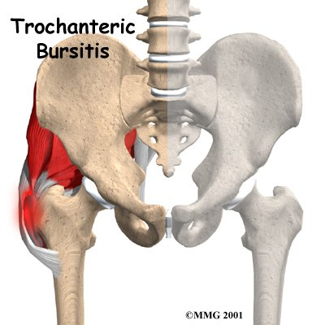

Slide 6
Posterior Hip Dislocations
ETIOLOGY – Hip and knee usually flexed to 90 degrees, a force drives head of femur posteriorly and superiorly
PATHOLOGY – Rupture posterior capsule and blood vessels supplying head of femur
SIGNS AND SYMPTOMS – Severe pain, inability to move, assumes position of hip flexion/adduction/internal rotation, greater trochanter appears prominent and knee of involved extremity rests on uninvolved extremity
COMPLICATIONS – Associated fractures, sciatic nerve palsy, avascular necrosis of the femoral head, traumatic arthritis
TREATMENTS – Immediate emergency care, monitor ABCs, watch out for shock, reduction by a physician under anesthesia, immobilize for 6 weeks

Slide 7
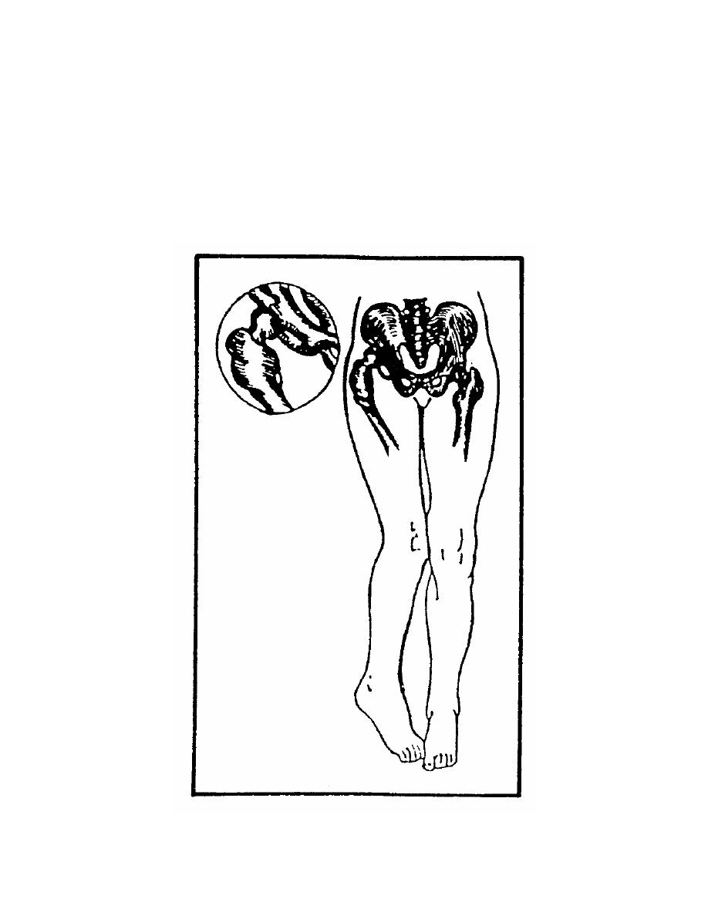

Slide 8
Stress Fractures of the hip
Fractures resulting from repetitive loading with relatively low magnitude forces. Common at pubis, femoral neck, and proximal 1/3 of the femur.
ETIOLOGY – Low bone mineral density (eating disorders); amenorrhea (no period); excessive increase in activity level; muscle fatigue
PATHOLOGY – Incomplete fracture of bone due to added stresses placed on bone by muscles
SIGNS AND SYMPTOMS – Point tenderness with deep palpation, night pain, aching pain localized, increased pain on extreme hip rotation and inability to stand on involved leg (femoral neck fractures)
COMPLICATIONS – Displaced or complete fracture if misdiagnosed
TREATMENT – Crutches, rest, ice, referral

Slide 9
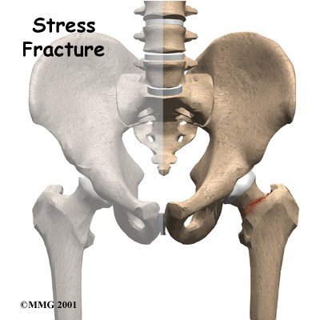

Slide 10
Avulsion Fractures
Muscle or tendon pulls a piece of bone away from insertion site **Common in young athletes**
COMMON SITES and MUSCLE THAT CAUSES INJURY:
- ASIS = Sartorius
- Lesser Trochanter = Psoas Major
- AIIS – Rectus Femoris
- Ischial Tuberosity = Hamstrings
- Pubis = Adductors
- Illiac Crest = Abdominal Muscles
SIGNS AND SYMPTOMS – Point tenderness, deep disabling pain, pain increases with AROM and manual muscle tests
TREATMENT – PRICES, meds, crutches for continued rest, 3-4 months for complete resolution

Slide 11
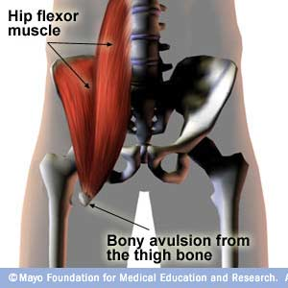

Slide 12
Quadriceps Contusion
Bruise to quadriceps musculature
ETIOLOGY – Severe blow to thigh causes bleeding in the muscles
SIGNS AND SYMPTOMS – Mild swelling, discoloration, decreased ROM and strength, point tenderness, thigh becomes stiff
COMPLICATIONS – Myositis ossificans
TREATMENT – Rest, ice and compression with knee in a flexed position, elevation, meds, crutches and limited movement initially, protection using donut style padding is mandatory for return to activity

Slide 13
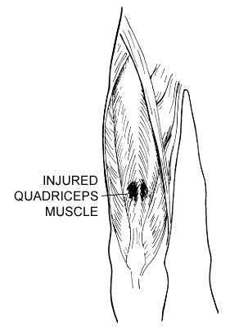

Slide 14
Muscle Strains
ETIOLOGY – Sudden burst of speed that requires explosive and violent muscle contraction. Commonly occur at hamstrings, quadriceps, and adductors
**Don’t forget degrees of injury**
1st – Stretch of the muscle(s), minor discomfort, point tenderness,
and limited to little or no swelling, no lack of stability
2nd – Tears of the muscle(s), pain, swelling, point tenderness, loss
of function, pain with movement, a little instability
3rd – Complete tearing of the muscle(s), joint instability, extreme
pain or little pain (nerve damage), loss of function, point
tenderness, rapid swelling, avulsion fractures is possible
depending on area
SIGNS AND SYMPTOMS – Local point tenderness, decreased ROM, decreased strength
TREATMENT – PRICES, modalities (ice, heat, US, E-stim)

Slide 15
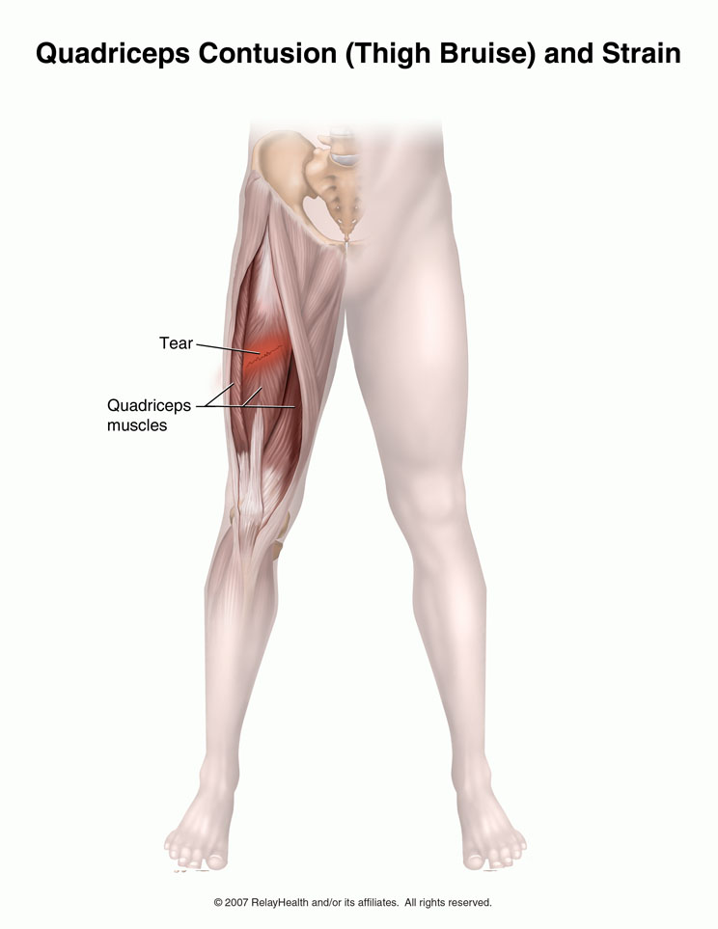

Slide 16
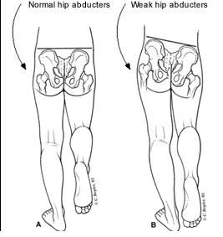
Trendelenburg Test- tests for a weak Gluteus Medius Muscle

Slide 17
Trendelenburg Test
This procedure is designated to evaluate strength of the gluteus medius muscle. Stand behind the patient and observe the dimples overlying the posterior superior iliac spines. Normally, when the patient bears weight evenly on both legs, these dimples appear level. Then ask the patient to stand on one leg. If they stand erect, the gluteus medius muscle on the supported side should contract as soon as the leg leaves the ground and should elevate the pelvis on the unsupported side. This elevation indicates that the gluteus medius muscle on the supported side is functioning properly. However, if the pelvis on the unsupported side remains in position or actually descends, the gluteus medius muscle on the supported side is either weak or nonfunctioning.

Slide 18
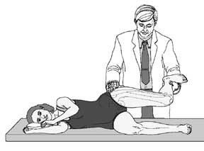
Ober Test-tests for a tight IT Band

Slide 19
Ober Testing of the IT Band
Have the patient lie on their side with their involved leg uppermost. Abduct the leg as far as possible and flex the knee to 90 degrees while keeping the hip joint in the neutral position to relax the iliotibial tract. Then release the abducted leg. If the IT tract is normal, the thigh should drop to the adducted position. However, if there is a contrastructure of the tensor fascia latae or IT band, the thigh remains abducted when the leg is released.

Slide 20
Thomas Test
Although the Thomas Test is a specific test designed to detect flexion contractures of the hip, it may also be used to evaluate range of hip flexion.
The patient should be supine on the examination table, with his pelvis level and square to his trunk so that an imaginary line drawn between the anterior superior iliac spines is perpendicular to the axis of his body. Stabilize the pelvis by placing your hand under the patient’s lumbar spine and flexing his hip, bringing his thigh up onto his trunk. As you flex the hip, notice at what point his back touches your hand. The previous lordosis of the lumbar spine is then flattened, the pelvis is stabilized, and further flexion can originate only in the hip joint. Flex the hip as far as possible. Normal flexion limits allow the anterior portion of the thigh to rest against the abdomen, almost touching the chest wall. Flex the other hip in a similar manner. Then have the patient hold one leg on his chest and let his other leg down until it is flat on the table. If the hip does not extend fully, the patient may have a fixed flexion contracture of that hip. If he rocks forward, lifting his thoracic spine from the table, or arches his back to reform the lumbar lordosis when he lowers his leg, a fixed flexion deformity is again indicated, since rocking and arching of the back are compensatory mechanisms to facilitate lowering of a contracted hip. The extent of a flexion contracture can be approximated if you observe the patient from the side and estimate the angle between his leg and the table at the point of greatest extension.

Slide 21
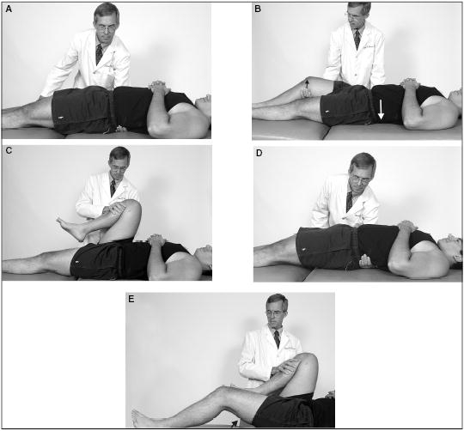
Thomas Test- tests for tight Hip Flexor Muscles

Slide 22
Checking Hip Levels
ASIS
PSIS
Iliac crest

Slide 23
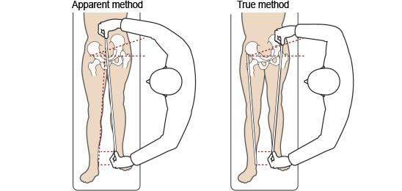
Special Tests: Leg Length

Slide 24
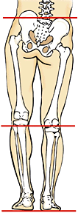
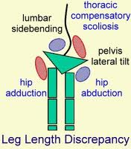
Leg Length Issues Create:

