Slide 1
Hip Evaluation
Chapter 17 Pages 389-393

Slide 2
H: History
Ask questions to determine the type of injury and the mechanism of how it happened.
Questions may include:
  What were you doing when you hurt your hip?
  How did the injury happen?
  What happened?
  What position was the hip in at the time of injury?
  What type of pain is there? Sharp or dull.
  Did you hear a snap or a pop?
  Can you point to the exact site of pain?
  Is this a new injury? Or has it happened before?
  What makes it feel better or what makes it feel worse?

Slide 3
More on History
  Do you have any weakness? Numbness?
  Does pain radiate down the back or front of the legs or buttocks?
  When is the pain worst? (during activity, at night, at rest)
  How disabling is this injury? On a scale of 1 to 10, 10 means call 911, what would this injury be?
  Can you bear weight on your leg/hip and walk normally or do you walk with a limp?
  Was there immediate swelling, or did the swelling occur later (or at all)? Where did the swelling occur?
  What past hip injuries have you had?

Slide 4
O: Observation
Look for signs and symptoms of injury at the HIP. Try to determine the severity based on them.
Some signs and symptoms may include:
  Walking with a limp or unable to bear weight
  Swelling
  Deformity
  Eccymosis or discoloration
  Are the Hips Symmetic- Tilted Anteriorly or Posteriorly
  Heat or warmth
  Crepitus or abnormal sounds at the Hip
  Redness
  Feeling or Sensation
  Range of Motion (ROM)
  Areas of Pain and Point Tenderness
  Muscle Atrophy

Slide 5
More on Observation
Observe from the front, see if the hip look even.
Observe from the side, is the pelvis tilted?
Does standing produce pain?
Does standing on one leg create problems?
Observe the athlete during walking, bending, sitting, and standing.

Slide 6
P:Palpation
To determine what anatomy is involved in the injury.
Palpate bony structures first, then ligaments and muscles/tendons.
Make a note of any swelling, deformities, lumps, muscle spasms, or muscle guarding.
Also check for feeling and circulation.
Next palpate things you KNOW you can FIND…..

Slide 7
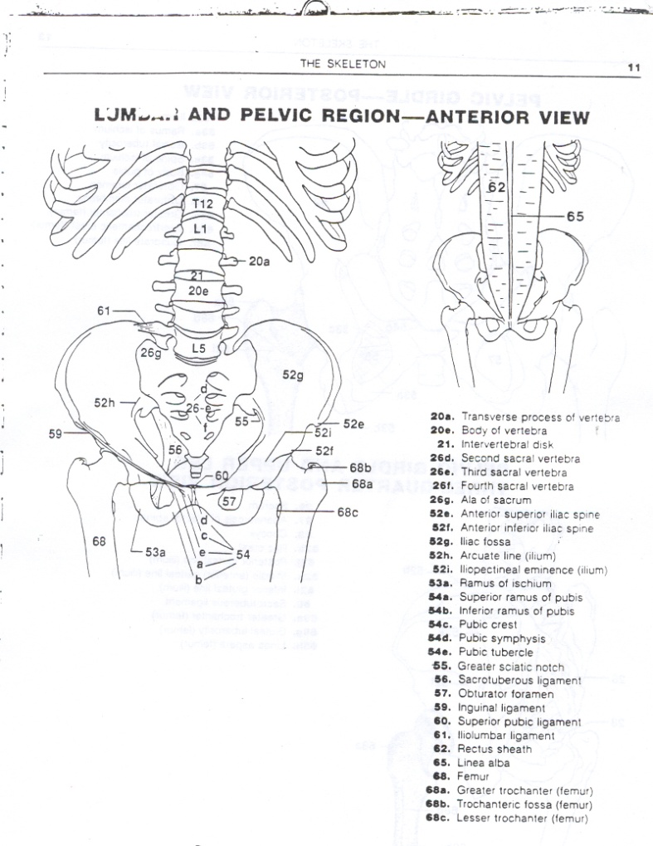
Bony Palpation: Anteriorly
At the hip, palpate
  ASIS- Sartorius
  AIIS- Rectus femoris
  Greater Trochanter
  Iliac Crest
  Femoral Condyles
At the lower leg, palpate
  Pes Ansurine-SGT
  Fibula
  Tibia

Slide 8
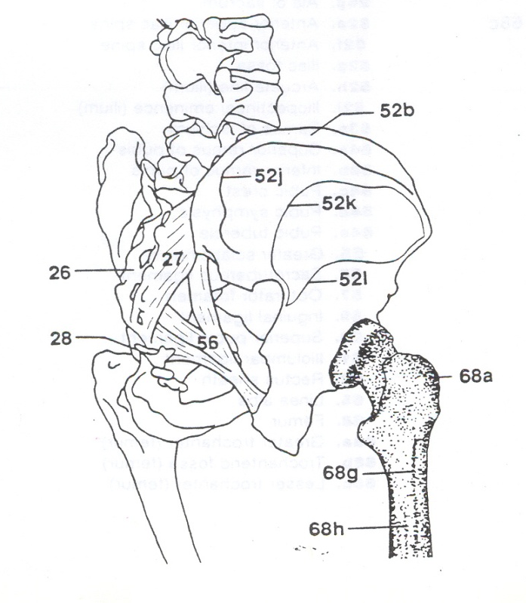
Bony Palpation
At the hip, palpate
  Sacrum
  Ischial Tuberosity-Hamstrings
  PSIS- spine muscles

Slide 9
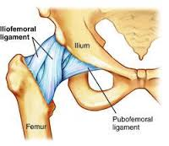
Palpate the Ligaments
  You can not palpate ligaments at the hip.
    Iliofemoral
    Pubofemoral
    Inguinal
    Ligamentum Teres
    Transverse Acetabular

Slide 10
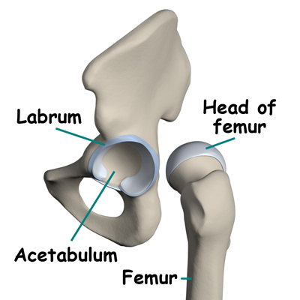
Palpate the Cartilage
You can not palpate cartilage at the hip.
  Labrum on the Acetabulum

Slide 11
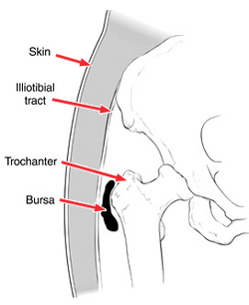
Palpate the Bursae
The Trochanteric Bursa is often injured at the hip. It sits underneath the ITB at the greater trochanter.

Slide 12
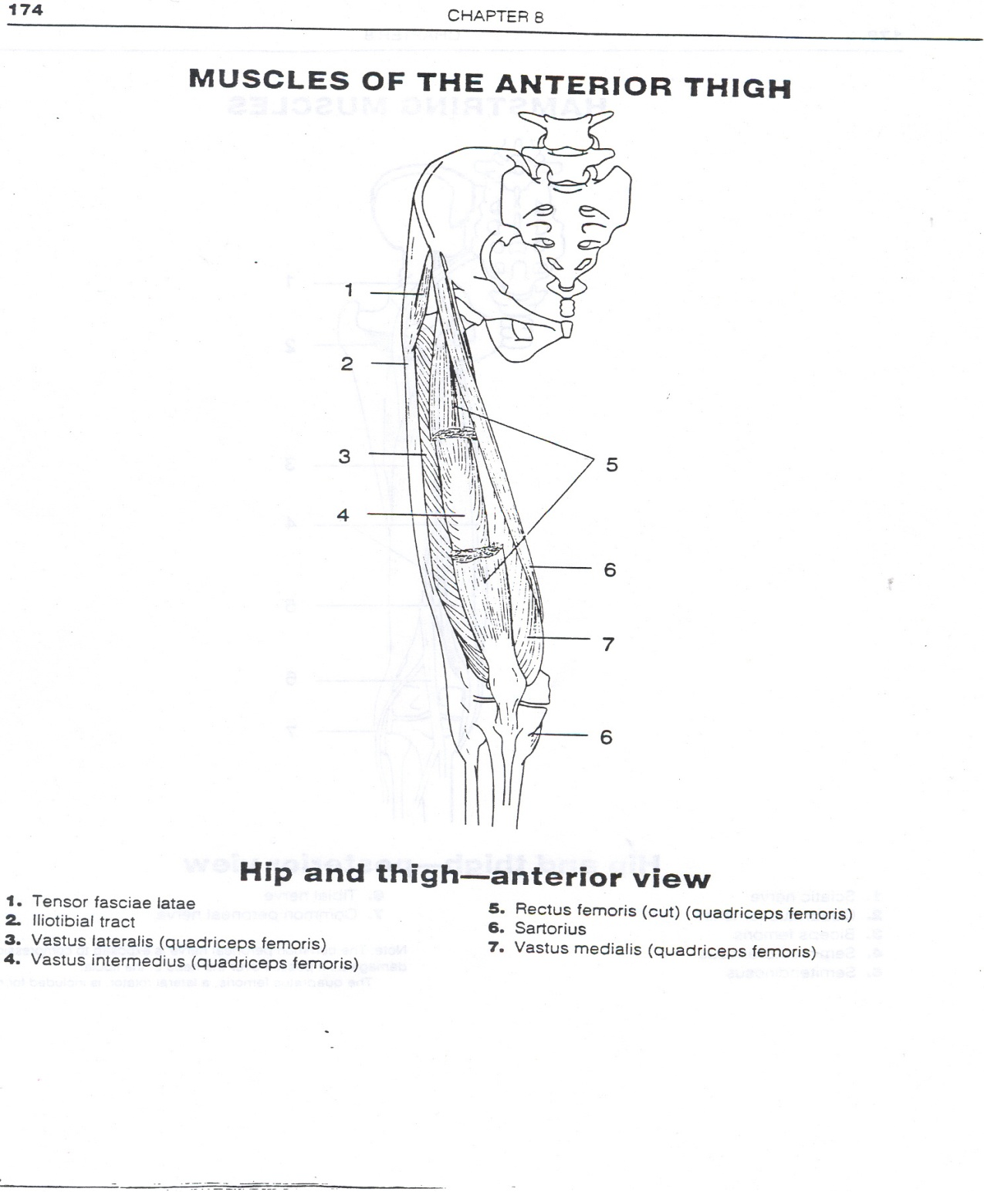
Palpate the Muscles/Tendons
Anterior Thigh
  Sartorius
  Quadriceps specifically the
    Rectus Femoris
    Vastus Medialis
  Patellar/Quadriceps Tendon- over the patella and to the tibial tuberosity

Slide 13
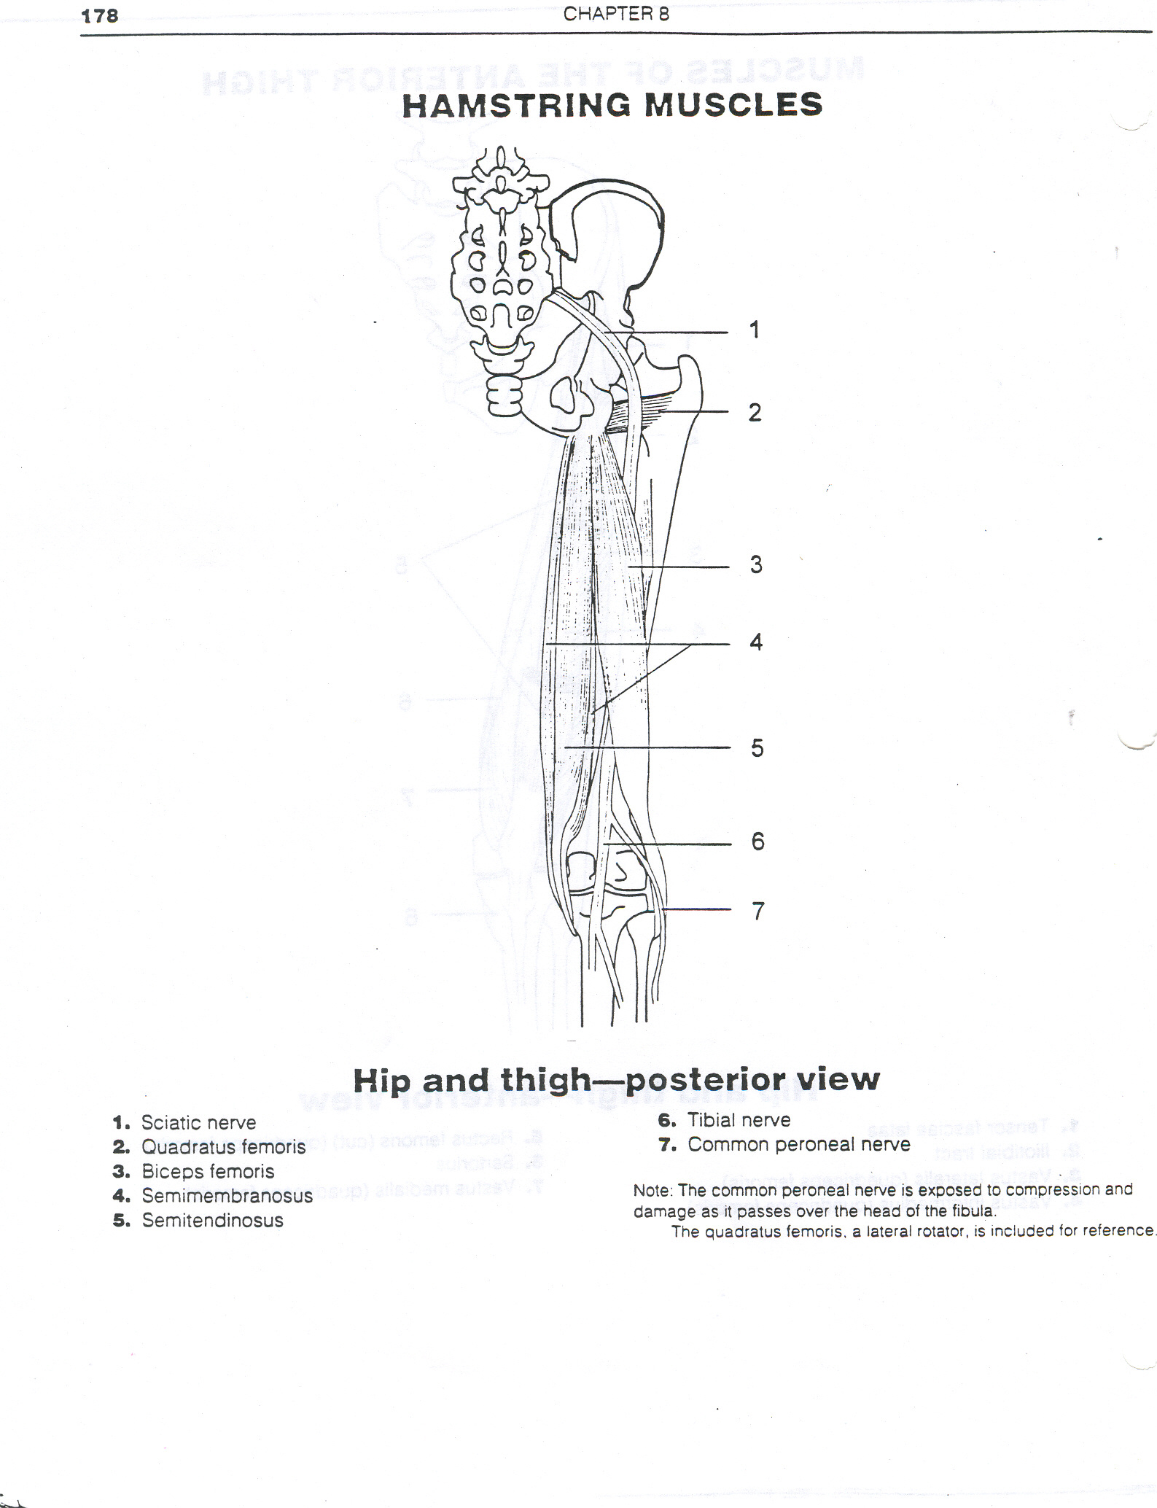
Palpate the Muscles/Tendons
Posterior Thigh
  Hamstrings specifically the
  Biceps Femoris
  Semitendinosus at the Pes Ansurine

Slide 14
Palpate the Muscles/Tendons
Gluteus Maximus
Gluteus Medius
But don’t forget the External Rotators:
  PGOGOQ

Slide 15
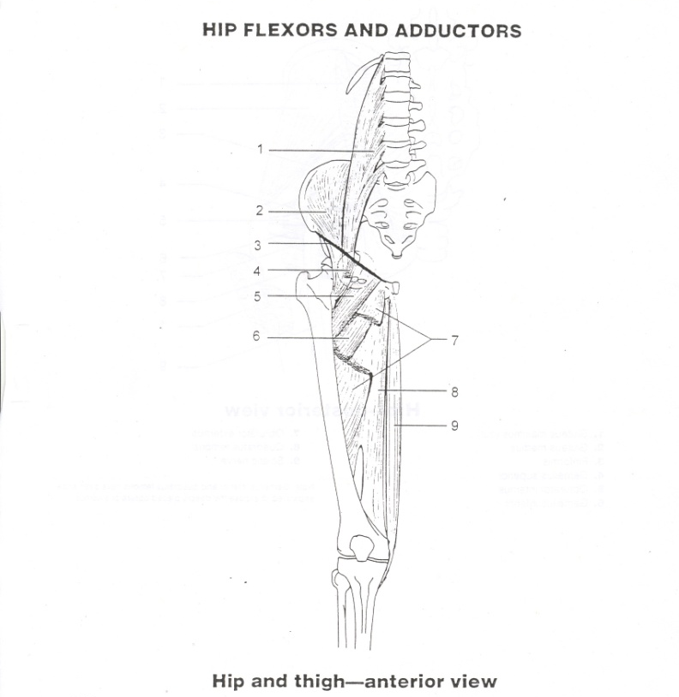
Palpate the Muscles/Tendons
Rectus Femoris
Groin
  Adductors
  Gracilis

Slide 16
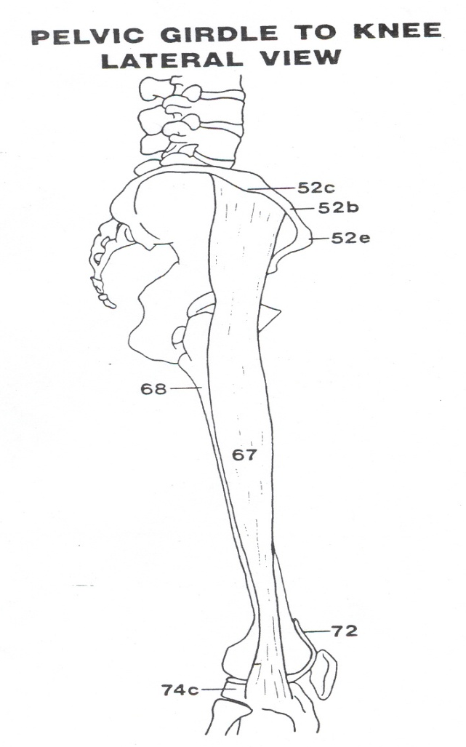
Don’t Forget the IT Band
The IT Band connects the Hip to the Knee.

Slide 17
S:Special Tests
ROM: Active and Passive
STRENGTH: Manual Muscle Tests
SPECIAL TESTS: Stability
FUNCTIONAL: Sport Specific Tests

Slide 18
ROM: Active and Passive
Can the athlete perform movements at the HIP without pain or problems?
Perform movements bilaterally (with each HIP)?
Passive ROM: the evaluator moves the HIP of the injured athlete; generally, problems with PROM = ligament is injured
Active ROM: the evaluator asks the athlete to perform each movement at the HIP; generally, problems with AROM = muscle/tendon is injured

Slide 19
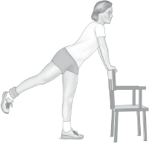
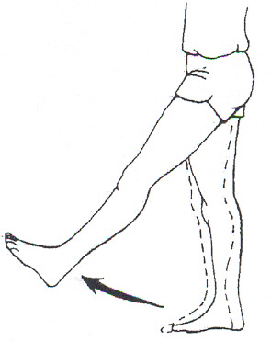
Movements of the Hip
Hip Flexion
Hip Extension

Slide 20
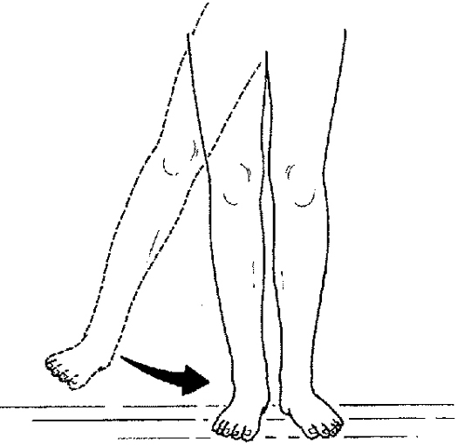
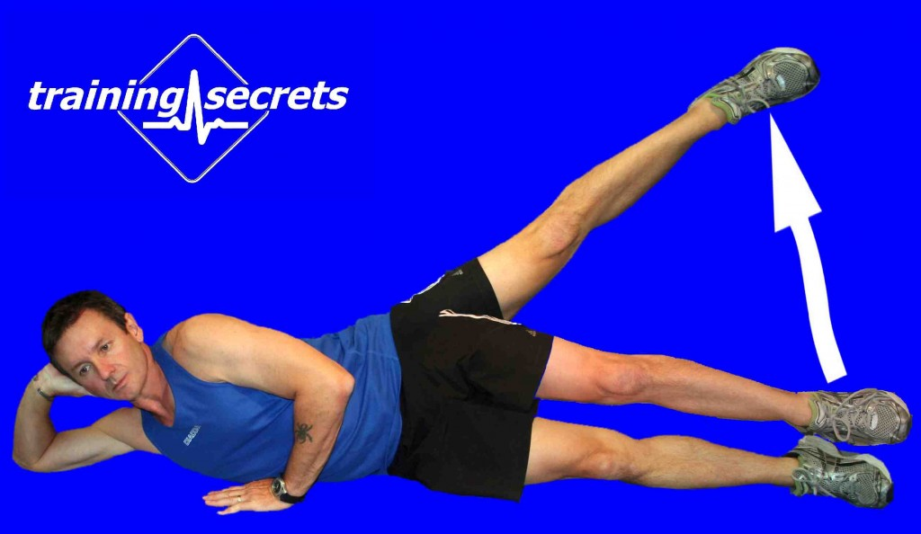
Movements of the Hip
Hip Abduction
Hip Adduction

Slide 21
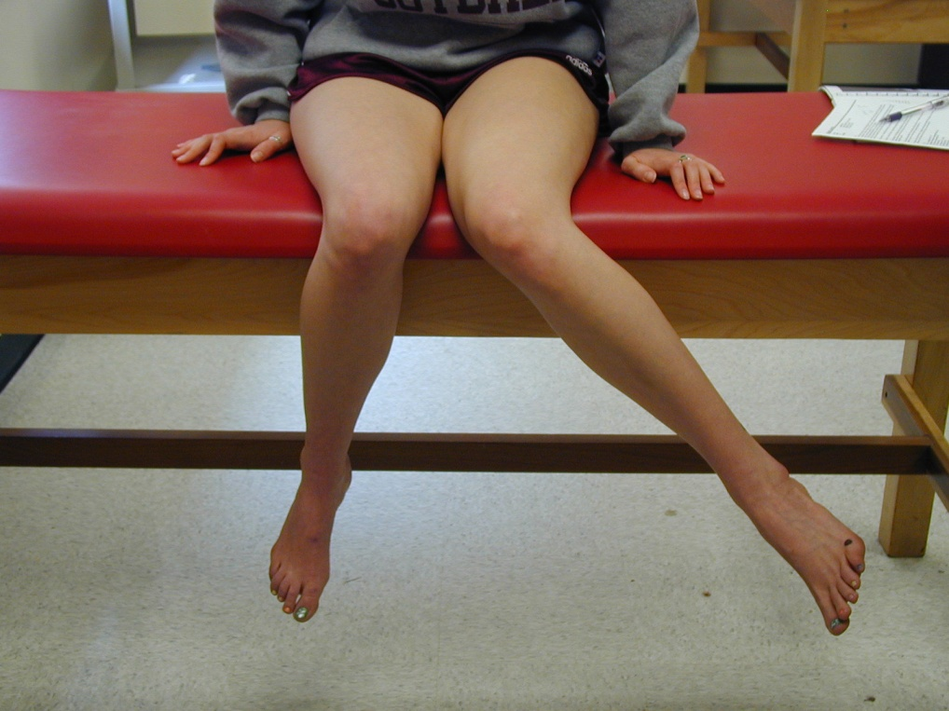
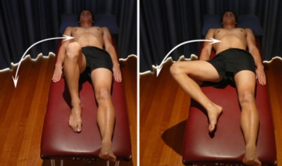
Movements of the Hip
Hip Internal Rotation
Hip External Rotation

Slide 22
Strength: MMT
Perform all movements of the Hip with resistance.
Determine if there is a weakness.

Slide 23
Color Coded Based on Action
1 | 2 | 3
External Rotation (ER) | Abduction Internal Rotation (ABD/IR) | Abduction External Rotation Extension (ABD/ER/Ext)
Flexion (Flex) | Flexion Internal Rotation (Flex/IR) | Flexion Abduction External Rotation (FABER)
Extension (Ext) | Adduction Internal Rotation (ADD/IR) | Flexion Adduction Internal Rotation (FADIR)

Slide 24
Color coded based on Action
1 | 2 | 3
Piriformis Gemellus Superior Obturator Internus Gemellus Inferior Obturator Externus Quadratus Femoris | Gluteus Medius Gluteus Minimus | Gluteus Maximus
Rectus Femoris Iliacus Psoas Major/Minor | Pectineus Tensor Fasciae Latae (TFL) | Sartorius
Biceps Femoris | Adductor Longus Adductor Brevis Adductor Magnus | Gracilis

Slide 25
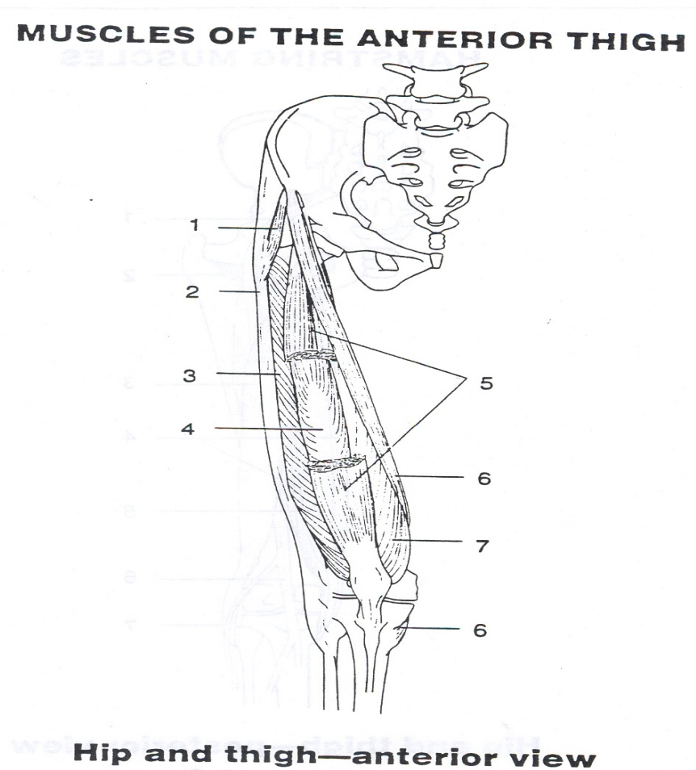
More Strength: MMT

Slide 26

More Strength: MMT

Slide 27
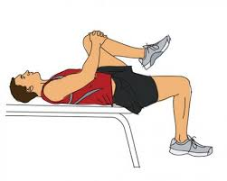

Special Tests: Specific Problems
Thomas Test-tests for Hip Flexor tightness
Straight Leg Raise-tests for tight Hamstrings

Slide 28
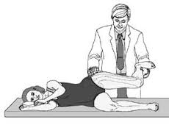
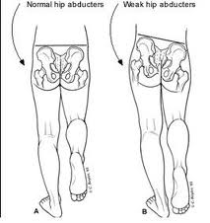
More Special Tests
Trendelenberg Test-tests for a weak
Gluteus Medius
Ober Test-tests for a tight IT Band

Slide 29
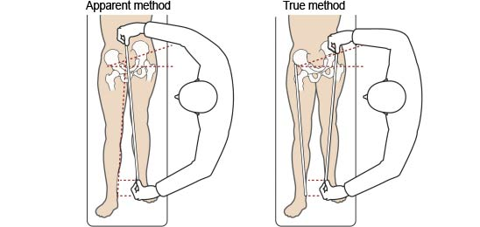
Special Tests: Leg Length

Slide 30
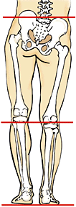
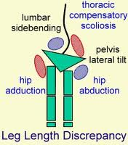
Leg Length Issues Create:

Slide 31
Functional: Sports Specific Tests
Can the athlete:
  Walk
  Hop
  Jump
  Run
  Sprint
  Back pedal
  Cut
  Squat
  Lunge
  Change Direction
Depends on the sport:
  Soccer-Kick/Jump up and Head the Ball
  Volleyball-Jump Serve/Spike
  Track-Stride Out/Hurdle/Jump/Get in the Starting Block
  Football-Get in Stance/Cut/Change Direction/Start and Stop

