Slide 1
The KNEE

Slide 2
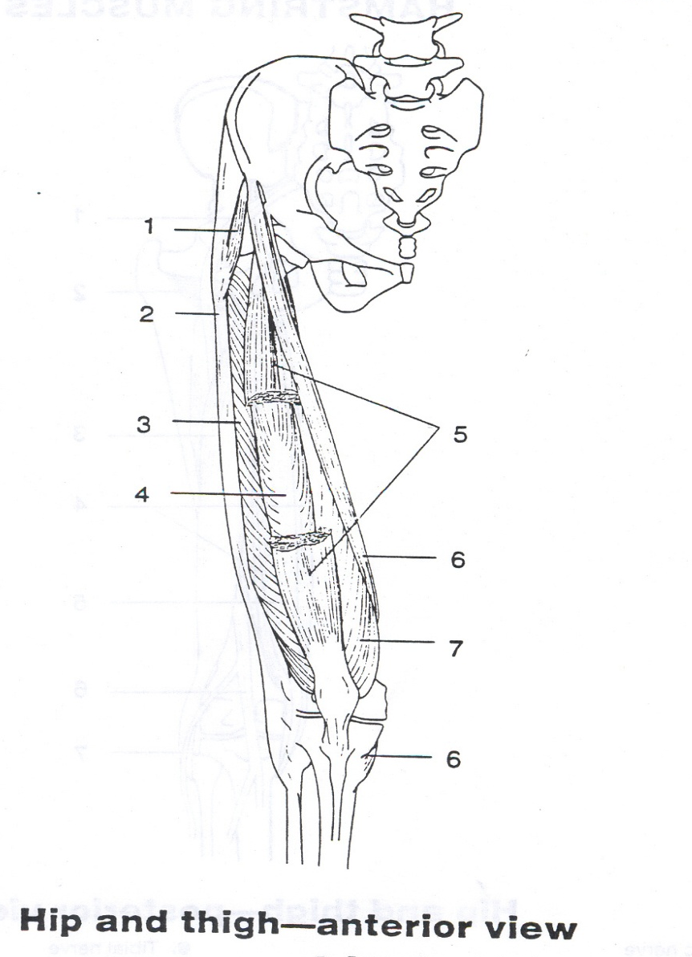
Muscles of the KNEE- Quadriceps
Vastus Lateralis
Vastus Intermedias
Vastus Medialis
Rectus Femoris
Anterior Muscles of the THIGH= Knee Extension

Slide 3
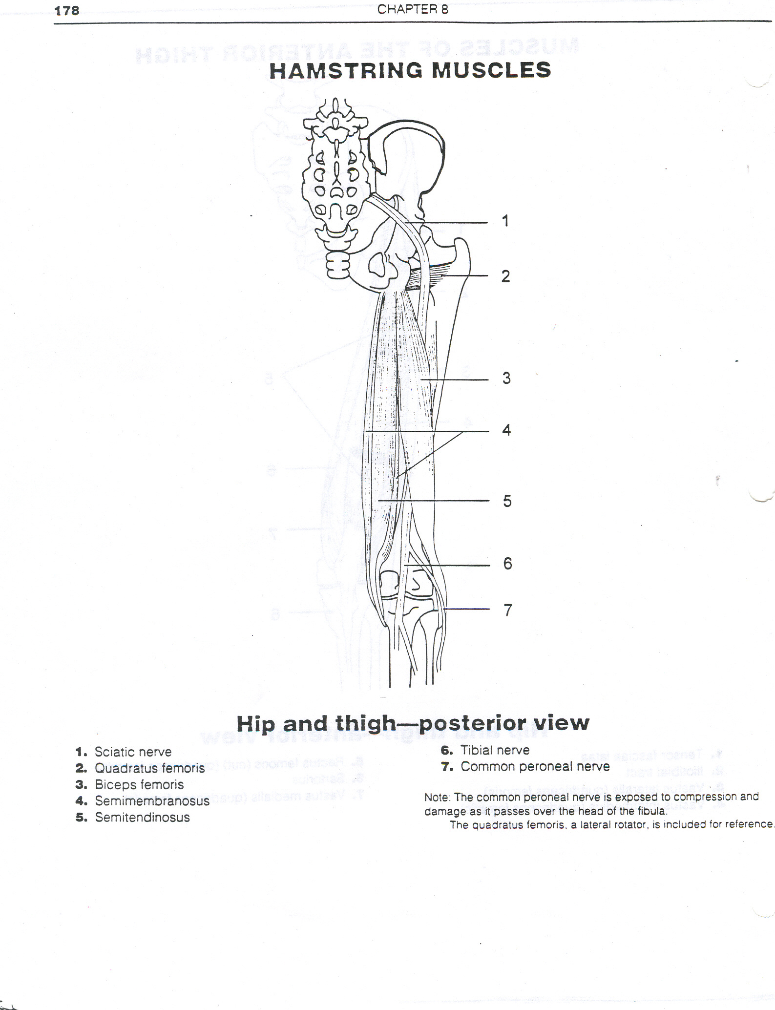
Muscles of the KNEE- Hamstrings
Biceps Femoris
Semimembranosus
Semitendinosus
Posterior Muscles of the THIGH = Knee Flexion

