Slide 1
Maintaining Cardiorespiratory Fitness

Slide 2
Cardiorespiratory Endurance
Cardiorespiratory Endurance: whole body activities for extended period of time
Aerobic exercise
Low intensity exercise that can be sustained for a long period of time
Anaerobic exercise
Activity where intensity is so high that demand for oxygen is greater than body’s ability to deliver

Slide 3
System’s four components
Heart
Lungs
Blood vessels
Blood
Improvements in endurance are the results of improvements in these 4 components

Slide 4
Types of Training for Cardiorespiratory Endurance
Continuous
Mode (type of exercise) - must be aerobic in nature
Frequency (at least 3 times/week)
Duration(at least 20 minutes)
Intensity (monitor intensity as % of heart rate or perceived exertion)
Training heart rate – target heart rate

Slide 5
Calculating Target Heart Range
.60(MHR-RHR) + RHR
.85(MHR-RHR) + RHR
MHR=Maximum Heart Range: 220-age
RHR=Resting Heart Range: normal heart rate
Average Adult 60-80 beats per minute
It is important to Exercise in this range in our to get the maximal benefits of your Cardiorespiratory Endurance.

Slide 6
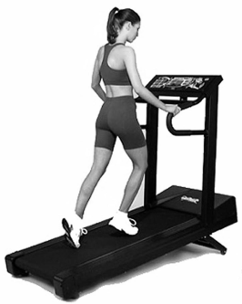
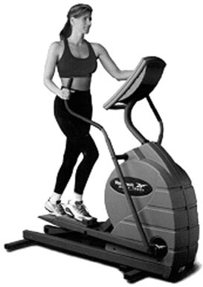
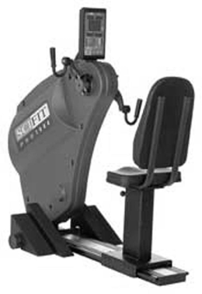

Slide 7
Single most neglected component of rehabilitation
When injury occurs athlete is forced to miss training time which results in decreased cardiorespiratory endurance unless training occurs to help maintain it
Alternative activities must be substituted that allow athlete to maintain fitness
Put into rehabilitation program as early as possible

