Slide 1
ModalitY Review

Slide 2
Type of Modality and Depth of Penetration
Electrical Stimulating Currents
Depth of Penetration=
Type of Modality=
Ultrasound
Depth of Penetration=
Type of Modality
Cryotherapy and Thermotherapy
Depth of Penetration=
Type of Modality=
Massage and Analgesics
Depth of Penetration=
Type of Modality=

Slide 3
Depth of Penetration
Electrical Modalities
Electrical Stimulating Currents
Depth of Penetration= between the pads; very superficial
Acoustic Modalities
Ultrasound
Depth of Penetration= 3 to 5 cm
Infrared Modalities
Cryotherapy (ice) and Thermotherapy (heat)
Depth of Penetration= 1 cm
Mechanical/Manual Modalities
Massage (deep tissue)-also a form of heat
Depth of Penetration= based on pressure applied
Analgesics (pain relieving cream/gel/ointment)

Slide 4
Purpose of Cryotherapy
Reduce ?
Reduce ?
Reduce ?
4 Sensation Stages of Cryotherapy:

Slide 5
Purpose of Cryotherapy
Reduce blood flow (circulation)
Reduce swelling and inflammation
Reduce pain
Sensation Stages of Cryotherapy:
Cold, Pain, Burn/Sting, Numb

Slide 6
Cryotherapy Options and Length of Treatment Time:
- Ice Bag- ?
- Cold Spray- ?
- Cold Whirlpool- (?°)
- Ice Massage/Ice Cup-?

Slide 7
Cryotherapy Options and Length of Treatment Time:
- Ice Bag- 15 to 20 minutes
- Cold Spray- 10 to 15 seconds
- Cold Whirlpool- (50-55°) 8 to 10 minutes
- Ice Massage/Ice Cup- 5 to 8 minutes

Slide 8
Contraindications for Cryotherapy
Do not use a cold treatment if the patient has the following situations:
Allergy to cold
Circulatory impairments
Wound healing (open wounds/skin conditions)
Hypertension- high blood pressure
Skin anesthesia

Slide 9
Purpose of Thermotherapy
Increase ?
Reduce ?
Increase ?

Slide 10
Purpose of Thermotherapy
Increase blood flow (circulation)
Reduce muscle stiffness
Increase muscular relaxation

Slide 11
Thermotherapy Options and Length of Treatment:
-Hydrocollator Pads-? minutes
-Hot Whirlpool (?˚)- ? minutes
-Massage- ? minutes

Slide 12
Thermotherapy Options and Length of Treatment:
-Hydrocollator Pads-10 minutes
-Hot Whirlpool (?˚)- 8-10 minutes
-Massage- 8-10/30+ minutes

Slide 13
Contraindications for Thermotherapy:
Do not use a heat treatment if the patient has the following situations:
Acute and post acute trauma
Poor circulation
Malignancy (open wounds or skin conditions)
Skin anesthesia

Slide 14
Ultrasound
What type of modality is an Ultrasound?
What is the depth of penetration?
Why do we use ultrasound as a therapeutic treatment?

Slide 15
Ultrasound
Ultrasound is defined as inaudible, acoustic vibrations of high frequency that may produce either thermal or non thermal physiological effects.
This modality stimulates repair of soft tissue and pain relief.
It is a form of acoustic energy used for deep tissue heating.
Depth of penetration= 3 to 5 cm

Slide 16
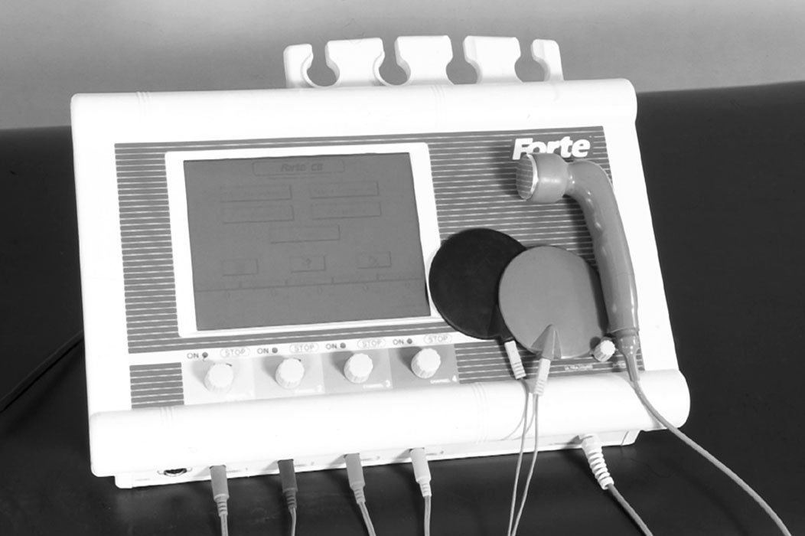
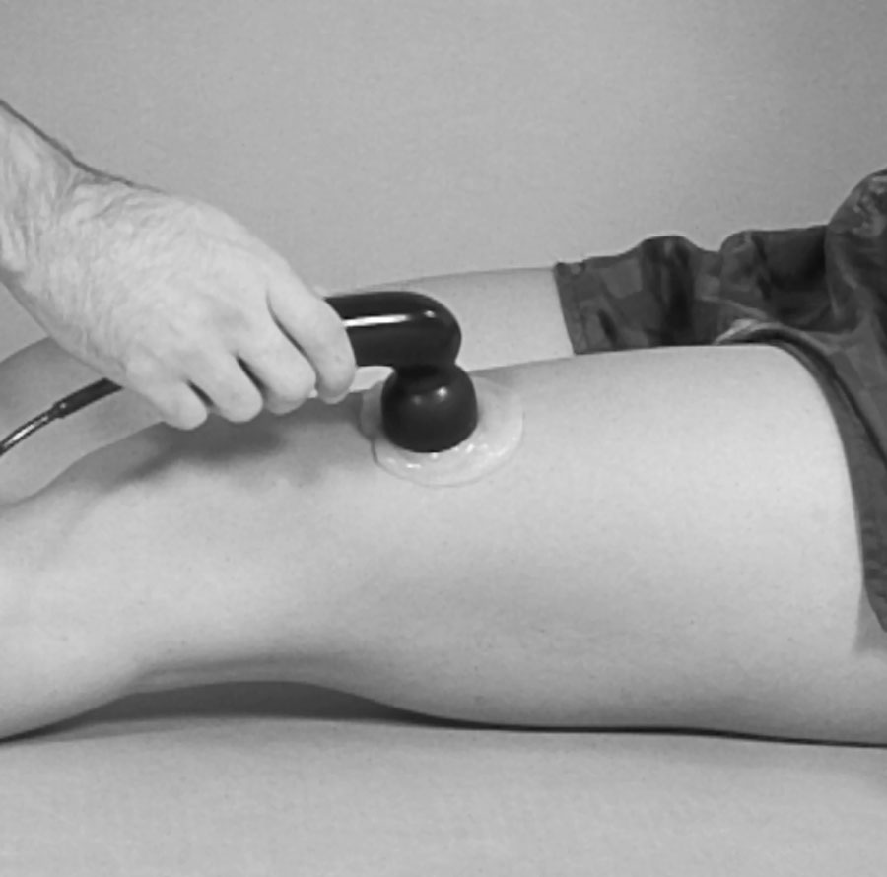

Slide 17
What is the Frequency and Intensity for Ultrasound?
Frequency range between _____ and _____ MHz
______ MHz ultrasound allows for deeper penetration while _____ MHz is absorbed more superficially
Area of transducer that produces sound is the effective radiating area
Intensity is measured or delivered in (W/cm²).
Non-thermal Ultrasound= ___________

Slide 18
What is the Frequency and Intensity for Ultrasound?
Frequency range between .75 and 3.0 MHz
1 MHz ultrasound allows for deeper penetration while 3 MHz is absorbed more superficially
Area of transducer that produces sound is the effective radiating area
Intensity is determined by amount of energy delivered to the sound head (W/cm²)
Non-thermal Ultrasound= under .2 W/cm²

Slide 19
Ultrasound Application to the Skin
What are the 3 methods or techniques to use the Ultrasound?

Slide 20
Ways to Apply the Ultrasound Machine to the Skin.
Application
Direct skin application
Underwater application
Used for irregularly shaped structures
Body part is submerged in water
Bladder technique
Used when body part can not be immersed in water
Balloon filled w/ gel or water

Slide 21
How fast do you move the Ultrasound?
Moving the transducer
Should be moved at a rate of _______ cm/sec
Must maintain contact of transducer with surface of skin
Circular or stroking patterns should be used

Slide 22
How fast do you move the Ultrasound?
Moving the transducer
Should be moved at a rate of 4cm/second
Must maintain contact of transducer with surface of skin
Circular or stroking patterns should be used

Slide 23
Treatment Time and Contraindications
Time
Duration tends to last ________ minutes
Contraindications
???

Slide 24
Treatment Time and Contraindications
Time
Duration tends to last 5-10 minutes
Contraindications
Be careful with anesthetized areas, reduced circulation
Avoid high fluid regions of the body, acute injuries, and epiphyseal areas of children

Slide 25
Electrical Muscle Stimulator
_____________________ is applied to nerve tissue at certain intensities and duration to reach tissue excitability thresholds resulting in membrane depolarization

Slide 26
Electrical Muscle Stimulator
Electricity is applied to nerve tissue at certain intensities and duration to reach tissue excitability thresholds resulting in membrane depolarization
Target sensory, motor, and pain nerve fibers in an effort to produce specific physiological effects

Slide 27
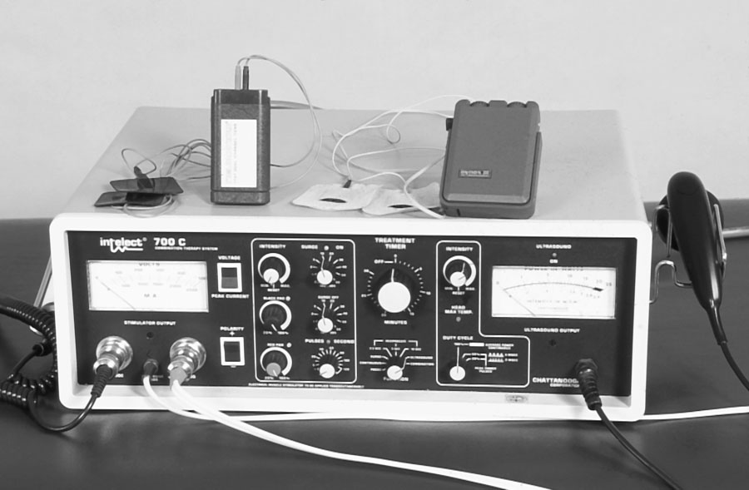

Slide 28
Types of E-stim and its Purpose
Electrical Stimulating Units
Three types of units
Purpose for using E-stim

Slide 29
Types of E-stim and Purpose
Electrical Stimulating Units
Three types of units
TENS - transcutaneous electrical nerve stimulators
NMES/EMS - neuromuscular electrical stimulators or electrical muscle stimulators
MENS/LIS – micro-current electrical nerve stimulators or low-intensity stimulators
Purpose for using E-stim
Useful in pain modulation and muscle contractions

Slide 30
Ultrasound Indications and Treatment TIme
Indications
Treatment Time = __________ minutes

Slide 31
Ultrasound Indications and Treatment Times
Indications
Pain Modulation- 80 pps
Muscle Contraction-20-60 pps
Muscle pump
Muscle strengthening
Retardation of atrophy
Muscle re-education
Treatment time 15-20 minutes and repeated multiple times over the course of a week

Slide 32
Why Massage???

Slide 33
Why Massage???
Encourage lymph drainage
Stretch superficial scar tissue
Stretch connective tissue (friction massage)
Increase circulation – due to increased metabolism
Relaxation

Slide 34
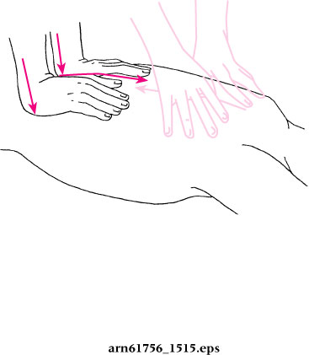
Massage Strokes- What technique is used First?

Slide 35
Massage Strokes- What technique is used First?
Effleurage
Stroking divided into light and deep

Slide 36
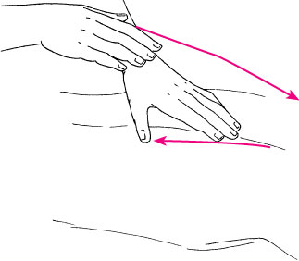
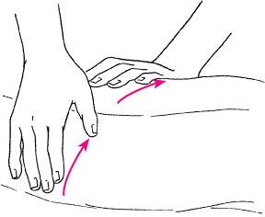
Effleurage

Slide 37
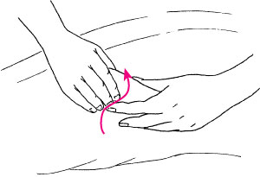
What massage technique involves Kneading?

Slide 38
What massage technique involves Kneading?
Petrissage
Involves picking up skin between thumb and forefinger, rolling and twisting in opposite directions

Slide 39
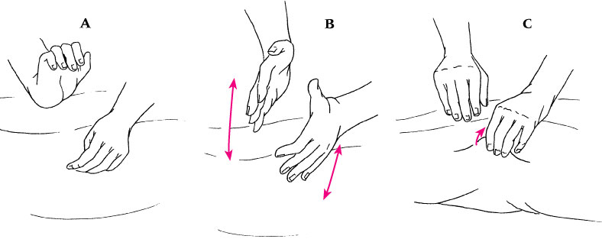
What type of Massage Technique is this?

Slide 40
Tapotement
Cupping
Hacking
Pinching

Slide 41
Guidelines for Massage
Make the athlete comfortable
Develop confident, gentle approach to massage
Stroke towards heart to enhance lymphatic and venous drainage
Know when to avoid massage
Acute conditions and skin conditions

