Slide 1
Muscles of the Elbow, Wrist, and Hand

Slide 2
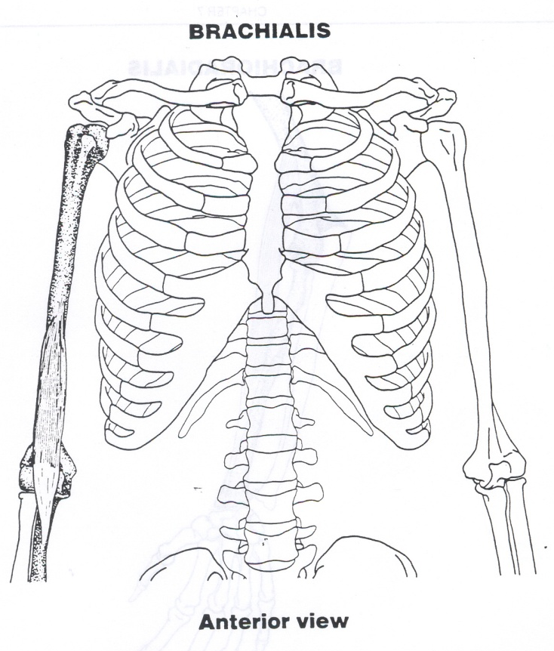
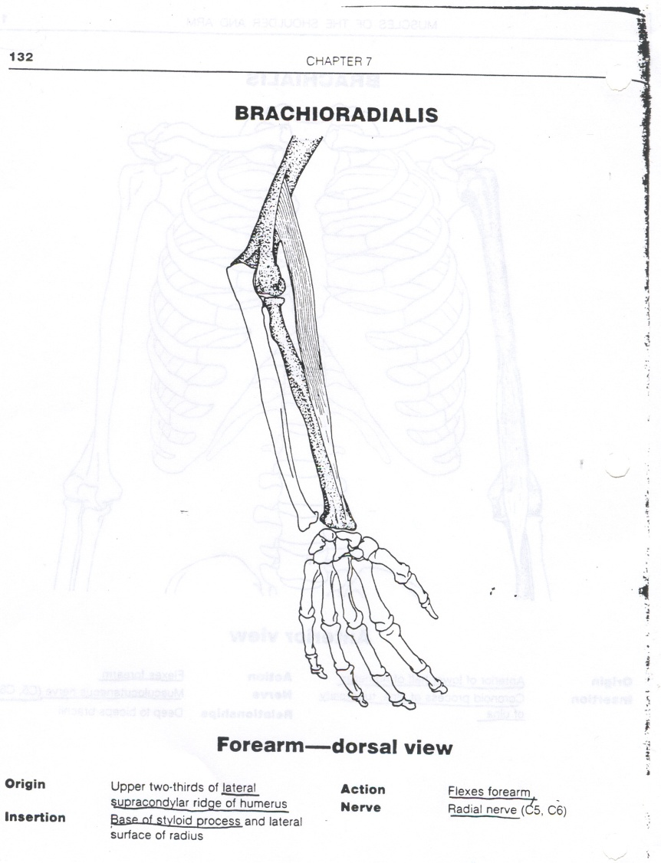
Flexes Forearm/Elbow

Slide 3
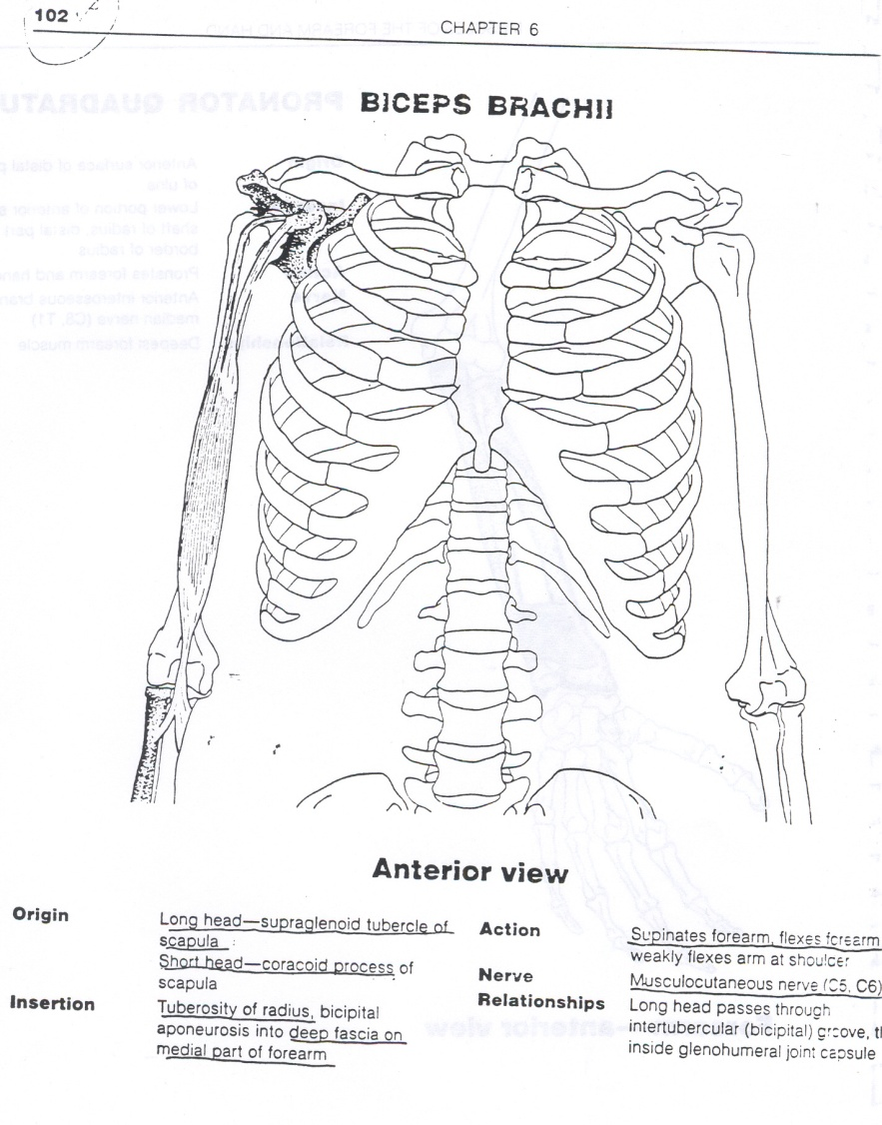
Flexion and Supination of the Elbow/Forearm

Slide 4
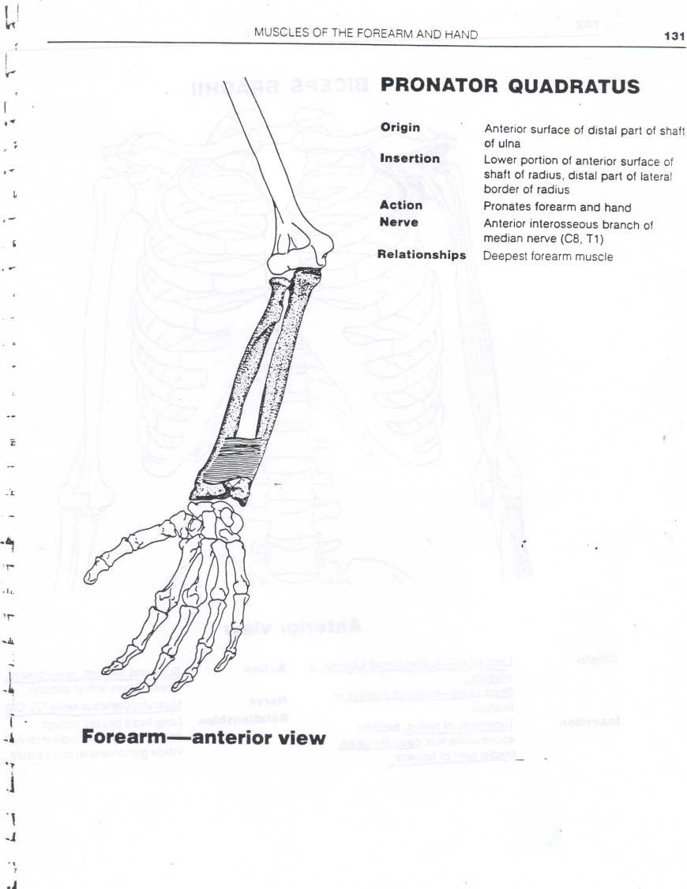
Pronation
Pronator Quadratus

Slide 5
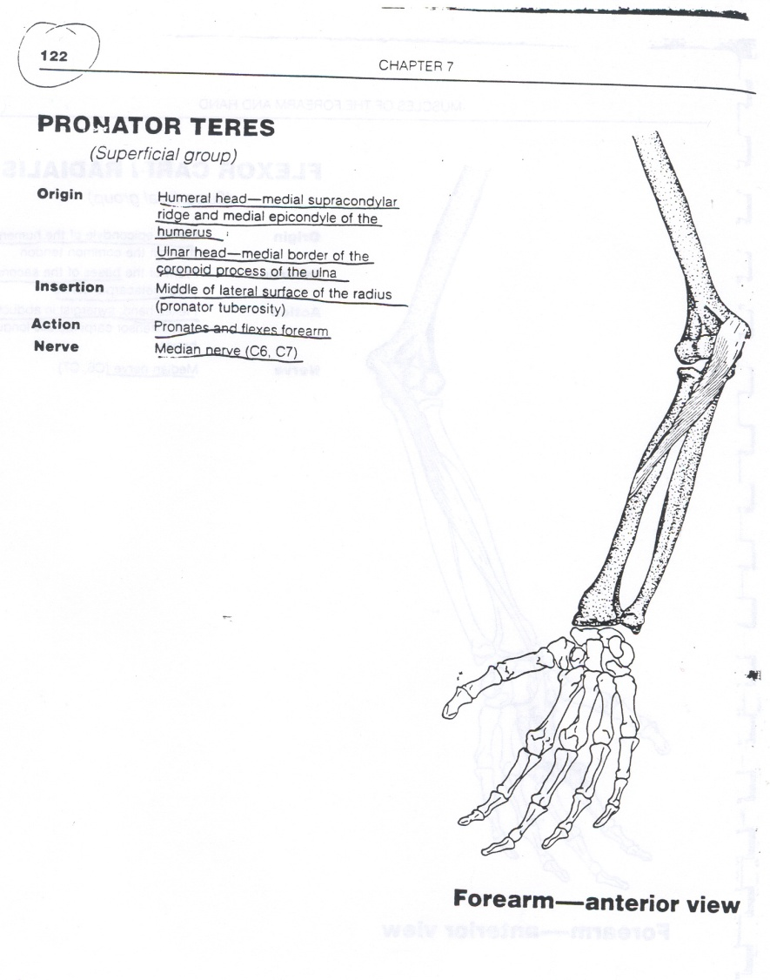
Pronates and Flexion of the Elbow
Pronator Teres

Slide 6
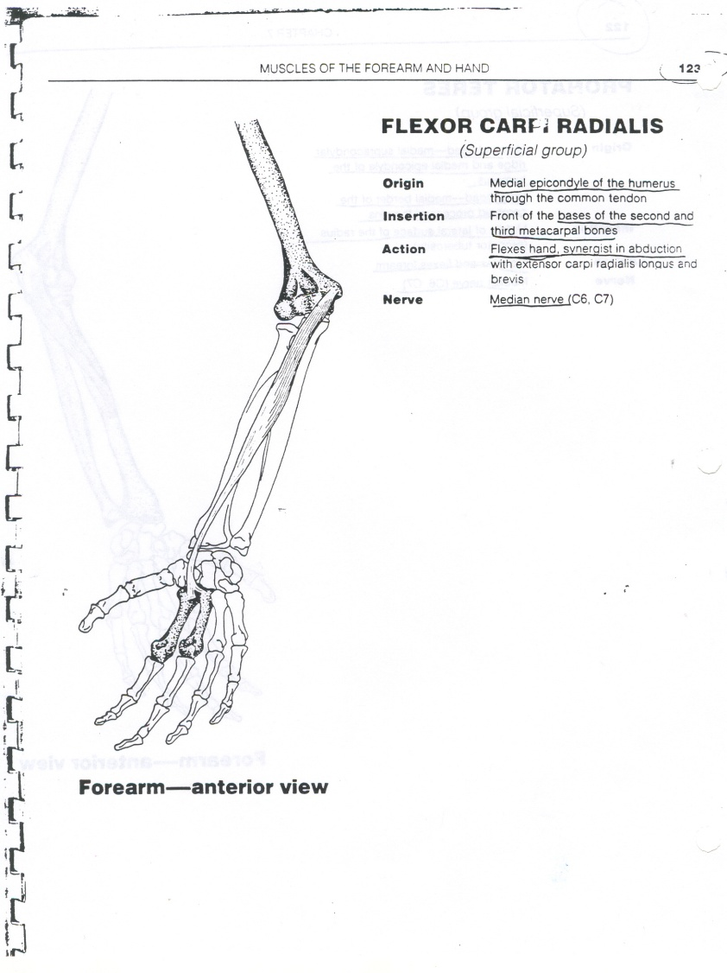
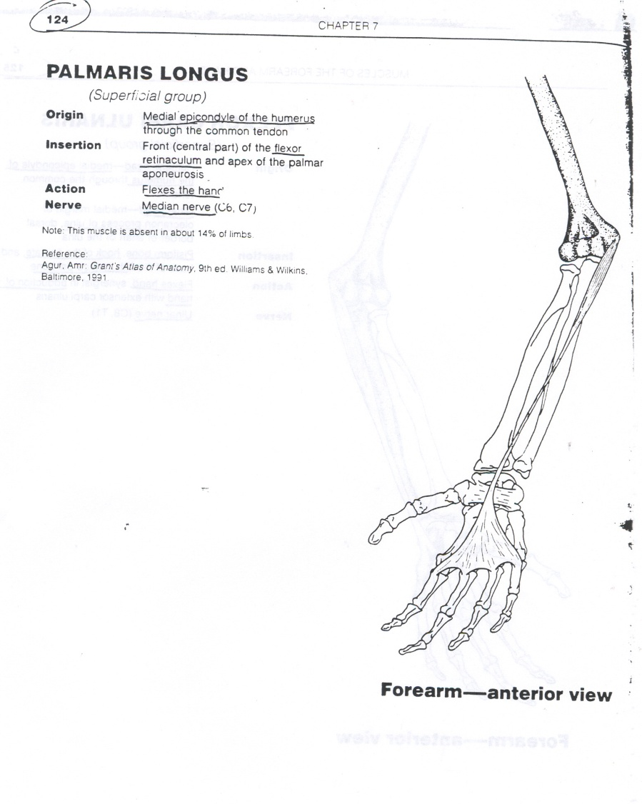
Flexion of Wrist/Hand
Flexor Carpi Radialis
Palmaris Longus

Slide 7
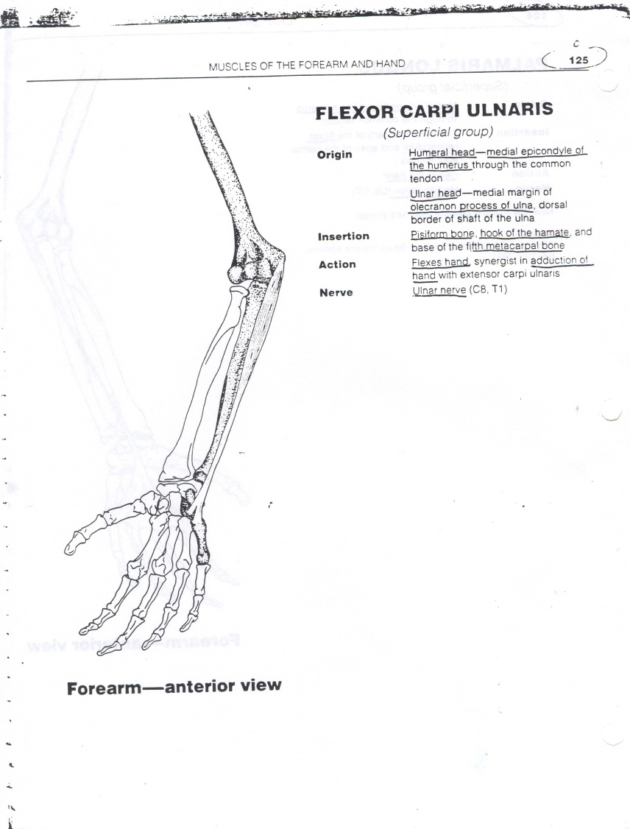
Flexion of Wrist/Hand
Flexor Carpi Ulnaris

Slide 8
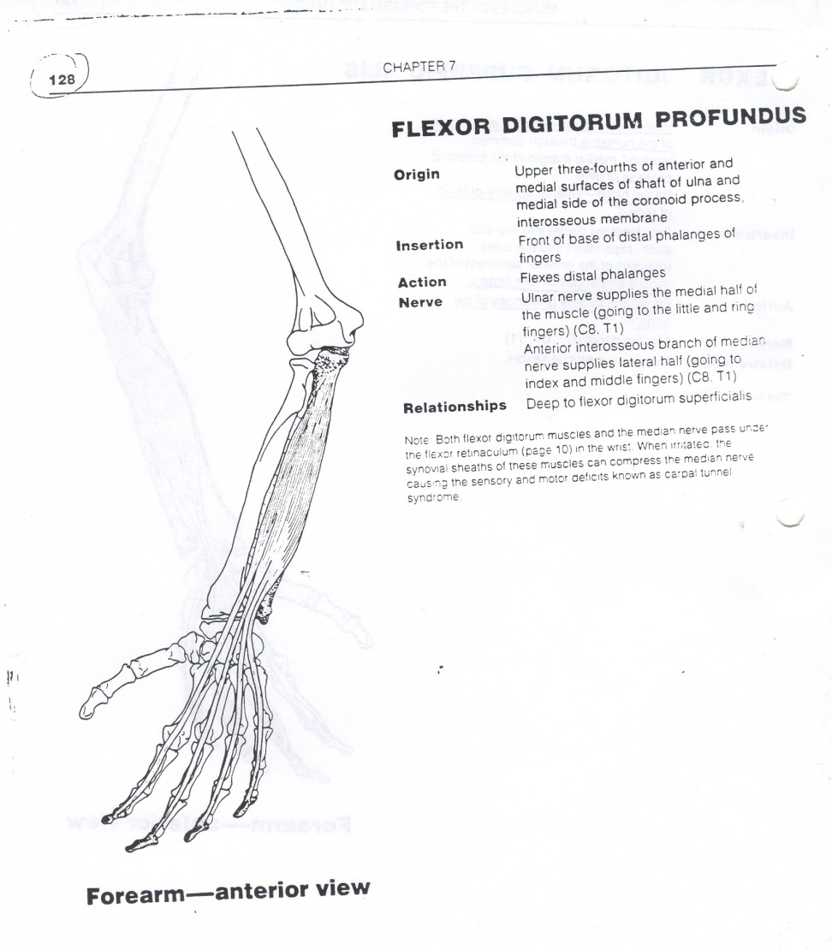
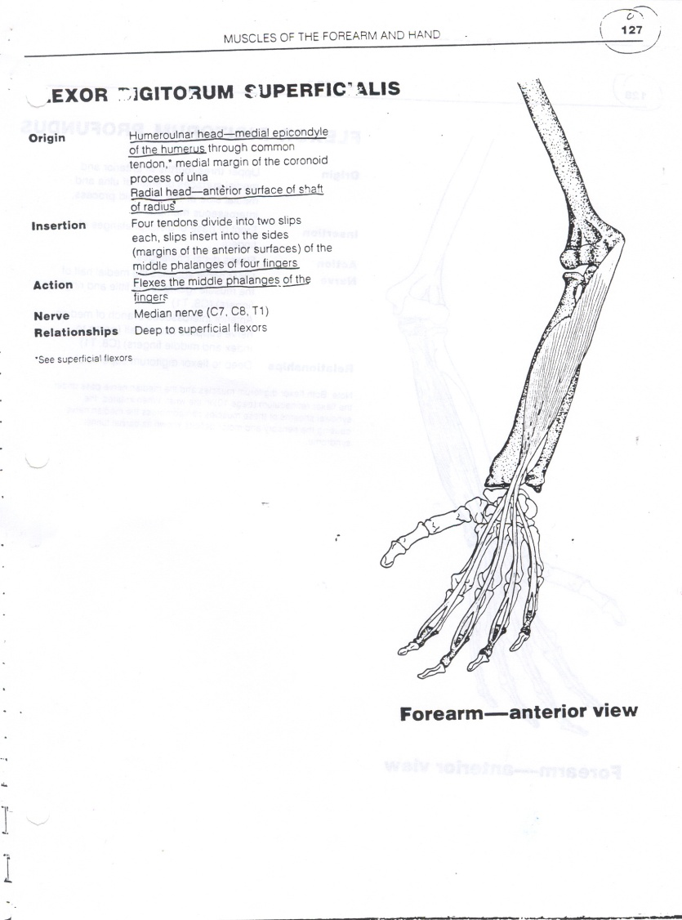
Flexion of the FINGERS
Flexor Digitorum Profundus
Flexor Digitorum Superficialis

Slide 9
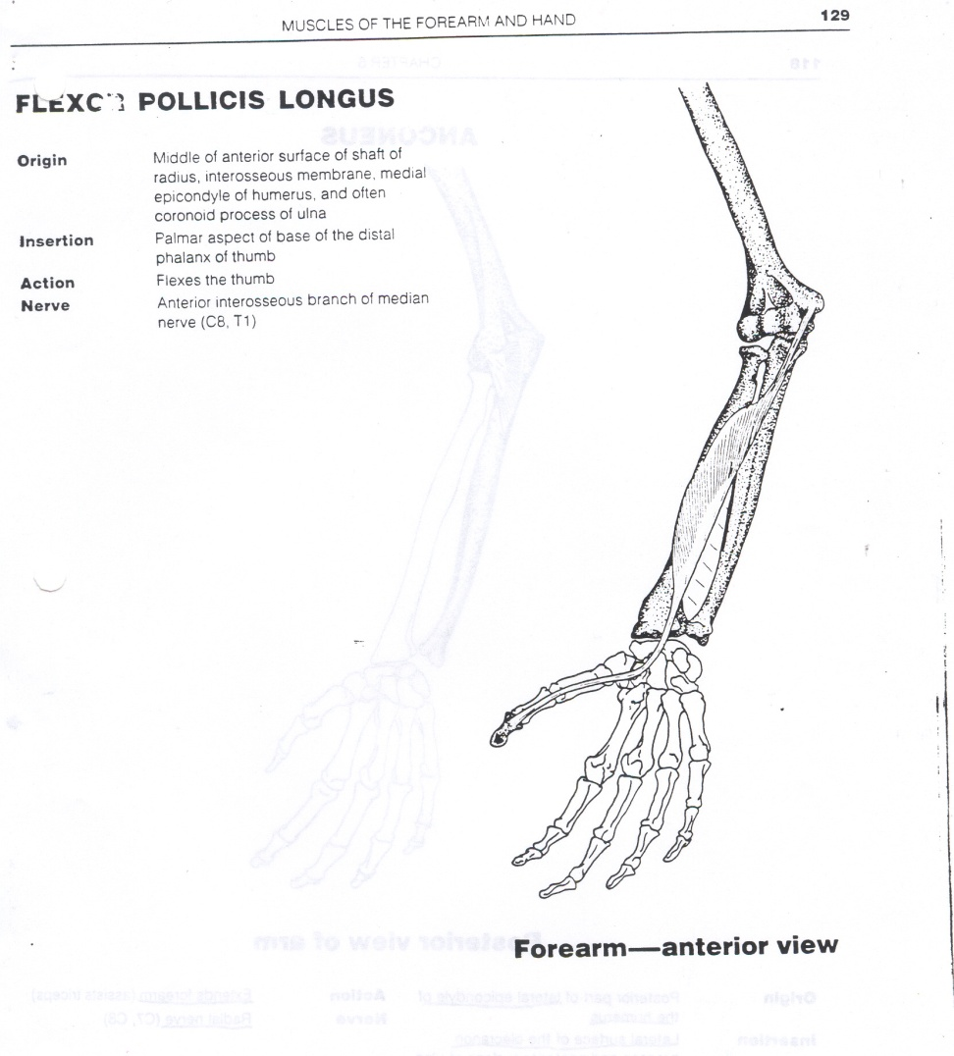
Flexion of the THUMB
FLEXOR POLLICIS LONGUS

Slide 10
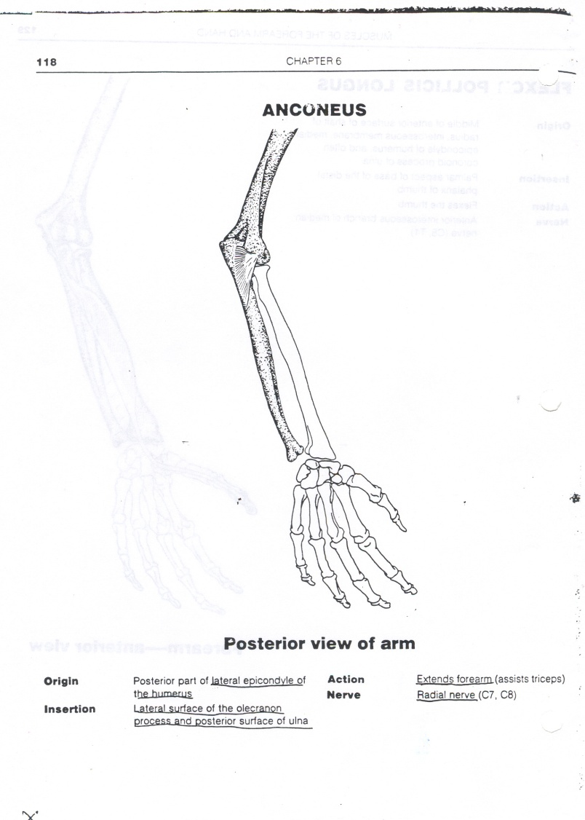
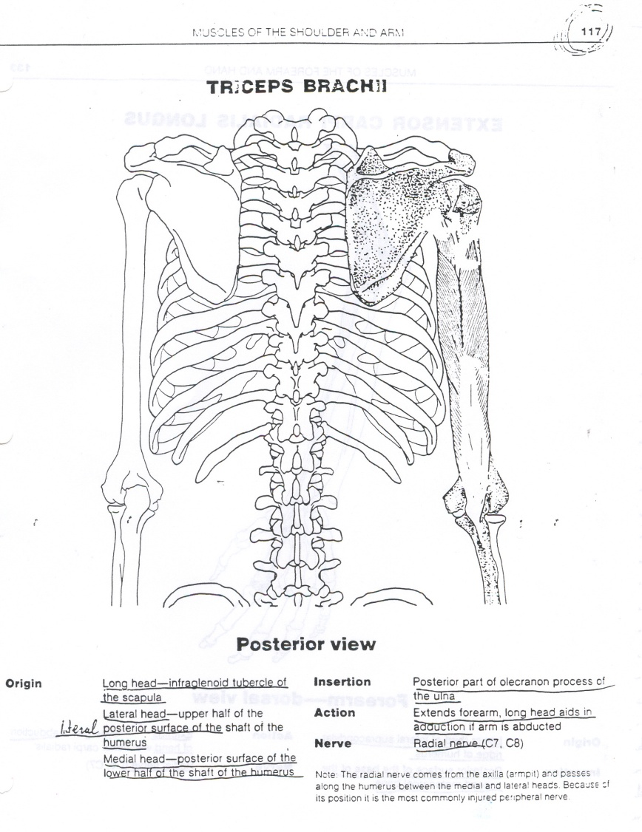
Extends Elbow

Slide 11
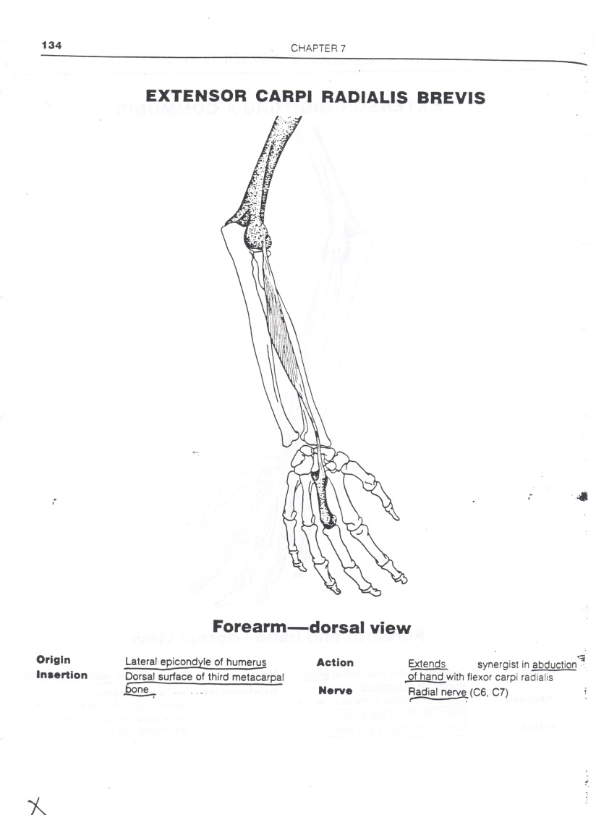
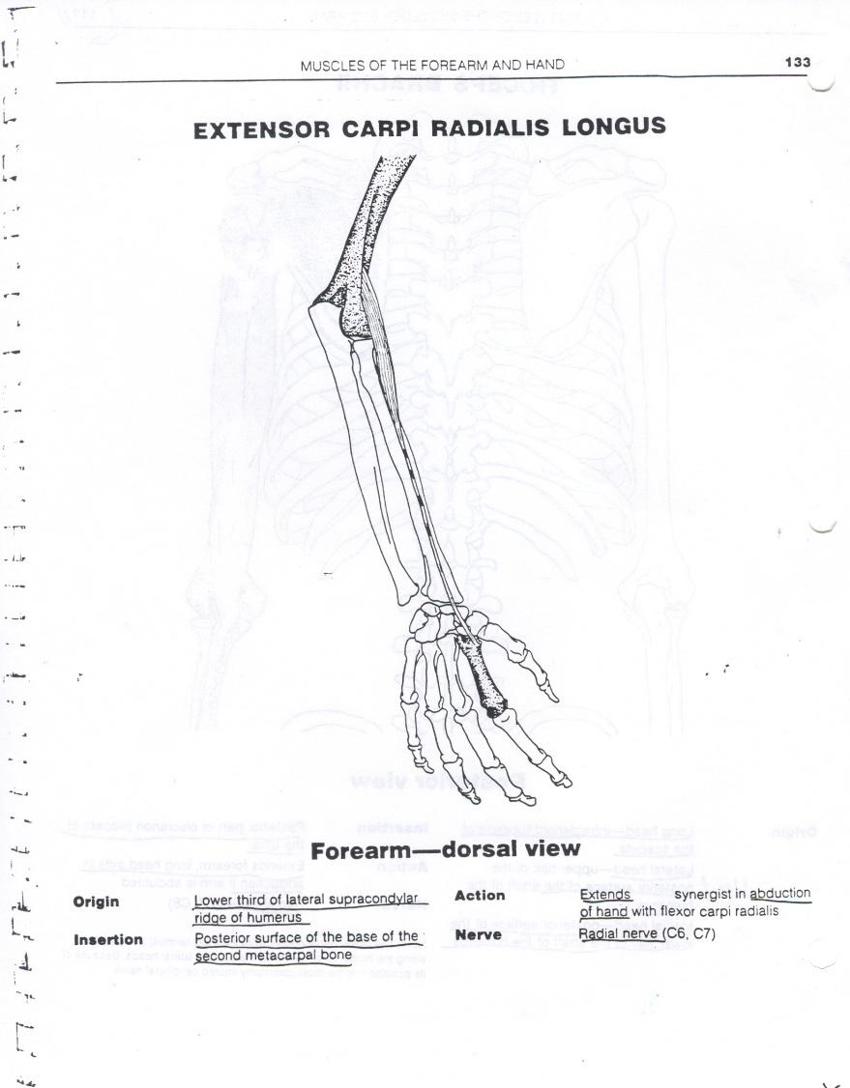
Extends Wrist and Radial Deviation

Slide 12
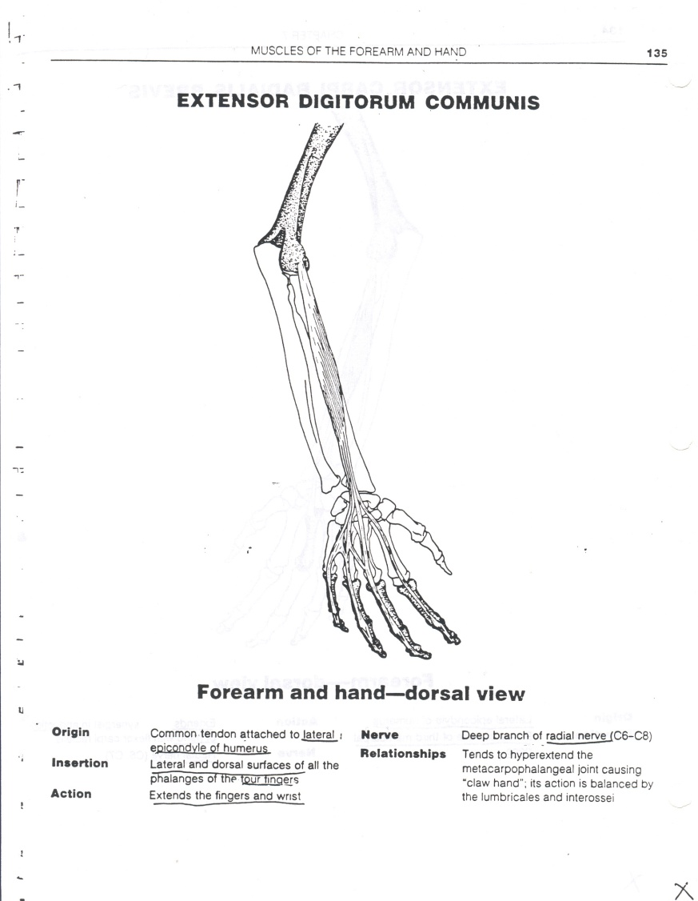
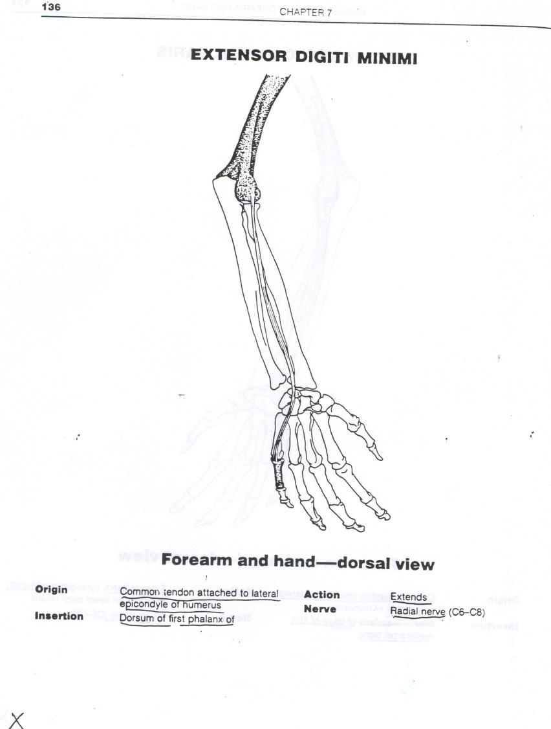
Extends Fingers

Slide 13
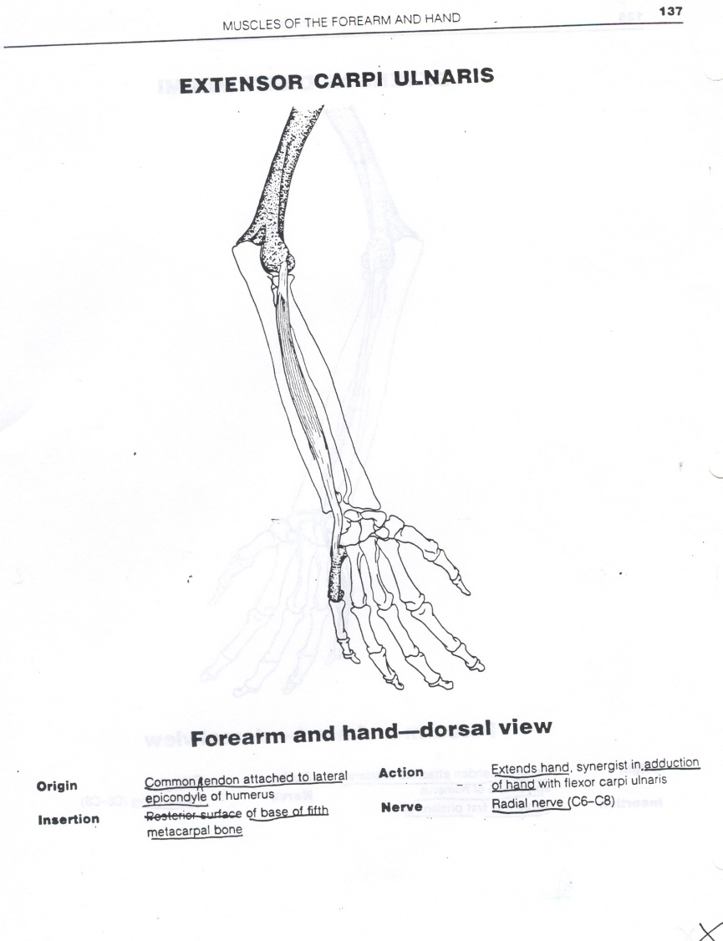
Extends Wrist

Slide 14
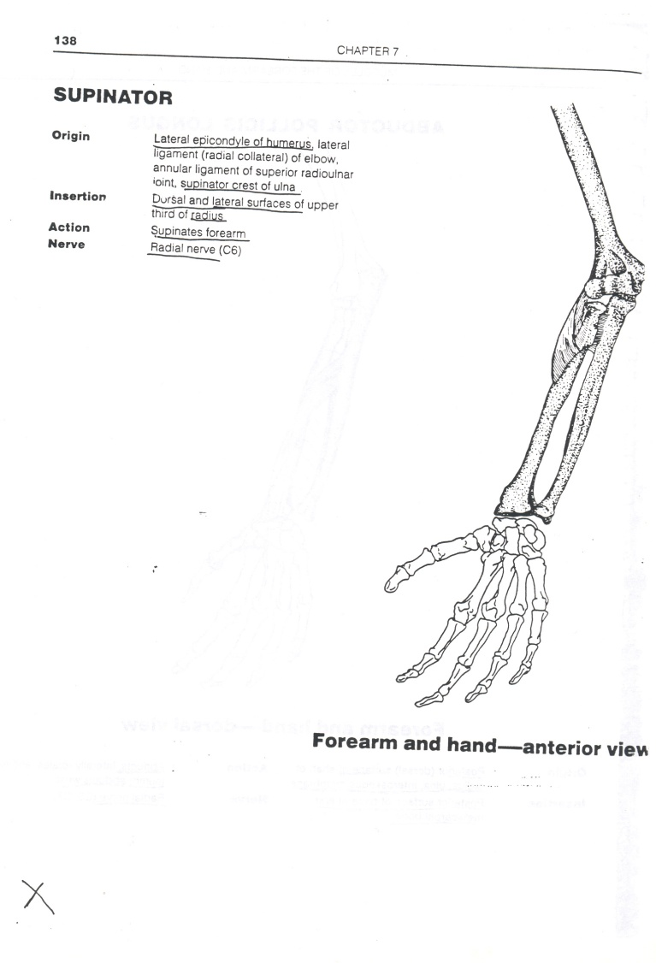
Supinates Wrist/Forearm
SUPINATOR

Slide 15
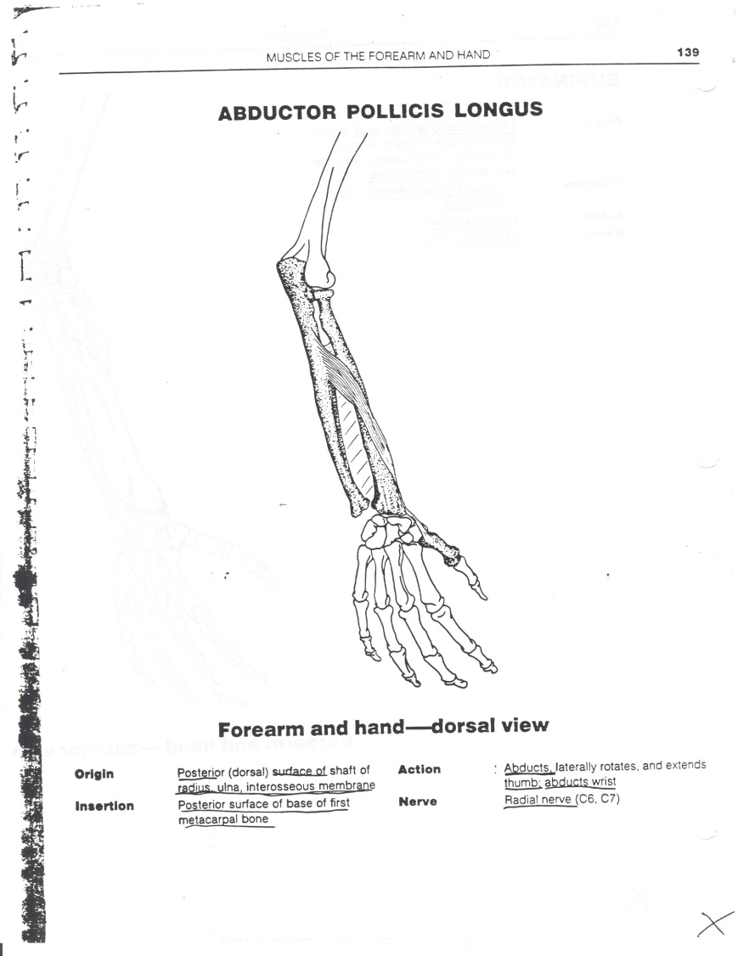
Abduction of the THUMB

Slide 16
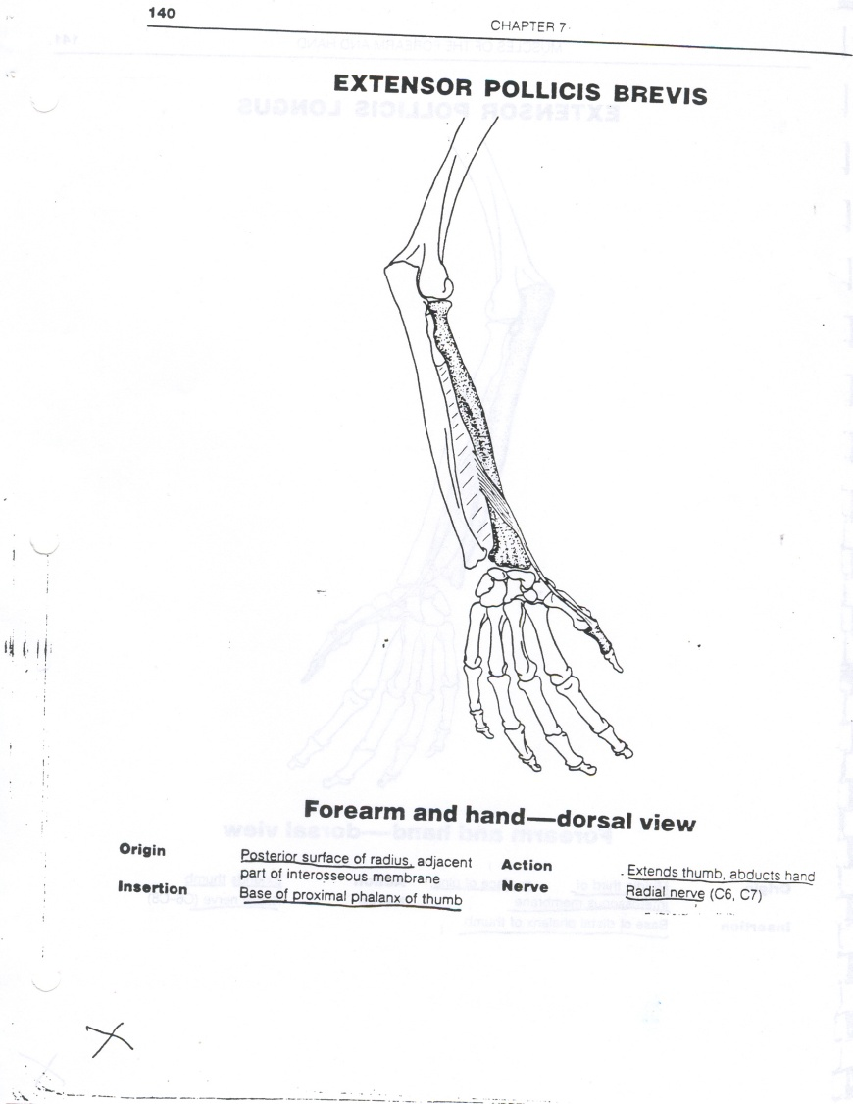
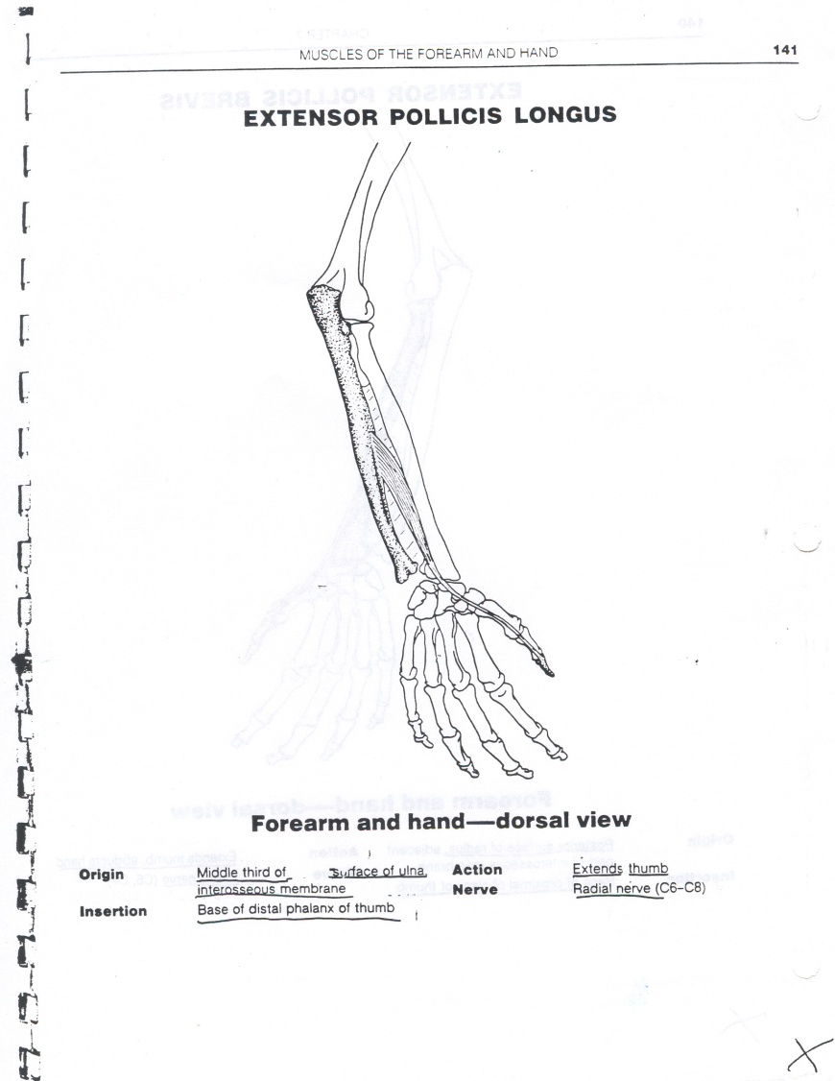
Extension of the THUMB

Slide 17
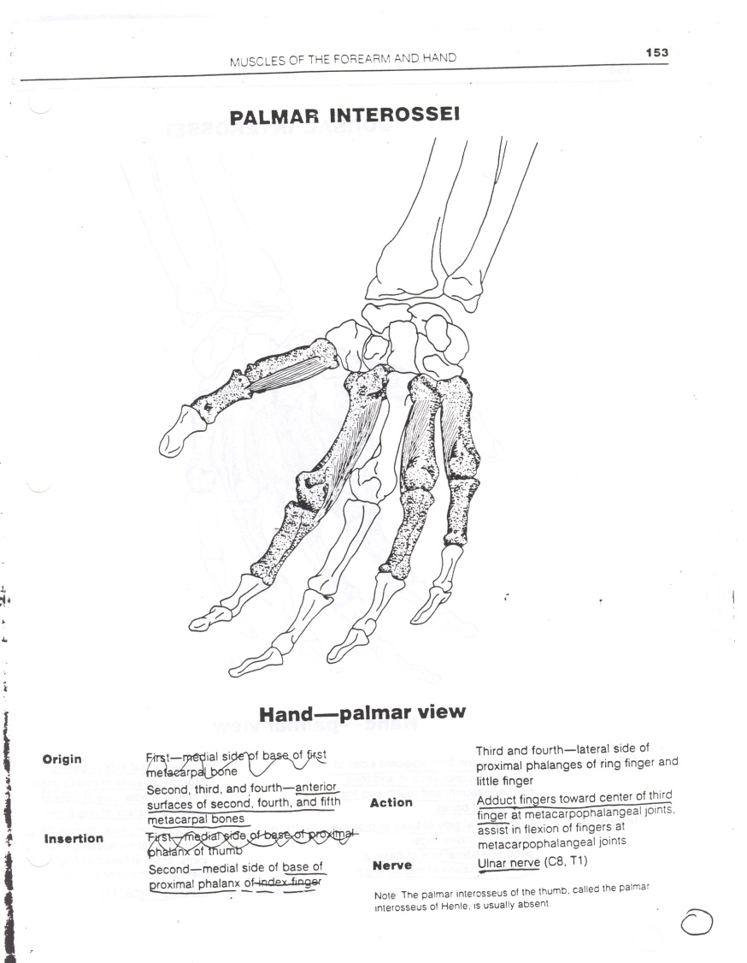
Finger Adduction (PAD)

Slide 18
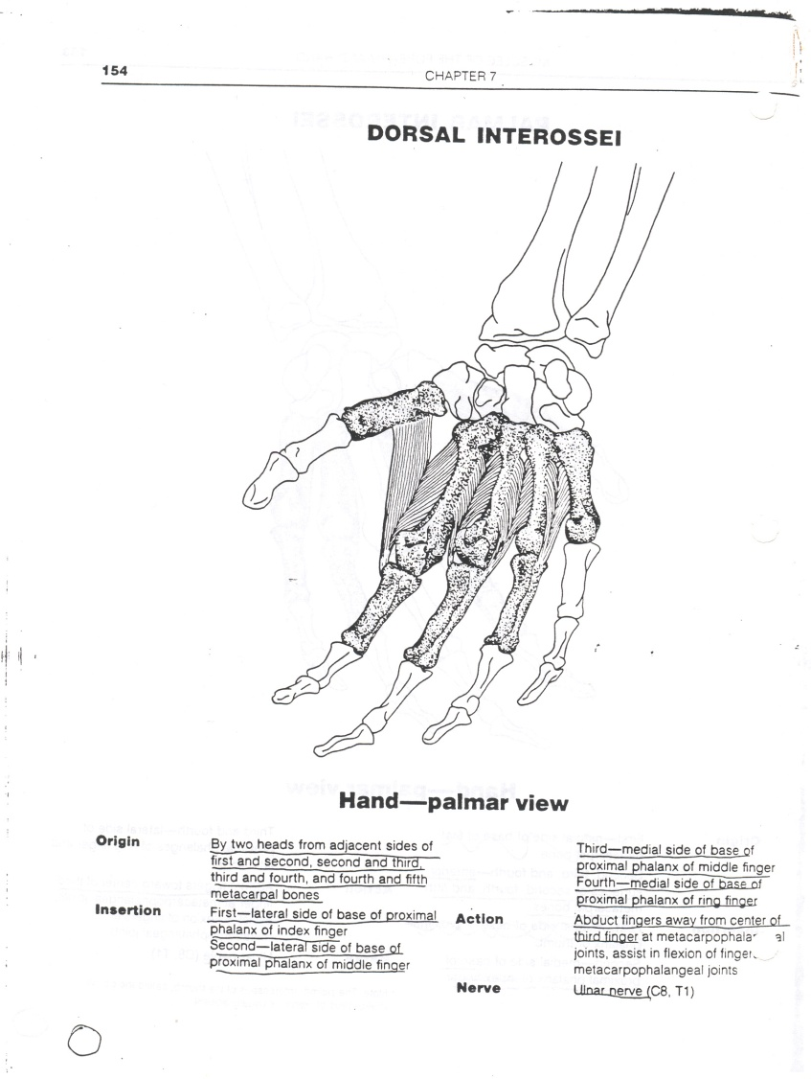
Finger Abduction (DAB)

