Slide 1
Muscles of the Shoulder

Slide 2
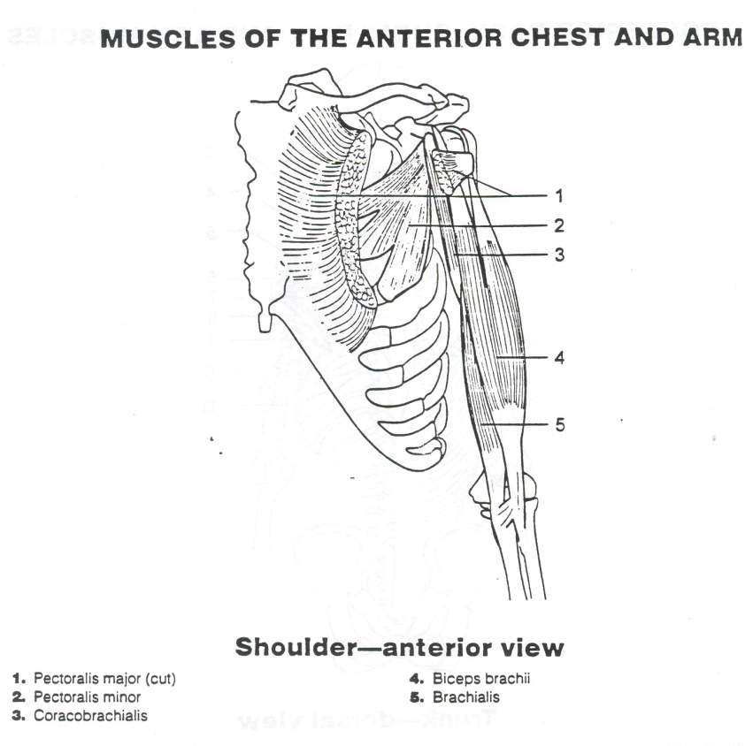
Anterior Muscles
Biceps Brachii- FLEX
Coracobrachialis-FLEX/ADD
Pectoralis Major- FLEX/horizontal ADD/IR
Pectoralis Minor- Depression/Draws Scapula Forward (Protraction)/Raises Ribs (Inspiration)
Deltoideus- FLEX/IR/ABD/Ext/ER

Slide 3
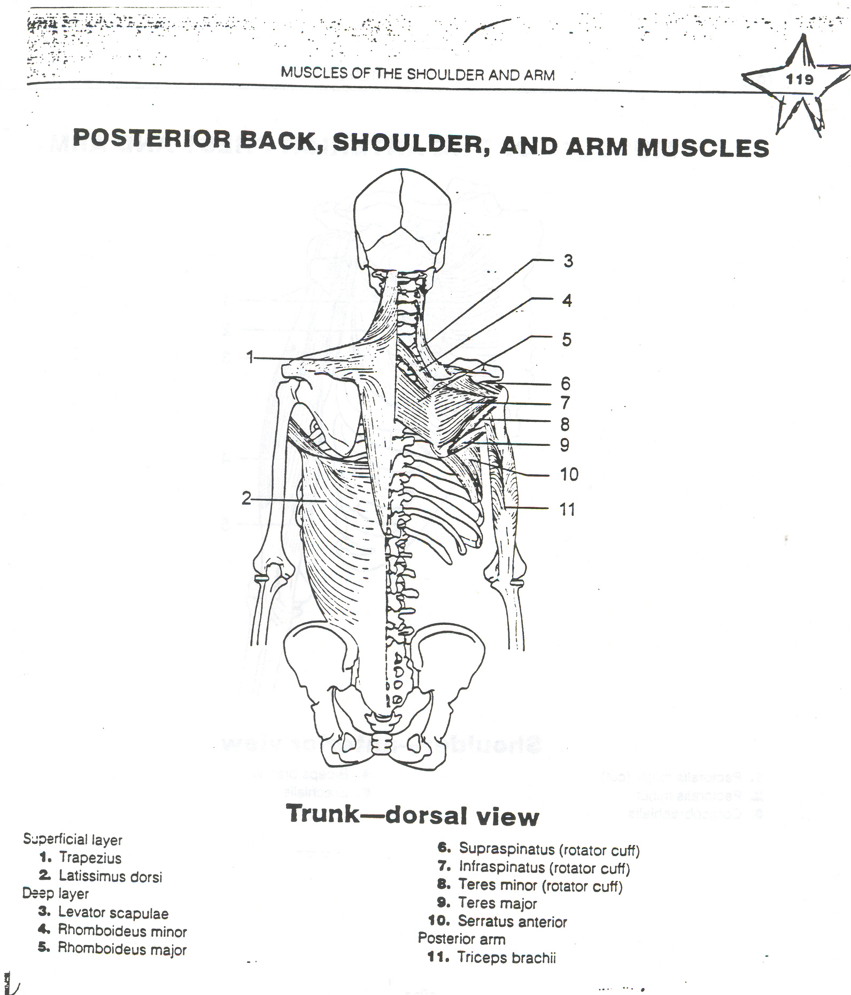
Rotator Cuff Muscles
Supraspinatus- ABD
Infraspinatus- ER
Teres Minor- ER
Subscapularis- IR

Slide 4
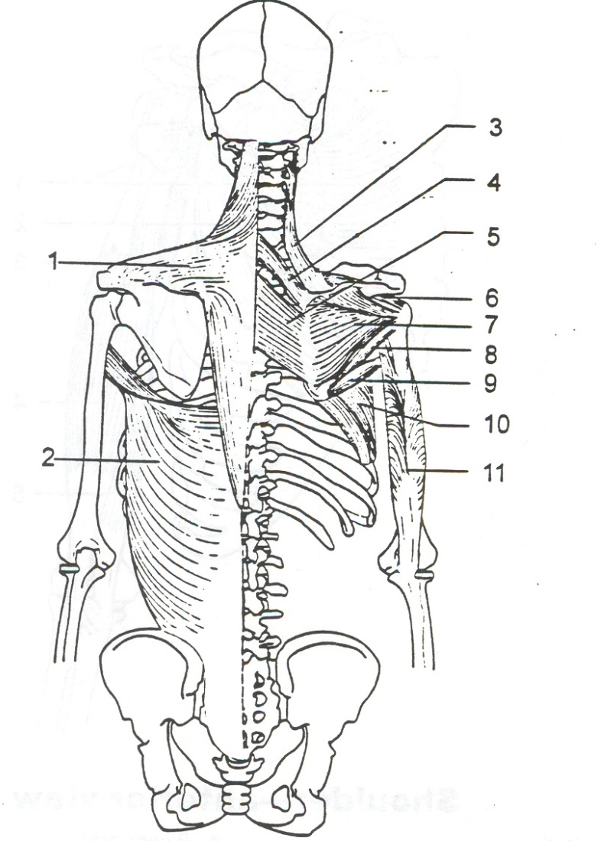
Posterior Muscles
Levator Scapulae-elevation
Triceps-EXT
Rhomboid Major-retraction/downward rotation
Rhomboid Minor-retraction/downward rotation
Latissmus Dorsi-EXT/ADD/IR
Teres Major-EXT/ADD/IR
Serratus Anterior-Upward Rotation/Protraction/FLEX
Trapezius-Elevation/Upward Rotation/Retraction/Depression/Downward Rotation

