Slide 1
Regaining Balance

Slide 2
Regaining Balance
Involves complex integration of muscular forces, neurological sensory information from mechanoreceptors and biomechanical information
Balance - positioning center of gravity (CoG) w/in the base of support

Slide 3
Balance
If CoG extends beyond this base, the limits of stability have been exceeded and a corrective step or stumble will be necessary to prevent
Even when “motionless” body is constantly undergoing constant postural sway w/ reflexive muscle contractions which correct and maintain dynamic equilibrium in an upright posture

Slide 4
Balance
When balanced is challenged the response is reflexive and automatic
The primary mechanism for controlling balance occurs in the joints of the lower extremity
The ability to balance and maintain it is critical for athletes

Slide 5
How Balance relates to Neuromuscular Control
If an athlete lacks balance or postural stability following injury, they may also lack proprioceptive and kinesthetic information or muscular strength which may limit their ability to generate an adequate response to disequilibrium

Slide 6
A rehabilitation plan must incorporate functional activities that incorporate balance and proprioceptive training

Slide 7
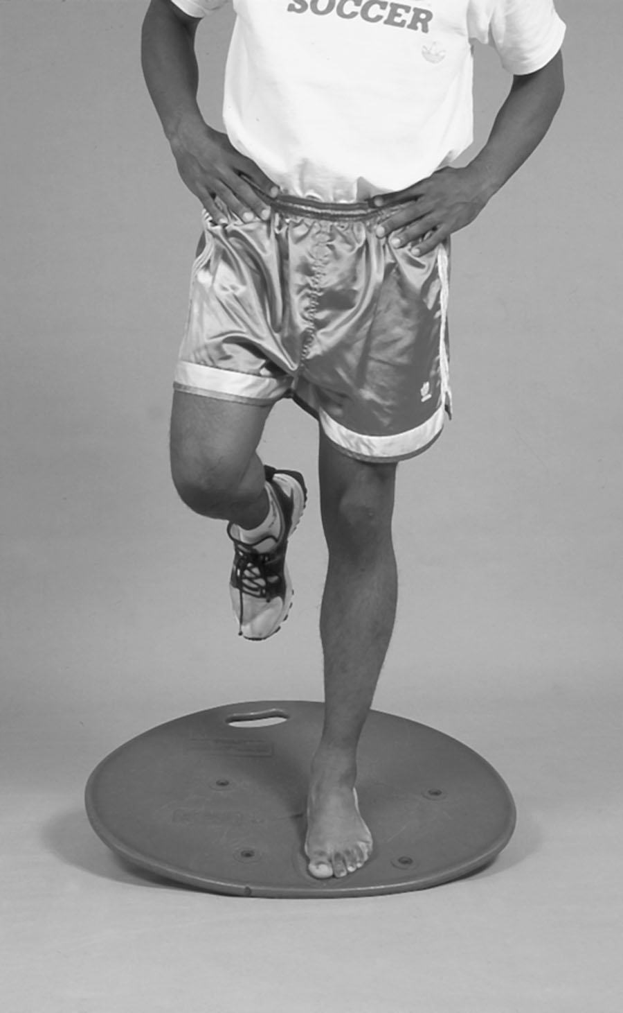
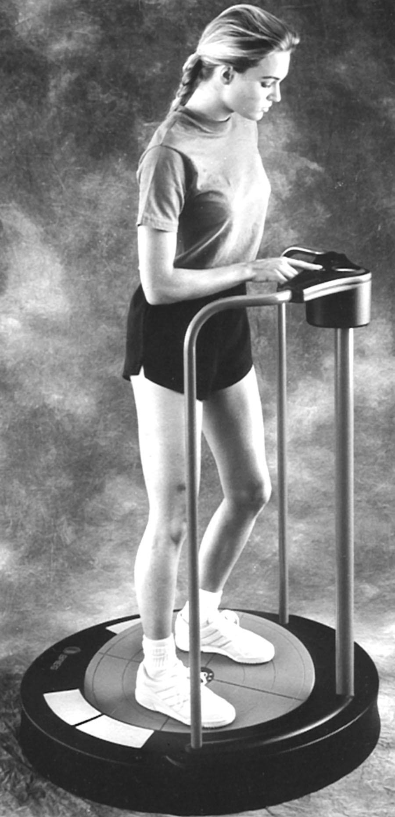
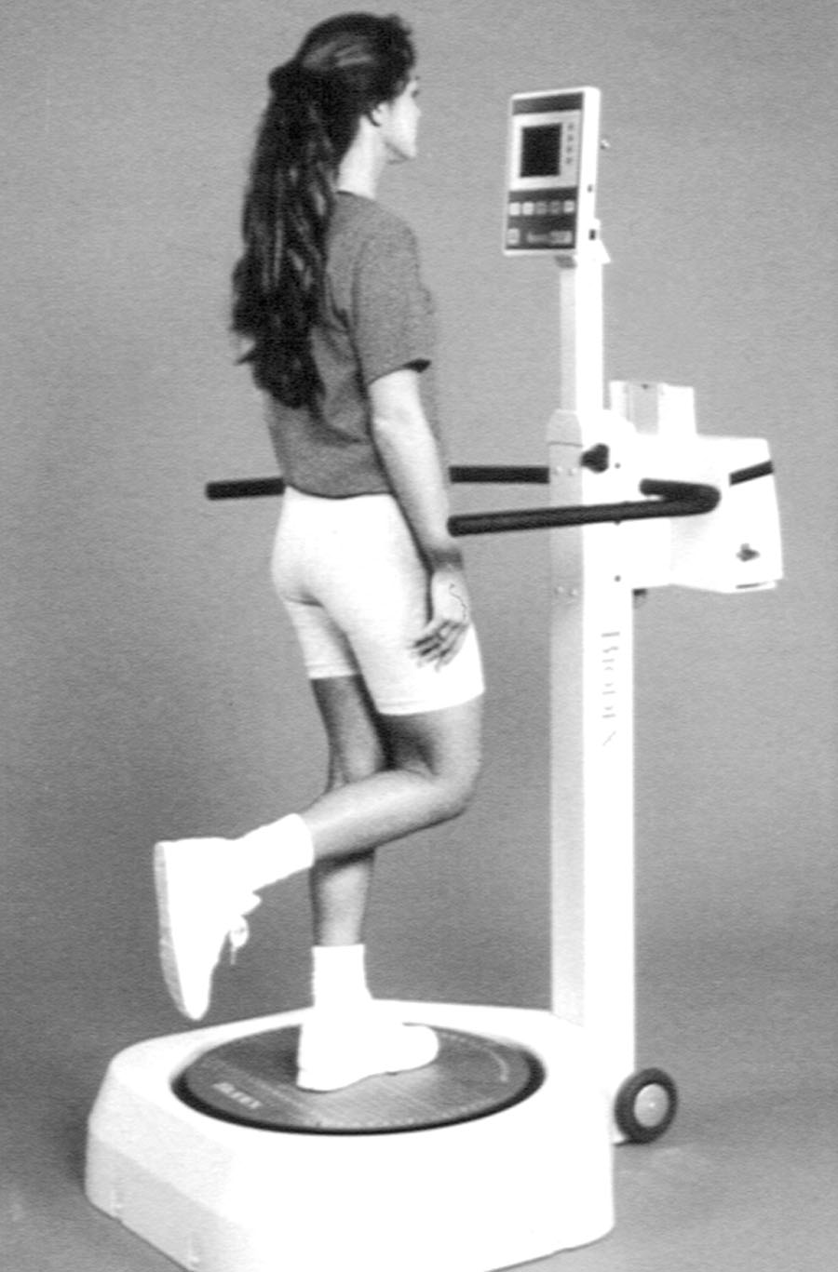
Balance Equipment

