Slide 1
Restoring Muscular Strength, Endurance, and Power

Slide 2
Muscle Strength, Power, and Endurance
Muscular strength: ability to generate force against resistance
Muscular endurance: repetitive muscular contractions (increase strength = increase endurance
Power: the relationship between strength and time

Slide 3
Muscle Contractions
Isometric contraction
No length change occurs during contraction
Concentric- shortening of muscle with contraction in an effort to overcome more resistance
Eccentric - lengthening of muscle with contraction because load is greater than force being produced

Slide 4
Factors that Determine Levels of Muscular Strength
Size of muscle:
Function of diameter and of muscle fibers
Hypertrophy vs. Atrophy
Number of muscle fibers
Neuromuscular efficiency
Initial gains are due to increased efficiency
More effectively engage specific motor units
Biomechanical factors
Bones and muscles = Levers and pulleys

Slide 5
Fast-Twitch vs. Slow-Twitch Muscle Fibers
Motor units with distinct metabolic and contractile capability
Individual make-up
Muscles contain both types of fibers
Muscle functioning impacts ratios (postural vs. powerful movement)
Genetically determined
Slow twitch (Type I):
Generally major constituent of postural muscles
Fast twitch (Type II)
High force in short amount of time
Produce powerful movements

Slide 6
Levels of Physical Activity
Will influence increase/decrease in muscle strength
Also impacts cardiorespiratory fitness, flexibility and increases in body fat
Overtraining
Psychological and physiological breakdown
Signs
Apathy, loss of appetite, staleness, declines in performance, weight loss, inability to sleep
Prevent through appropriate training protocol, proper diet, and rest

Slide 7
Resistance Training
Among the most essential factors necessary when restoring function of a body part to pre-injury status
Variety of techniques can be utilized
Isometrics
Progressive resistance-Isotonic
Isokinetics
Plyometrics
Circuit Training
Calisthenic
Emphasize work through a full ROM

Slide 8
Techniques of Resistance Training
SAID Principle (Overload/Progression) must be applied
Specific Adaptation to Imposed Demands
Must work muscle at increasingly higher intensities to enhance strength over time
If intensity of training does not increase, but training continues, muscle strength will be sustained

Slide 9
Isometrics
Performed in early part of rehab following period of immobilization
Used when resistance through full range could make injury worse
Increase static strength, work to decrease/limit atrophy, create a muscle pump to decrease swelling

Slide 10
Isometric Exercise
Contraction where muscle length remains unchanged
Muscle contraction that lasts 10 seconds and should be perform 5-10 times/daily
Pro: quick, effective, cheap, good for rehab
Con: only works at one point in ROM, produces spiking of blood pressure due to Valsalva maneuver

Slide 11
Progressive Resistance Exercise(PRE) or Isotonic Exercise
Can be performed using a variety of equipment
Utilizes isotonic contractions to generate force while muscle changes length
Concentric and eccentric strengthening exercises should be utilized

Slide 12
Progressive Resistance Exercises (Isotonic training)
Shortening/lengthening contractions against fixed resistance
Concentric vs. Eccentric
Various types of equipment can be utilized
(Free weights, machine weight)
Spotter is necessary for free weight training to prevent injury, motivate partner, and instruct on technique

Slide 13
Concentric and eccentric training should be incorporated for greatest strength improvement
Concentric phase of lift should last 1-2 seconds; eccentric phase 2-4 seconds
Variations exist between free and machine weight lifting
Motion restrictions, levels of muscular control required, amount of weight that can be lifted
Equipment design, varying resistances

Slide 14
When training should be able to perform 3 sets of 6-8 repetitions
Increases should occur in increments of 10%
Training of a particular muscle group should occur 3-4 times per week (not on successive days)

Slide 15
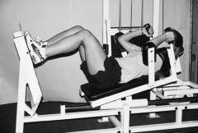
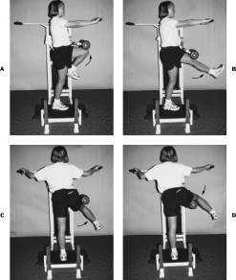
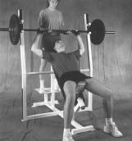
Progressive Resistance Exercises

Slide 16
Muscular Endurance vs. Strength
Training for endurance enhances strength and vice versa
Training for strength should involve lower repetitions at heavier weight
Training for endurance requires lower weight at 12-15 repetitions

Slide 17
Open vs. Closed Kinetic Chain Exercises
Anatomical functional relationship for upper and lower extremities
OKC (Open Kinetic Chain)
When foot or hand are not in contact with the ground or supporting surface
CKC (Closed Kinetic Chain)
Foot or hand are weight bearing
Widely used = more functional

Slide 18
Isokinetic Exercise
Incorporated in later stage of rehabilitation process
Uses fixed speeds w/ accommodating resistance to provide maximal resistance throughout ROM
Speed of movement can be altered
Commonly used as part of the criteria for return to functional activity

Slide 19
Isokinetic Training
Muscle contraction at a constant velocity
Maximal and constant resistance throughout the full range of motion
Maximal effort = Maximal strength gains
Rehab
Never widely used in strength training
Losing popularity in rehabilitation settings

Slide 20
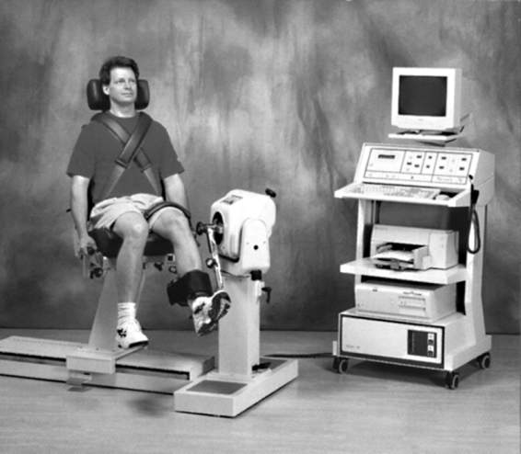

Slide 21
Plyometric Exercise
Incorporated into later stages of program
Use quick stretch of muscle to facilitate subsequent concentric contraction
Useful in production of dynamic movements
Associated with muscular power
Generation of force rapidly – key to successful performance in many activities

Slide 22
Plyometric Exercise
Rapid stretch, eccentric contraction followed by a rapid concentric contraction to create a forceful explosive movement
Rate of stretch vs. magnitude
Jumps, bounds, medicine ball throws
Very technical training - skills must be learned with appropriate technique
Often develop muscle soreness as a result of extensive eccentric loading

Slide 23
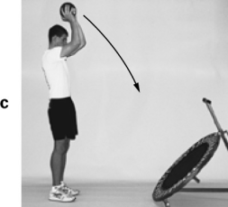
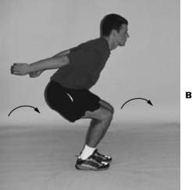
Plyometrics- jumps, hops, skips

Slide 24
Calisthenic Strengthening Exercises
Free exercise
Isotonic training
Gravity’s involvement determines level of intensity
Full range of motion, may incorporate holding phase
Pull-ups, push-ups, back extensions, leg extensions

Slide 25
Circuit Training
Combination of exercise stations
8 - 12 stations, 3 times through
Design for different training goals
Flexibility
Calisthenics
Aerobic exercise

