Slide 1
Shoulder Evaluation
CHAPTER 18
Pages 414-418

Slide 2
H: History
List 10 questions an ATC would ask to evaluate an injured shoulder.

Slide 3
H: History
What happened to cause this pain?
Have you ever had this problem before?
What is the duration and intensity of the pain?
Where is the pain located?
Is there crepitus during movement ?or numbness? or distortion in temperature such as a cold or warm feeling?
Is there a feeling of weakness or a sense of fatigue?
What shoulder movements or positions seem to aggravate or relieve the pain?
Has anything been done to make this feel better? (ice, heat, massage, medication)

Slide 4
O: Observation
List at least 5 signs/symptoms an ATC would look for in a shoulder evaluation.

Slide 5
O: Observation (Anterior)
Are both shoulders even with one another?
Is one shoulder held higher because of muscle spasm or muscle guarding?
Is the lateral end of the clavicle prominent (sticking up)?
Is the lateral acromion process more prominent?
Does the clavicle look deformed?
Is the deltoid muscle deformed?
Is there any indentation in the biceps brachii?

Slide 6
O: Observation (Lateral)
Is there kyphosis in the thoracic spine or are the shoulders slumped forward?
Is there forward or backward arm hang?

Slide 7
O: Observation (Posterior)
Is there asymmetry such as a low shoulder, uneven scapulae, or winging of one scapula and not the other?
Is the scapula protracted because of a constricted pectoral muscle?
Is there a winging scapula on one or both sides?

Slide 8
More things to observe
  Walking with arm swing or leaning toward injured side
  Swelling
  Deformity
  Eccymosis or discoloration
  Heat or warmth
  Crepitus or abnormal sounds at the Shoulder
  Redness
  Feeling or Sensation
  Range of Motion (ROM)
  Areas of Pain and Point Tenderness
  Muscle Atrophy

Slide 9
P: Palpate
List all the structures you can TOUCH on the Shoulder.
  Bones
  Joints
  Ligaments
  Muscles
    Anterior
    Posterior

Slide 10
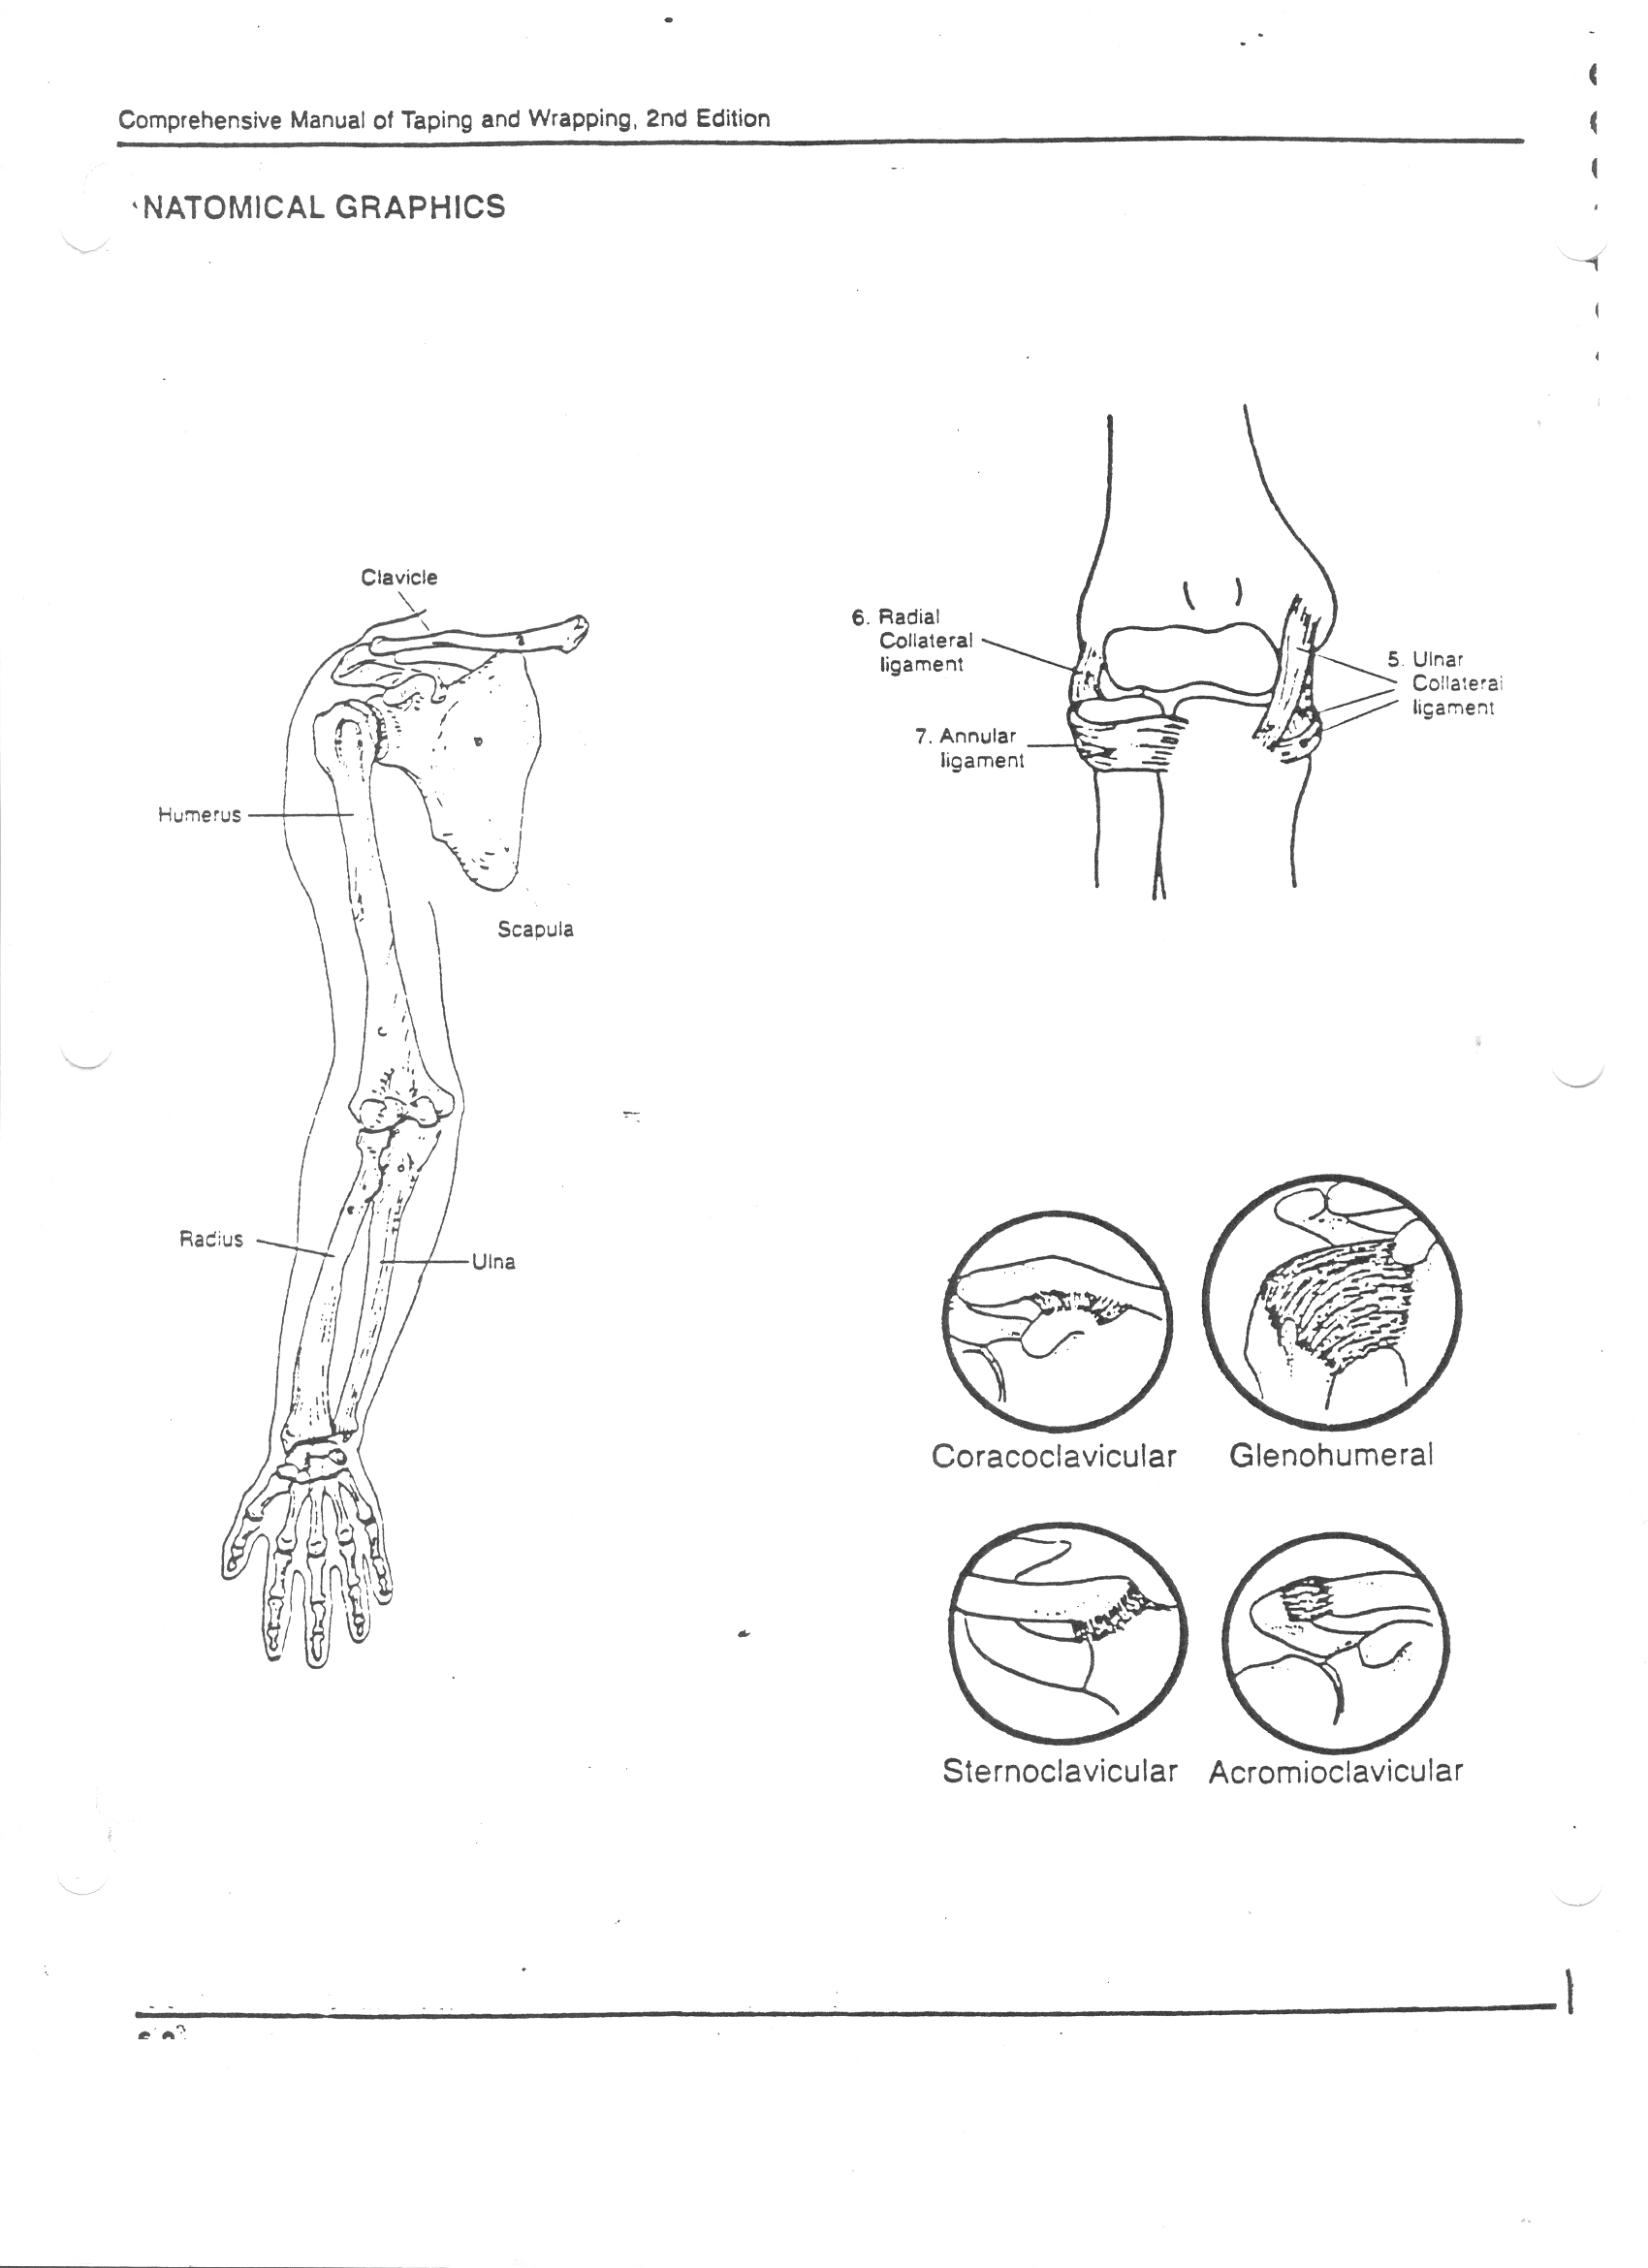
P: Palpation of the Shoulder Joint
Bony Palpation
  Humerus
    Humeral Head
    Epicondyles (Medial and Lateral)
    Bicipital Groove
  Scapula
    Spine
    Acromion Process
    Coracoid Process
    Superior/Inferior Angle
    Medial/Lateral Border
  Clavicle
    SC joint
    AC joint
  Sternum
    Manubrium
    Body
    Xiphoid Process

Slide 11
P: Palpation of the Ligaments of the Shoulder
You can palpate the
  Acromioclavicular Ligament (AC) at the AC joint
  The Sternoclavicular (SC) Ligament at the SC Joint

Slide 12
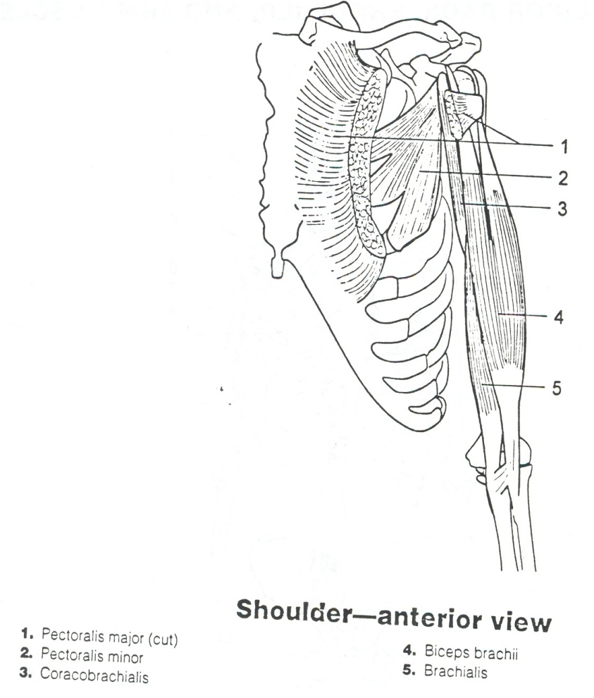
P: Palpation of the Shoulder Muscles
You can palpate the following Muscles of the Anterior Chest, Arm, and Shoulder.
  Pectoralis Major
  Biceps Brachii
  Coracobrachialis
  Deltoideus

Slide 13
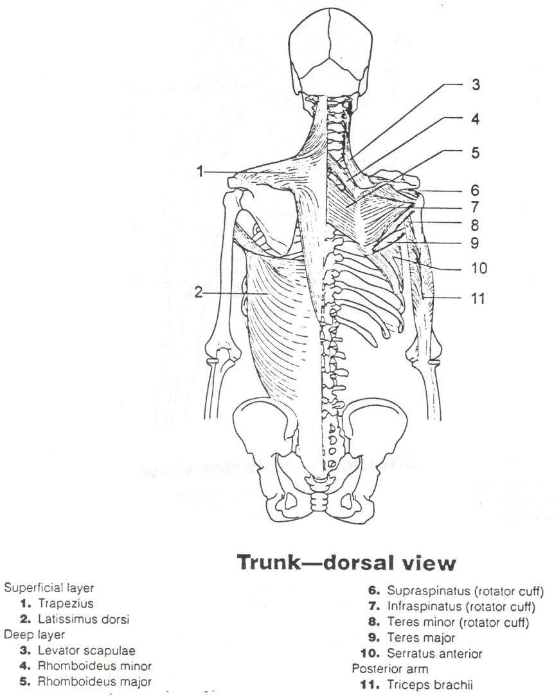
P: Palpation of the Shoulder Muscles
You can palpate the following Muscles of the Posterior Back, Shoulder, and Arm.
  Trapezius
  Supraspinatus
  Infraspinatus
  Rhomboideus Major/Minor
  Latissmus Dorsi
  Triceps

Slide 14
S: Special Test
Special Tests Include:
  Range of Motion (ROM)
  Manual Muscle Tests (MMT)
  Special Tests
  Functional Tests

Slide 15
S: Special Tests
(Anterior Muscles-AROM/PROM)
1 | 2 | 3 | 5
Flexion At Elbow-Supination and Flexion | Adduction Flexion At Elbow-Pronation | Flexion Horizonal Adduction Internal Rotation (IR) | Flexion IR Abduction Extension ER
Internal Rotation (IR) |  | Raises Ribs-Inspiration Draws Scapula Forward-Protraction Depression

Slide 16
S: Special Tests
(Anterior Muscles-AROM/PROM)
1 | 2 | 3 | 5
Biceps Brachii (Green) | Coraco-brachialis (Blue) | Pectoralis Major (Purple) | Deltoideus (Orange)
Subscapularis (Brown) Rotator Cuff |  | Pectoralis Minor (Red)

Slide 17
S: Special Tests
(AROM/PROM-Posterior Muscles)
1 | 2 | 3 | 5
Elevation | Retraction Downward Rotation | Extension Adduction Internal Rotation | Elevation Upward Rotation Retraction Downward Rotation Depression
Abduction | Retraction Downward Rotation | Internal Rotation Adduction Extension
External Rotation (ER) | Upward Rotation Protraction Flexion
External Rotation(ER)
Extension At Elbow-Extension

Slide 18
S: Special Tests
(AROM/PROM- Posterior Muscles)
1 | 2 | 3 | 5
Levator Scapulae (Turquoise) | Rhomboideus Major (Light Green) | Latissmus Dorsi (Light Pink) | Trapezius (Black)
Supraspinatus (Yellow) Rotator Cuff | Rhomboideus Minor (Dark Blue) | Teres Major (Lavendar)
Infraspinatus (Dark Pink) Rotator Cuff | Serratus Anterior (Tan)
Teres Minor (Gray) Rotator Cuff
Triceps Brachii (Light Blue)

Slide 19
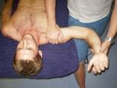

S: Special Tests for Shoulder Instability (Dislocations/Subluxation of the GH Joint)
Apprehension Test
(Crank Test)
Relocation Test

Slide 20

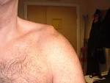
S: Special Tests
Appley’s Scratch Test-determines ROM
Piano Key Sign-tests for AC joint sprain

Slide 21


S: Special Tests-tests for injuries or weakness in the Rotator Cuff Muscles
Empty Can Test
Drop Arm Test

Slide 22

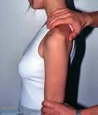
S: Special Tests
Shoulder Impingement Test-tests for Bursitis/Tendonitis of RC
Sulcus Sign-tests the GH ligament

Slide 23
S: Special Tests
(Anterior Muscles-MMT)
1 | 2 | 3 | 5
Flexion At Elbow-Supination and Flexion | Adduction Flexion At Elbow-Pronation | Flexion Horizonal Adduction Internal Rotation (IR) | Flexion IR Abduction Extension ER
Internal Rotation (IR) |  | Raises Ribs-Inspiration Draws Scapula Forward-Protraction Depression

Slide 24
S: Special Tests
(Anterior Muscles-MMT)
1 | 2 | 3 | 5
Biceps Brachii (Green) | Coraco-brachialis (Blue) | Pectoralis Major (Purple) | Deltoideus (Orange)
Subscapularis (Brown) Rotator Cuff |  | Pectoralis Minor (Red)

Slide 25
S: Special Tests
(Posterior Muscles-MMT)
1 | 2 | 3 | 5
Elevation | Retraction Downward Rotation | Extension Adduction Internal Rotation | Elevation Upward Rotation Retraction Downward Rotation Depression
Abduction | Retraction Downward Rotation | Internal Rotation Adduction Extension
External Rotation (ER) | Upward Rotation Protraction Flexion
External Rotation(ER)
Extension At Elbow-Extension

Slide 26
S: Special Tests
(MMT- Posterior Muscles)
1 | 2 | 3 | 5
Levator Scapulae (Turquoise) | Rhomboideus Major (Light Green) | Latissmus Dorsi (Light Pink) | Trapezius (Black)
Supraspinatus (Yellow) Rotator Cuff | Rhomboideus Minor (Dark Blue) | Teres Major (Lavendar)
Infraspinatus (Dark Pink) Rotator Cuff | Serratus Anterior (Tan)
Teres Minor (Gray) Rotator Cuff
Triceps Brachii (Light Blue)

Slide 27
Special Tests: Functional/Sports Specific Tests
Can the athlete use their arm when they :
  Walk
  Hop
  Jump
  Run
  Sprint
  Back pedal
  Cut
  Squat
  Lunge
  Change Direction
Depends on the sport:
  Soccer- Throw ins
  Volleyball-Jump Serve/Spike
  Softball/Baseball- Throw/Catch
  Football-Get in Stance/Cut/Change Direction/Start and Stop/Catch/Throw a Ball
  Tennis-Serve, Backhand/Forehand

