Slide 1
Shoulder Injuries

Slide 2
Fractures
Location
Clavicle: where it changes shape
Scapula: rare injury
Humerus: neck of humerus or shaft
Mechanism of Injury
Fall on an outstretched arm
Direct blow
Signs and Symptoms
Pain and point tenderness over fracture site
Possible deformity
Swelling and possible crepitus
Decreased ROM and strength over shoulder joint
Treatment
Immobilization
PRICES
Referral to physician for x-rays/evaluation

Slide 3
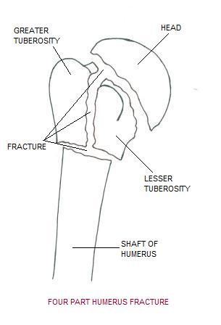
Fractures Continued…

Slide 4
Dislocations
Anterior: Forward/downward displacement of the shoulder, COMMON INJURY, usually reoccurs
Posterior: backward displacement of the shoulder, unusual and difficult to spot and treat
Mechanism of Injury
Fall on an outstretched arm
Vigorous pulling of the arm in either direction
ANTERIOR: ABDUCTION/EXTERNAL ROTATION
Signs and Symptoms
Intense pain until shoulder is reduced
Possible deformity
Reduced or no ROM
Possible numbness and tingling over arm
Treatment
Do not try to reduce dislocation
Ice and immobilize (SLING/SWATHE) for transport
Referral immediately

Slide 5
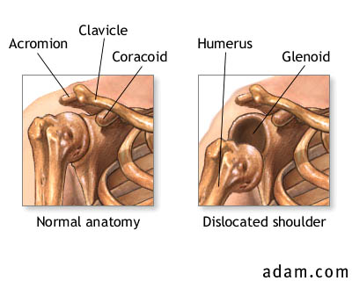
Dislocations Continued…

Slide 6
Apprehension Test
Apprehension test: This test puts the shoulder in a position where the patient may become apprehensive that it is about to dislocate. The examiner will want to know this and will look for signs that the patient is apprehensive. Lying on the back, the patient's arm is extended 90º from the side and rotated clockwise ("externally rotated"). This is similar to the position your arm would be in if you were getting ready to throw a ball or wave to someone. From this position, the examiner will continue to externally rotate the patient's arm. This is the position that puts the most strain on the ligaments which stop normally stop the shoulder from dislocating anteriorly. If those ligaments are weak or damaged, the shoulder may feel like it is going to pop out of joint -- which is what the physician wants to know (Fig. 5d).

Slide 7
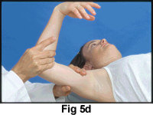
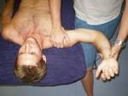
Shoulder (GH JOINT) Instability (Dislocations/Subluxation)
Apprehension Test
(Crank Test)
Relocation Test

Slide 8
AC (Acromioclavicular) Joint Seperation
Mechanism
Fall on outstretched arm
Fall on the tip of the shoulder
Signs and Symptoms
Point tenderness over ligament area at the AC joint
Pain and an inability to move arm, especially Abduction
Deformity possible, depending on severity
Types of Seperation and Severity of Seperation
1st degree: partial seperation of ligament, no deformity
2nd degree: moderate seperation of ligament, mild to moderate deformity
3rd degree: complete tear of ligament, deformity
Treatment
Ice
Sling for comfort
Possible referral, depending on the severity
Rehabilitation includes controlling pain, re-establishing ROM and strength, and return to activity

Slide 9
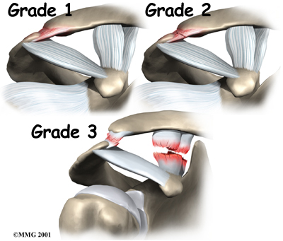
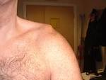
AC Sprain or Joint Seperation
Piano Key Sign-tests for AC joint sprain
Grades of Injury

Slide 10
Test of Acromioclavicular Joint Instability (Piano key sign)
The acromioclavicular joint is first palpated to determine if there is any displacement of the acromion process and the distal head of the clavicle. Next, pressure is applied to the distal clavicle in all four directions to determine stability and any associated increase in pain. Pressure is applied to the tip of the shoulder, which compresses the acromioclavicular joint and may also increase pain.

Slide 11
Rotator Cuff Strain or Tear (“SITS” Muscles)
Rotator Cuff Muscles: Supraspinatus, Infraspinatus, Teres Minor, Subscapularis
Suprasinatus involved 75% of the time with rotator cuff injuries.
Mechanism
Fall on outstretched shoulder
Lifting or throwing of heavy objects without proper warm-up
Poor overhead mechanics
Signs and Symptoms
Pain over shoulder joint, increases with ROM
Point tenderness over shoulder
Decreased ROM due to pain
Muscular weakness possible, depending on severity
Treatment
Rest
Ice
Stretching followed by strengthening exercises
Proper techniques in overhand movement
Referral if problem persists

Slide 12
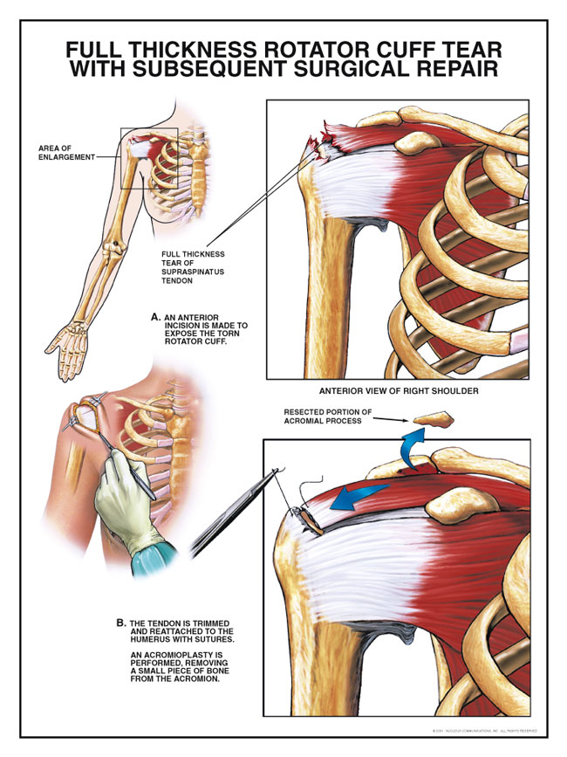
Rotator Cuff Strain or Tear Continued…

Slide 13
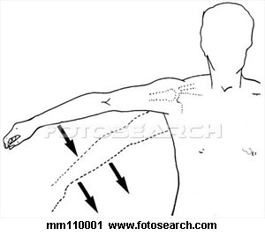
Drop Arm Test-Tests for Injury to Rotator Cuff Muscle (Supraspinatus)
a diagnostic test for a tear in the supraspinatus tendon. The result is positive if the patient is unable to lower the affected arm slowly and smoothly from a position of 90 degrees of abduction.

Slide 14
Special Tests-tests for injuries or weakness in the Rotator Cuff Muscles
Empty Can Test
Drop Arm Test

Slide 15
Contusion to Upper Arm (Deltoid – Most Common)
Precautions-prevent the possibility of myositis ossificans (calcium formation from repetitive trauma)
Mechanism
Direct blow
Fall on arm
Signs and Symptoms
Point tenderness and swelling over area
Pain on palpation and active ROM
Bruising and possible limp in muscle belly
Possible a decreased ROM
Treatment
Ice
Padding and protection
Strengthening exercises

Slide 16
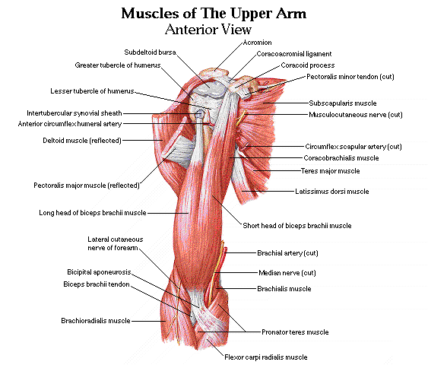

Slide 17
Brachial Plexus Injuries (Stingers or Burners)
Bundles of nerves that run from the neck to the shoulder area. Commonly injured in football
Mechanism
Arm trapped down inferiorly and head rotated and pushed to the side laterally (stretch injury)
Signs and Symptoms
Numbness and tingling in the arm
Loss of strength and some ROM
Athlete usually carries arm to the side, bending to one side
Possible pain and soreness over arm
Treatment
Check neck to rule out fracture
Hold athlete out of action until ROM and full strength return
Ice
Referral if problem reoccurs

Slide 18
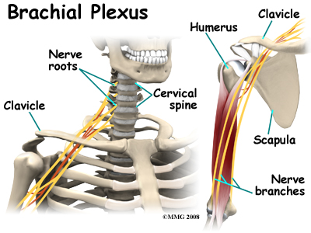
Brachial Plexus Injuries Continued…

Slide 19
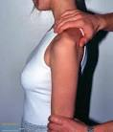
More Special Tests
Shoulder Impingement Test-tests for Bursitis/Tendonitis of RC
Sulcus Sign-tests the GH ligament

Slide 20
MORE SPECIAL TESTS
Appley’s Scratch Test-determines ROM limitations

