Slide 1
Spine Conditions

Slide 2
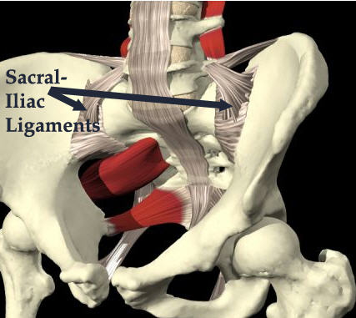
Sacroiliac Sprain
Cause of Injury
Result of twisting with both feet on the ground, stumbles forward, falls backward, steps too far down, heavy landing on one leg, bends forwards with knee locked during lifting.
Signs of Injury
Palpable pain and tenderness over the joint, medial to the PSIS w/ some muscle guarding.
Pelvic asymmetries are possible
Special Tests: SI Compression and Distraction
Care
Ice can be used to reduce pain
Bracing can be helpful in acute sprains
Strengthening exercises should be used to
stabilize the joints

Slide 3
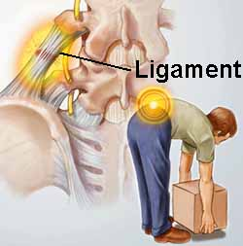
Low Back Pain
Cause of injury
Mechanical defects of the spine
(posture, obesity, and body mechanics)
Back Trauma
Signs of Injury
Pain, possible weakness, antalgic gait, associated with ligamentous sprain, muscle strains and bony defects
Neurological signs and symptoms are possible
Care
Correct alignments and body mechanics
Strengthening and stretching – avoid unnecessary stresses and strains associated with daily living

Slide 4
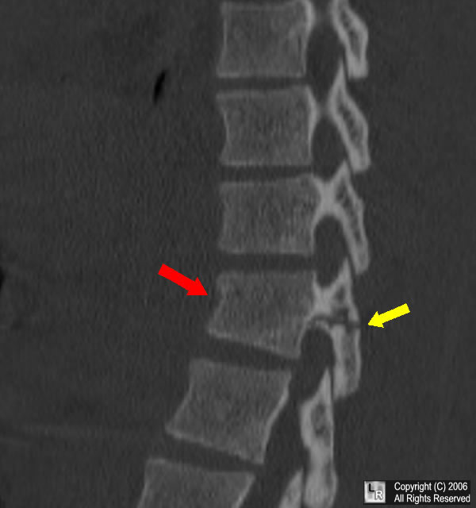
Lumbar Vertebrae Fracture
Cause
Compression fractures or fracture of the spinous or transverse processes
Compression fractures are usually the result of trunk hyperflexion or falling from height
Fractures of the processes are generally the result of a direct blow
Signs of Injury
Pain, possible weakness, antalgic gait, associated with ligamentous sprain, muscle strains and body defects
Neurological signs and symptoms are possible
Care
Correct alignments and body mechanics
Strengthening and stretching – avoid unnecessary
stresses and strains associated with daily living

Slide 5
Coccyx Fractures
Cause of Injury
Generally the result of a direct impact which may be caused by forcibly sitting down, falling, or being kicked by an opponent
Signs of Injury
Pain is often prolonged and at times chronic
Tenderness over the bone and pain with sitting
Care
Analgesics and a donut pillow/ring seat to relieve pressure while sitting
Pain from a fractured coccyx could last months

Slide 6
Herniated Disk
Cause of Injury
Caused by abnormal stresses and degeneration due to use
(forward bending /flexion and twisting/rotation)
Signs of Injury
Centrally located pain that radiate unilaterally
Symptoms are worse in the morning
Onset is sudden or gradual, pain may increase after the athlete sits and then tries to resume activity
Forward being and sitting increase pain, while back extension reduces pain
SPECIAL TEST: Straight leg raise to 30 degrees is painful
Care
Rest and ice for pain management
Extension exercises may be comfortable
Core stabilization exercises should be integrated as athlete improves

Slide 7
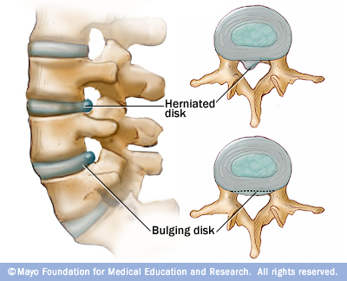
Herniated Disc

Slide 8
Spondylolysis and Spondylolisthesis
Cause of Injury
Spondylolysis refers to degeneration of the vertebrae due to congenital weakness (stress fracture or fracture results)
Slipping of one vertebrae above or below another is referred to as spondylolisthesis
Signs of Injury
Pain and persistent aching, low back stiffness with increased pain after activity
Frequent need to change position or “pop” back to reduce pain
Care
Bracing and occasionally bed rest for 1 – 3 days will help reduce pain
Progressive trunk strengthening, dynamic core strengthening, concentration on abdominal work
Increased susceptibility to lumbar strains and sprains and thus vigorous activity may need to be limited

Slide 9
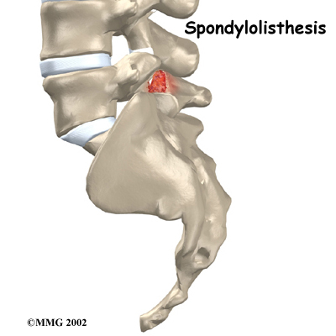
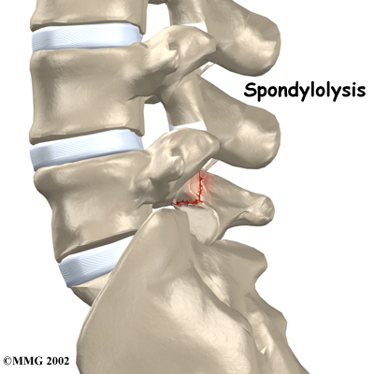
Spondylolysis and Spondylolisthesis

Slide 10
Cervical Fractures
Cause of Injury
Generally an axial load w/ some degree of cervical flexion
Addition of rotation may result in dislocation
Signs of Injury
Neck points tenderness, restricted motion, cervical muscle spasm, cervical pain, pain in the chest and extremities, numbness in the trunk and or limbs, weakness in the trunk and/or limbs, loss of bladder and bowel control
Care
Treat like an unconscious athlete until otherwise ruled out – use extreme care

Slide 11
Cervical Dislocation
Cause of Injury
Usually the result of violent flexion and rotation of the head
Signs of Injury
Considerable pain, numbness, weakness, or paralysis
Unilateral dislocation causes the head to be tilted toward the dislocated side with extreme muscle tightness on the elongated side
Care
Extreme care must be used – more likely to cause spinal cord injury than a fracture

Slide 12
Back Contusions
Cause of Injury
Significant impact or direct blow to the back
Signs of Injury
Pain, swelling, dislocation, muscle spasm and point tenderness
Management
PRICES for the first 72 hours
Ice massage combined with gradual stretching
Recovery generally last 2 days to 2 weeks

Slide 13
Low Back/Lumbar Muscle Strain
Cause of Injury
Sudden extension contraction overload generally in conjunction w/ some type of rotation
Chronic strain associated with posture and mechanics
Signs of Injury
Pain may be diffuse or localized
Pain w/ active extension and passive flexion
Care
PRICES to decrease spasm; followed by a graduated stretching and strengthening program (core stability exercises)
Elastic wrap/back brace may be useful for support and compression
Compete bed rest may be necessary if it is severe enough
NSAID’S

Slide 14
Acute Strains of the Neck and Upper Back
Cause of Injury
Sudden turn of the head, forced flexion, extension or rotation
Generally involves upper trapezius muscles
Signs of Injury
Localized pain and point tenderness, restricted motion, reluctance to move the neck in any direction
Care
RICE and application of a cervical collar
Follow – up care will involve ROM exercises, isometrics which progress to a full isotonic strengthening program, cryotherapy and superficial thermotherapy, analgesic medications

Slide 15
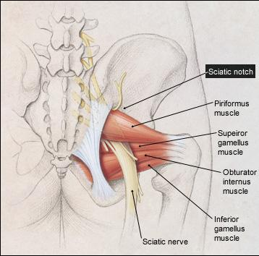
Sciatica
Cause of Injury
Inflammatory condition of the sciatic nerve
Nerve is vulnerable to direct blows that place abnormal amounts of pressure on nerve
Signs of Injury
Arises abruptly or gradually;
produces sharp shooting pain, tingling
and numbness
Sensitive to palpation
SPECIAL TEST: straight leg raises
intensifying the pain (pain shoots
down the leg)
Care
Rest is essential; acutely –
recovery = 2 – 3 weeks
Treat the cause of inflammation;
NSAID’S

Slide 16
Cervical Sprain (Whiplash)
Cause of Injury
Generally the same mechanism as a strain, but more violent
Involves a snapping of the head and neck – compromising the anterior or posterior longitudinal ligament, the interspinous ligament and the supraspinous ligament
Signs of Injury
Similar signs and symptoms to a strain – however, they last longer
Tenderness over the transverse and spinous processes
Pain will usually arise the day after the trauma (result of muscle spasm)
Management
Rule out fracture, dislocation, disk injury or cord injury PRICES for first 48 – 72 hours, possibly bed rest if severe enough, analgesics and NSAID’S, mechanical traction

Slide 17
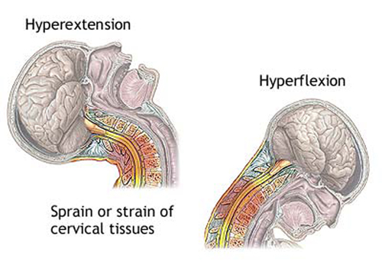
Whiplash

Slide 18
Pinched Nerve (Brachial Plexus Injury) [Stinger/Burner]
Cause of Injury
Result of stretching or compression of the brachial plexus
Referred to as a stinger or burner
Signs of Injury
Burning sensation, numbness and tingling as well as pain extending from the shoulder into the hand
Some loss of function of the arm and hand for several minutes
Symptoms rarely persist for several days
Repeated injury can result in neuritis, muscular atrophy, and permanent damage
Care
Return to activity once S&S have returned to normal
If repeated offender, Strengthening and stretching program

Slide 19
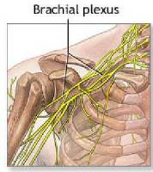

Slide 20
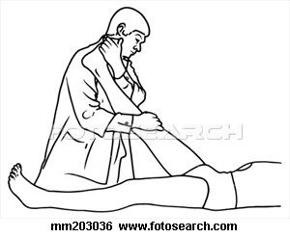
Straight Leg Raises
Straight leg raises applies pressure to the sacroiliac joint and may indicate a problem either in the sciatic nerve, the sacroiliac joint, or the lumbar spine (herniated disc).

Slide 21
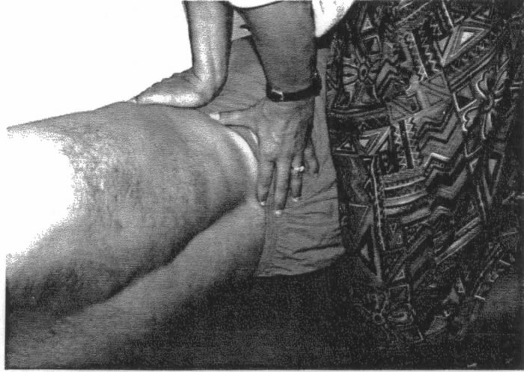
Compression and Distraction Tests
Sacroiliac compression and distraction tests are useful in determining if there is a problem in the sacroiliac joint

Slide 22
Go Find A Sports Video!!

