Slide 1
Spine and Thorax/Abdomen Evaluation
Use Textbook Pages 467-471 for Spine Chapter 20
Use Textbook Pages 488-490 for Thorax/Abdomen Chapter 21

Slide 2
History ?s For Spine—RULE OUT Cervical Spine….CALL 911 in needed!
What happened?
Did you hit someone or land directly on the top of your head?
Were you knocked out or unconscious?
Do you have any pain in your neck?
Do you have tingling, numbness, or burning in your shoulders, arms, or hands?
Do you have equal muscle strength in both hands?
Are you able to move your ankles or toes?
Any changes in bowel or bladder?

Slide 3
Once C-spine is ruled out, more ?s:
Where is the pain located?
What kind of pain do you have?
What were you doing when the pain began?
Were you standing, sitting, bending, or twisting?
Did the pain begin immediately?
How long have you had this pain?
Do certain movements or positions cause more pain?
Can you assume a position that gets rid of the pain?
Is there any tingling or numbness in the arms and legs?
Is there any pain in the buttocks or the back of the legs?
Have you ever had any back pain before?
What position do you usually sleep in? How do you prefer to sit?

Slide 4
History ?s for Thorax and Abdomen
What happened to cause this injury?
Was there direct contact or a direct blow?
What position were you in?
What type of pain is there (sharp, dull, localized, etc.)?
Was there immediate or gradual pain?
Do you feel any pain other than in the area where the injury occurred?
Have you had any difficulty breathing?
Are certain positions more comfortable than others?
Do you feel faint, lightheaded, or nauseous?
Do you feel any pain in your chest?

Slide 5
More History ?s For
Thorax and Abdomen
Did you hear or feel a pop or crack in your chest?
Have you had any muscle spasms?
Have you noticed any blood in your urine?
Is there any difficulty or pain with urinating?
Was the bladder full or empty?
How long has it been since you have eaten?

Slide 6
Observation
Normal Pulse Rate
  Adult 60-80 beats/minute
  Child/Infant 80-100 beats/minute
Normal Breathing Rate
  Adult 12-15 breaths/minute
  Child/Infant 20-25 breaths/minute
Normal Temperature ORAL 98.6 and RECTAL 99.6
Pupils should be of EQUAL SIZE. Pupils should respond to light. Pupils should CONSTRICT (get smaller) in the LIGHT and DILATE (get larger) in the DARK.
Normal Blood Pressure for an Adult is 120/80 (systolic/diastolic). Systolic is when the heart contracts and diastolic is when the heart relaxes.

Slide 7
Specific and Obvious Sign of Injury
Blood in Urine (hematuria) = Kidney Contusion; Runner’s Bladder
Difficulty Breathing = Injury to the Lungs (Pneumothorax)
Coughing up Blood = Injury to the Lungs (Hemathorax)
Kehr’s Sign (pain in the arm)= Injury to the Spleen
McBurney’s Point (pain between ASIS and belly button)= Appendicitis
Referred Pain in the Right Scapula/Shoulder/Chest = Liver Contusion or Injury
Numbness of Tingling in Leg/Foot or Shooting Pains down Leg= Sciatica

Slide 8
More Signs and Symptoms-Spine
Does posture exhibit signs of kyphosis, lordosis, or scoliosis?
Is the athlete willing to move the head and neck freely?
Are the shoulders level and symmetrical?
Is the head tilted to one side?
Is one scapula lower or more prominent?
Is the trunk bent or curved to one side?
Is one hip more prominent?
Are the hips tilted?
Are the ribs more pronounced?
Does one arm hang longer than another?
Is one patella lower than another?

Slide 9
More Signs and Symptoms-
Thorax and Abdomen
Most important, is the athlete breathing? Breathing normal?
Is the athlete having difficulty breathing deeply, or is the athlete struggling to catch his or her breathe?
Does breathing cause pain?
Is the athlete holding the chest wall?
Is there symmetry in movement of the chest during breathing?
What is the body position of the athlete?
Is there protrusion or swelling in the abdomen?
Does the thorax appear to be symmetrical?
Are the abdominal muscles tight and guarding?
Is the athlete holding or splinting a portion of their abdomen?

Slide 10
More to OBSERVE
  Walking with a limp or unable to bear weight
  Leaning forward or backward with walking
  Posture-Kyphosis, Lordosis, or Scoliosis
  Swelling
  Deformity
  Eccymosis or discoloration
  Are the Hips Symmetric- Tilted Anteriorly or Posteriorly
  Are the Legs the Same Length
  Heat or warmth
  Crepitus or abnormal sounds while sitting, standing, or moving
  Redness
  Feeling or Sensation
  Range of Motion (ROM)
  Areas of Pain and Point Tenderness
  Muscle Atrophy or Weakness

Slide 11
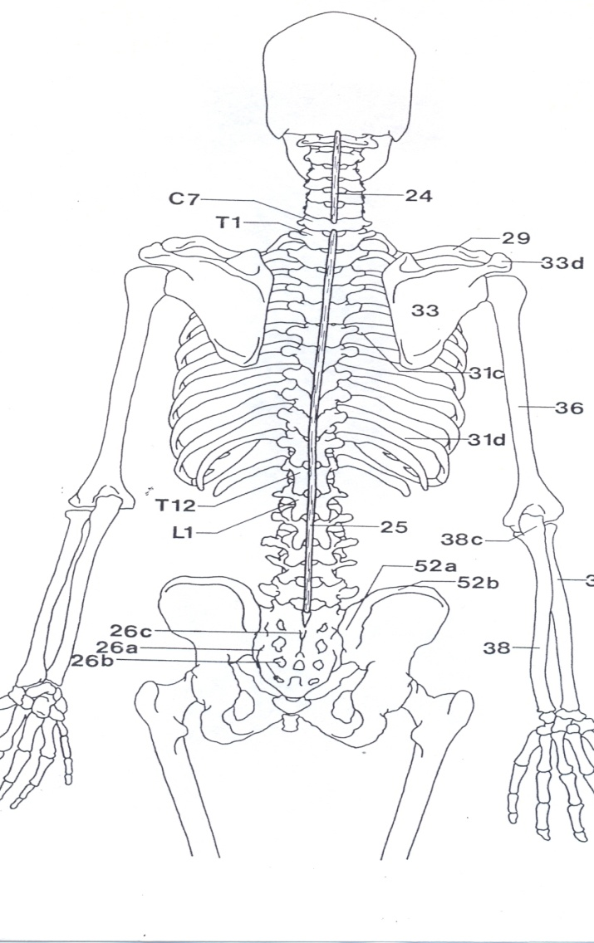
Palpation- Spine (Prone)
BONY ANATOMY –
  Cervical Spine (C1-C7)
  Thoracic Spine (T1-T12)
  Lumbar Spine (L1-L5)
    Spinous Processes
    Transverse Processes
  Sacrum
  Coccyx

Slide 12
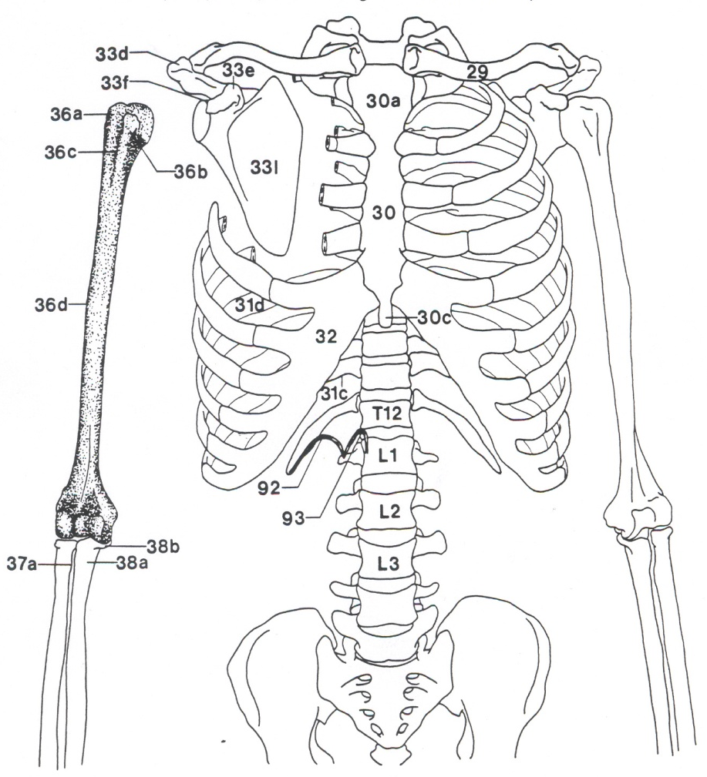
Palpation-Thorax and Abdomen (Supine)
BONY ANATOMY-
  Thoracic Spine (T1-T12)
  Lumbar Spine (L1-L5)
  Ribs
    True
    False
    Floating
  Sternum
    Manubrium
    Body
    Xiphoid Process

Slide 13
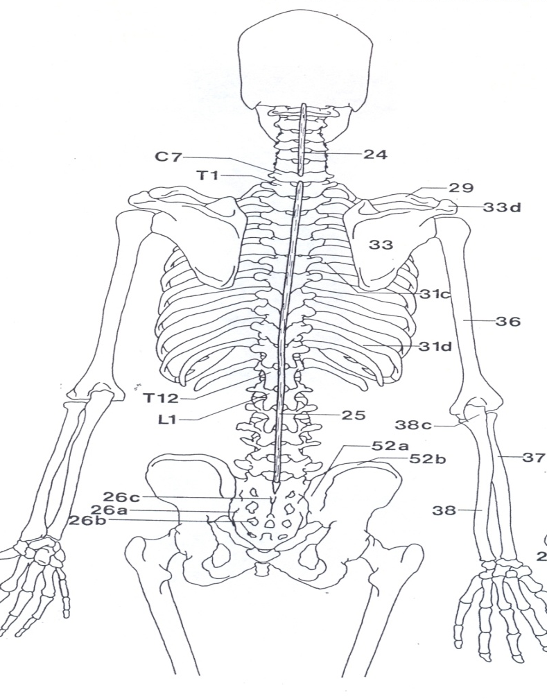
Palpation- Above and Below
Skull (Cranium)
Pelvis
  Ilium (ASIS, AIIS, PSIS, PIIS, Iliac Crest)
  Pubis (Pubic Symphysis)
  Ischium (Ischial Tuberosity)
Femur
  Greater Trochanter

Slide 14
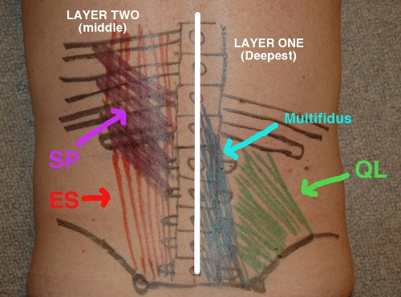
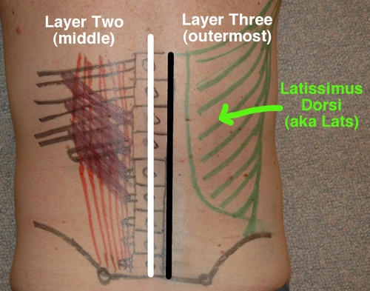
Palpate SOFT TISSUE (MUSCLES)

Slide 15
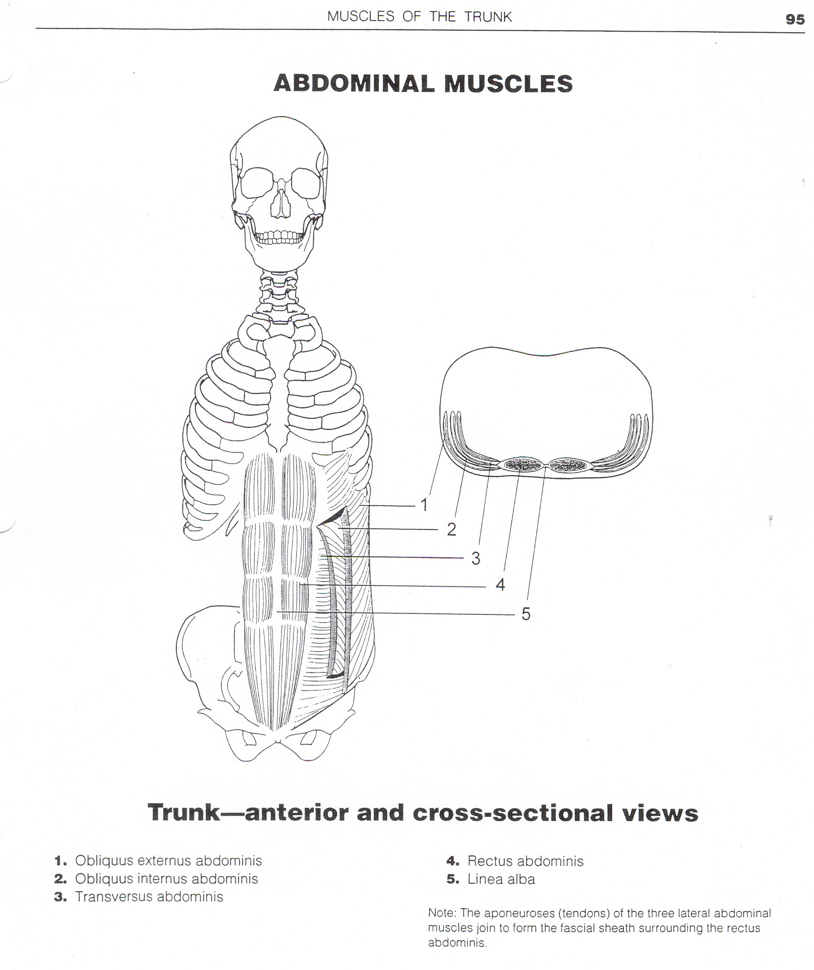
Palpate SOFT TISSUES (MUSCLES)

Slide 16
Special Tests
AROM/PROM
Special Tests
MMT
Functional/Sports Specific Test

Slide 17
AROM/PROM-Spine
MUSCLES OF THE SPINE | MUSCLES OF THE ABDOMEN
ERECTOR SPINAE SPINALIS ERECTOR SPINAE ILIOCOSTALIS ERECTOR SPINAE LONGISSIMUS (BLUE) | OBLIQUUS INTERNUS OBLIQUUS EXTERNUS (BLACK)
MULTIFIDIS (PURPLE) | RECTUS ABDOMINUS (YELLOW)
QUADRATUS LUMBORUM(GREEN) | TRANSVERSE ABDOMINUS (RED)

Slide 18
AROM/PROM-Spine
MUSCLES OF THE SPINE | MUSCLES OF THE ABDOMEN
EXTENSION AND LATERAL FLEXION(BLUE) | ROTATION AND LATERAL FLEXION(BLACK)
EXTENSION AND ROTATION (PURPLE) | FLEXION(YELLOW)
LATERAL FLEXION (GREEN) | COMPRESSION (RED)

Slide 19
AROM/PROM-Thorax/Abdomen
Muscles of Thorax | Muscles of the Abdomen
Intercostales Externus Serratus Posterior Superior | Obliquus Externus Obliquus Internus
Intercostales Internus | Transverse Abdominus
Serratus Posterior Inferior Diaphragm | Rectus Abdominus

Slide 20
AROM/PROM-Thorax/Abdomen
Muscles of Thorax | Muscles of the Abdomen
Inspiration (Inhale) BLUE | Rotation and Lateral Flexion BLACK
Expiration (Exhale) ORANGE | Compression RED
Expands the Ribcage GREEN | Flexion YELLOW

Slide 21
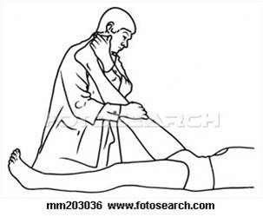
Special Tests- Straight Leg Raise
Disk Pathology (Herniated)- Pain with 30 degrees
Sciatica- Radiating/Shooting Pain

Slide 22

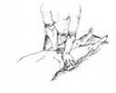
Special Tests- SI Joint Issue
SI Distraction
SI Compression

Slide 23
MMT-Spine
MUSCLES OF THE SPINE | MUSCLES OF THE ABDOMEN
ERECTOR SPINAE SPINALIS ERECTOR SPINAE ILIOCOSTALIS ERECTOR SPINAE LONGISSIMUS (BLUE) | OBLIQUUS INTERNUS OBLIQUUS EXTERNUS (BLACK)
MULTIFIDIS (PURPLE) | RECTUS ABDOMINUS (YELLOW)
QUADRATUS LUMBORUM(GREEN) | TRANSVERSE ABDOMINUS (RED)

Slide 24
MMT-Spine
MUSCLES OF THE SPINE | MUSCLES OF THE ABDOMEN
EXTENSION AND LATERAL FLEXION(BLUE) | ROTATION AND LATERAL FLEXION(BLACK)
EXTENSION AND ROTATION (PURPLE) | FLEXION(YELLOW)
LATERAL FLEXION (GREEN) | COMPRESSION (RED)

Slide 25
MMT-Thorax/Abdomen
Muscles of Thorax | Muscles of the Abdomen
Intercostales Externus Serratus Posterior Superior | Obliquus Externus Obliquus Internus
Intercostales Internus | Transverse Abdominus
Serratus Posterior Inferior Diaphragm | Rectus Abdominus

Slide 26
MMT-Thorax/Abdomen
Muscles of Thorax | Muscles of the Abdomen
Inspiration (Inhale) BLUE | Rotation and Lateral Flexion BLACK
Expiration (Exhale) ORANGE | Compression RED
Expands the Ribcage GREEN | Flexion YELLOW

Slide 27
Functional: Sports Specific Tests
Can the athlete:
  Walk
  Hop
  Jump
  Run
  Sprint
  Back pedal
  Cut
  Squat
  Lunge
  Change Direction
Depends on the sport:
  Softball/Baseball-Swing the Bat/Throw/Get in Stance for Position
  Track-Stride Out/Hurdle/Jump/Get in the Starting Block
  Tennis-Serve/Backhand and Forehand the Ball/Volley
  Golf-Lean over to pick up ball/Drive/Putt/Swing the Club

Slide 28
When Should you Call 911???
Sacroiliac Sprain Runner’s Nipple/Cyclist’s Nipple
Low Back Pain Abdominal Muscle Strain
Lumbar Vertebrae Fracture Contusions of the Abdominal Wall
Coccyx Fracture Hernia (Inguinal or Femoral)
Herniated Disk Spleen Injuries
Spondylolysis Kidney Contusions
Spondylolisthesis Liver Contusions
Cervical Fracture Appendicitis
Low Back/Lumbar Muscle Strain Injuries to the Bladder
Acute Strains of the Neck and Upper Back Rib Contusion
Sciatica Rib Fracture
Cervical Sprain (Whiplash) Costal Cartilage Injury
Pinched Nerve (Brachial Plexus Injury) Intercostal Muscle Injury
Lung Injury (Pneumothorax/Hemothorax) Cooper’s Ligament Sprain

