Slide 1
Thorax and Abdomen Injuries
Sports Medicine II

Slide 2
Rib Contusion
Causes of Injury (COI) – Blow to the rib cage can bruise ribs, musculature or result in fracture
Signs of Injury (SOI) – Painful breathing (particularly if muscles are involved); point tenderness; pain with rib compression
Care – PRICES, NSAID’s, rest and decrease in activity

Slide 3
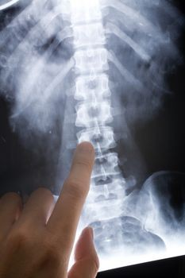

Slide 4
Rib Fractures
COI – Caused by a direct blow or the result of a violent muscular contraction; violent coughing or sneezing
SOI – Pain with inspiration, point tenderness, and possible deformity with palpation
Care – Refer for X-rays, support and rest; brace, generally heals in 3-4 weeks

Slide 5
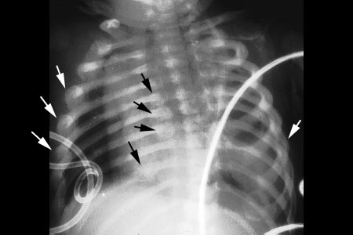

Slide 6
Costal Cartilage Injury
COI – Result of a direct blow to the anterolateral aspect of the rib cage
SOI – Localized pain in region of costachondral junctions, pain with movement, difficult breathing, point tenderness and possible deformity
Care – Rest and immoblization; Healing may take 1-2 months

Slide 7
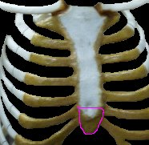
Costal Cartilage is located in between the sternum and ribs. Pain can be anywhere in this region.

Slide 8
Intercostal Muscle Injury
COI – Muscles are subject to contusions and strains. Occur most often from direct blows or sudden torsion of the trunk
SOI – Pain occurs on active motions; pain with inspiration and expiration, coughing, sneezing, and laughing
Care – Immediate pressure and application of cold for approximately 20 minutes. After hemorrhaging is controlled, immobilize the injury to make the athlete comfortable.

Slide 9
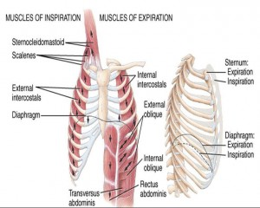

Slide 10
Lung Injuries
COI – Pneumothorax: Pleural cavity becomes filled with air, negatively pressurizing the cavity, causing a lung to collapse
Tension Pneumothorax: Pleural sac on one side fills with air displacing lung and heart, compressing the opposite lung
Hemothorax: Blood in pleural cavity causes tearing or puncturing of the lungs or pleural tissue
Traumatic Asphyxia: Result of a violent blow or compression of rib cage; causes cessation of breathing and immediate medical attention
SOI – Breathing difficulty, shortness of breath, chest pain on side of injury, coughing up blood, cyanosis (turning blue), and potential shock. With collapse of lung, medical attention is required immediately.
Care – Each of these conditions are medical emergencies and require immediate attention. Transport athlete to hospital immediately.

Slide 11
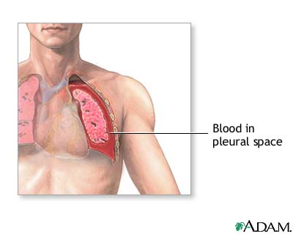

Slide 12
Breast Problems
COI – Constant uncontrolled movement (particularly in large breasted women); stretching of Cooper’s ligament; Runner’s and cyclist’s nipple (nipple is rubbed raw from friction)
Management – Females should wear well-designed bras that have minimum elasticity and allows for little movement; Special plastic cup-type brassieres may be required in sports with high levels of physical contact; Use of an adhesive bandage can be used to prevent runner’s nipple; Wearing a windbreaker can prevent cyclist’s nipple

Slide 13
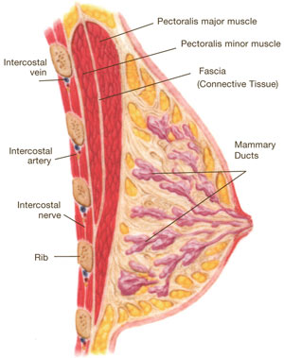

Slide 14
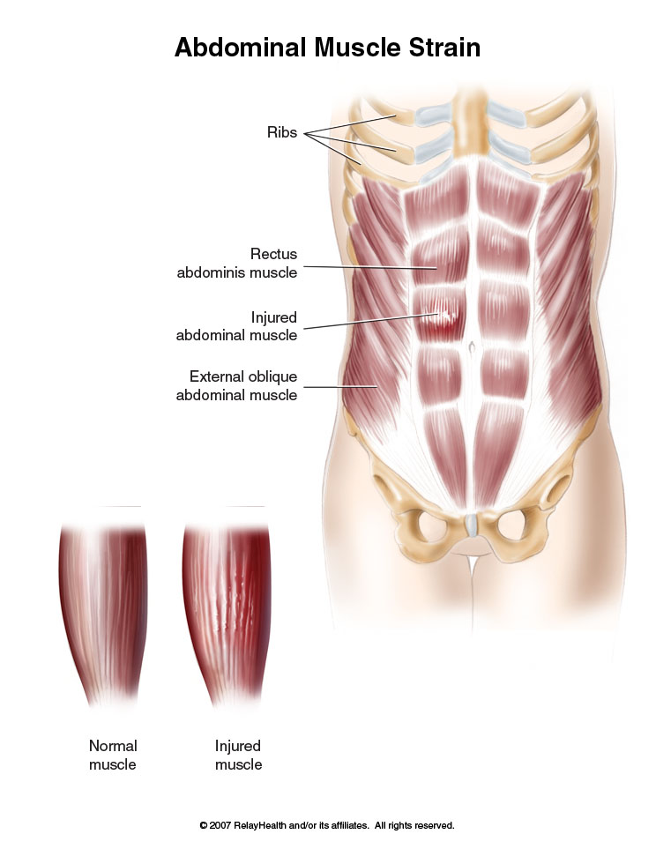
Abdominal Muscle Strain
Result of sudden twisting or reaching of trunk, tearing abdominal musculature

Slide 15
Contusions to Abdominal Wall
COI – Caused by compressive force, generally occurring in collision sports. Extent of injury depends on whether force is blunt or penetrating
SOI – May cause hematoma to develop under fascia of surrounding muscle tissue. Swelling may cause pain and tightness within the region
Care – Cold pack and compression. Be sure to check for signs of internal injuries. Conservative management. Exercise should be kept pain free.

Slide 16
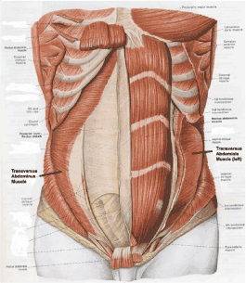

Slide 17
Hernia
COI – Protrusion of abdominal viscera through portion of abdominal wall (congenital or acquired).
Inguinal vs. femoral hernias. Women generally have femoral hernias. Men generally have inguinal hernias. Hernias are named for their location-inguinal region (hip/crotch) and femoral (more inferior than inguinal and on the femur).
SOI – Acquired hernia occur when natural weakness is further aggravated by a direct blow or strain from lifting heavy objects
-History of direct blow to groin area, pain and prolonged discomfort, superficial protrusion with pain increasing with coughing and reported pulling sensation in groin area.
Care – Most physicians prefer athlete to refrain from hard physical activity until surgically repaired. Mechanical devices are not suitable for athletics due to friction and irritation they produce. While exercise is thought to be beneficial with regards to strengthening; that is not the case.

Slide 18
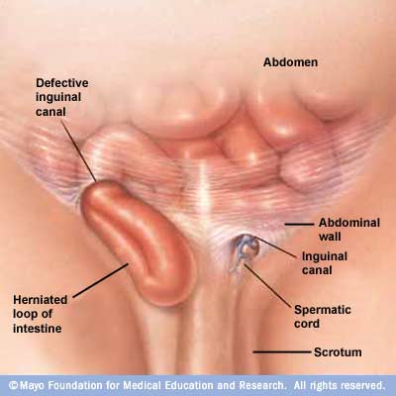

Slide 19
Injury of the Spleen
COI – Result of a direct blow to right upper quadrant; Infectious mononucleosis (causing an enlarged spleen)
SOI – Indications of a ruptured spleen involve history of a direct blow, signs of shock, abdominal rigidity, nausea, vomiting, Kehr’s sign (pain in left shoulder). Ability to splint self may produce delayed hemorrhaging – easily disrupted resulting in internal bleeding.
Care – Conservative treatment involves 1 week of hospitalization and a gradual return to activity. Surgery will result in 3 months of recovery while removal of spleen will result in 6 months removal from activity. In cases of mononucleosis athlete may resume training in 3 weeks if spleen not enlarged and if there is no fever.

Slide 20
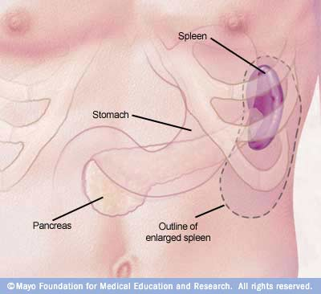

Slide 21
Kidney Contusion
COI – result of an external force (force and angle dependent)
SOI – May display signs of shock, nausea, vomiting, rigidity of back muscles, and hematuria (blood in urine); Referred pain (costovertebral angle posteriorly radiating forward around the trunk)
Care – Monitor status of urine. theIf blood in urine, go to doctor. 24 hour hospitalization and observation with a gradual increase in fluid intake may be required. Surgery may be required if hemorrhaging continues. 2 weeks of rest and close surveillance following initial return to activity is necessary.

Slide 22
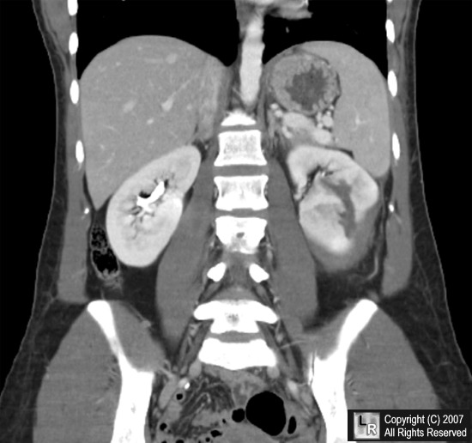

Slide 23
Liver Contusion
COI – Blunt trauma – right side of rib cage; More susceptible if enlarged due to disease
SOI – Hemorrhaging and shock may be present. May require immediate surgery. Referred pain in the right scapula, shoulder and substernal area and occasionally in left anterior side of chest
Care – Referral to a physician for diagnosis and treatment

Slide 24
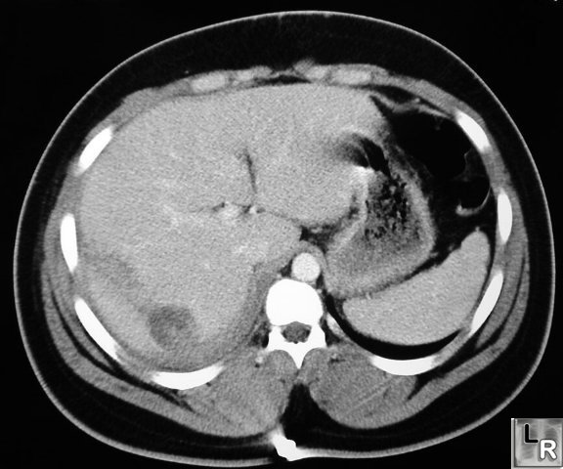

Slide 25
Appendicitis
COI – Inflammation of the appendix (chronic or acute); Result of blockage, lymph swelling, or tumor. Early stages present as a gastric structure that can rupture into bowels causing peritonitis
SOI – Mild to severe pain in lower abdomen associated with nausea, vomiting and low grade fever. Pain may localize in lower right area (McBurney’s point-pain between belly button and right ASIS of the hip)
Care – Surgical intervention is often necessary (particularly if it is resulting in an obstructured bowel = life threatening)

Slide 26
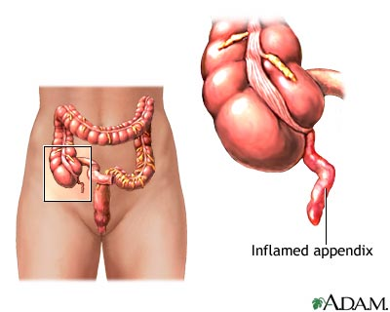

Slide 27
Injuries to the Bladder
COI – Blunt force to the lower abdomen may cause injury to urinary bladder if distended with urine. Hematuria is often associated with contusion of bladder during running (runner’s bladder)
SOI – Pain, discomfort of lower abdominal region, abdominal rigidity, nausea, vomiting, shock, bleeding from the urethra, increases quantity of bloody urine. Athlete should be instructed to monitor urine. Inability to urinate will present in case of ruptured bladder.

Slide 28
